Slide 1
Nu Xu – Spokesperson
Xin Dong – Physics Analysis Coordinator
Jim Thomas – Talk Committee Chair
Ernst Sichtermann – eSTAR Task Force co-convener
Grazyna Odyniec – Beam Energy Scan Focus Group co-convener
Hiroshi Masui - Physics Working Group co-convener, BulkCorr
Hans Georg Ritter – HFT Project Deputy CPM
Leo Greiner – Subproject Leader HFT Pixel Detector
Jim Thomas – Subproject Leader SSD Upgrade
Jim Thomas – Responsible for TPC Calibration
Patrick Huck, Chris Powell – Embedding Deputy

Slide 2
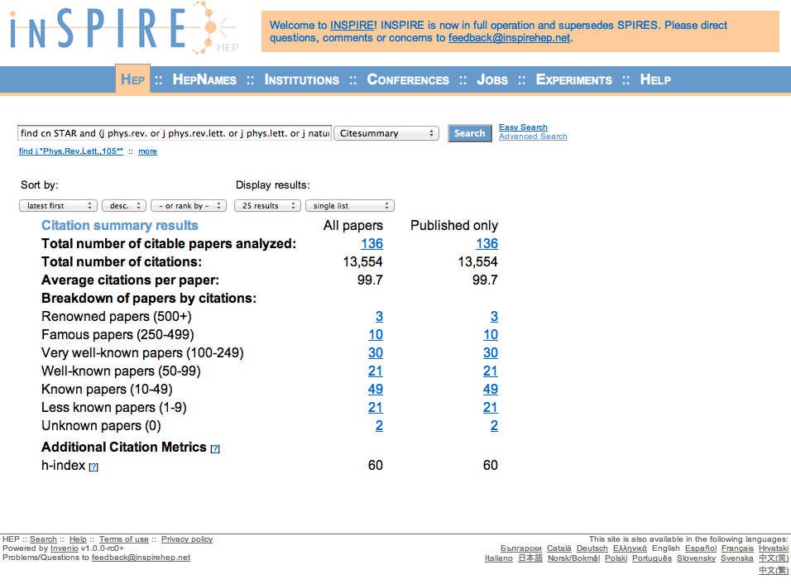
As of July, 2012

Slide 3
Recent Publications (June 2009 - )
48 STAR Publications
1 Nature, 1 Science
10 Physical Review Letters
24 Physical Review C
9 Physical Review D
3 Physics Letters B
1 Nuclear Physics A
21 STAR Publications with at least one lead author from LBNL
1 Nature
3 Physical Review Letters
11 Physical Review C
5 Physical Review D
1 Physics Letters B
Other individual publications:
1 Science
2 Physics Letters B
1 Ann. Rev. of Part. and Nucl.
1 Physical Review C

Slide 4
Students (institution, year of Ph.D.) conducting thesis work in RNC.
R. Cendejas - UCLA, 2012
C. Jena – Institute of Physics, India, TBD
D. Kikola - Warsaw Univ. of Tech., 2011
X.F. Luo – Univ. of Sci. and Tech. of China, 2010
C. Powell - Univ. of Cape Town, South Africa, TBD
E. Sangaline - UC Davis, TBD
S. Shi – Central China Normal Univ., 2010
X. Sun - Harbin Inst. of Tech., China, TBD
X. Zhang - Nanjing Univ., 2010
J. Zhao - Shanghai Inst. of Applied Physics, China, TBD

Slide 5
Presentations
Quark Matter 2011, Annecy, France
  Hiroshi Masui – STAR highlights
  Alexander Schmah – Elliptic flow from BES (STAR)
  Yifei Zhang – Open charm hadron production (STAR)
  Jie Zhao – Dielectron production (STAR)
Quark Matter 2012, Washington D.C.
  Xin Dong – STAR highlights
  Evan Sangaline – R_{AA} and R_{cp} from BES (STAR)

