Slide 1


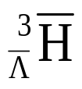
Antimatter and Hypernuclei at RHIC
Zhangbu Xu
(for the STAR Collaboration)
Heavy and Exotic Antimatter
What has RHIC discovered?
  and signal (for discovery)
  How Anti-Helium-4 was discovered
What can we do with the discovery?
  Production Rates for antimatter
  Even Heavier antimatter?
Outlook

Slide 2
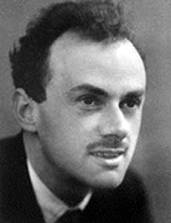
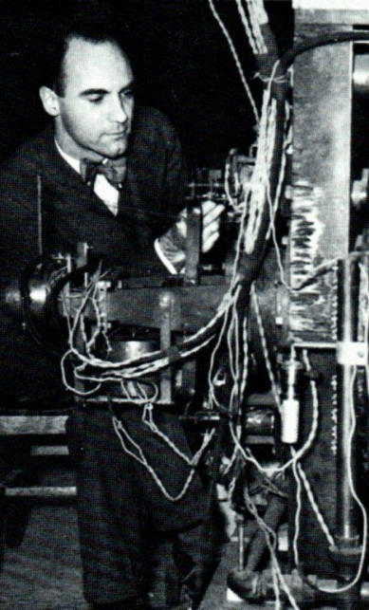
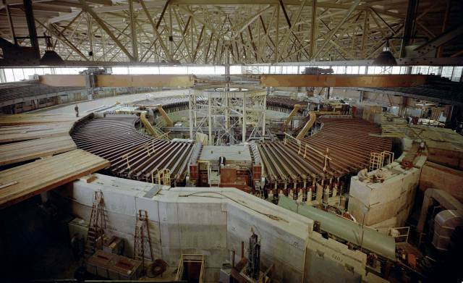

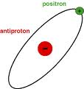
History of Antimatter
In 1928, Paul Dirac theorized possibility of antimatter as one of his equations for quantum mechanics had two “solutions” (regular matter and antimatter)
In 1932, Carl Anderson discovered positrons while studying cosmic rays
Two teams working at the Bevatron in Lawrence Berkeley National Lab discovered antiprotons and antineutrons in 1955 and 1956
In 1965, Antoni Zichichi of CERN and Leon Lederman of Brookhaven National Lab simultaneously discovered antideuteron
In 1995, CERN created antihydrogen atoms at the LEAR by slowing the antiprotons and attaching positrons
Courtesy of Will Pascucci, Choate Rosemary Hall; Wallingford, CT
2010 Summer High-School Student

Slide 3
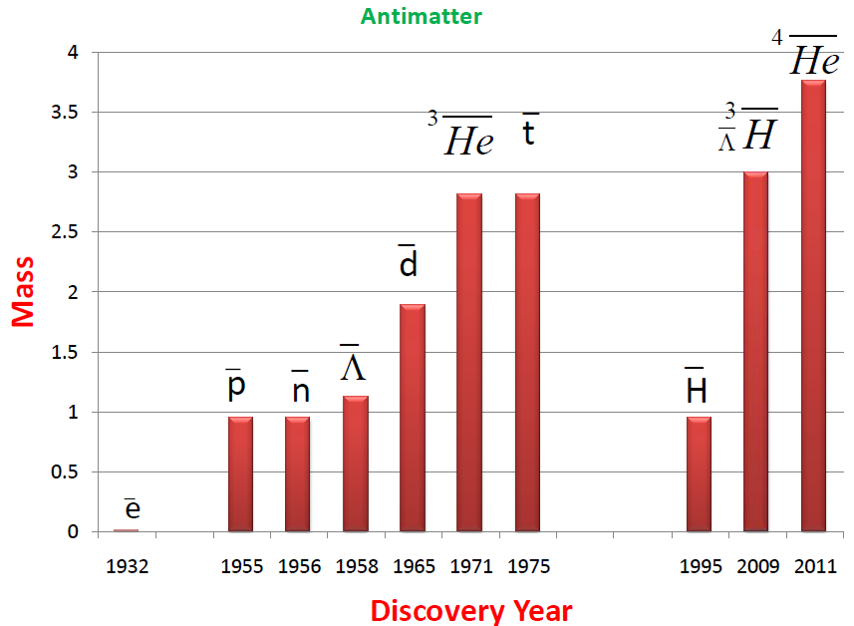

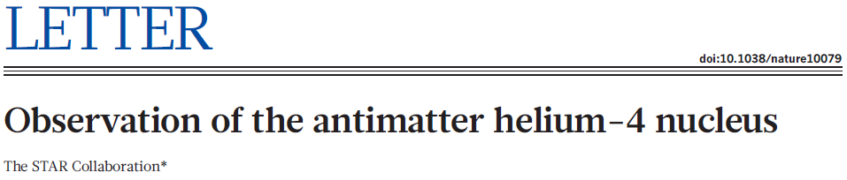

What is Antimatter?
“Those who say that antihydrogen is
antimatter should realize that we are
not made of hydrogen and we drink
water, not liquid hydrogen”
-- Dirac
Quoted from A. Zichichi (2008)
Antiparticles and antimatter:
the basic difference
Annihilate with normal matter
π⁺,π⁻ are each other’s antiparticle
Nuclear force
Relatively long lifetime

Slide 4
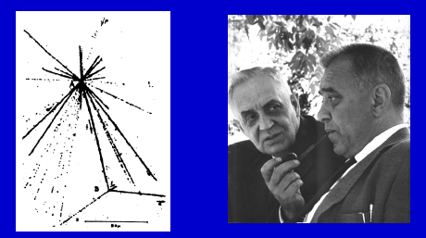
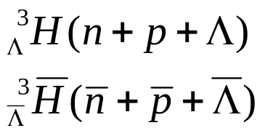
What are Hypernuclei ?
Nucleus which contains at least one hyperon in addition to nucleons.
Hypernuclei of lowest A
u d
u
u d
u
u d
u
³He
u d
u
t
u d
d
³_{Λ}H
u d
s
u d
d
u d
d
u d
d
Y-N interaction: a good window to
understand the baryon potential
Binding energy and lifetime are
very sensitive to Y-N interactions
Hypertriton: ΔB=130±50 KeV; r~10fm
Production rate via coalescence
at RHIC depends on overlapping wave
functions of n+p+Λ in final state
Important first step for searching for
other exotic hypernuclei (double-Λ)
The first hypernucleus was discovered by Danysz and Pniewski in 1952. It was formed in a cosmic ray interaction in a balloon-flown emulsion plate.
M. Danysz and J. Pniewski, Phil. Mag. 44 (1953) 348
No one has ever observed
any antihypernucleus before RHIC
Notes:
4

Slide 5
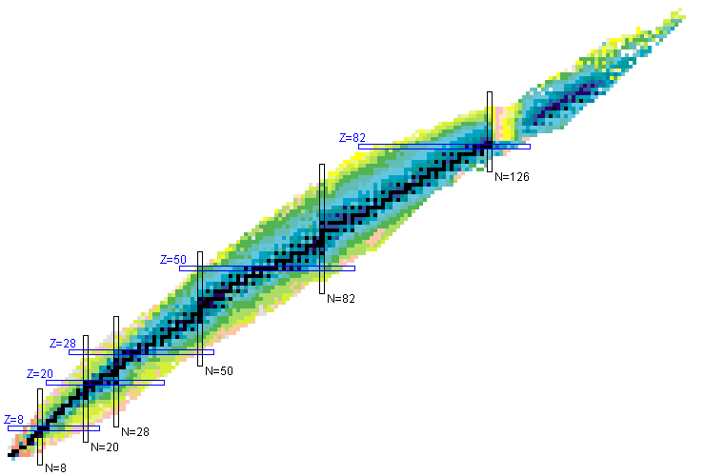
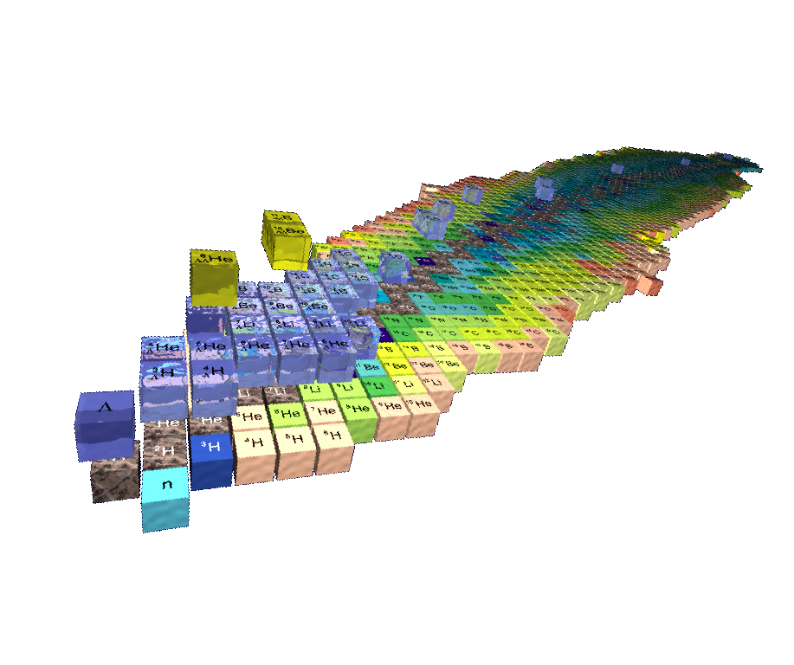
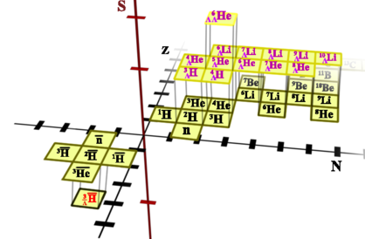
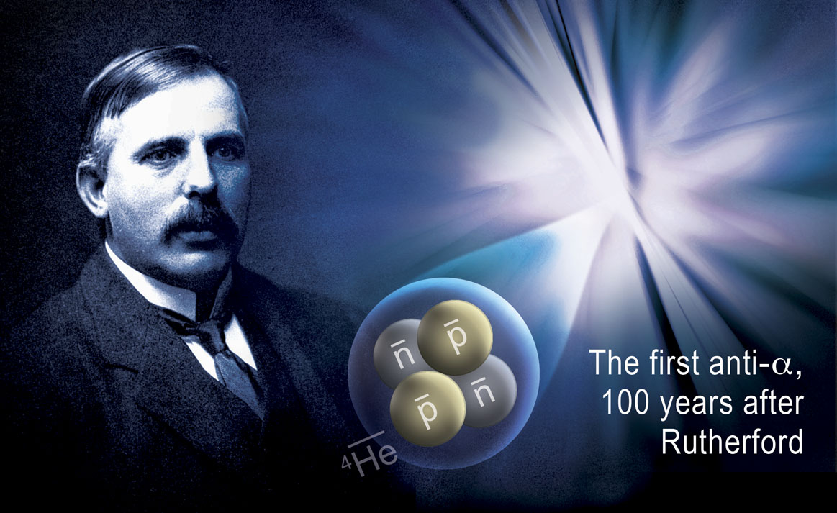

3-D Chart of Nuclides
S=-2
S=-1
S=-0
-2
-1

Slide 6
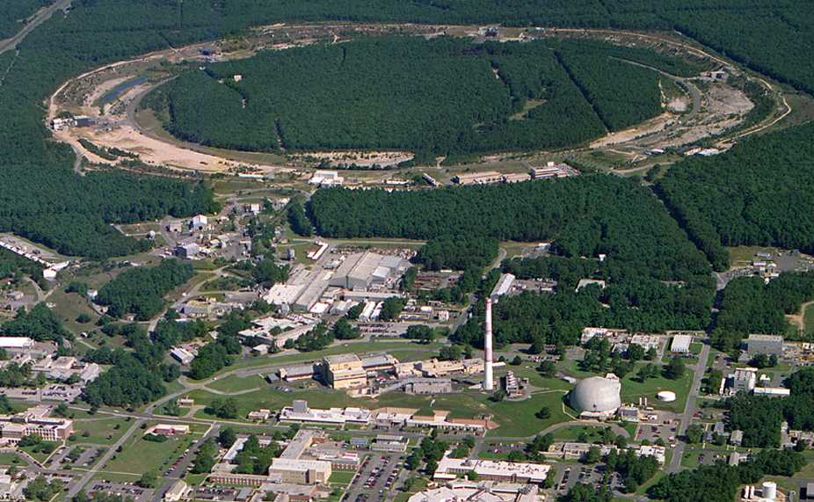
Relativistic Heavy Ion Collider (RHIC)
PHOBOS
BRAHMS
RHIC
PHENIX
STAR
v = 0.99995⋅c = 186,000 miles/sec
Au + Au at 200 GeV
AGS
TANDEMS
Animation M. Lisa

Slide 7
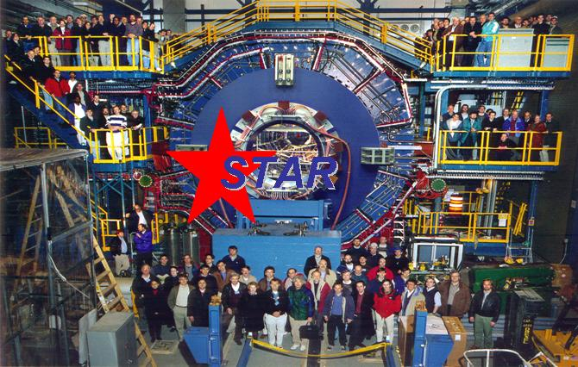
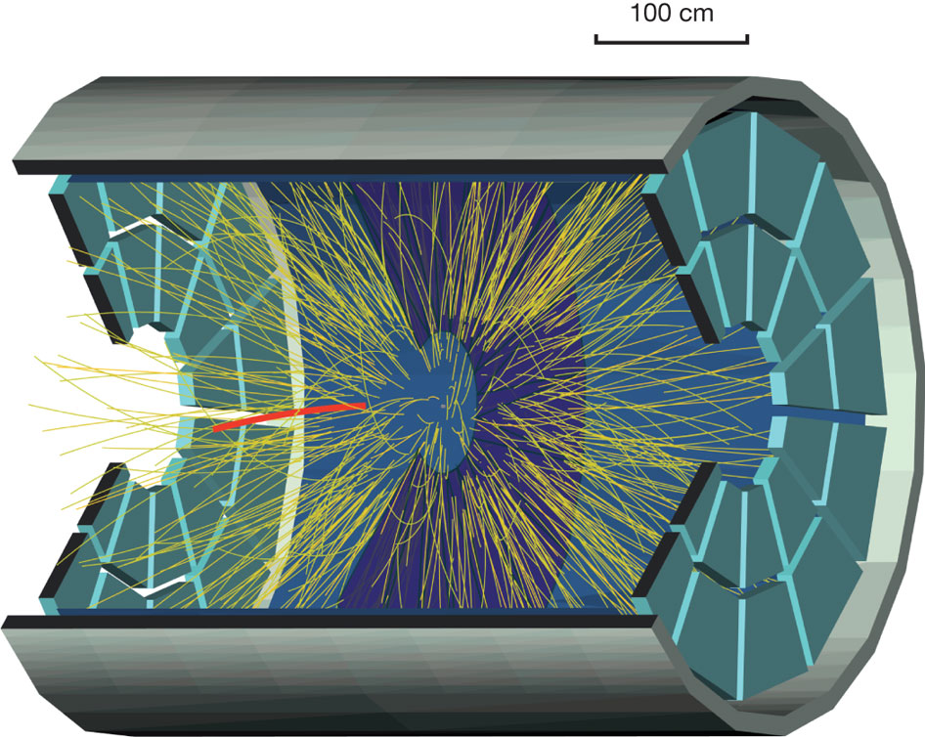

Slide 8
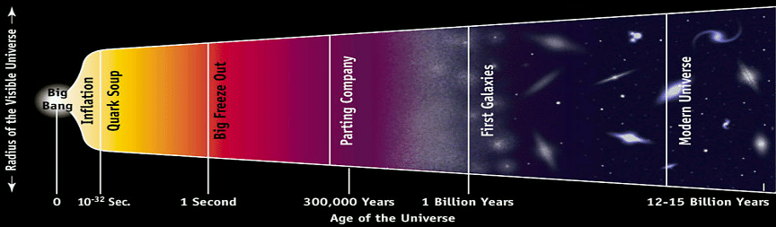
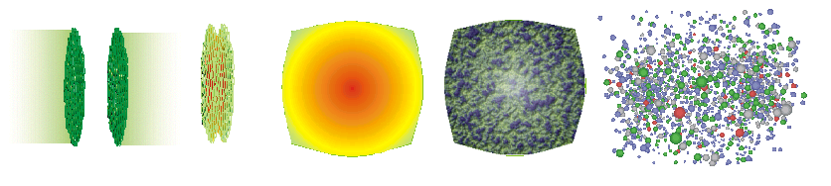
Little Big Bang
BIG; All 4 forces at work; Gravitation dominates; QGP@10⁻⁶s; Slow expansion; Antimatter-matter annihilate;
RHIC
TIME
Little; Strong force at work; QGP@10⁻²³s; Fast expansion; Antimatter-matter decouple; repeat trillion times

Slide 9
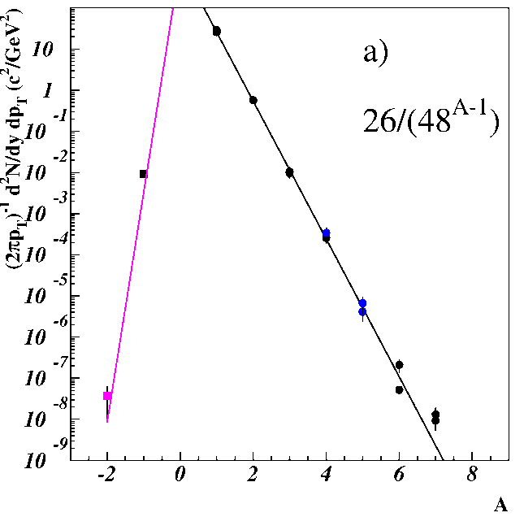
Can we observe hypernuclei at RHIC?
Low energy and cosmic ray experiments (wikipedia):
hypernucleus production via
  Λ or K capture by nuclei
  the direct strangeness exchange reaction
  hypernuclei observed
  energetic but delayed decay,
  measure momentum of the K and π mesons
In high energy heavy-ion collisions:
  nucleus production by coalescence, characterized by penalty factor.
  AGS data^{[1]} indicated that hypernucleus production will be further suppressed.
  What’s the case at RHIC?
聚并
[1] AGS-E864, Phys. Rev. C70,024902 (2004)
Notes:
9

Slide 10
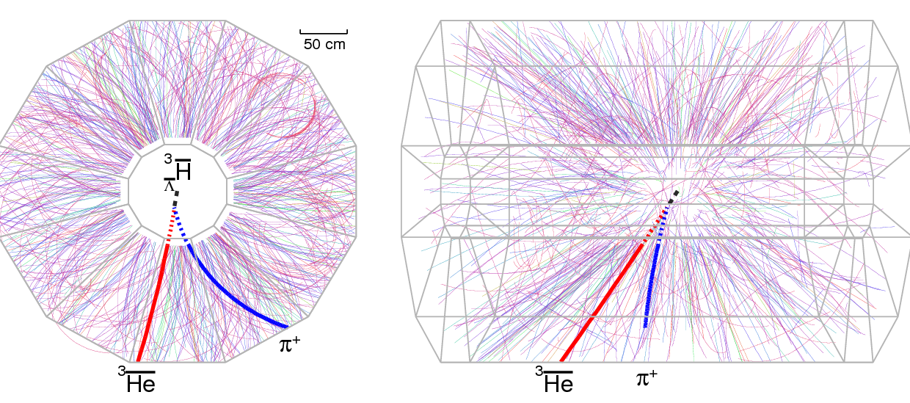
A candidate event at STAR
Run4 (2004)
200 GeV Au+Au collision

Slide 11
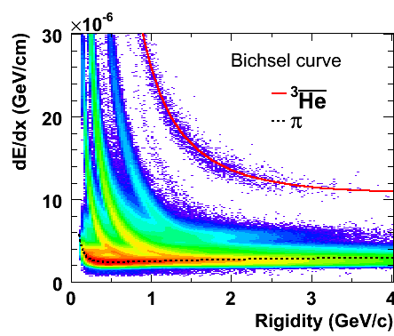

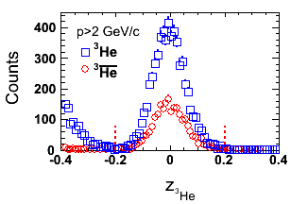
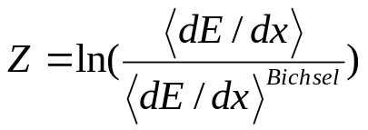
³He & anti-³He selection
Select pure ³He sample: -0.2<Z<0.2 & dca <1.0cm & p >2 GeV
  ³He: 2931(MB07) + 2008(central04) + 871(MB04) = 5810
  Anti-³He: 1105(MB07) + 735(central04) + 328(MB04) = 2168

Slide 12
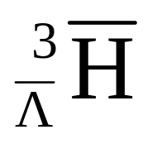
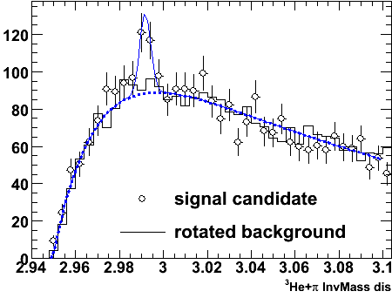
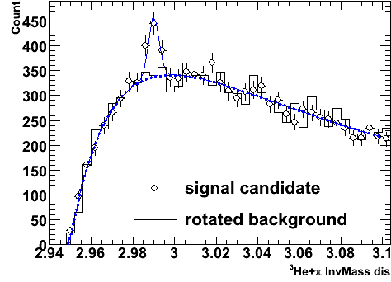
and Combined signals
Combine hypertriton and antihypertriton signal:
225±35
Signal observed from the data (bin-by-bin counting):
70±17;
Mass: 2.991±0.001 GeV; Width (fixed): 0.0025 GeV;
This provides a >6σ signal for discovery

Slide 13
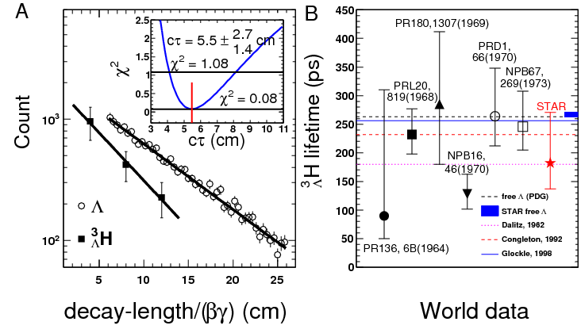
Lifetime of a hypertriton
Lifetime related to binding energy
Theory input: the Λ is lightly bound in the hypertriton
[1] R. H. Dalitz, Nuclear Interactions of the Hyperons (Oxford Uni. Press, London, 1965).
[2] R.H. Dalitz and G. Rajasekharan, Phys. Letts. 1, 58 (1962).
[3] H. Kamada, W. Glockle at al., Phys. Rev. C 57, 1595(1998).

Slide 14
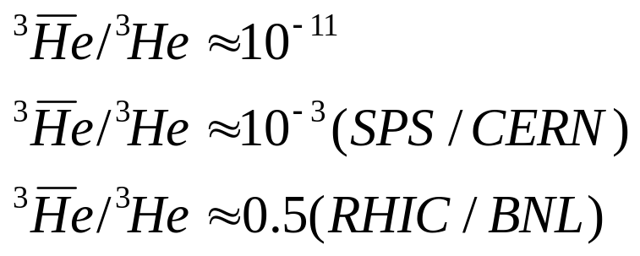
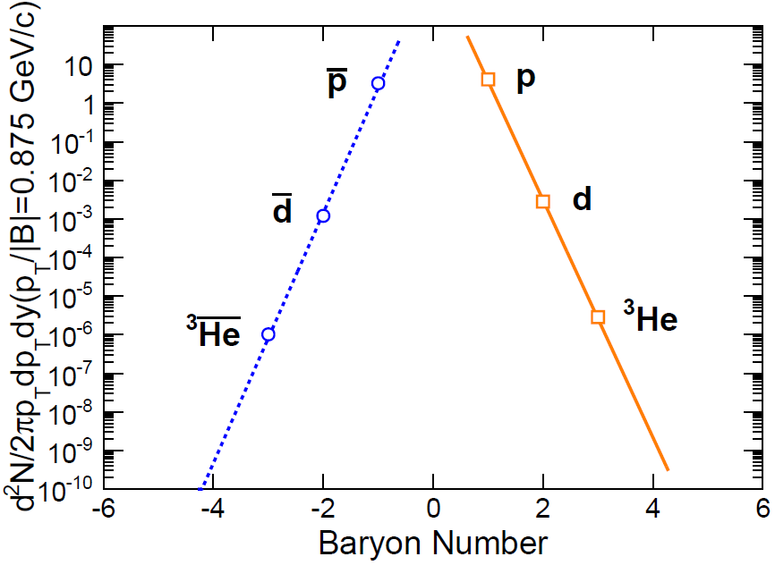
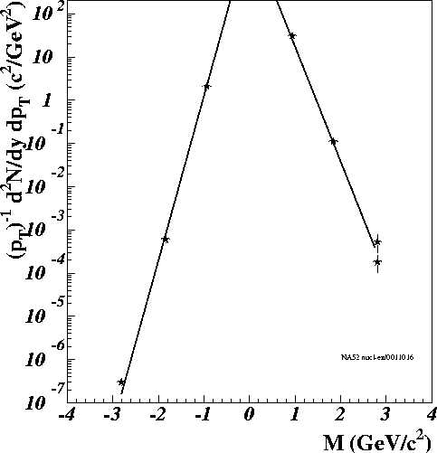
Matter and antimatter are not created equal
But we are getting there !
(AGS,Cosmic)
AGS
RHIC
SPS
NA52

Slide 15
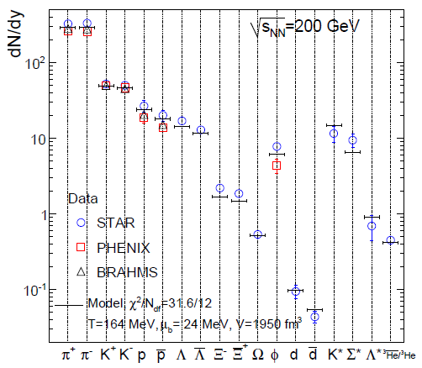
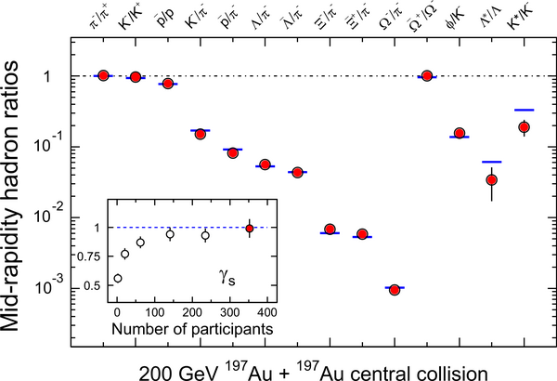
Flavors (u,d, s) are not created equal except in possible QGP
J. Rafelski and B. Muller, Phys.Rev.Lett.48:1066,1982
STAR whitepaper, NPA757(2005)
A. Andronic, P.Braun-Munzinger, J.Stachel, Phys. Lett. B 673 (2009) 142
A. Andronic, P.Braun-Munzinger, K.Redlich, J.Stachel, Phys. Lett. B 652 (2007) 259; B 678 (2009) 350; arXiv:1002.4441

Slide 16
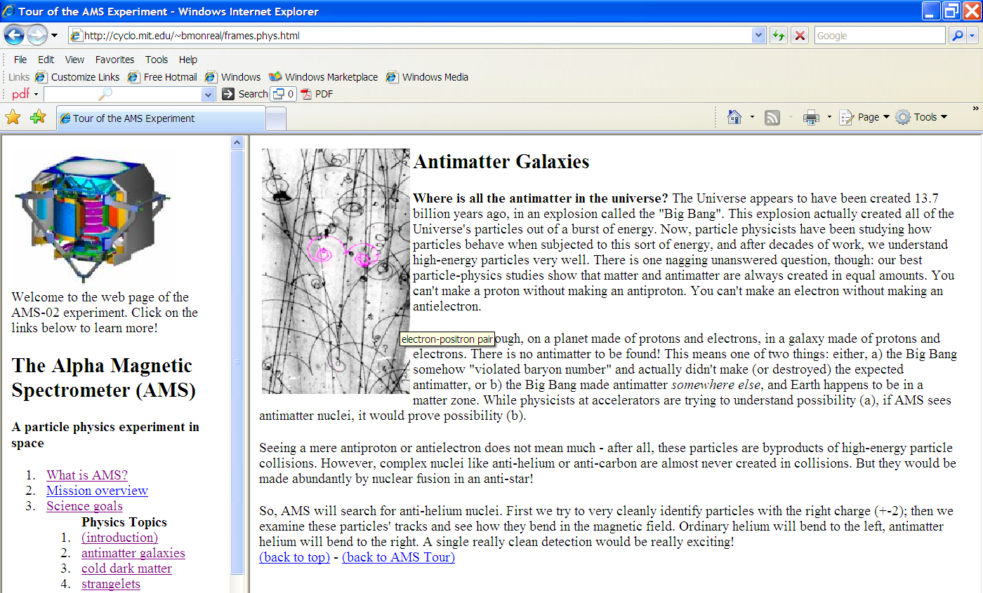
Antinuclei in nature (new physics)
To appreciate just how rare nature produces antimatter (strange antimatter)
RHIC: an antimatter machine
Seeing a mere antiproton or antielectron does not mean much– after all,
these particles are byproducts of high-energy particle collisions.
However, complex nuclei like anti-helium or anti-carbon are almost
never created in collisions.
AMS antiHelium/Helium sensitivity: 10⁻⁹
Dark Matter, Black Hole➔ antinucleus production via coalescence

Slide 17
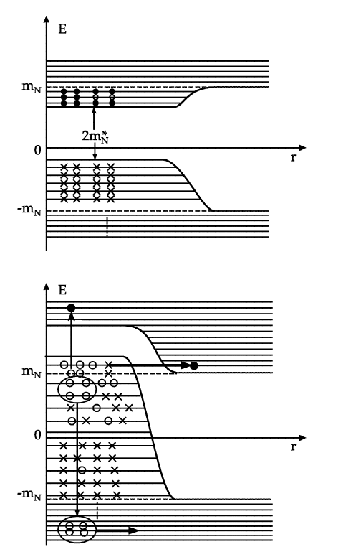
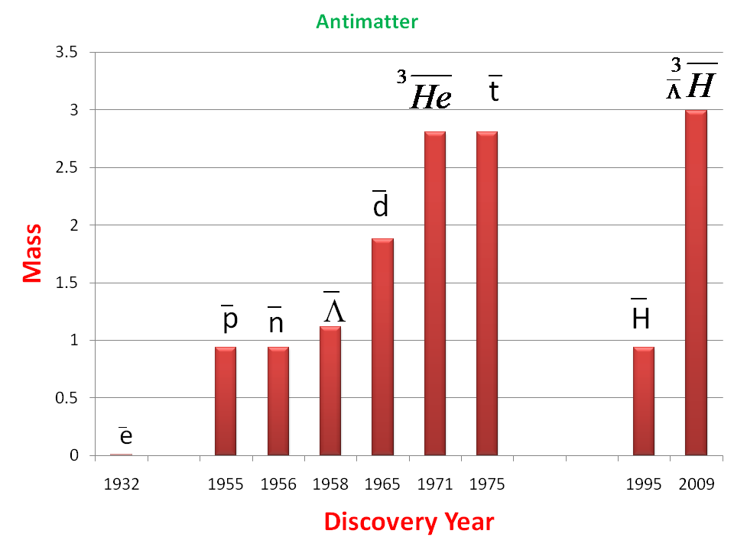
Antimatter Project: 40 years per step
‾α
?
??
2011
The extension of the periodic system into the sectors of hypermatter
(strangeness) and antimatter is of general and astrophysical importance.
… The ideas proposed here, the verification of which will need the
commitment for 2-4 decades of research, could be such a vision
with considerable attraction for the best young physicists… I can already
see the enthusiasm in the eyes of young scientists, when I unfold these
ideas to them — similarly as it was 30 years ago,…
---- Walter Greiner (2001)
Pull ‾α from vacuum (Dirac Sea)

Slide 18
Projected Discovery of antimatter Helium-4 nucleus from STAR
Can we get to
antimatter ⁶He, ⁶Li?
Production rate
1 million times lower than anti-Helium-4
Unless technology or
production mechanism
change dramatically,
NO!
2009 prediction
>10‾α arXiv:0909.0566

Slide 19
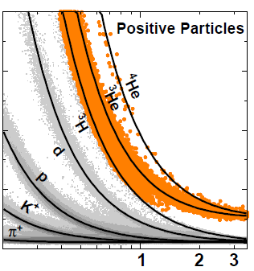
How to identify Helium-4
dE/dx in Time Projection Chamber
Separation at low pT
Merged with Helium-3 at p>3.5GeV/c
Most of the statistics at that range
Need a different detector
60
dE/dx (KeV/cm)
20
Nature Letters:
Received 14 March; accepted 4 April 2011.
Published online 24 April 2011.
p/Z (GeV/c)

Slide 20
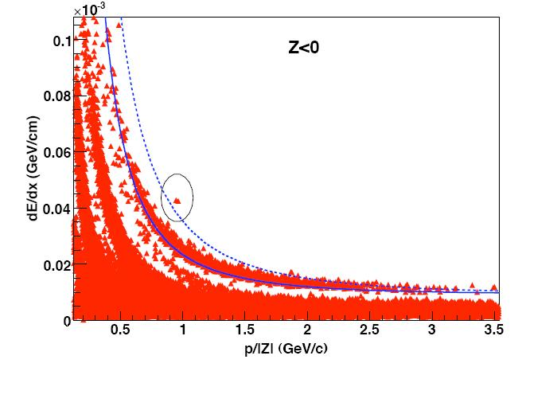
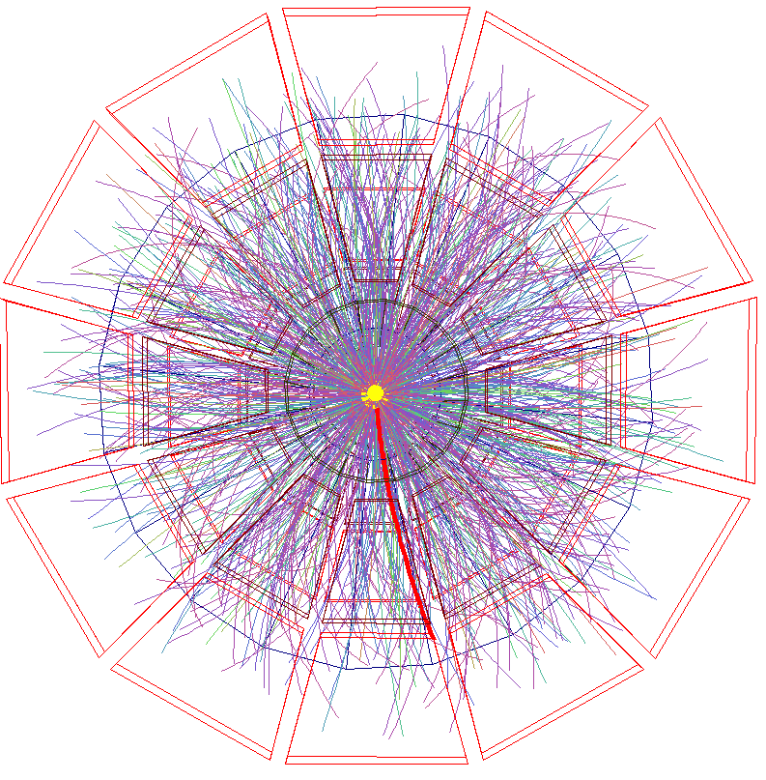
Candidates identified by TPC (2007)
Two candidates;
Clean separation;
To claim the discovery:
need more statistics and
confirmation using new detector
Jianhang Zhou (Rice) PHD thesis 2009
Light (Anti-)Nuclei Production in the STAR Experiment at RHIC

Slide 21
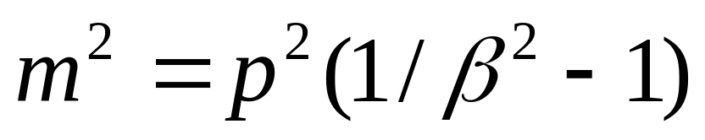
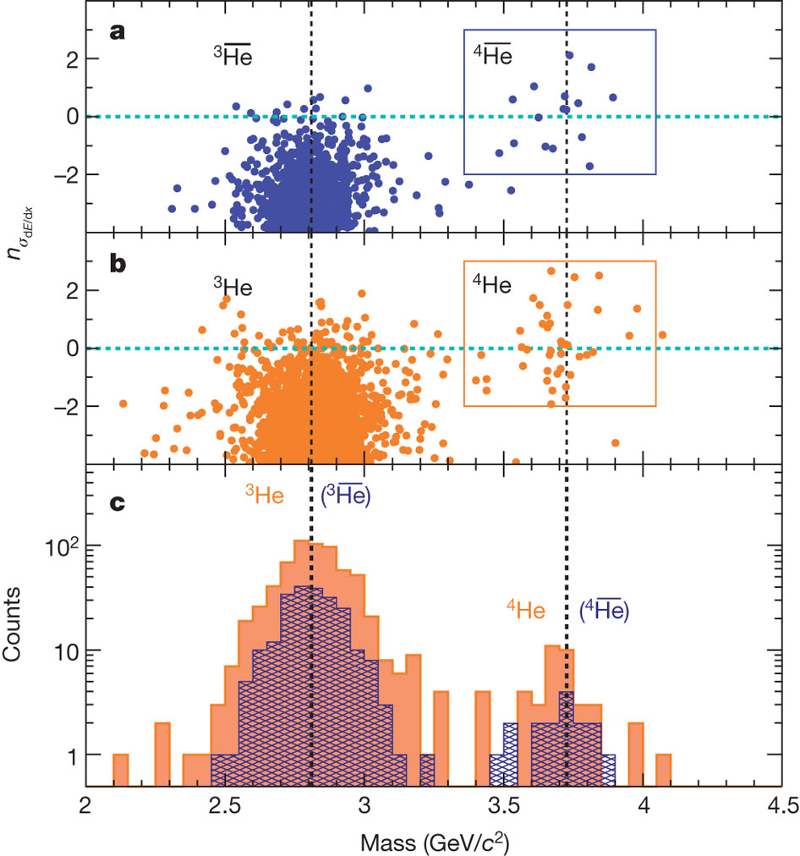
The Power of Time-of-Flight Detector
Two detectors confirm each other
With different methods:
dE/dx vs mass
18 count of antimatter Helium-4
Clean separation of Helium isotopes
Data Acquisition 10→100→1000Hz
TOF 100% installed in 2009:
A US-China joint Project for STAR
High-Level Trigger for express output
Collider performance and Luminosity
More details on Sunday in talk
by Hao Qiu (H7.00007)

Slide 22
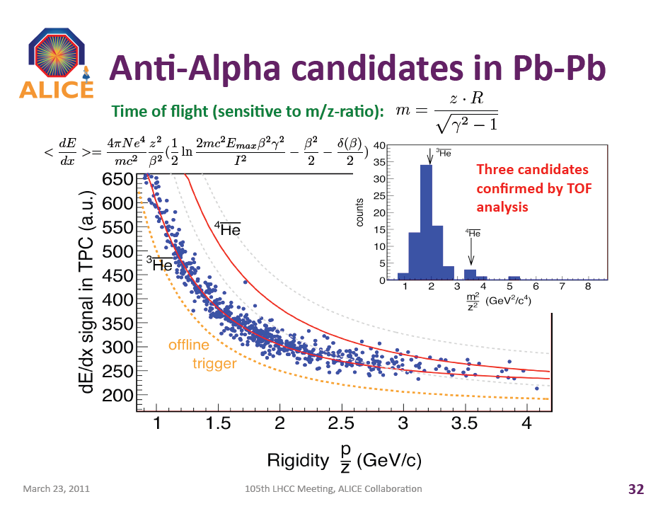
“ALICE came second but it's amazing to see how fast the results came,” exclaims Paolo Giubellino, the experiment’s spokesperson. – CERN Bulletin

Slide 23
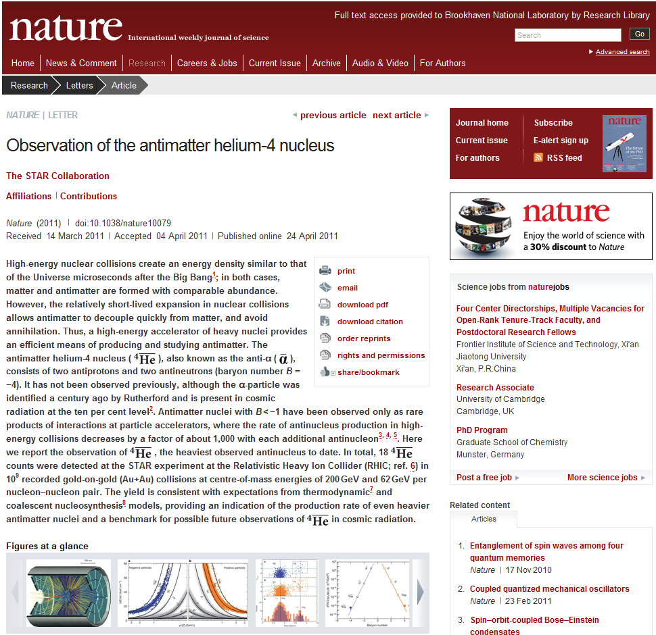
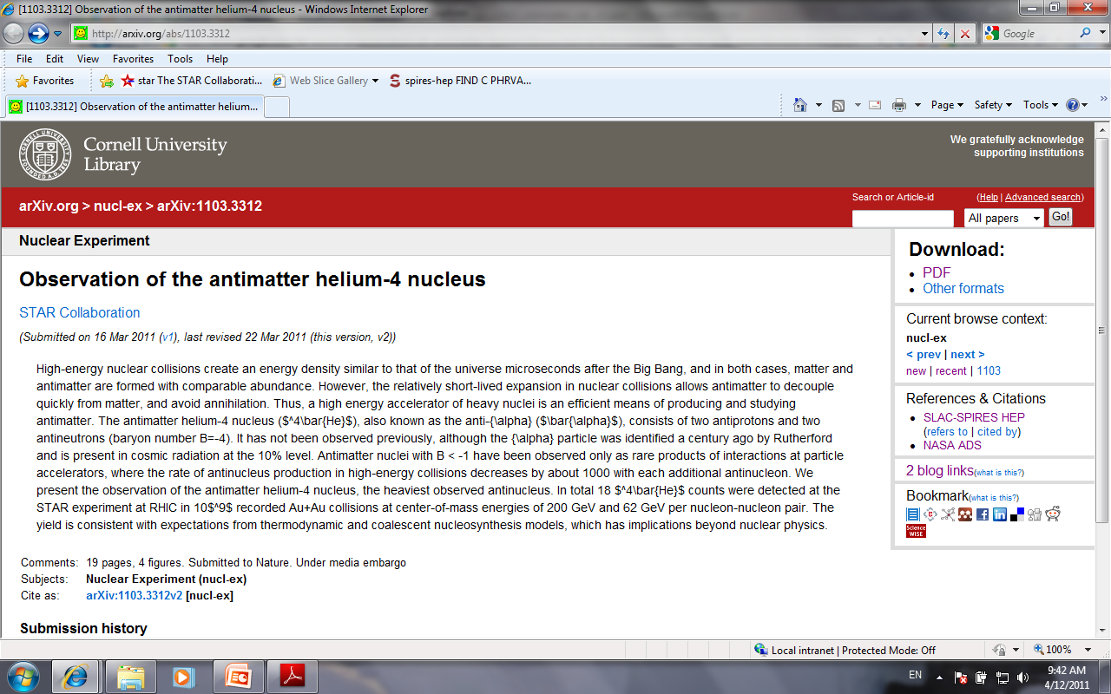

Slide 24
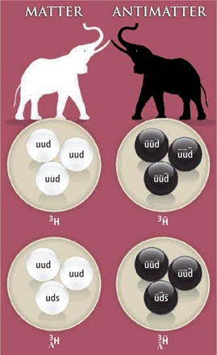
Existence is no surprise
It's still unclear whether finding the antihypertriton will have practical implications for physics, said Frank Close, a physicist at the University of Oxford and author of the book Antimatter. "One way of saying it is it's stamp collecting. Some stamps are more exciting than others," he said. "The fact that this particle has been found confirms our general belief that antimatter should exist just as much as matter exists," Close added. --- February 2011, National Geographic
"It is an enormous technical achievement that they can extract these rarely produced objects," says Tom Cohen, a nuclear physicist at the University of Maryland, College Park. "But everybody believed—I should almost say knew—
that anti-alpha particles could exist." Cohen compares the feat
with climbing the world's tallest mountain: "It's really impressive that
you can do it, but the fact that there's a summit to Mount Everest is
not a big surprise.“
"It's really, really very impressive that they're able to do that, to see these rare
events and convincingly isolate them," he says. "What they've found is that
there is no shock; it's where it's predicted to be.“
“Some of my colleagues take it for granted that there obviously has to be
an anti-alpha. My view, and I am a theorist, is that it is just an idea –
of course a good idea - until it is actually seen. The fact that you encountered
the antihypertriton - no one's obvious choice - on the way, is a sign that probing
the attainable structure of antimatter is a real scientific adventure. “
Science Perspectives Vol 328

Slide 25
Predictability is a shock
If I told you that:
create a state of matter at 4x10¹² degrees
out of a few thousands of particles
Matter and antimatter do not annihilate at
energy density 100 times the normal nuclear density
Anti-nuclei and nuclei with weak binding energy
carry information from the QGP phase transition
(Temperature = 160MeV)
All particles maintain statistical equilibrium
(no sign of annihilation but coalescence)
Models that assume thermal equilibrium correctly account for
yields spanning 11 orders of magnitude.
(1000 π, 10⁻⁸ ⁴He)
±0.00000000001
How many of you would say that “I expect that!”?
That is what we did when we found all these
Heavy antimatter nuclei!

Slide 26
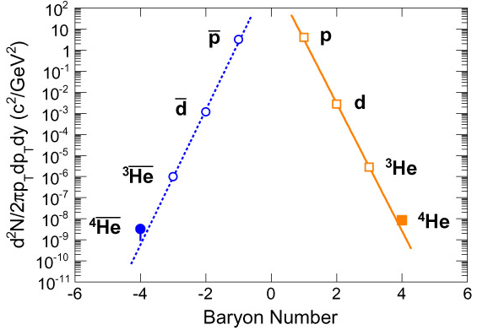
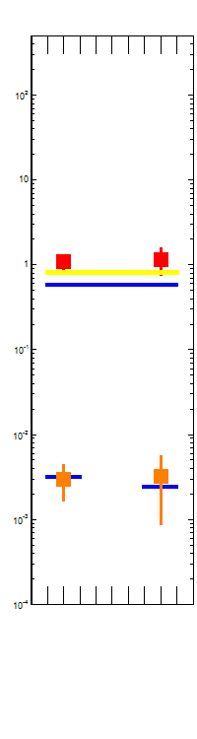


Predictable Production Rate
A. Andronic, P. Braun-Munzinger, J. Stachel, and H. Stocker,
Phys.Lett.B697:203-207,2011
Why is it so predictable?
T=164MeV?
+ -

Slide 27
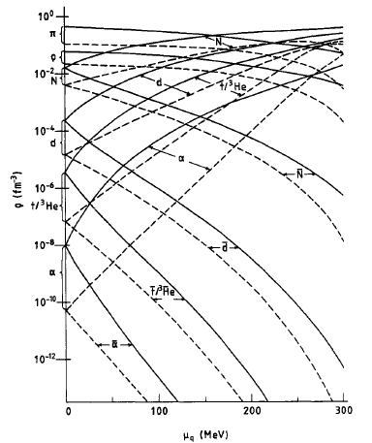
Even Heavier Antimatter
Formation of antimatter clusters in the hadronisation phase transition:
U. Heinz et al. JPG: 12 (1986) 1237
Pull ‾α from vacuum (Dirac Sea):
W. Greiner, IJMPE 5 (1995) 1

Slide 28
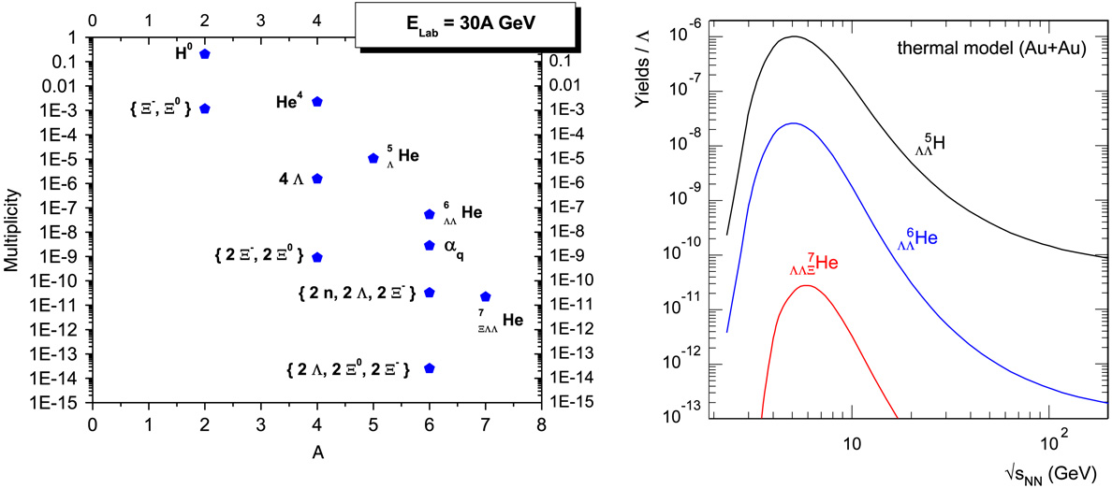
Exotic Hypernuclei
FAIR RHIC LHC
A. Andronic, P. Braun-Munzinger, J. Stachel, Nucl. Phys. A 772 (2006) 167.
P. Braun-Munzinger, J. Stachel, J. Phys. G 21 (1995) L17
A. Andronic: SQM09

Slide 29
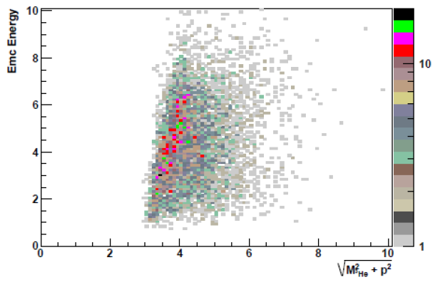
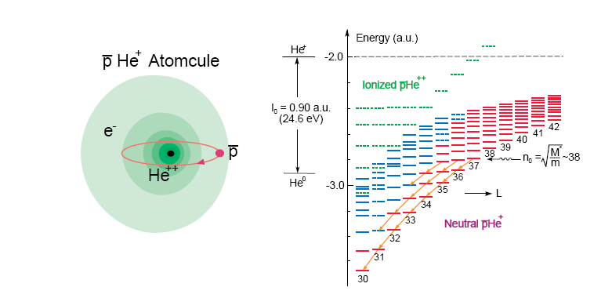

Other antimatter searches at RHIC
Unstable Antimatter Nuclei
Antinuclei Atomcules
Metastable antiproton-helium atom discovered at KEK:
Iwasaki, PRL 67 (1991); nature 361 (1993) 238
Mass difference: p-pbar < 2x10⁻⁹; Hori, PRL 96 (2006);
measurement of baryon mass and magnetic moment
for CPT test at LEAR/CERN
http://asacusa.web.cern.ch/ASACUSA/index-e.html
Anti-He3 energy deposit in calorimeter
‾d‾t ‾He3
⁴Li➔³He+p
⁴He*➔d+d, t+p
⁵Li➔⁴He+p
⁴_{Λ}H➔⁴He+π
Antimatter mounic hydogen: ‾p-μ⁺
Production of muon-meson atoms in Ulrearelativistic heavy-ion collisioins:
G. Baym et al., PRD 48(1993)
Hydrogenlike atoms from ultrarelativistic nuclear collisions:
J. Kapusta and A. Mocsy, PRC 59 (1999)
Measurement of the rate of formation of π-μ atoms in K_{L}⁰ decay:
S.H. Aronson et al., PRL 48 (1982)
>1000 candidates in 500M central events

Slide 30

Conclusion and Outlook
has been observed for 1st time
Discovery of antimatter Helium-4
_{Λ}³H→d+p+π channel measurement: d and ‾d via ToF.
Search for other hypernucleus: ⁴_{Λ}H, double Λ-hypernucleus.
heavier antinuclei, antinucleus atomcules, muonic hydrogen
RHIC: best antimatter machine

Slide 31

from Hypernuclei to Neutron Stars
      hypernuclei Λ-B Interaction Neutron Stars
S=-2
S=-1
S=-0
Saito, HYP06
Several possible configurations of Neutron Stars
  Kaon condensate, hyperons, strange quark matter
Single and double hypernuclei in the laboratory:
  study the strange sector of the baryon-baryon interaction
  provide info on EOS of neutron stars
J.M. Lattimer and M. Prakash,
"The Physics of Neutron Stars", Science 304, 536 (2004)
J. Schaffner and I. Mishustin, Phys. Rev. C 53 (1996):
Hyperon-rich matter in neutron stars

Slide 32


Strangeness Fluctuation
UrQMD E-by-E Distribution of the strangeness to baryon fraction in the transverse plane (z=0 fm).
Jan Steinheimer , Horst Stoecker, Ingo Augustin, Anton Andronic, Takehiko Saito,Peter Senger, Progress in Particle and Nuclear Physics 62 (2009) 313317
J. Steinheimer: SQM09

Slide 33


Energy scan to establish the trend
S. Zhang et al., arXiv:0908.3357 (PLB)
Beam energy | 200(30—200) GeV | ~17 (10—30)GeV | ~5 (5-10) GeV
Minbias events# (5σ) | 300M | ~10—100M | ~1—10M
Penalty factor | 1448 | 368 | 48
³He invariant yields | 1.6x10⁻⁶ | 2x10⁻⁴ | 0.01
³_{Λ}H/³He assumed | 1.0 | 0.3 | 0.05
Hypertriton only
STAR: DAQ1000+TOF

Slide 34

Creating first Antinucleus Atomcules
Metastable antiproton-helium atom discovered at KEK:
Iwasaki, PRL 67 (1991); nature 361 (1993) 238
Mass difference: p-pbar < 2x10⁻⁹; Hori, PRL 96 (2006);
measurement of baryon mass and magnetic moment
for CPT test at LEAR/CERN
http://asacusa.web.cern.ch/ASACUSA/index-e.html
‾d‾t ‾He3
What happens if we replace antiproton
with antideuteron, antitriton or antiHelium3
Atomic structure should be the same
for antideuteron and antitriton (-1 charge)
Reduced mass M* will be different.
Only RHIC can answer this question with
enough antimatter nuclei for such study
Possible Physics Topics:
Measure antinucleus mass and magnetic moment for CPT test,
Study the antinucleus annihilation process (sequence)
antinucleus-nucleus Annihilation
(what do they create? Hot or cold matter)
Maybe even antiAlpha Atomcule

