Slide 1
The Chiral Magnetic Effect in Hot QCD and
The Isobar run in 2018
Jim Thomas
Lawrence Berkeley National Laboratory
1/24/2018

Slide 2
What are we doing in the 2018 Run?
STAR is proposing to run ⁹⁶Zr + ⁹⁶Zr collisions and ⁹⁶Ru + ⁹⁶Ru collisions at RHIC in 2018. 3 weeks each. Zr and Ru are isobars.
Isobars are nuclei with the same mass, nearly the same shape, but with different number of protons
There exist 4 stable isobaric systems where the change in Z is large
Element Z Mass Abundance
Zr 40 96 2.80%
Mo 42 96 16.68%
Ru 44 96 5.54%
Sn 50 124 5.79%
Te 52 124 4.74%
Xe 54 124 0.09%
Te 52 130 34.50%
Xe 54 130 4.07%
Ba 56 130 0.11%
Xe 54 136 8.86%
Ba 56 136 7.85%
Ce 58 136 0.19%
ΔZ = 4
All are stable isotopes and they make good beams in the accelerator

Slide 3
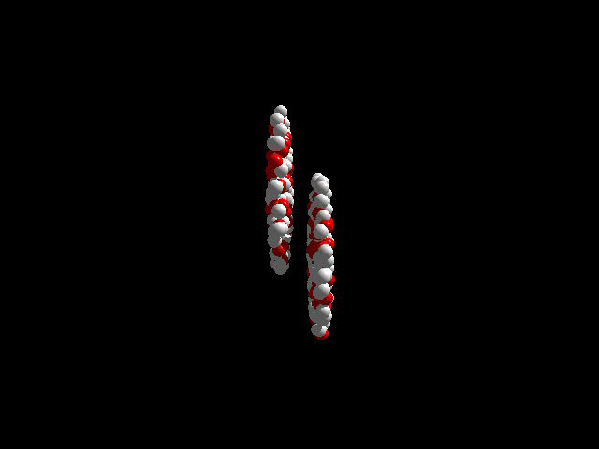
Charges in motion
Charges in motion create strong magnetic fields

Slide 4
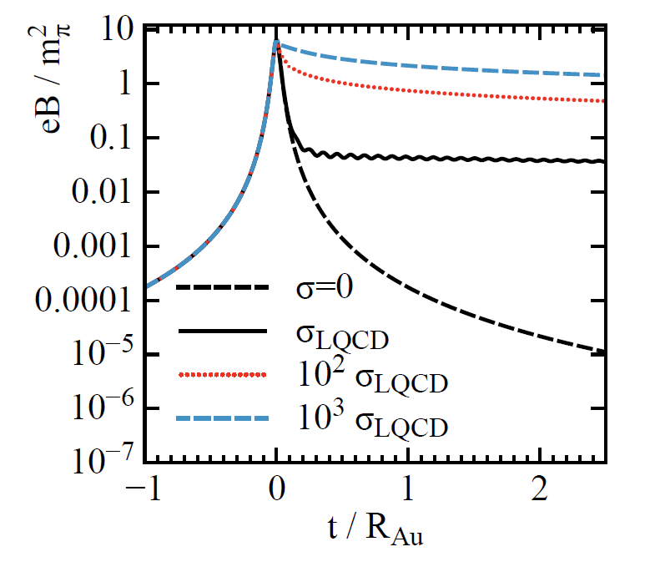
The B_{EM} field – 10¹⁸ gauss at the peak
The B field is strong and short duration due to the velocity of the passing ions
  MRI uses 10⁴ gauss
  1000x MagnetoStar
Magneto hydrodynamic effects in the QGP extend the lifetime of the B field
  aka Lenz’s Law
  Finite conductivity
Recent calculations suggest the lifetime is extended in a plasma but the magnitude is reduced x50 from the peak at the relevant time scale
L. McLerran, V. Skokov, Nucl.Phys. A929 (2014) 814-190

Slide 5
Wow! … but who cares?
The Nucleus is a laboratory to study fundamental physics
  Strong B_{EM} fields do useful work

Slide 6


Mnemonic for remembering the strong interaction
-
+
The E&M interaction is mediated by a non-self interacting particle
Gluons form flux tubes and other more complex topological configurations
$$\overline{q}$$
$$q$$
The Strong interaction is mediated by a self interacting particle
Notes:
The strong interaction is mediated by a massless self interacting particle called the gluon. This leads to a most unusual property of the strong interaction: it is called confinement. The self-interaction of the gluons exchanged by two quarks causes the field between the quarks to be drawn down into a flux tube or “string”. And as the length of the string increases, the number of self interactions and thus the energy of the string increases. The rate of increase of energy with length is linear at large distance, Energy = C / r + k * r , leading to a constant restoring force, k. So if you pull hard enough on the quarks, the string will break and a quark-antiquark pair will be created to terminate the ends of the string fragments. Thus, a quark cannot be isolated. The only way to study a "free" quark is to put quark pairs in a very dense plasma where nearest neighbor interactions can disrupt the strings. Under these conditions, the gluon exchanges will be isotropic in space and the quark can act as if it is isolated and free. (In the same sense that an electron is free in an plasma.) RHIC will produce sufficiently dense states of matter to allow us to study quark deconfinement and assymptotic freedom.
Compare the strong interaction to the electromagnetic interaction (upper vs. lower figure). The E&M interaction is mediated by photons which have infinite range and do not interact with one another. Thus, the propagation of photons is purely geometric which leads to a 1/R**2 force.
Strictly speaking, the model presented in this viewgraph is a mnemonic for understanding the strong interaction. It is not a complete description of the strong interaction nor is it extremely precise. But it describes a great deal in very few waves of the hand. A more accurate description of quark confinement is achieved by noting that there is a formal analogy between QCD and QED if you swap the roles of the Electric and Magnetic interaction. You must also add the color degrees of freedom. Under these circumstances, quark confinement is the analog of the Meisner effect where a super-conductor expels lines of magnetic flux. But in QCD, the vacuum expels the electric flux between the two quarks causing the flux lines to be collapsed down into a narrow flux tube, or string.

Slide 7
Quark and Gluon interactions
The “Force Law” for quarks and gluons depends on whether the quarks are found in isolation or in a dense environment
  In isolation: stretch a flux tube and it will get longer and eventually break. The longer the tube, the more energetic (massive) the system.
  In a dense environment, short distance interactions become important. These short range interactions dissolve the flux tubes into a soup of q and g interactions: a quark gluon plasma
  Quarks become “free” particles in a QGP and they also become (nearly) massless in a QGP due to Chiral symmetry restoration
  This “freedom” is what makes Ultra Relativistic Heavy Ion Collisions interesting to the experimentalist and calculations possible for the theorist
Notes:
QCD changes the familiar QED screening to anti–screening:
αs(r) ≃ 3π (11Nc/2 − Nf ) ln(r0/r)
as long as the number of flavors does not exceed 16 (Nc = 3), the anti–screening originating from gluon loops overcomes the screening
due to quark–antiquark pairs, and the theory, unlike electrodynamics, is weakly coupled at short distances: αs(r) → 0 when r → 0.

Slide 8
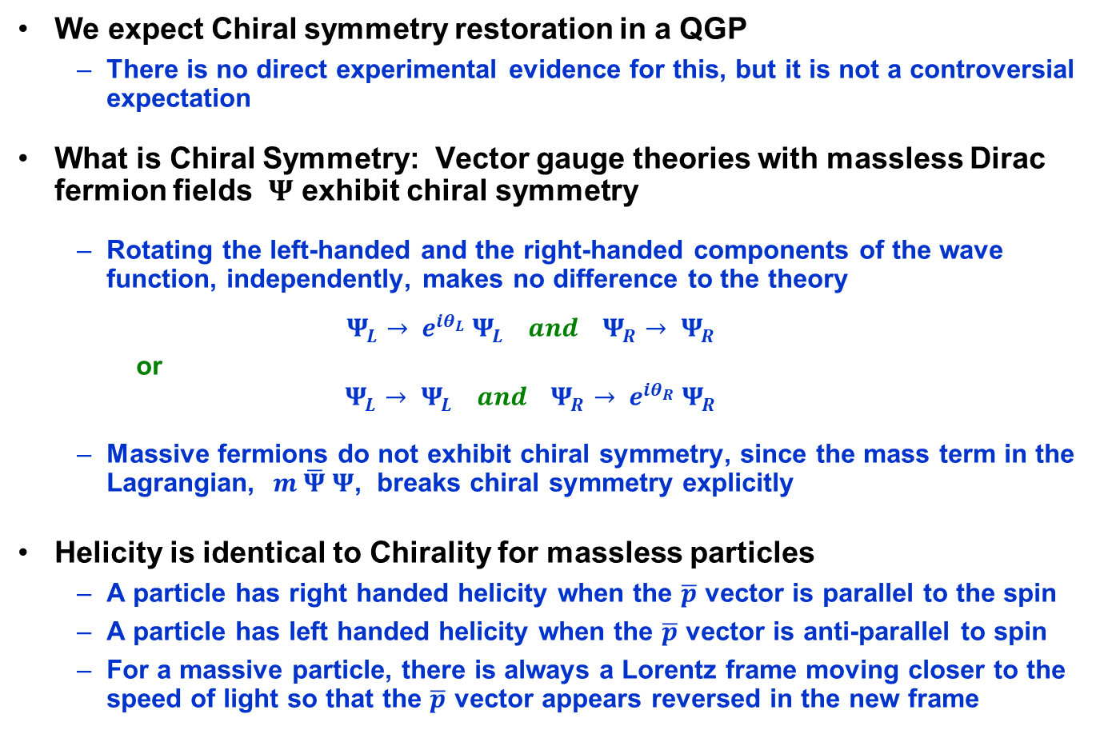
Chiral Symmetry
We expect Chiral symmetry restoration in a QGP
  There is no direct experimental evidence for this, but it is not a controversial expectation
What is Chiral Symmetry: Vector gauge theories with massless Dirac fermion fields $Ψ$ exhibit chiral symmetry
  Rotating the left-handed and the right-handed components of the wave function, independently, makes no difference to the theory
  $$Ψ_{L}→ e^{iθ_{L}} Ψ_{L} and{ Ψ}_{R}→ Ψ_{R}$$
    or
  $$Ψ_{L}→ Ψ_{L} and{ Ψ}_{R}→ {e^{iθ_{R}} Ψ}_{R}$$
  Massive fermions do not exhibit chiral symmetry, since the mass term in the Lagrangian, $m \overline{Ψ} Ψ$, breaks chiral symmetry explicitly
Helicity is identical to Chirality for massless particles
  A particle has right handed helicity when the $\overline{p}$ vector is parallel to the spin
  A particle has left handed helicity when the $\overline{p}$ vector is anti-parallel to spin
  For a massive particle, there is always a Lorentz frame moving closer to the speed of light so that the $\overline{p}$ vector appears reversed in the new frame

Slide 9
Gluon Fields in a QGP
Complex gluon field configurations are common in a QGP
  Examples include: Links, knots, and anti-screening due to gluon loops
  QCD supports many topologically distinct vacuum states
    And some of these topologically distinct states violate P and CP
      What? Doesn’t the strong interaction conserve Parity?
      Parity is conserved in the strong interaction … but only in cold QCD.

Slide 10
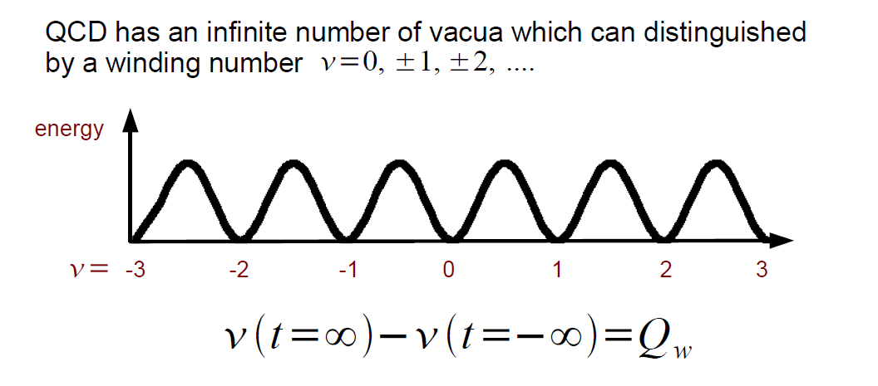

Hot QCD allows for metastable states … lots of them
Moving from one vacuum state to another is the result of changing the topological charge of the system
Topological charge flips helicity and thus counts the difference between the number of right and left handed quarks
Topological charge changing transitions also violate local P and CP conservation
Ground State
sphalerons
instantons
What every experimentalist likes to see in a theory publication …
  “The consequences and magnitude of these effects are subject to experimental study and verification”
    Kharzeev, McLerran, and Warringa arXiv:0711.0950 and
    Nucl. Phys. A803 (2008) 227.
From a humble experimentalist’s point of view … these theories appear to be fully vetted; CP and P violating domains almost certainly occur in ultra-relativistic HI collisions. The question is whether the effects are large enough to be observed …
Notes:
Topological charge flips helicity of a quark. From right to left, or vice versa.

Slide 11
The Chiral Magnetic Effect (CME)
Now that we have our tools in place, lets start discussing the Chiral Magnetic Effect
  Theorists call it the Chiral Magnetic Effect. I am an experimentalist so call it Chiral Magnetic Engineering
Three things must come together, simultaneously, to make the Chiral Magnetic Effect work
  Strong magnetic fields (10¹⁵ - 10¹⁸ gauss!)
  Chiral Symmetry restoration
  Topological Charge changing transitions in hot QCD

Slide 12
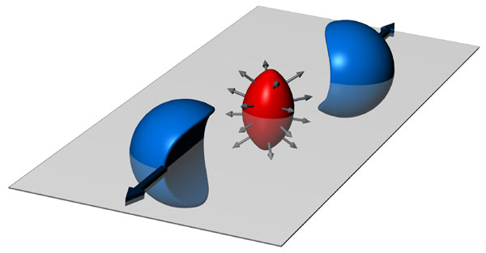
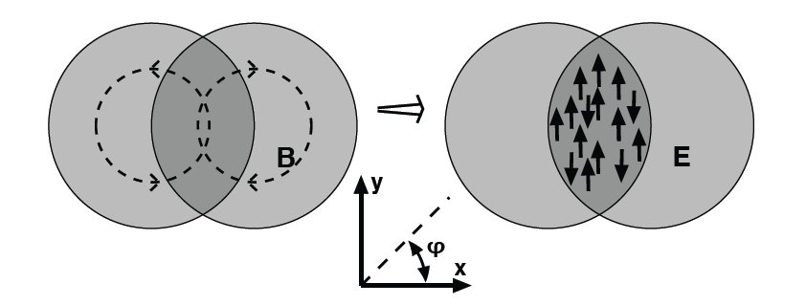
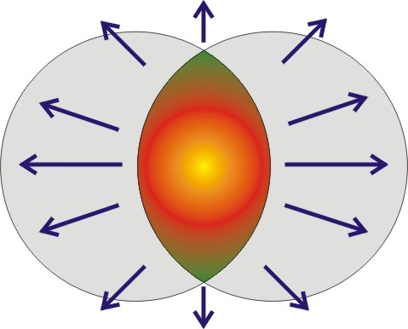
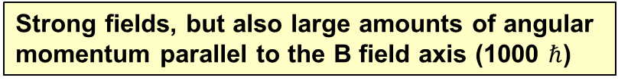
A collision has Angular Momentum and a B field
Electromagnetic charges in motion create an E&M magnetic field (not a color magnetic field)
The magnetic fields can reach 10¹⁸ gauss. Stronger than on the surface of a neutron star.
S. Pratt
Quarks interact with the magnetic field via their spin and magnetic moment
Quarks will align themselves parallel or anti-parallel to the B field direction
The B field is a long range phenomena; it affects every quark in the de-confined system … every quark is spin-aligned
Strong fields, but also large amounts of angular momentum parallel to the B field axis (1000 $ℏ$)

Slide 13
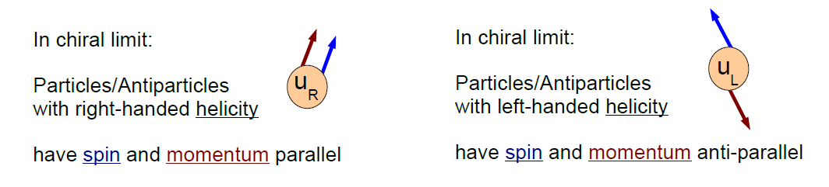
Quarks interact with the B field via their spin
Assume: chiral symmetry is restored in a QGP
Assume: quark masses drop to ~0 after chiral symmetry restoration
Chirality and helicity are the same for massless particles … so in the limit of zero mass, it is easy to define chirality
(not so easy for non-zero mass)
The QCD Lagrangian is chirally symmetric for massless particles
  The pion is the Goldstone boson for Chiral symmetry
  Chiral symmetry is spontaneously broken & gives mass to hadrons

Slide 14
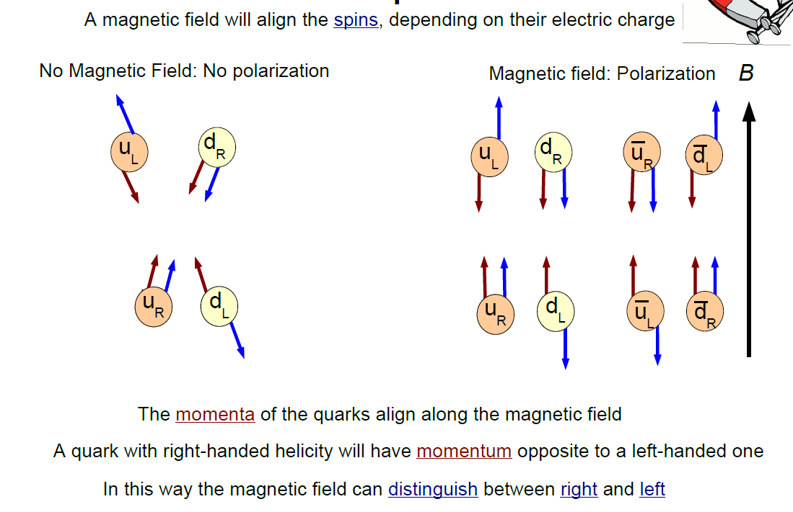
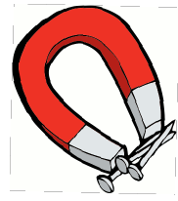
How does the B field affect the Quarks?
H. Warringa
Notes:
Note that charge motion is balance if the number of right and left handed quarks is the same

Slide 15
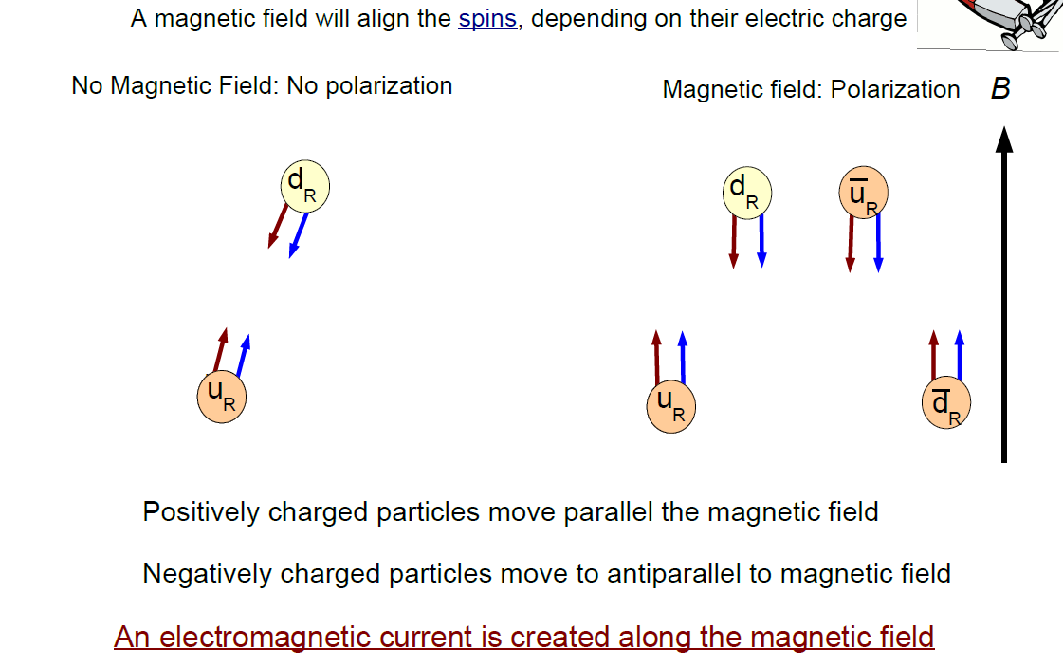
Topological Charge flips chirality: L to R
Topological Charge fluctuations create an excess of right, or left handed quarks.
Note that right handed quarks move up or down based on charge.
H. Warringa
Notes:
Topological charge flips helicity. Note that these results have been reproduced on the Lattice

Slide 16
Separation of Charge wrt the reaction plane
If a chirally restored bubble is created in a heavy ion collision, the positively charged quarks will go up … then hadronize … and yield an excess of positive pions above the plane
Unfortunately, it could be just the opposite in the next event depending on the topological charge in the bubble
+
+
+
+
+
+
The signal is manifestly
parity odd ⇒
x ⇒ -x , p ⇒ -p
but the observable will be even
The charge-flow asymmetry is too small to be seen in a single event but may be observable with correlation techniques
+
+
+
-
-
-
-
-
-
-
-
-
Notes:
Charge separation is parity odd. Check the finger physics of saying the signal is manifestly odd because p=-p etc. This is true … Parity (in 3D) is reversal of all momentum components. So signal is parity odd … however, if you change the sign of all charges, then the B field changes too so, overall, the signal is charge even

Slide 17
Hypothesis Testing
Theoretical Expectations
  The Chiral Magnetic Effect will cause a separation of charge, above and below the reaction plane
    If the CME effect occurs in HI collisions, then it would be evidence for local P and CP violation in the strong interaction
    If observed, it is the smoking gun for chiral symmetry restoration
The Null Hypothesis
  Heavy Ion reactions do not cause a separation of charge, above and below the reaction plane

Slide 18
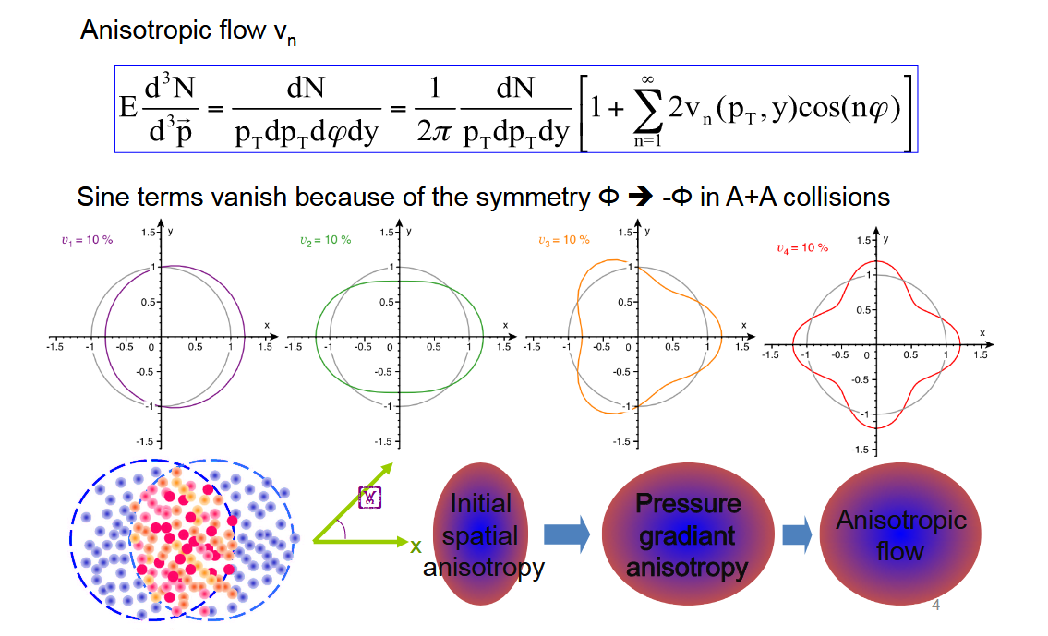
Our Tools: Anisotropic Flow
Che-Ming Ko, Texas A&M University

Slide 19
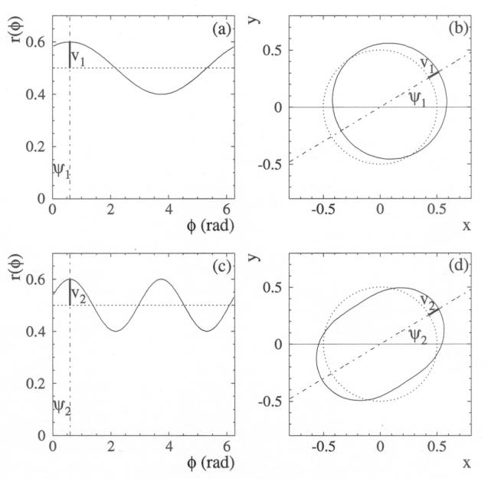
Interpreting Flow – order by order
n=1: Directed Flow has a period of 2π (only one maximum)
  v₁ measures whether the flow goes to the left or right – whether the momentum goes with or against a billiard ball like bounce. For collisions of identical nuclei, symmetry forces v₁ to be an odd function of η
n=2: Elliptic flow has a period of π (two maximums)
  v₂ represents the elliptical shape of the momentum distribution. It is an even function of η for identical nuclei
If parity is conserved, sin() terms drop out
isotropic
parity
non-conserving
directed
elliptic
higher order terms

Slide 20


The Experimental Observable
The coefficients for the Fourier expansion of the invariant yield are
or
  where the average is taken over all particles in the event and ψ_{R} is the known reaction plane angle (e.g. from a forward detector if we are using TPC data)
  The second method is a true two particle correlation (many details left out)
A clever observable: ⟨ cos (φ_{i} + φ_{j} - 2 φ_{k} ) ⟩ … a triple correlation
  Mixed Harmonics:
  Measure (v₁² – a₁²) * v₂ because v₂ is large and it amplifies the parity non-conserving signal, a₁, while preserving reasonable statistical errors.
  The signal is parity odd, but the observable (v₁² – a₁²) * v₂ is even. Best way to measure charge sensitive flow because v₁ ⇒ 0 and (v₁² – a₁²) * v₂ ⇒ -a₁² * v₂
Under certain assumptions v₁ is directed flow
  Note that a ‘normal’ v₁ measurement for pions in a Au-Au reaction has an intrinsic symmetry that suggests weighting by sign(η)
  Don’t do this for CME work: We are looking for charge flow that goes up/down so choose to do the sum without sign(η) weighting and thus the ‘normal’ v₁ will cancel out. (See next bullet). This assumes symmetric η acceptance.

Slide 21
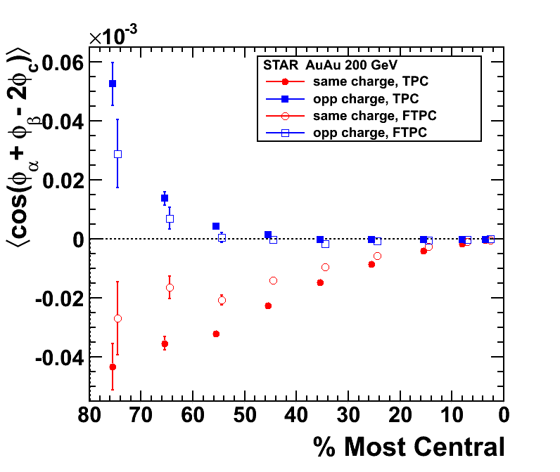
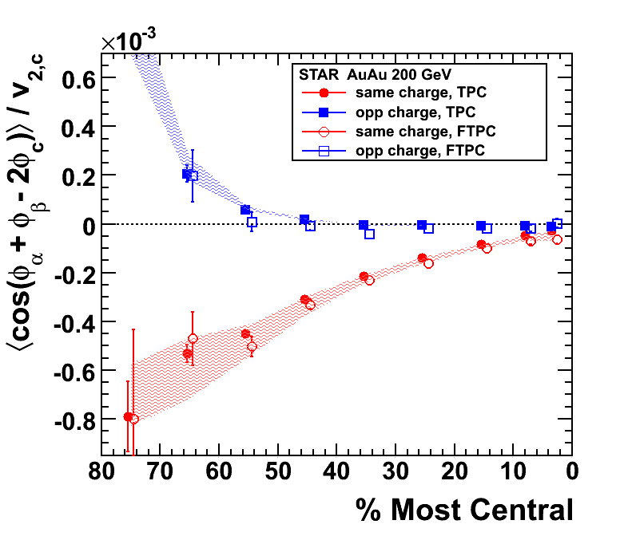
Like Sign and Opposite Sign Correlations
Abelev et al. (STAR Collaboration), PRL 103, 251601 (2009) Abelev et al. (STAR Collaboration), PRC, 81, 054908 (2010)
A charge separation signal appears in the data; independent of how we determine the reaction plane with different estimates of Ψ_{R} (i.e. φ_{c} )
  Signal is present if Ψ_{R} is found with the TPC, FTPC, or even ZDC.
  Systematic errors in panel II, above, cover the range introduced by using v₂{2} or v₂{4} in the calculation
and so is a candidate CME signal
  Same sign a_{i,γ} flow is negative … Opposite sign a_{i,γ} flow is positive
Notes:
Using ZDC-SMD for the (first harmonic) event plane yields similar agreement, though with larger uncertainties.
Center points: obtained using v2{FTPC} … Systematic bands: lower limits - using v2{2}, upper – v2{4}; where v2{4} is not available it is assumed that using v2{FTPC} suppresses non-flow by 50%.

Slide 22
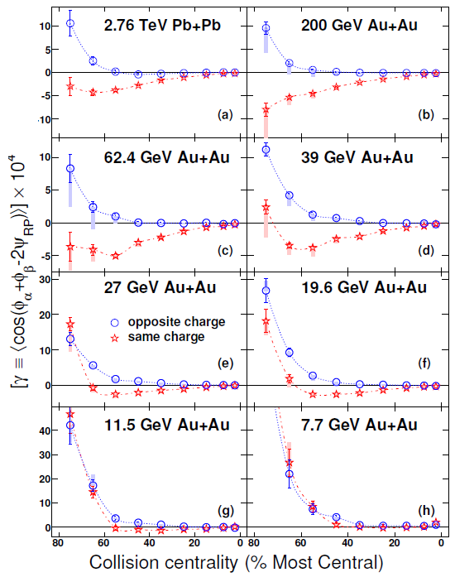
ALICE, STAR and the Beam Energy Scan
Significant charge separation observed at all but the lowest energies
γ_{sc} < 0 and γ_{oc} > 0 as expected
The data demonstrates importance of background contributions
CME - suppression of signal at low energies due to a short lifetime for the QGP or perhaps even a phase transition
arXiv:1608.00982v1 [nucl-th] 2 Aug 2016

Slide 23
The Background Hypothesis
Charge separation in HI collisions has definitely been observed. This falsifies the null hypothesis and is consistent with the expectations for the CME over a wide range of conditions
Background Hypothesis: The observed charge separation is due to non-CME background effects
  If a comprehensive background model can be found that explains all the data then this would rule out the CME
  This needs to be investigated but is much harder to falsify
Many investigations have been started and the literature is full of proposed models that explain some of the data
  But to the best of my knowledge, no model has been proposed that can accurately explain all of the charges separated data

Slide 24
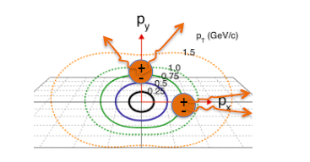
Background – a few words
Structure of correlator allows control of a wide class of backgrounds
As previously noted, the magnitude of v₁ is small and the directed flow terms sum to zero due to our choice to *not* weight the sum by sign(η)
The correlator represents the difference between correlations
projected onto an axis in the reaction plan and onto an axis perpendicular to the reaction plane
  This removes correlations among particles that are not related to the reaction plane orientation
A source of background that may persist in the data are particles from a cluster (resonance decay or jet) where the cluster is flowing with respect to the reaction plane
Flow boost collimates pairs more strongly in-plane than out-of-plane; potentially leading to false correlations.
Notes:
This correlator represents the difference between correlations projected onto an axis in the reaction plane and the correlations projected onto an axis that is out-of-plane or perpendicular to the reaction plane. The key advantage of using a difference equation is that it removes all the correlations among particles and that are not related to the reaction plane orientation [16, 17]. As Eq. 4 implies, by using hcos( + − 2RP )i instead of hsin sini, the background to our measurement
of haai is now not Bout, but [Bout − Bin], where Bin is the contribution of the in-plane correlations which are analogous to Bout. Only the parts of such correlations
that depend on azimuthal orientation with respect to the reaction plane remain as backgrounds. Studies of the various physics contributions to [Bout − Bin]
are discussed in detail in Section VII. Note that the contribution given by the term hv1,v1,i can be neglected because directed flow averages to zero in a rapidity region symmetric with respect to mid-rapidity, as used in this analysis, due to the symmetry of the collision, and the contribution due to directed flow fluctuations is very small
Among those are processes in
which particles and are products of a cluster (e.g.
resonance, jet, di-jets) decay, and the cluster itself exhibits
elliptic flow [17, 18] or decays (fragments) differently
when emitted in-plane compared to out-of-plane.

Slide 25
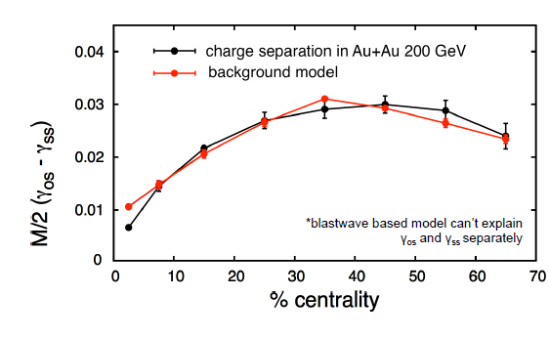

Serious Challenges to the CME interpretation
Two particle decays, such as resonance decays, are background
  Back to back decays look like charge separated events, but not correlated to the reaction plane. The γ observable should take care of most of the resonance decays … but perhaps not all of them
  Charge and momentum conservation, which are required in each event, can be thought of as 2 particle decays that separate charges in each event. Unfortunately, suitable tuning of hydro models can describe the charge separated data for (γ_{oc} - γ_{sc}) but not for γ_{oc} and/or γ_{sc}, separately.
The signal (γ_{oc} - γ_{sc}) should be independent of v₂ . It isn’t.
  The experimentally observed signal decreases linearly as v₂ ⇒ 0
  Understanding this observation is difficult because v₂ is a positive definite quantity and it does not average to zero for central collisions w/ fluctuations
The most recent challenge comes from CMS
  In an about to published paper, they report Pb-Pb and p-Pb data that shows similar results for both datasets
  Expect to extinguish the QGP in p-Pb
  Expect to disorient the direction of the B field in p-Pb

Slide 26
An Isobar Run at RHIC
Adjusting the B field in these collisions, in a controlled way, is a way to distinguish signal from background
If we can control the B field, but hold all other parameters constant, then we could see if the signal changes with as the B field changes
Fortunately, this is possible with nuclear isobars
  Compare two identical systems but with different atomic number (Z)

Slide 27
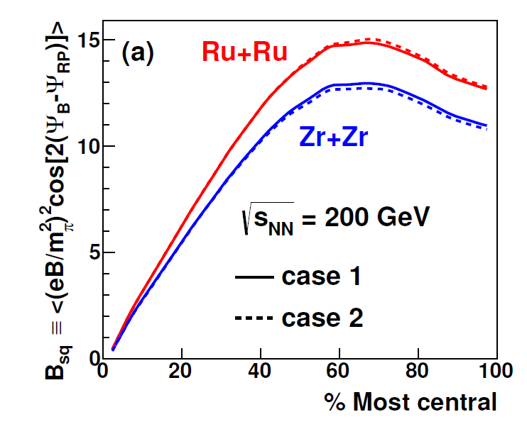
RHIC will run Isobaric Beams in 2018
arXiv:1608.00982v1 [nucl-th] 2 Aug 2016
We have […] investigated the case for colliding nuclear isobars […] and find the case compelling. We recommend that a program of nuclear isobar collisions to isolate the chiral magnetic effect from background sources be placed as a high priority item in the strategy for completing the RHIC mission.

Slide 28
Summary
STAR & ALICE see clear evidence for charge separation in Au-Au, Pb-Pb, Cu-Cu and U-U collisions at 27, 39, 62.4, 200 GeV/A and 2.76 TeV/A
  The signal is not so small … |a| ~ 10⁻² , and is accessible with standard tools
  The signal goes away at energies below 19.6 GeV/A
Charge separation may be an indicator of the Chiral Magnetic Effect . It could also be due to background effects.
The Chiral Magnetic Effect, if it has been observed,
  Provides for the study of topologically complex gluon configurations
  Strong magnetic fields
  and Chiral Symmetry restoration
However, there are poorly understood backgrounds that could mimic or mask the expected signal
  The result is of such fundamental importance that more controlled experiments are justified and required
RHIC will be running ⁹⁶Zr and ⁹⁶Ru beams in 2018 to try to sort this out
  Approximately 500 M events, each, and/or about 3 weeks each
For more information see: Volker Koch et al. 2017 Chinese Phys. C 41 072001
and/or arXiv:1608.00982v1 [nucl-th] 2 Aug 2016

Slide 29
Backup Slides

Slide 30
⁹⁶Zr + ⁹⁶Zr and ⁹⁶Ru + ⁹⁶Ru collisions
Isobaric collisions allow us to compare two colliding systems with
  the same mass
  (nearly) the same shape and geometry
  but different number of protons (and thus different E and B fields)
Study phenomena as a function of the neutron/proton ratio
  Fundamental physics with excellent control over background effects
Flow, specifically directed flow v₁, has been shown to have a strong n/p ratio dependence at 55 MeV / nucleon
  Due to larger cross section for n-p collisions compare to n-n or p-p
  Pak, Benenson, et al., PRL 78 (1997) 1022 (hadronic dof, non-QGP)
What happens at 200 GeV/nucleon? (QGP dof)
  Sensitivity to the equation of state (EOS)
  Advances in relativistic hydrodynamics
  Study of phenomena that are sensitive to the strong electric and magnetic fields that are created when two nuclei collide – such as CME, Lamdba Polarization, perhaps even ultra-peripheral collisions

Slide 31
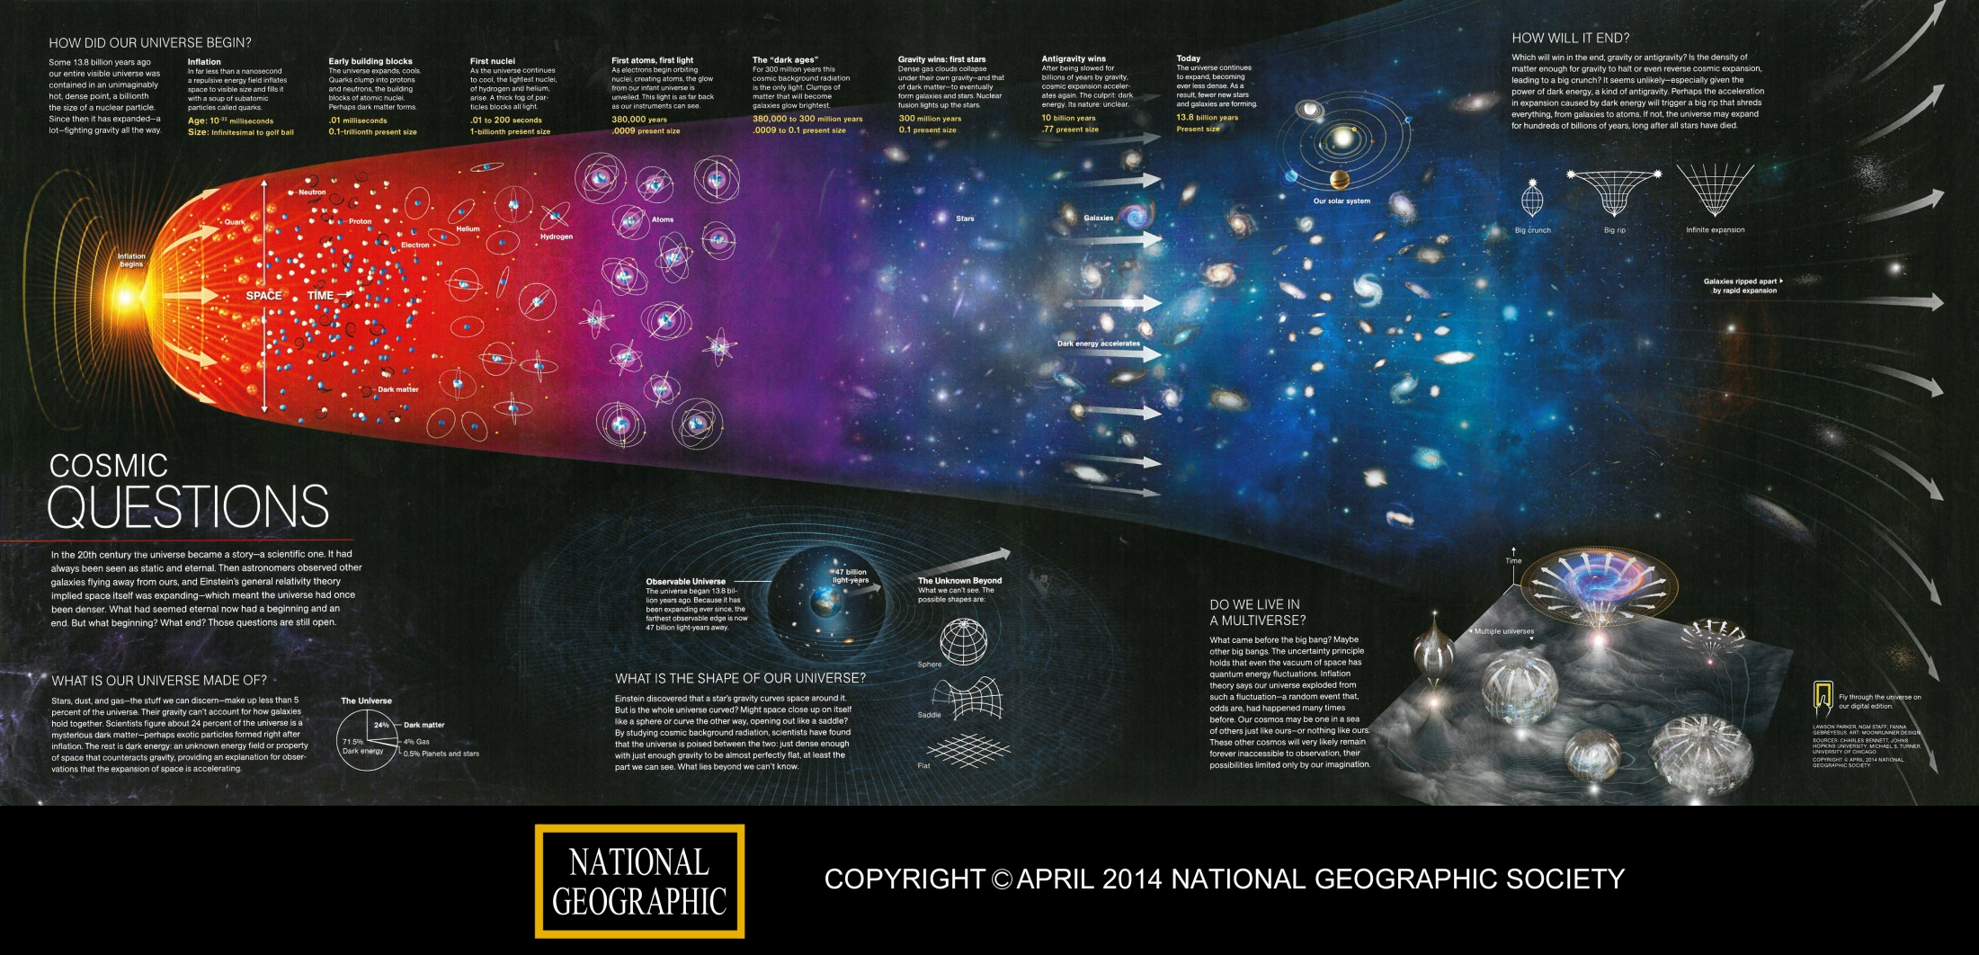
The early Universe
The Universe was filled with hot and dense matter at the earliest times
Nanoseconds – the Inflation epoc w/ topologically complex gluon fields
Microseconds – a Quark Gluon Plasma; flux tubes decay and form quarks
Seconds – first Nuclei are formed. Atoms come 380,000 years later.
Notes:
First nuclei are, of course, protons and neutrons. Alpha is extremely rare … but it can seed other important nuclear reactions.
Should probably say “gauge” fields here rather than gluon fields for the inflation epoc. Leading candidate is non-abelian gauge fields in the early Universe. If its 3+1 spacetime then its gluons. But gravity is weird and perhaps more than 3 spatial dimensions come into play. It is gluon fields in the QGP epoc.

Slide 32
A Mystery
Where does the energy come from to drive inflation?
We don’t know.
We presume that the early Universe is filled with topologically complex gauge fields (perhaps in 3 dimensions) that look a lot like gluon fields
  This promises to lead to the discovery of lots of interesting phenomenology

Slide 33
Summary II
QCD is a non-abelian gauge theory that is filled with fascinating phenomenology
Heavy Ion Colliders make some of this phenomenology accessible to the experimentalist
It is important to understand non-abelian gauge theories (in all dimensions) because you can only have knots in 3 spatial dimensions and perhaps that is why we live in a 3D world
“We suggest a structure for the vacuum comprised of a network of tightly knotted/linked flux tubes formed in a QCD-like cosmological phase transition and show that such a network can drive cosmological inflation. As the network can be topologically stable only in three space dimensions, this scenario provides a dynamical explanation for the existence of exactly three large spatial dimensions in our Universe.”
Berera et al. arXiv:1508.01458 [hep-ph]

Slide 34
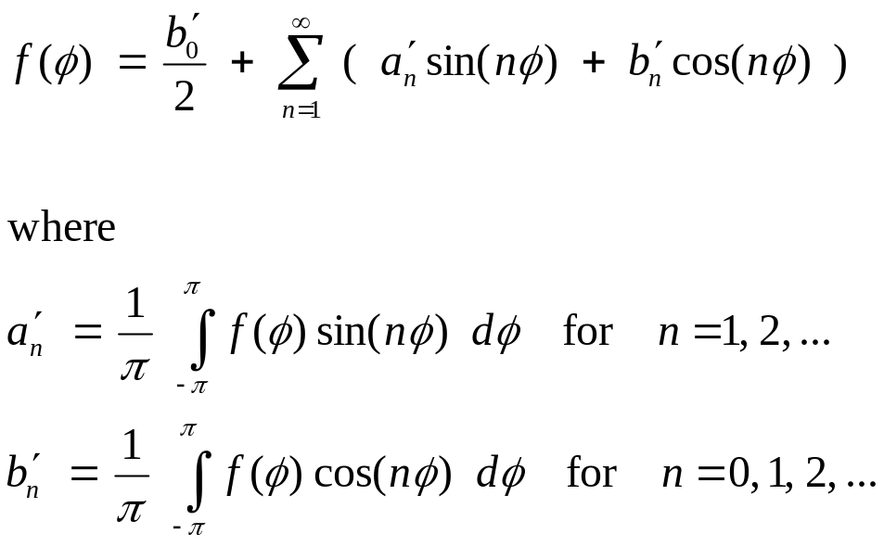
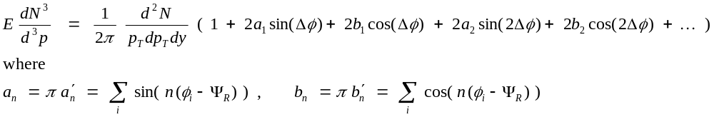
Full Fourier Transform of the Invariant Yield
If we want to test if parity is conserved then we should keep the extra terms
The standard HI flow analysis assumes a = 0 and assigns b_{n} ≡ v_{n}

Slide 35
Analysis Uses Standard Flow Tools
Y_{Lab}
B
p_{β}
p_{α}
Δφ_{β}
Δφ_{α}
Ψ_{RP}
X_{Lab}
Reaction
Plane
The line between the centers of the nuclei and the beam axis define the reaction plane – perpendicular to angular momentum vector and B field

Slide 36
Analysis Uses Standard Flow Tools
Y_{Lab}
B
p_{β}
p_{α}
Δφ_{β}
Δφ_{α}
Ψ_{RP}
X_{Lab}
Reaction
Plane
The line between the centers of the nuclei and the beam axis define the reaction plane – perpendicular to angular momentum vector and B field

Slide 37
So far …
So far, we have done no useful work with the magnetic field
  But we have done some fascinating nano-engineering
Lets pause for a moment to introduce one more crazy feature of (hot) QCD …
  Toplogical charge changing transitions flip the helicity of the participating quarks so bouncing from one vacuum state to another changes the helicity of the system

Slide 38
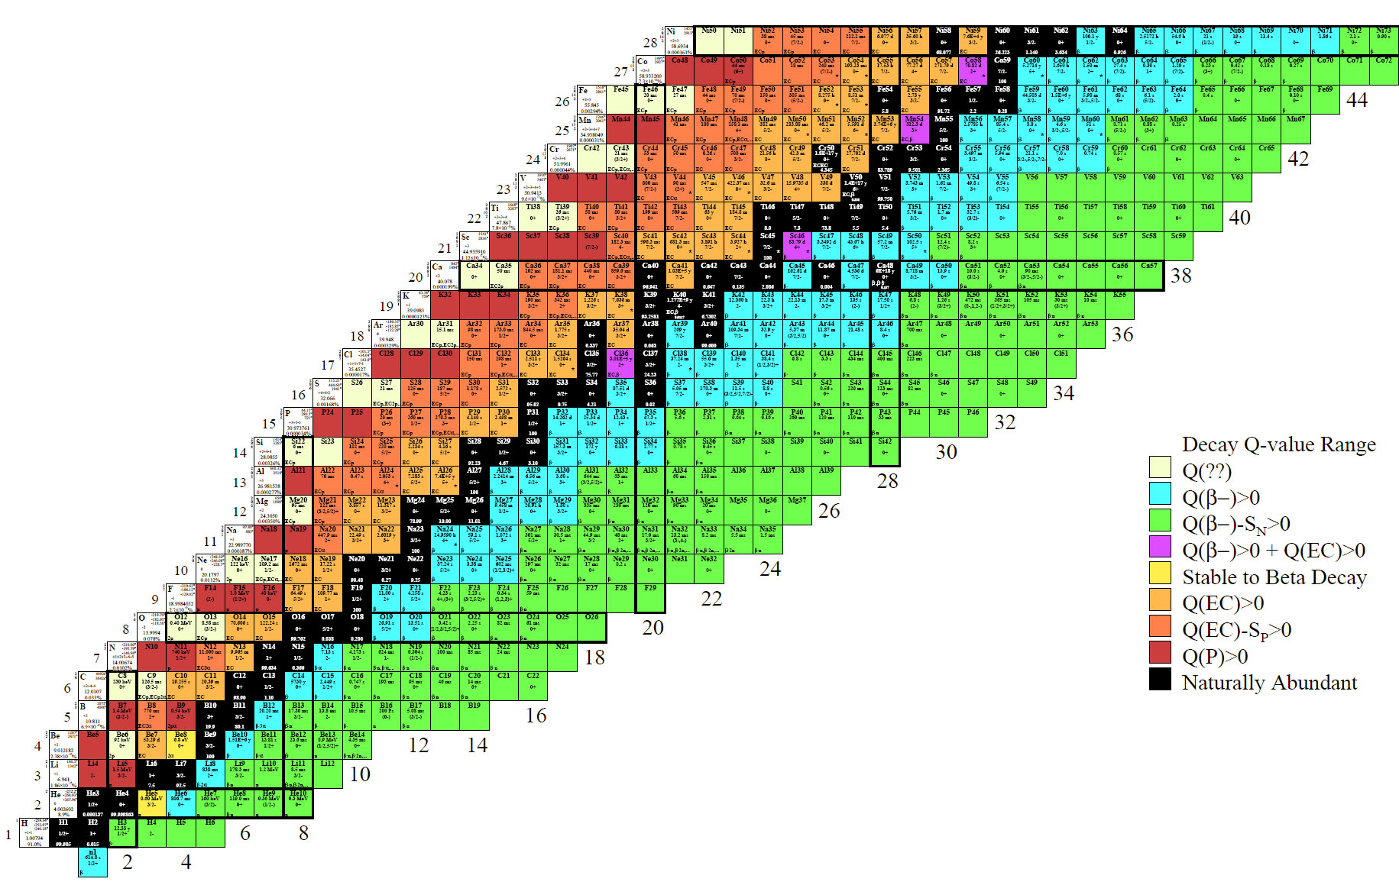
Table of the Isotopes
Isotopes of an element (same proton number) run along a row
Isotones (same neutron number) run in columns
Isobars (same mass number) run along the diagonals
Neutron rich elements on the right
Proton rich elements on the left
The valley of stability runs up the middle

Slide 39
Accelerated Beams of Isobars
Accelerated beams of isobars are interesting because we can compare two runs using beams with the same mass, nearly the same geometry, but different number of protons in the collision.
For example: Flow systematics, the Chiral Magnetic Effect and the Chiral Magnetic Wave
The first requirement for the use of an accelerated beam is that the isotopes must be stable
There are only 4 stable isobaric systems where the change in Z is greater than 2.
The four candidates with ΔZ = 4 are:
Element Z Mass Abundance
Zr 40 96 2.80%
Mo 42 96 16.68%
Ru 44 96 5.54%
Sn 50 124 5.79%
Te 52 124 4.74%
Xe 54 124 0.09%
Te 52 130 34.50%
Xe 54 130 4.07%
Ba 56 130 0.11%
Xe 54 136 8.86%
Ba 56 136 7.85%
Ce 58 136 0.19%
These are all ββ candidates

Slide 40
What have we learned from Experiments?
We study large systems, such as Au + Au, at high energy because studying a “free” quark is easier than solving the 3 body problem
  Thermodynamic variables work in this regime: Temperature, Viscosity
  Hydrodynamics works well to describe (most of) the data
Experimental results suggest that the QGP formed at RHIC and LHC energies behave like a strongly interacting liquid drop
A Fourier analysis of the angular distribution of particles emitted in a HI collision reveal event shapes
  Well described by (relativistic) Hydrodynamics
  With near zero viscosity (at the QM lower bound)
  We even use the language of fluid dynamics and talk about “flow”
Jets and R_{aa} taught us about strong coupling
  A QGP was expected, but a strongly interacting QGP was not

Slide 41
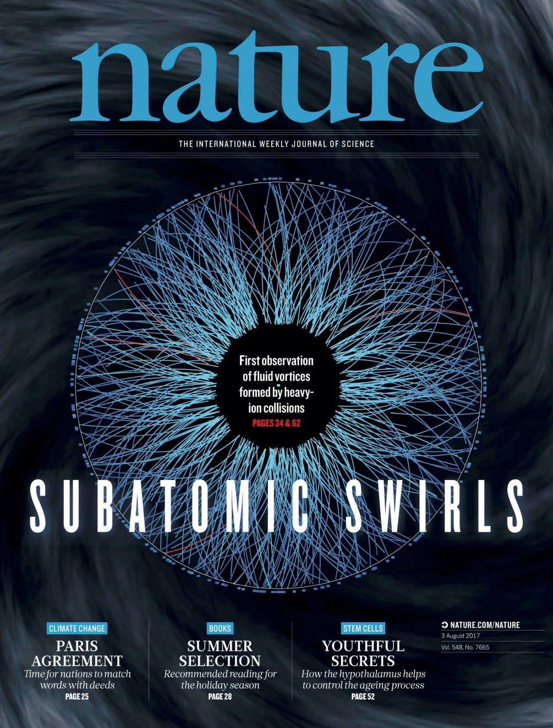
Vorticity in HI Collisions

Slide 42
Table of the Isotopes
Radioactive decays occur wherever it is energetically allowed and not forbidden by spin selection rules or forbidden by nuclear matrix elements.
All of these isotope are created by stellar burning and super nova explosions
(except hydrogen)
But, of course, not all are seen on earth

Slide 43
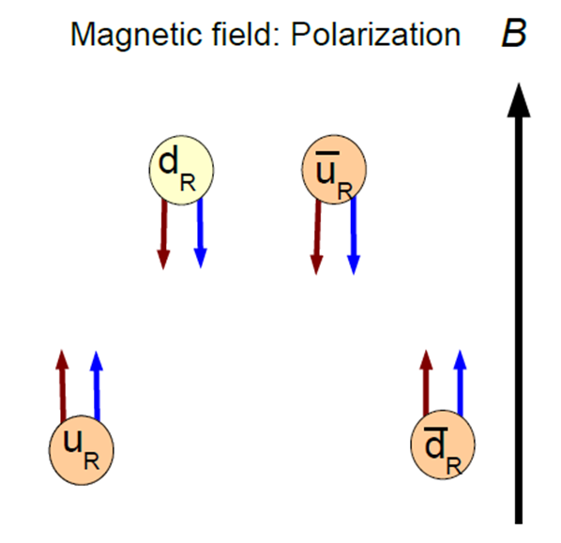
Making particles – neutral mesons won’t flow
Only a specific set of quarks can flow “up” in our example
  Upwards Flow: u, d̅, s̅
  Downwards Flow: u̅, d, s
  Assuming that down and strange
  behave the same way in a B_{EM} field
Meson flow is easy to understand
  Upwards Flow: u d̅ (π⁺), u s̅ (K⁺)
  Downwards Flow: u̅ d (π⁻), u̅ s (K⁻)
  Just by coincidence … neutral mesons fail
  to <flow>, even those combinations that
  coalesce from the vacuum. Event average == 0.
Baryons are trickier … assume that they proceed via a coalescing di-quark and pick up the third quark from the vacuum
  Upwards Flow: u u d (p), u̅ d̅ s̅ (Λ̅⁰ ) , d̅ s̅ s̅ (Ξ̅⁻ ), s̅ s̅ s̅ (Ω̅⁻)
  Downwards Flow: u̅ u̅ d̅ (p̅), u d s (Λ⁰), d s s (Ξ⁻), s s s (Ω⁻)
  Di-quark combinations that coalesce one quark from the vacuum will have event average == 0.
Useful to study other mesons and baryons
Notes:
If someone asks about isospin … the answer is “wow” you have really done your homework. Dima’s 711 paper points out that a topological charge change causes an isospin transition and so the effect is probably limited to pions (plus and minus). However, this result is only valid for Nf=2, and so it is probably OK to say that Strange baryons will flow, too. I am not sure if this is still true if we have two strange quarks … The bottom line is that there are systematic studies with robust theoretical predictions that can be tested. What is written on this page may need modification in light of the isospon flip.

Slide 44
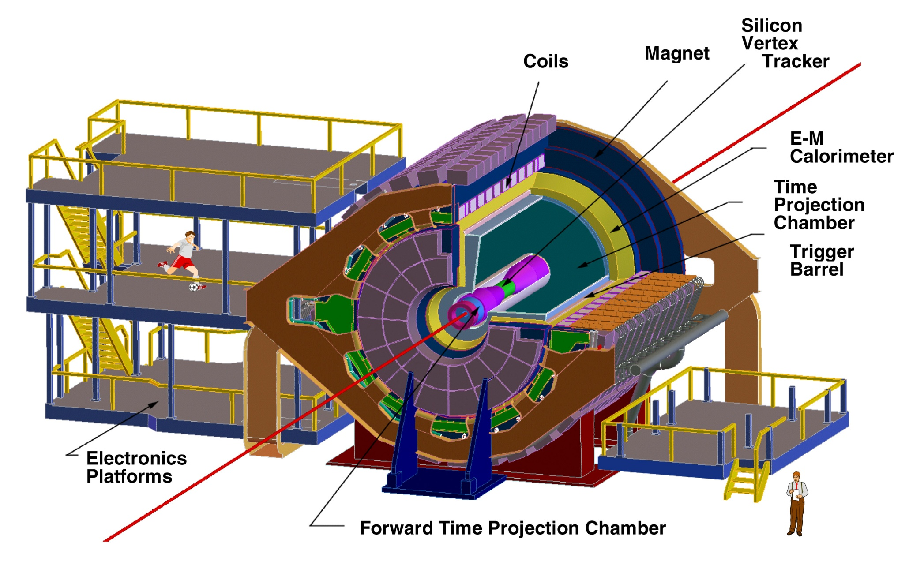
The STAR Detector at RHIC

Slide 45
Uncertainties in our theoretical understanding
Concerning the quantitative understanding of the CME in heavy-ion collisions, the dominant theoretical uncertainties originate from
A) the initial distribution of axial charges (e.g. Sphaleron transitions)
B) the evolution of the magnetic field
C) the dynamics of the CME during the pre-equilibrium stage
D) the uncertainties in the hadronic phase and the freeze-out

Slide 46
Experimental Background – a few words
Our observable is parity even and so may contain effects that are not related to strong parity violation
Structure of correlator allows control of a wide class of backgrounds
As previously noted, the magnitude of v₁ is small and the directed flow terms sum to zero due to our choice to *not* weight the sum by sign(η)
The correlator represents the difference between correlations
projected onto an axis in the reaction plane and an axis perpendicular to the reaction plane
  This removes correlations among particles that are not related to the reaction plane orientation
So a source of background that may persist in the data are particles from a cluster (resonance decay or jet) where the cluster is flowing with respect to the reaction plane
  These studies, and other simulations studies, are a continuing effort
Notes:
This correlator represents the difference between correlations projected onto an axis in the reaction plane and the correlations projected onto an axis that is out-of-plane or perpendicular to the reaction plane. The key advantage of using a difference equation is that it removes all the correlations among particles and that are not related to the reaction plane orientation [16, 17]. As Eq. 4 implies, by using hcos( + − 2RP )i instead of hsin sini, the background to our measurement
of haai is now not Bout, but [Bout − Bin], where Bin is the contribution of the in-plane correlations which are analogous to Bout. Only the parts of such correlations
that depend on azimuthal orientation with respect to the reaction plane remain as backgrounds. Studies of the various physics contributions to [Bout − Bin]
are discussed in detail in Section VII. Note that the contribution given by the term hv1,v1,i can be neglected because directed flow averages to zero in a rapidity region symmetric with respect to mid-rapidity, as used in this analysis, due to the symmetry of the collision, and the contribution due to directed flow fluctuations is very small
Among those are processes in
which particles and are products of a cluster (e.g.
resonance, jet, di-jets) decay, and the cluster itself exhibits
elliptic flow [17, 18] or decays (fragments) differently
when emitted in-plane compared to out-of-plane.

Slide 47
Strength of the Magnetic Fields
arXiv:1608.00982v1 [nucl-th] 2 Aug 2016
Strength of the magnetic field (squared) in ⁹⁶Zr and ⁹⁶Ru collisions measured in terms of the mass of the pion (squared)
Dashed and dotted lines are represent different assumptions about the shape of the nuclei (i.e. not spherical)

Slide 48
Hot QCD is not simply a cold and static theory
You may have heard the Parity is conserved in the strong interaction
Vafa and Witten (‘84) showed that P and CP violation are not possible in QCD (under certain fairly general conditions, with one exception that is not important to us, now)
  Theorem is valid for ground state QCD at zero temperature
  and zero density
Heavy Ion Collisions are not representative of ground state QCD
Conditions that allow for implicit P and CP violation in QCD
  Finite temperature
  Finite density
  Metastable vacua
  Out of equilibrium
  All of these are possible in a heavy ion collisions where, by hypothesis, Axial symmetry and Chiral symmetry are in transition.
Implicit P and CP violation is allowed in (hot) QCD
Notes:
Axial symmetry is exact in the classical lagrangian but it is broken by the quantum theory. (This is called an anomaly if symmetric in classical and broken in the quantum theory). Instantons are a gluon field configuration that are closely related to this anomaly.

Slide 49
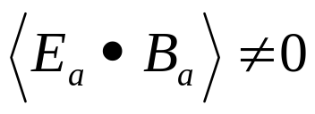
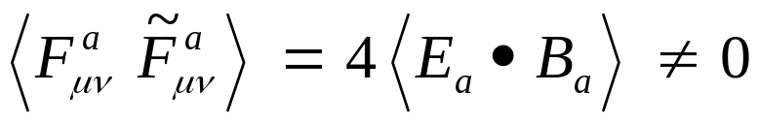
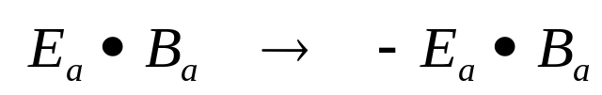
CP Violation – all scenarios involve
If the color B field has a component that is parallel to
the color E field then
and under P and CP transformations
which means that parity and CP symmetries are broken
Finally, gauge field configurations exist with finite action and quantized topological charge
  Q_{w} is the winding number .
These configurations are related to instanton and sphaleron transitions … but that topic is beyond the scope of my talk
Notes:
E is a vector and so is parity even. B is an axial vector and so is parity odd. Both change sign under Charge symmetry. Hence EdotB is C even and P and CP odd.

Slide 50
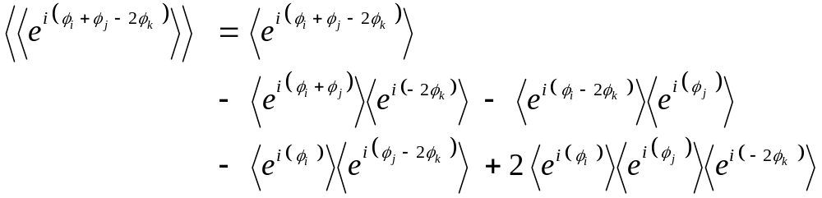
Cumulants and full PID for pions
Note that … ⟨ cos (φ_{i} + φ_{j} - 2 φ_{k} ) ⟩ = Re ⟨ e^{i} ^{(φi + φj - 2 φk )} ⟩
  This is the basis for the cumulant technique
  A powerful tool that allows us to subtract two particles correlations from the three particle correlation that we are trying to measure
  Automatically ‘re-centers’ the data (i.e. acceptance corrections)
So for example:
Test acceptance corrections … but also to test full PID
  All previous analyses were done for all-charged particles
  Now select pions (± 2σ) and reject electrons (± 2σ)
  Goal: to confirm that it is hadrons, not leptons, that show the PV signal

Slide 51


Full Cumulant – Analysis and Results
Real Terms
Imaginary Terms enter via cross-terms to create additional real terms
Acceptance corrections are crucial when doing full PID in STAR

Slide 52
Looking for new physics – Strong Parity Violation
The conventional point of view
  “Parity is conserved in the strong and electromagnetic interactions”
    See, for example, Perkins “Introduction to High Energy Physics”
The less-conventional point of view
  In the vicinity of a deconfining phase transition, the QCD vacuum can possess meta-stable domains leading to P and CP violation.
    See, for example, Kharzeev, Pisarski, and Tytgat PRL 81, 512 (1998).
Thanks to wonderful talks given by Harmen Warringa at BNL, Sergei Voloshin QM2009 and Evan Finch CPOD

Slide 53
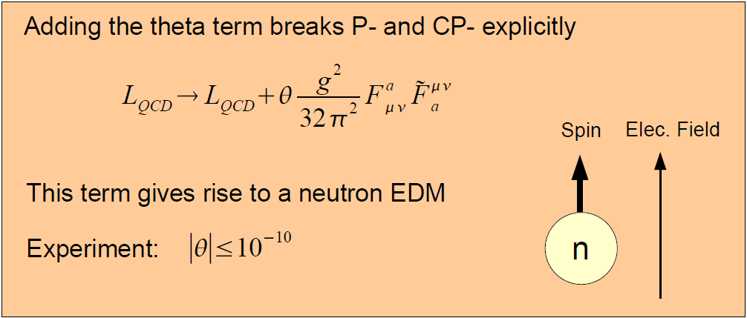
Explicit P and CP violation is allowed in QCD
A very simple addition to the bare QCD Lagrangian is interesting
  L_{QCD} → L_{QCD} + δ L
Why is θ so small?
  Perhaps due to Peccei-Quinn symmetry … which would imply the existence of axions.
An old but still interesting problem …
Notes:
Slide from harmon Warenga’s talk at BNL. Fmunu is the gluonic field tensor in analogy to the Fmunu from electrodynamics. Some authors us Gmunu to avoid confusion. Note that this isn’t really the harmonic oscillator of QCD. That distinction probably belongs to lambda phi**4 theories such as the sigma model.

Slide 54
Detour regarding Double Beta Decay
    This is too cool to pass up ….

Slide 55

Even the Neutron decays …
A free neutron is not stable and will decay via Beta Decay
  The half life is 614.6 seconds or cτ = 2.65 x 10⁸ km
    about equal to the attention span of a full professor of physics
conserve charge
n
p
+
e
+
conserve baryon number
conserve lepton number

Slide 56
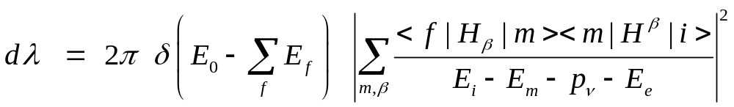
In QM, it is not necessary to conserve energy
(at every step); two neutron can decay simultaneously …
n
p
+
e
+
n
p
+
e
+
Two neutrino double beta decay is a 2nd order weak decay
  It is an allowed decay (in terms of spin selection rules)
  It proceeds via virtual states in the intermediate nucleus
It produces two electrons and two neutrinos in the final state
  First discussed by M. Goeppert-Mayer in 1935 and predicted to have a half life > 10²⁰ years. It has been observed in ¹³⁶Xe & more

Slide 57
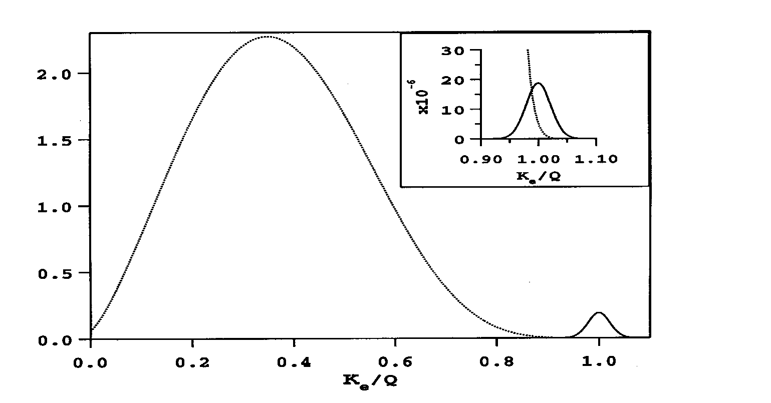
Two ν Double Beta Decay is a 4 Body Process
The summed energy of the 2 electrons in the final state is a broad spectrum that reaches from 0 to T₀ where T₀ is the kinematically allowed endpoint (shown as 1.0 in the figure).
The decay rate depends on T₀¹¹ and so there is great advantage to studying nuclear systems where the decay energy is large (typically a few MeV).

Slide 58
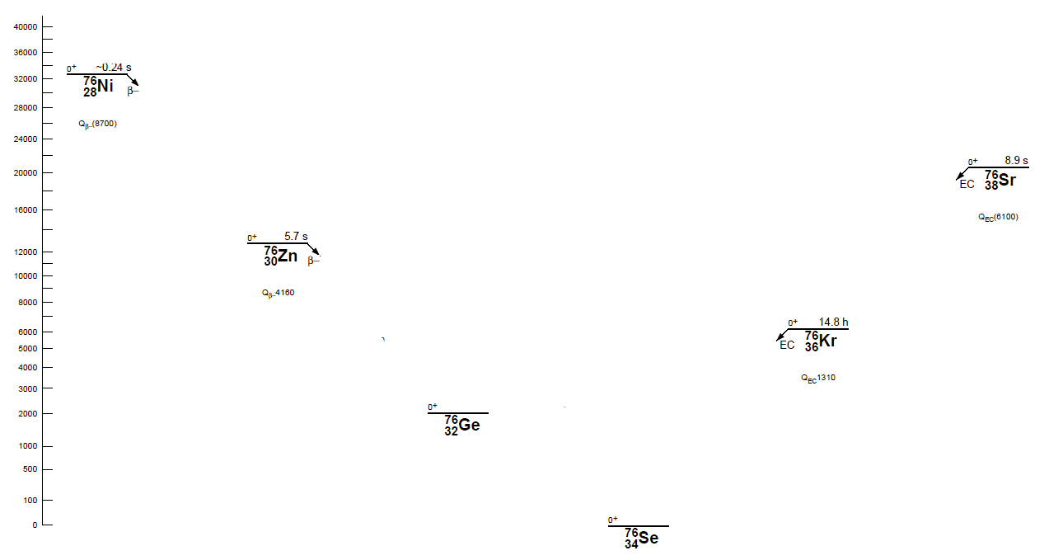
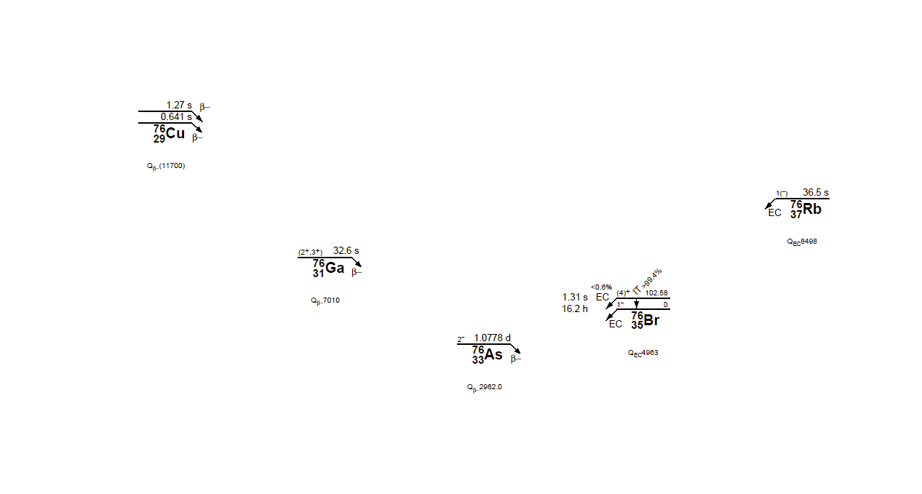
Energy is conserved when ⁷⁶Ge decays to ⁷⁶Se
Stable Isotope
except for ββ decay
Stable Isotope
2ν double beta decay is an allowed process, just very slow

Slide 59
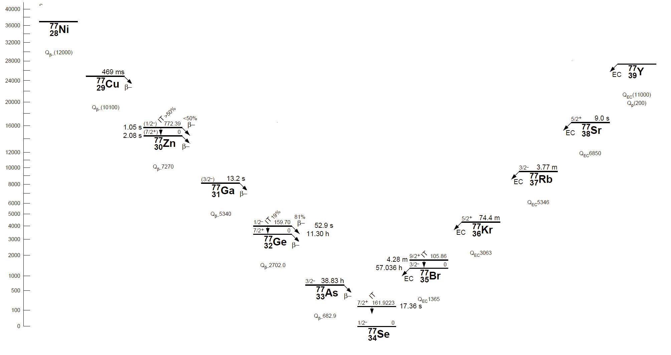
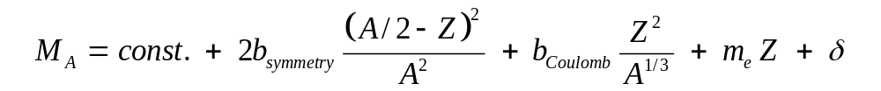
Isobars: The Valley of Stability at A = 77
Note: proton # increases
δ is the pairing energy
= 0 for odd A nuclei
∼ ± 12/A^{½} for odd N, odd Z,
or even N, even Z

Slide 60
The Pairing of Nucleons is Important (A = 76)
Odd-Odd nuclei
Even-Even nuclei
Stable Isotope
Stable Isotope
The pairing energy, δ, can create a situation where β decay is kinematically forbidden.

Slide 61

In QM, it is not necessary to conserve energy
(at each step); two neutrons can decay simultaneously
n
p
+
e
+
+
n
p
+
e
Zero neutrino double beta decay can occur if the anti-neutrino from one beta decay can be used to stimulate the decay of a second neutron in the same nucleus.
  This process has two electrons in the final state and no neutrinos
  It violates lepton number conservation
To do this, the neutrino must be its own anti-particle (a Majorana particle)
  There must be a solution to the helicity problem, too.
  One solution to this problem is m_{ν}

Slide 62
But Zero Neutrino Double Beta Decay is the prize!
n
p
+
e
+
Mass
+
n
p
+
e
The neutrino is left handed (spin opposite the direction of motion). The anti-neutrino is right handed (spin in the direction of motion).
  They must be identical for 0ν double beta decay to occur
If the ν is massive, then its velocity must be less than c and there exists a frame which is going faster than the ν. If the velocity of the frame exceeds the velocity of the ν then the ν appears to be going the other way in the new frame. In other words, its helicity is flipped.
0ν double beta decay is the smoking gun for a massive neutrino

Slide 63
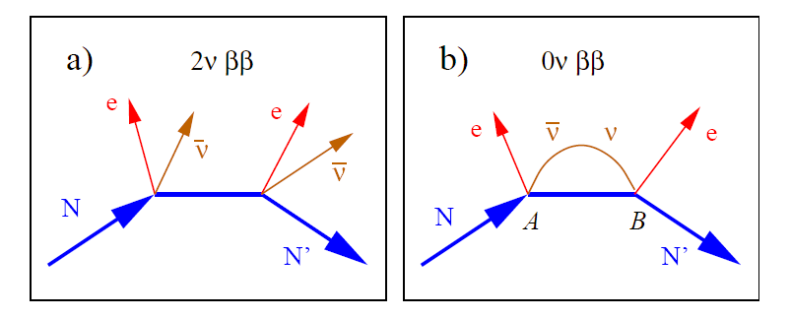
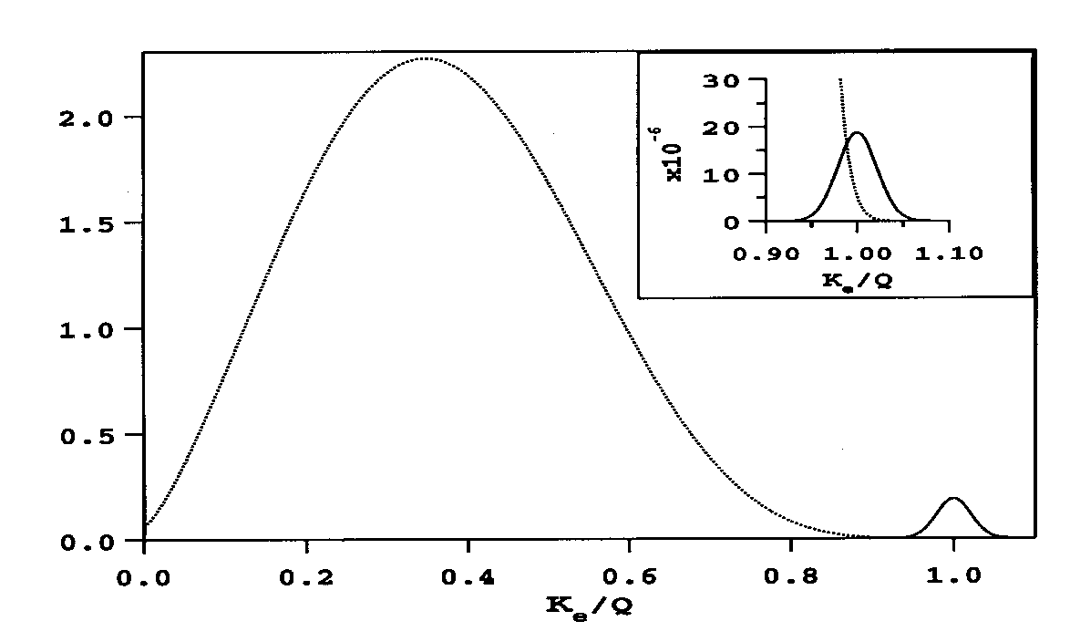
Two Modes of Double Beta Decay, 2ν and 0ν
The two modes can be distinguished by the summed energy of the electrons in the final state.
The 0ν decay is identified as the narrow peak at the kinematic limit of the decay process.
2ν spectrum
0ν peak

Slide 64
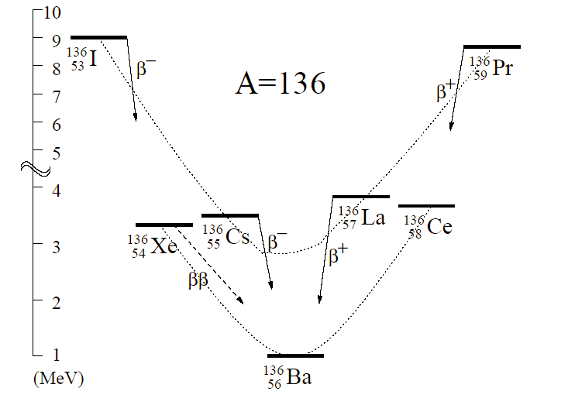
Other Isobars & Double Beta Decay systems
Parabola describing odd-odd nuclei
Gap created by energy released in making pairs of neutrons and/or protons
Stable Isotope
Parabola describing even-even nuclei
Stable Isotope
Except for ββ decay
Stable Isotope
¹³⁶Xe is another double beta decay candidate
Excellent, because ¹³⁶Xe can be the gas in a TPC and TPCs are really good at seeing the track of two electrons

Slide 65
End Detour
The observation of 0ν ββ would:
Determine the absolute mass scale for neutrinos
Demonstrate lepton number violation
Establish the neutrino as a massive Majorana particle

Slide 66
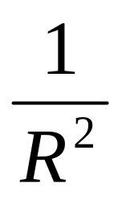
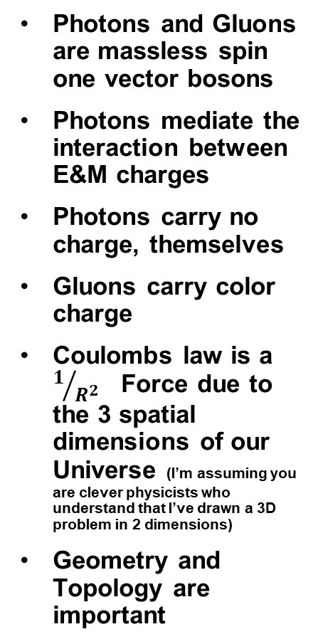
Photons and Gluons - similar but different
Photons and Gluons are massless spin one vector bosons
Photons mediate the interaction between E&M charges
Photons carry no charge, themselves
Gluons carry color charge
Coulombs law is a $1/{R^{2}}$ Force due to the 3 spatial dimensions of our Universe (I’m assuming you are clever physicists who understand that I’ve drawn a 3D problem in 2 dimensions)
Geometry and Topology are important
+
+

Slide 67
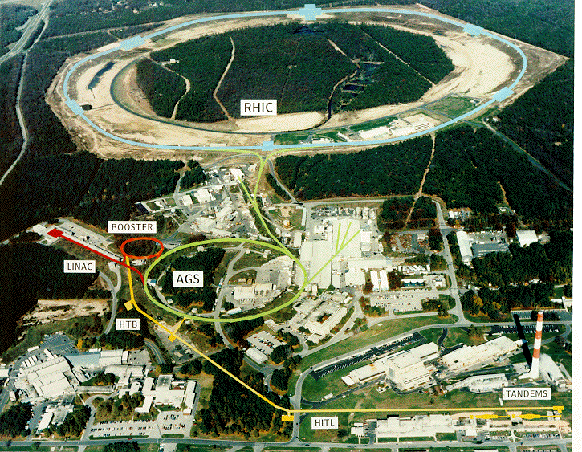


Who is RHIC and what does he do?
RHIC accelerates a variety of heavy ion beams up to 100 GeV/amu
Two Large and two small detectors have been built
STAR is the “Hadronic Signals” experiment
At its heart is a large Time Projection Chamber
h
Long Island

Slide 68
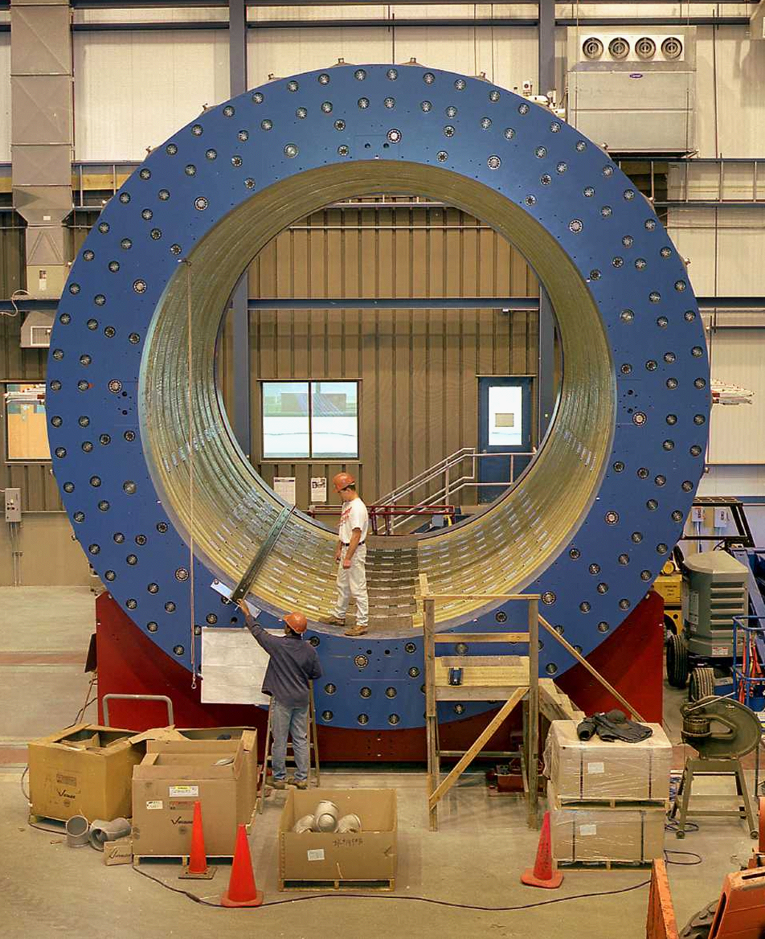
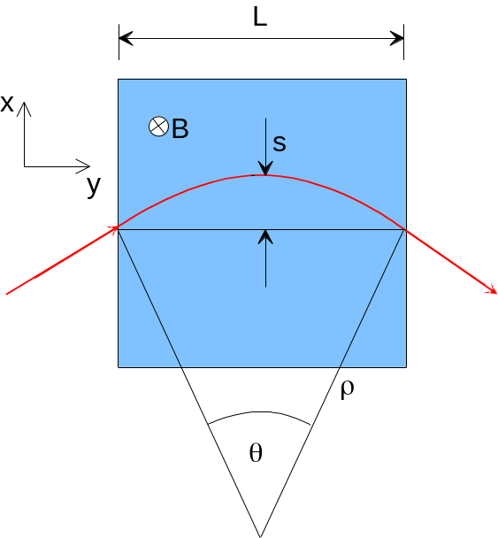
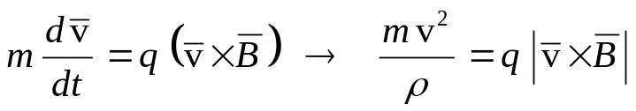
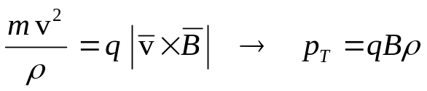

The STAR Magnet (room temp Aluminum coils)
A charged particle in a uniform field follows a (perfect) circular path

Slide 69
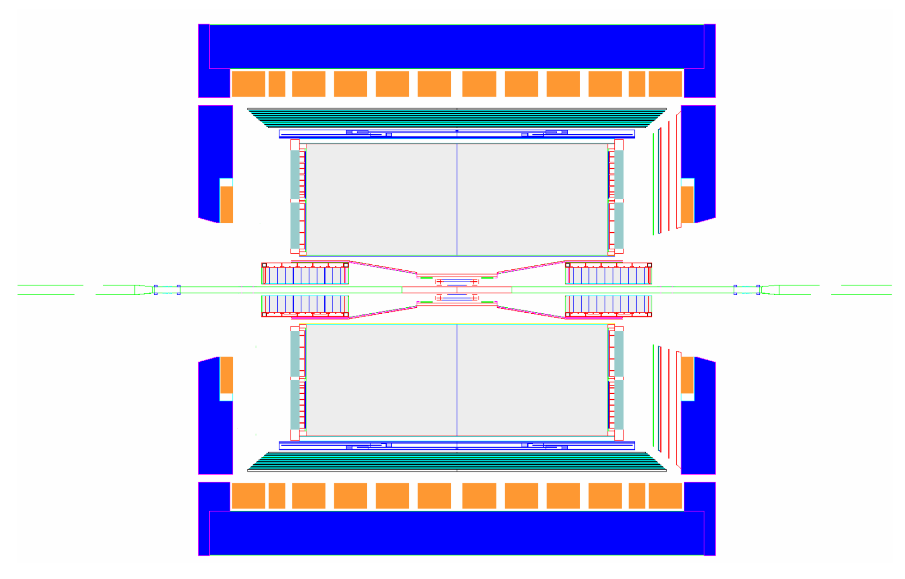
STAR from the Inside - Out
Magnet
Time Projection Chamber
Coils
Silicon Tracker
HFT & SSD (out)
TPC Endcap Readout
FTPC or GMT (out)
Event Plane Detector
Endcap Calorimeter
TOF
Barrel EM Calorimeter

Slide 70
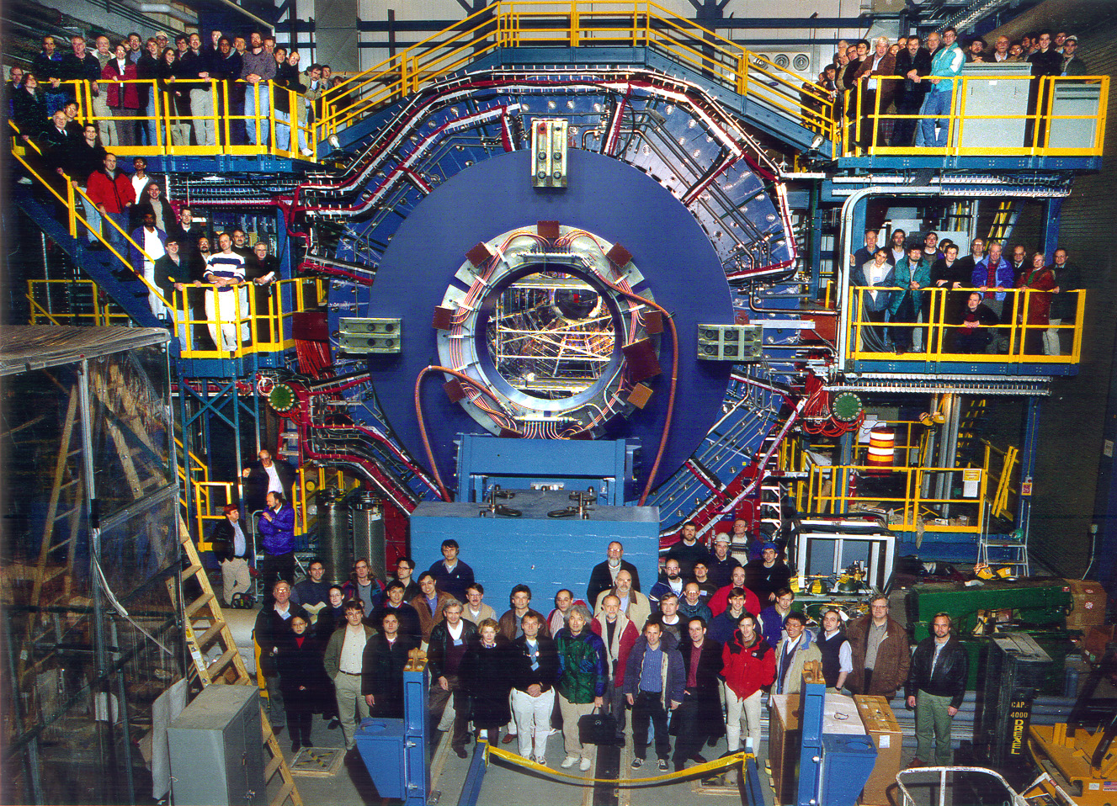
The STAR Collaboration

Slide 71


Au + Au Collision
A low multiplicity event due to a peripheral collision (b > 0)
Real-time track reconstruction
Pictures from Level 3 online display. ( < 70 mSec )

Slide 72


Au + Au Collision
A high multiplicity event due to a central collision (b=0)
Typically 1000 to 2000 tracks per event in the TPC
Two-track separation 2.5 cm
Momentum Resolution < 2%
Space point resolution ~ 500 μm
Rapidity coverage –1.8 < η < 1.8

Slide 73


v₃ – Triangular flow
Unlike elliptic flow, triangular flow does not depend on centrality (impact parameter)
v₃ is represents fluctuations in the participant distribution and thus is not a measure of fundamental physics
Mixed moments are also possible and they can be formulated to help us isolate the parity violating sign terms (a_{n})

Slide 74

Jets at RHIC taught us about strong coupling
Compare p-p (red) with Au-Au (black dots)
The backward going jet in a di-jet is present in p-p (and d-Au) collisions but missing in Au-Au
This suggests an opaque nuclear collision zone
Surface emission of a jet
Suppression of back-to-back correlations in central Au+Au collisions

Slide 75


Charges in motion create large Magnetic Fields
Only a few of the nucleons participate in the collision as determined by the impact parameter
The initial state is Lorentz contracted and time dilated
There is multiple scattering in the initial state before the hard collisions take place
  Cronin effect
Cross-sections become coherent.
  The uncertainty principle allows wee partons to interact with the front and back of the nucleus
  The interaction rate for wee partons saturates ( ρσ = 1 )
  A color glass condensate
Charges in motion create a strong magnetic field (E&M) (even in the initial state)
• proton • neutron • delta • pion string

Slide 76

The Field Strength into Perspective, m_{π}²
V. Skokov, RHIC Users Meeting, June 2017

Slide 77
Topological Charge flips chirality: L to R
H. Warringa

