Slide 1
The Silicon Strip Detector an overview and introduction
Jim Thomas
Lawrence Berkeley National Laboratory

Slide 2
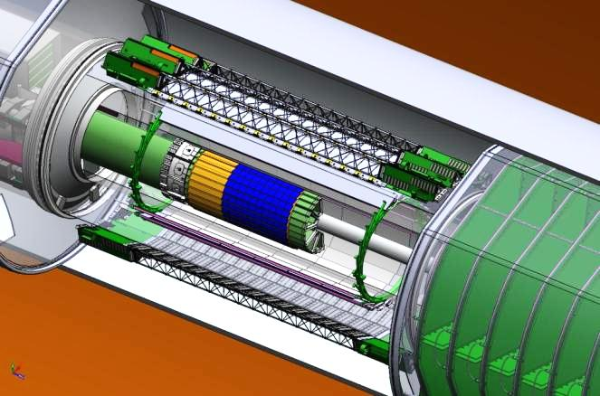
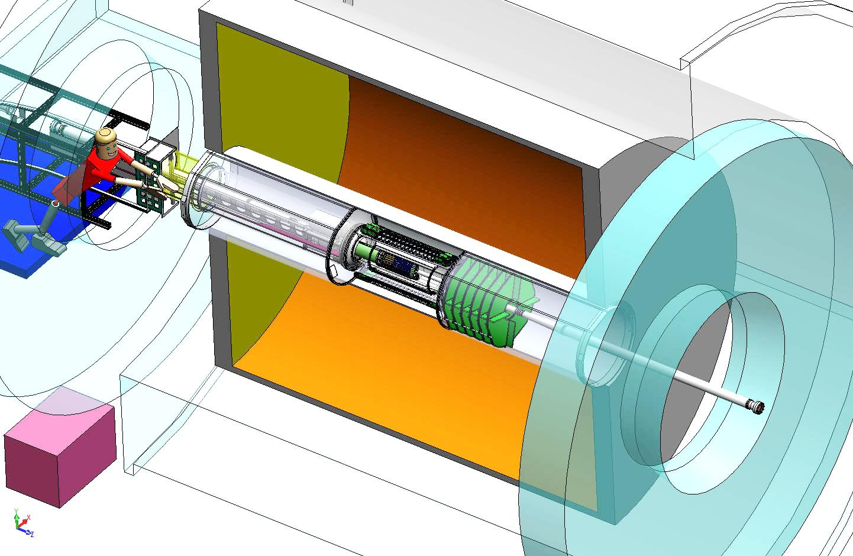
SSD Location in STAR
IFC
Inner Field Cage
SSD
Surrounds the PXL & IST @ 22 cm radius
OFC
Outer Field Cage
Magnet
End Cap
TPC Volume
Solenoid
The SSD is an existing detector that needs an upgrade to meet HFT specs

Slide 3
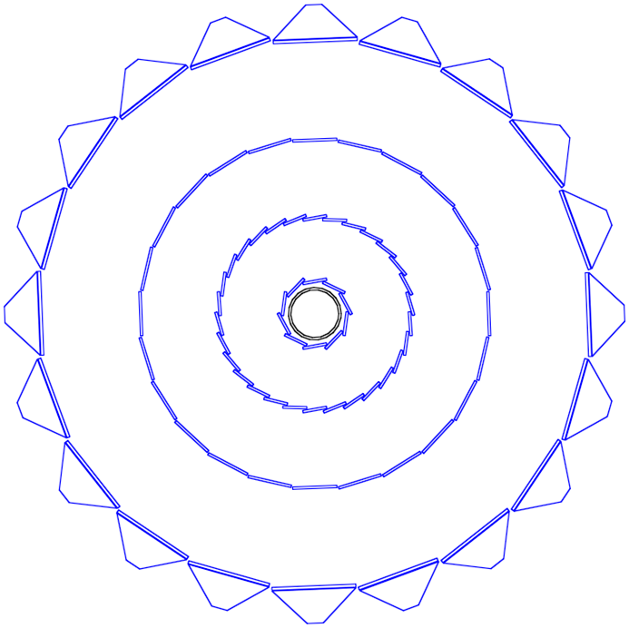
Si Detectors Inside the TPC
SSD
IST
  Goal: graded resolution and high efficiency from the outside → in
  TPC – SSD – IST – PXL
  TPC pointing resolution at the SSD is ~ 1 mm
  SSD pointing at the IST is ~ 400 μm ε = 0.98
  IST pointing at PXL 2 is ~ 400 μm ε = 0.98
  PXL 2 pointing at PXL1 is ~ 125 μm ε = 0.93
  PXL1 pointing at the VTX is ~ 40 μm ε = 0.94
Beampipe
Pixel Detector
~ 50 cm
The challenge is to find tracks in a high density environment with high efficiency because a D⁰ needs single track ε²

Slide 4
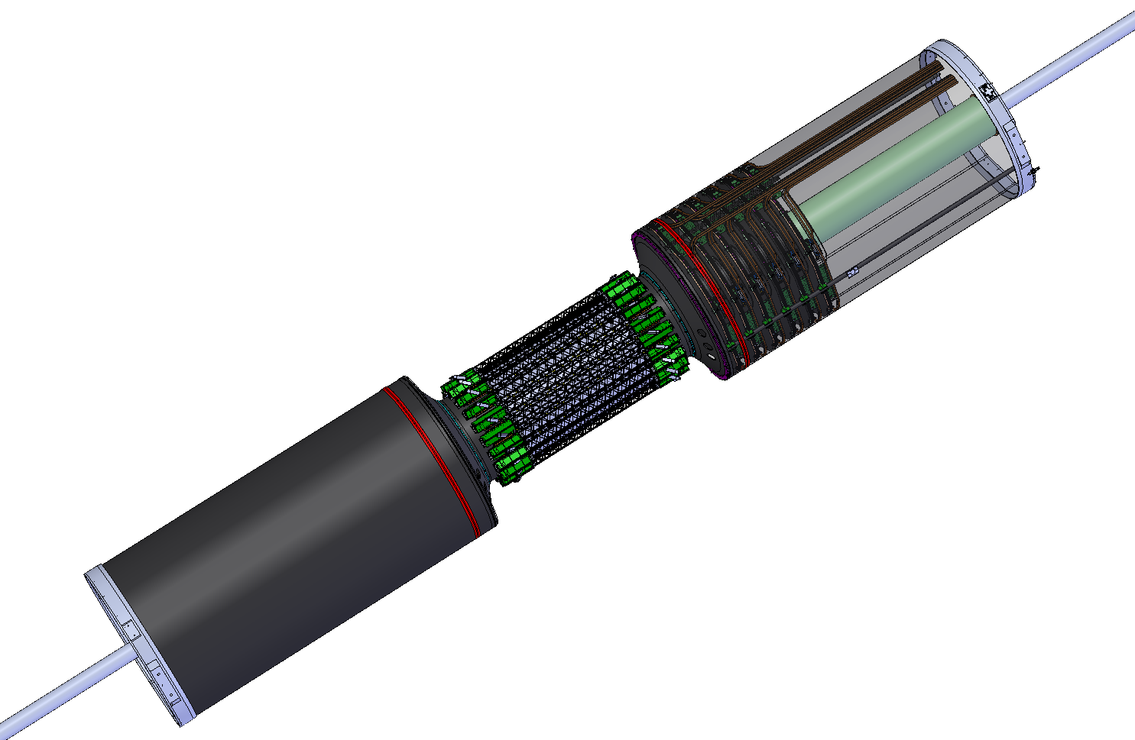
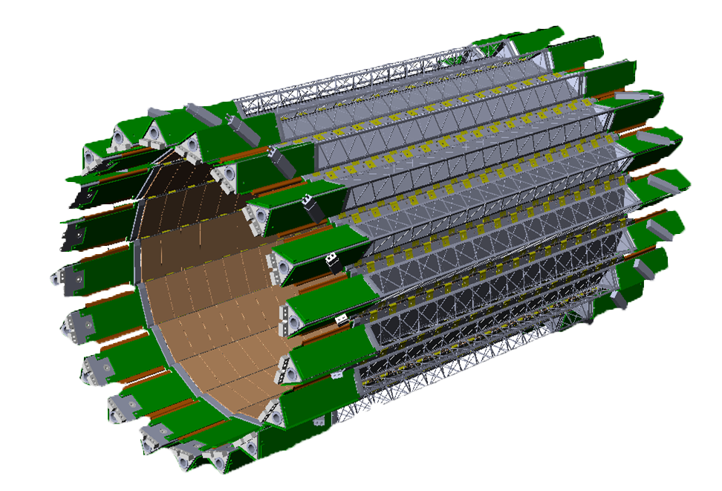
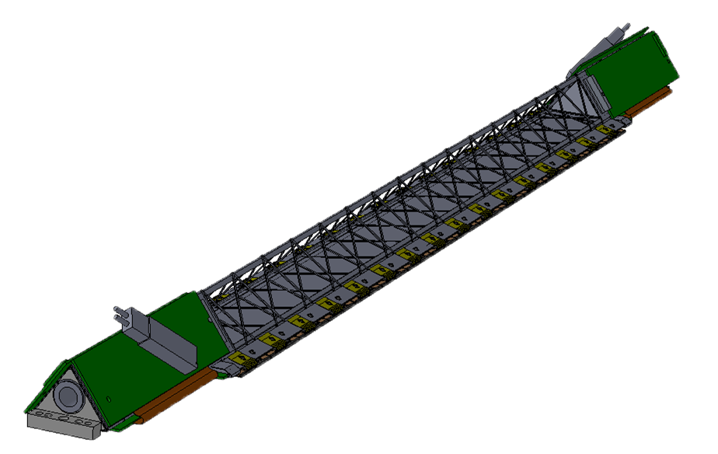
SSD Overview and a few acronyms
Transition Cone (shroud removed)
Outer Support Cylinder (OSC)
WSC
44 cm
20 Ladders
4.2 Meters
East Support Cylinder (ESC)
~ 1 Meter

Slide 5
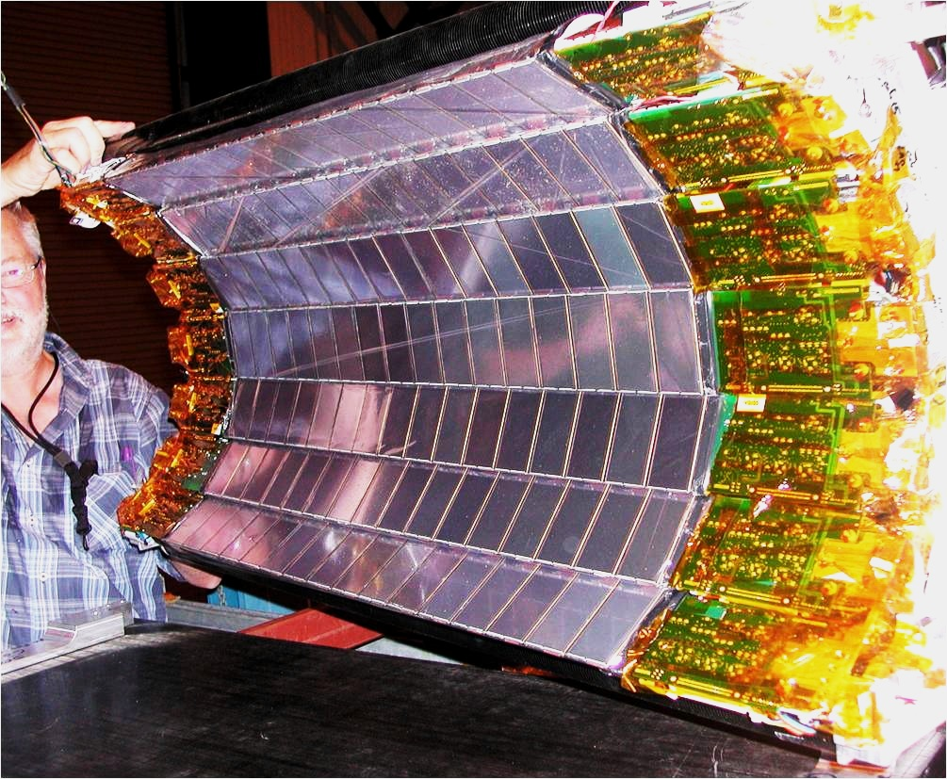
The Silicon Strip Detector
SSD
The SSD is an existing detector

Slide 6
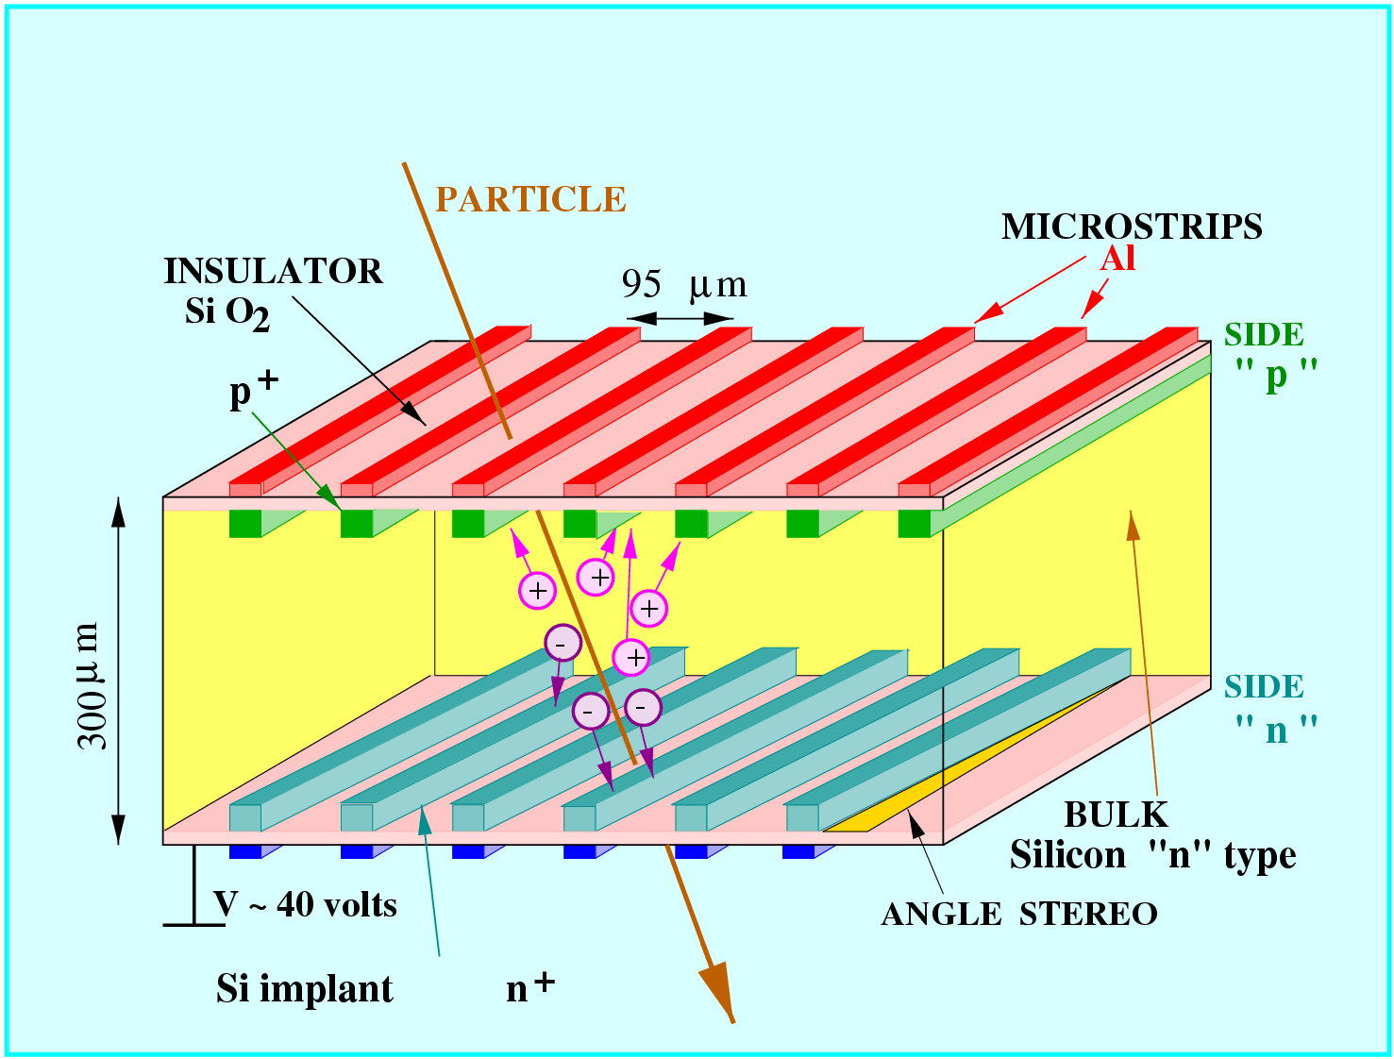
SSD Parameters
  Double sided Si wafers modules: 300 μm thick with 95 μm strips that are 4.2 cm long
    768 strips per side
    Strips crossed at 35 mrad
  effective resolution 30 μm x 900 μmm
  One layer at 22 cm radius
    20 ladders, 67 cm long
    16 modules per ladder
  air cooled
  ⎜η⎟ < 1.2
  1 % radiation length @ η = 0
~ 50 cm

Slide 7
Status of the ladders
The last run with the SSD was in 2007 … it wasn’t a good run
  cooling failures led to overheating and poor performance
  perhaps related to this, there were several bias capacitors that failed on the modules. This caused 3 ladders to ‘trip’ frequently.
  some ladder boards were damaged (ADC aging or other issues)
Status in May of 2008
  Six good ladders
  Seven ladders with one bad hybrid (half module)
  Nine ladders with several bad modules
  bad ladder boards do not matter because we are going to replace them
The ladders were refurbished in 2008 (see next page)
  Now 94% of modules (on 20 ladders) are good
  The modules & ladders have not be used since these repairs
The ladders have not been operated since 2008

Slide 8
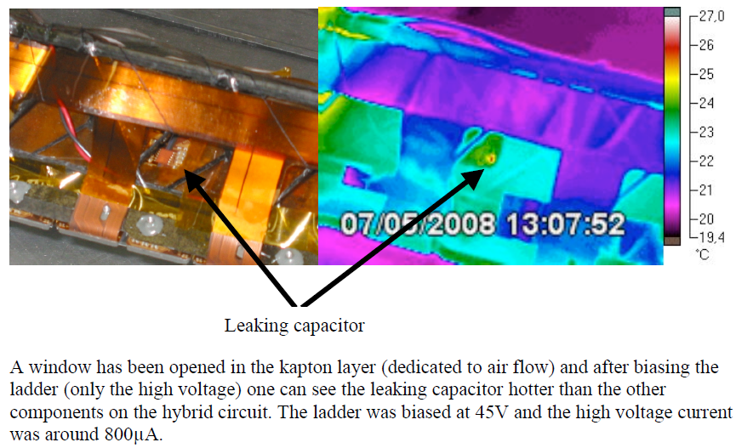
HV coupling capacitors were replaced

Slide 9
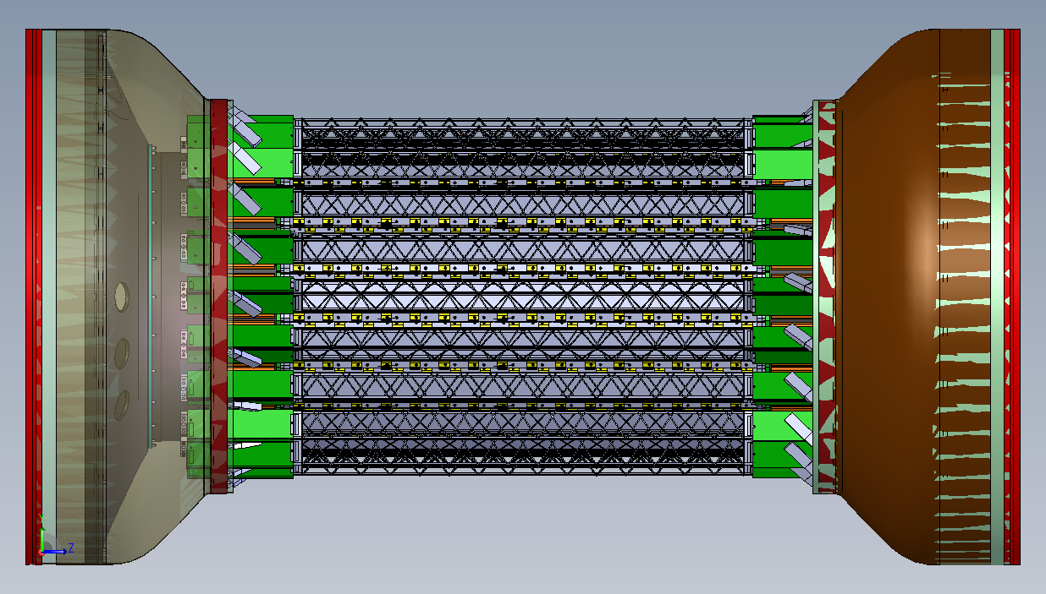
Schematic View of the new SSD

Slide 10
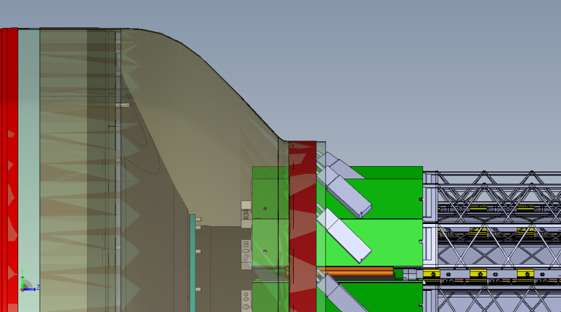
The SSD is an existing detector ⇒ upgrade
Existing Detector
w/ Si modules
Electronics Upgrade
in progress
Mechanical & Conv. systems … early days

Slide 11
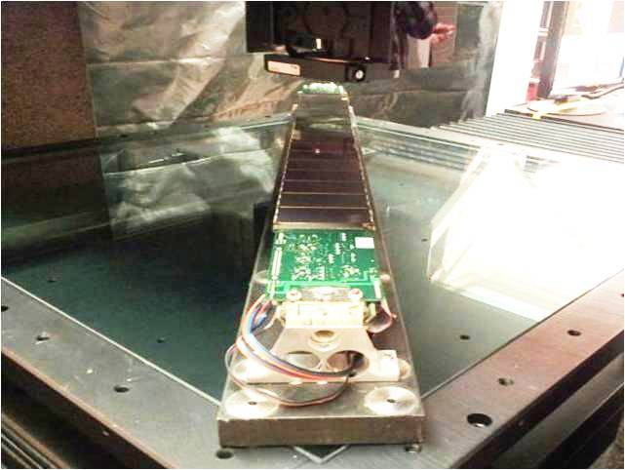
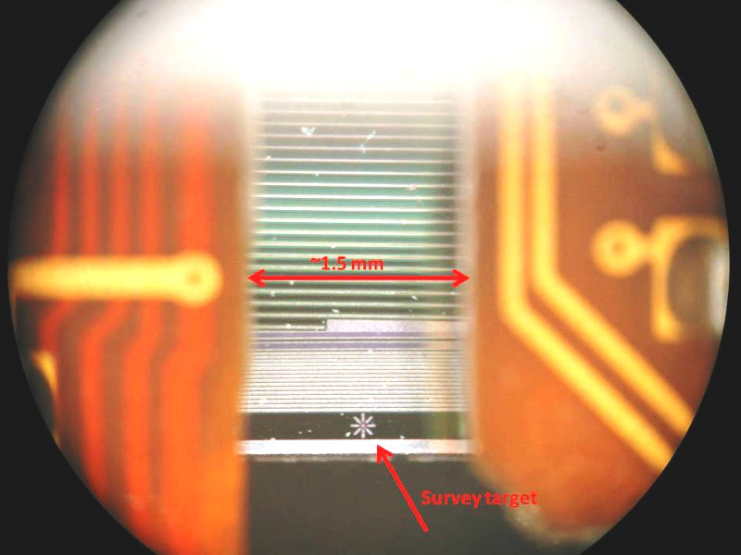
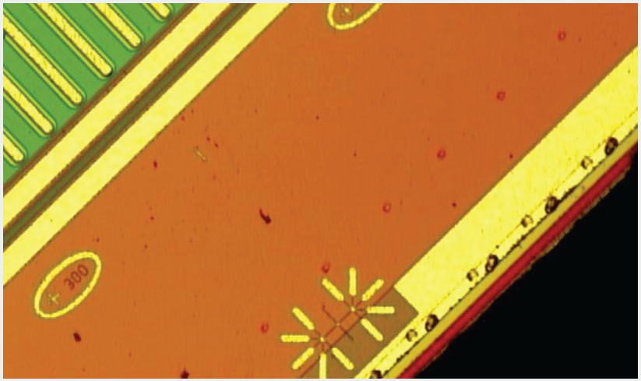
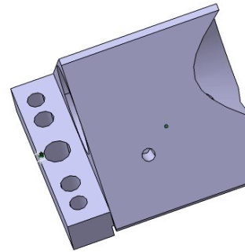
Progress: Ladder 0 is ready to be surveyed
Target on end of wafer (backside)
Reference point for survey and mounting on OSC
Targets on edges of wafer (front)

Slide 12

Readout Electronics – the heart of the upgrade
Ladder cards – 1.4.2.1
RDO (1 of 8) – 1.4.2.2
Slave
FPGA
VME FPGA
Fiber links
See talks by C. Renard and M.J. LeVine
VME interface
Slave
FPGA
DAQ – 1.4.2.3
Slave
FPGA
Master FPGA
DAQ interface
DDL
Slave
FPGA
Slave
FPGA
TRG interface
South platform VME crate
Outer support cylinder
DAQ room
Notes:
Ladder cards: one on each end of ladder, each reads out one face of ladder
Fiber links connect ladders to RDO
5 ladder cards – 5 ladder faces
One chip (slave FPGA) is dedicated to processing and buffering data from a single ladder
Master FPGA handles interaction with TRG and DAQ
Link to DAQ PC (DDL) is bidirectional 1.5 Gbps fiber [designed for ALICE @LHC]

Slide 13
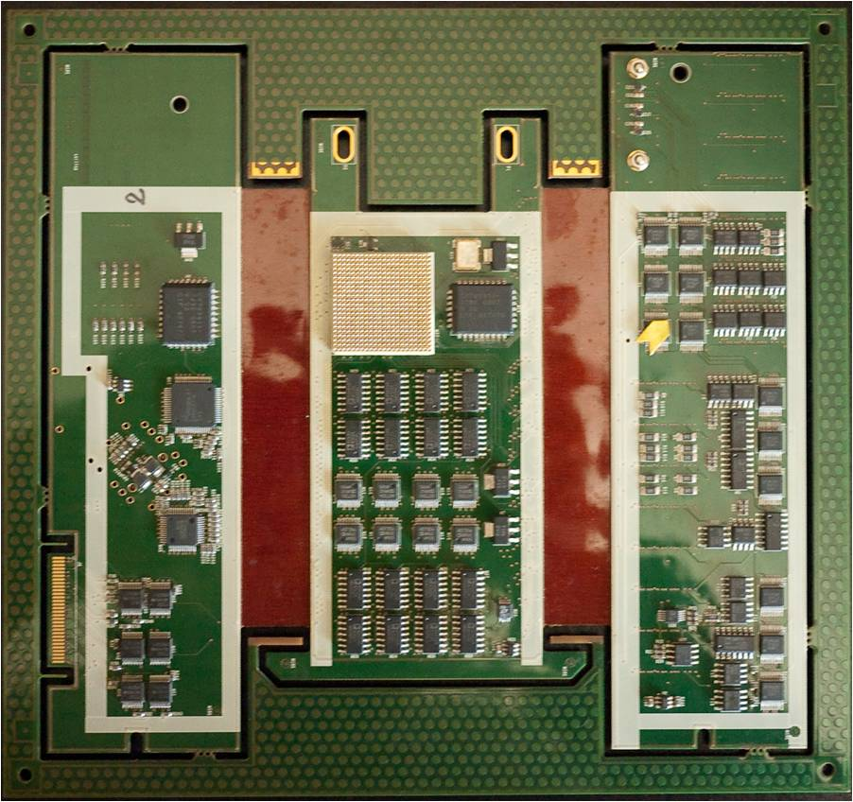
Progress: Ladder Card built and tested
Prototype with interposer card working since last summer
FPGAADC – DAC test as voltage ref. for ADC
A new layout has recently been completed and will be sent off for fabrication
(see talk by C. Renard)
Milestone:
Passing from prototype to pre-production version

Slide 14
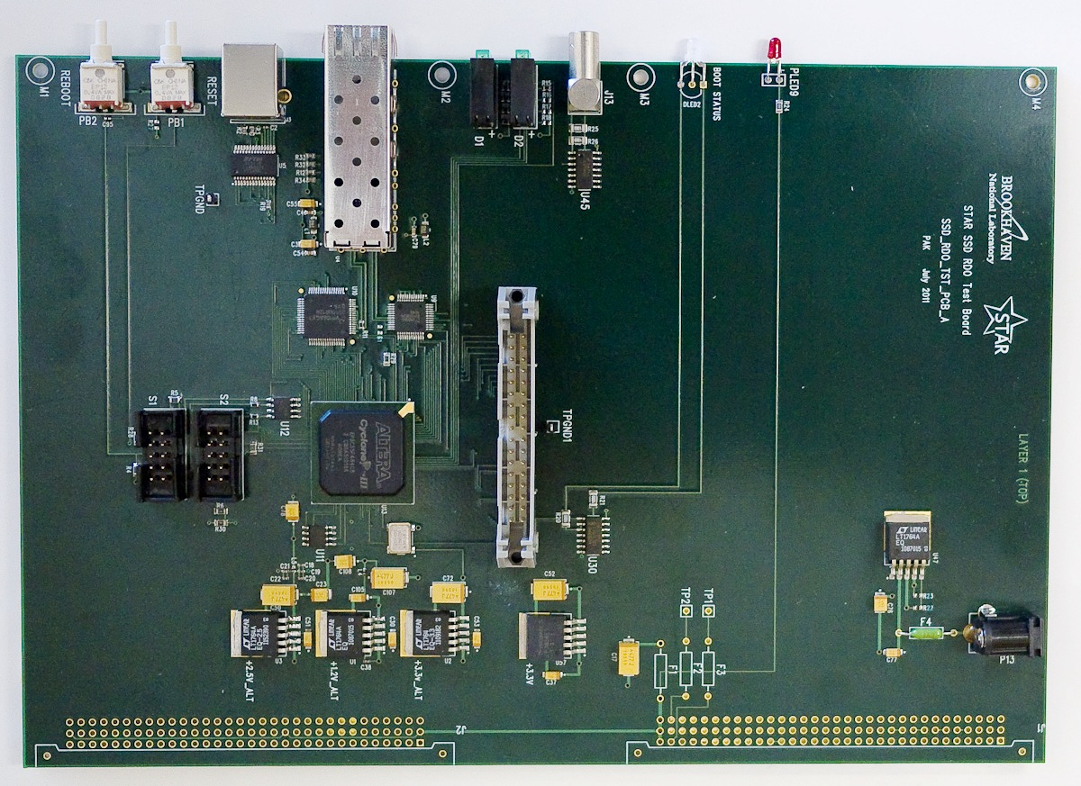
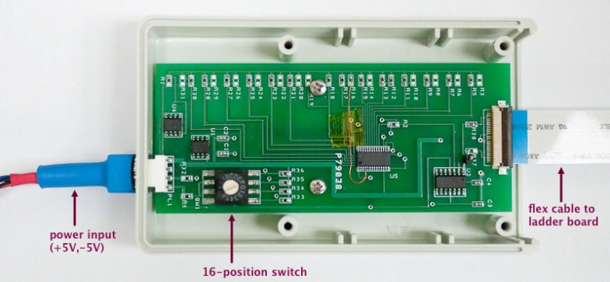
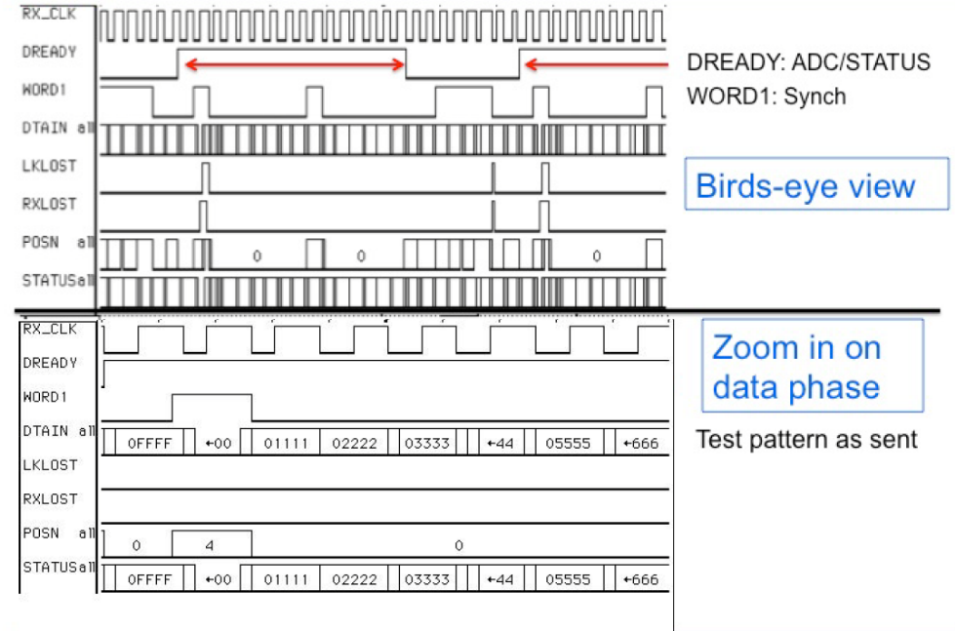
Progress: ‘Quick’ RDO built and tested
Prototype RDO board w/services for 1 ladder
A complete RDO board has recently been completed and sent off for fabrication
Milestone:
Passing from prototype to pre-production version

Slide 15
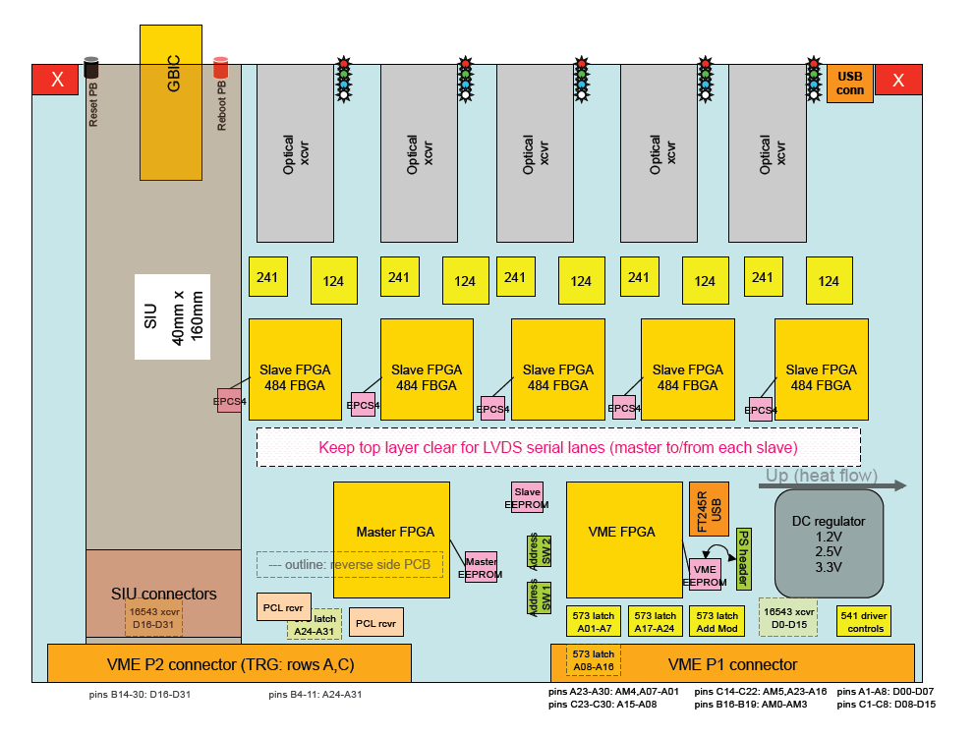
Progress: Readout Board Status (RDO)
✓Design of Slave FPGA complete
✓Pin outs for Master and VME FPGAs done
✓Full RDO board has been designed and laid out
✓ Components ordered
Fab will begin in July
See talk by M.J. LeVine

Slide 16
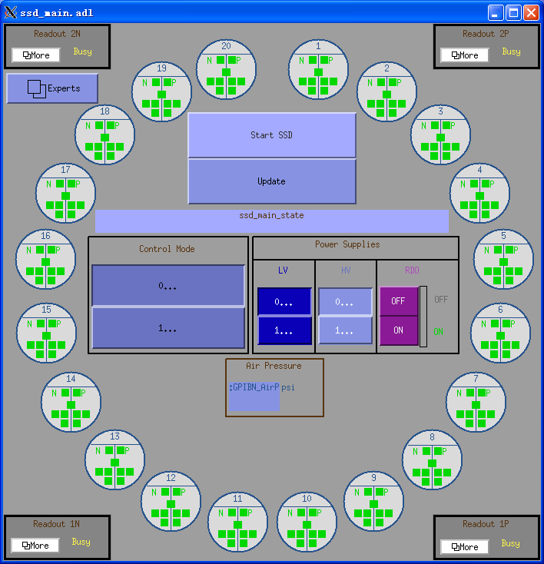
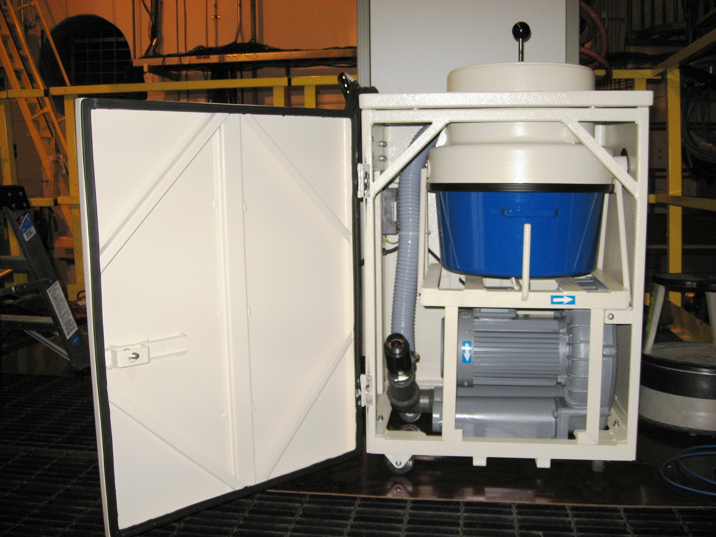
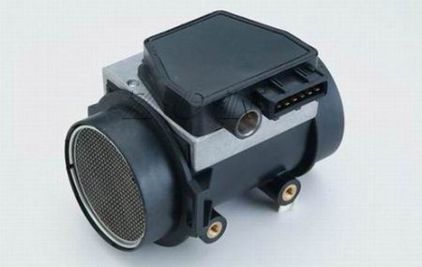
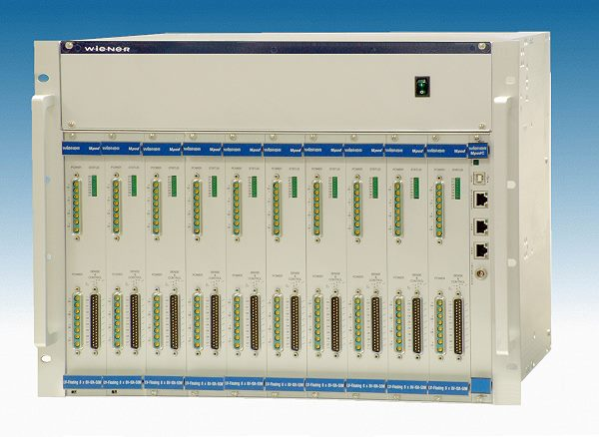
Progress: Slow Controls and Conventional Systems
We have developed a slow controls interface to the new Power supplies (See talk by Weihua Yan)
Working on the more complex problem of JTAG communication to the ladders
Prototype quantities of PS and Power modules are in-house
Cooling system is in-house and has been tested.
Cooling system – vacuum
Instrumentation for cooling

Slide 17
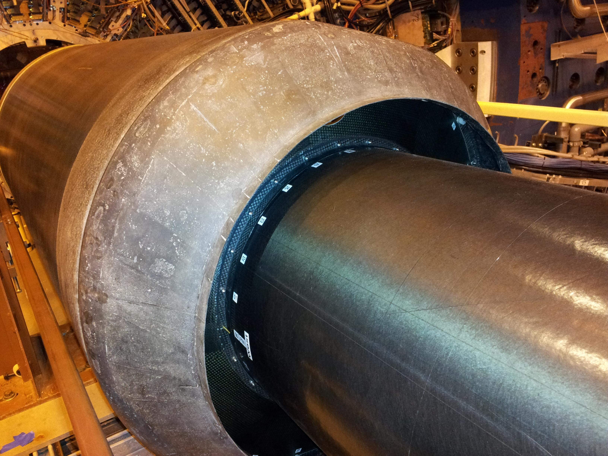
Mechanical Engineering: the OSC & Shroud
SSD Ladders go here

Slide 18
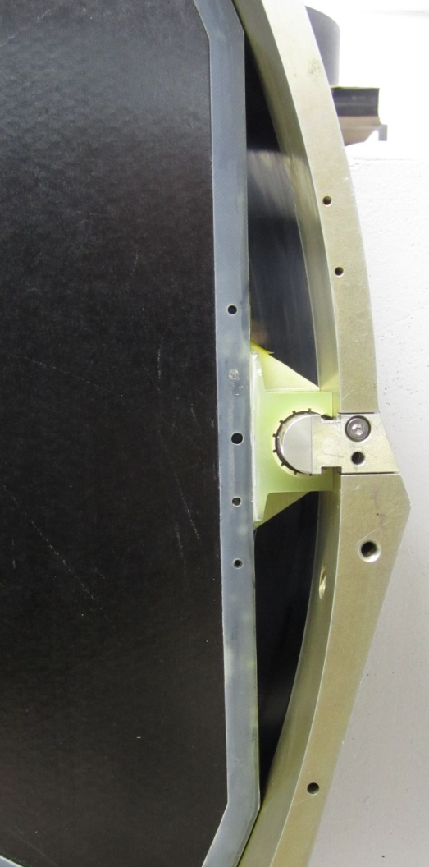
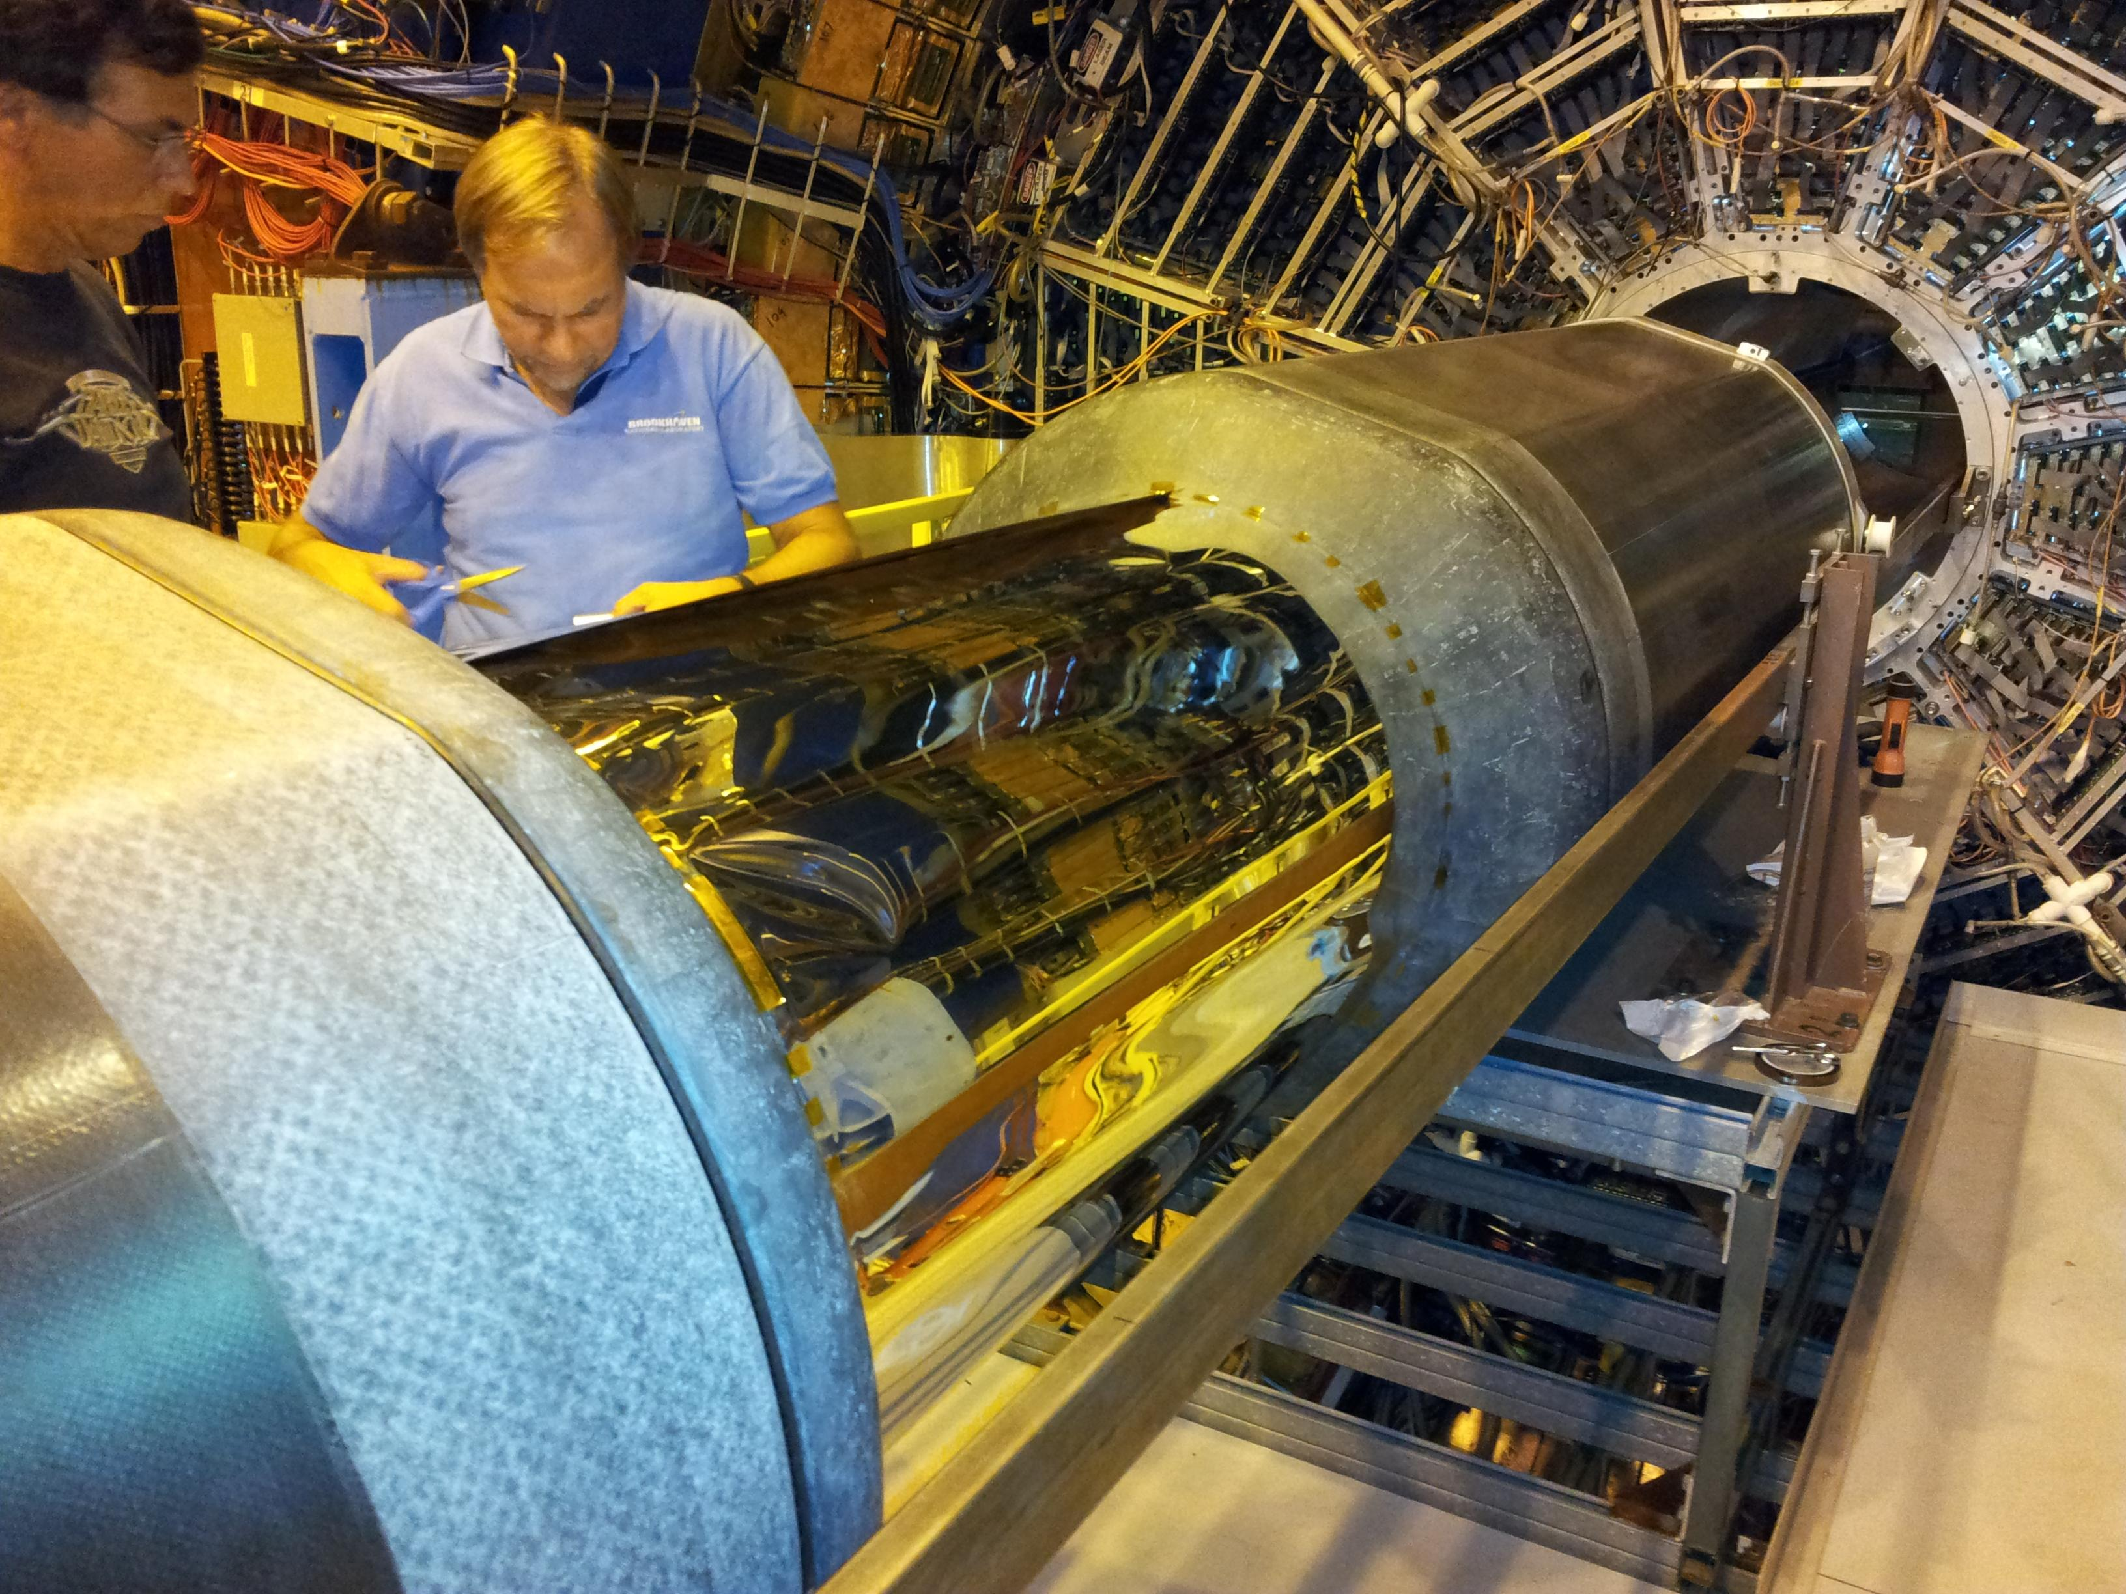
Progress: Mechanical Engineering
10 cm
Cable trays will be installed around FGT planes
OSC with shroud and E&M shield installed
SSD Specific work not yet complete

Slide 19
Milestones
WBS | New Task Name |  | New Date |  | Old Date
1.4.2.1.1.2 | L2 CP - SSD Prototype Ladder Board Design Finished |  | 10/15/2010 |  | 10/15/2010
1.4.2.2.1.3 | L2 CP - SSD QRDO Board design finished |  | 7/19/2011 |  | 7/25/2011
1.4.2.2.1.7 | L3 CP - QRDO Complete |  | 8/23/2011 |  | 5/9/2011
1.4.2.1.1.9 | L3 CP - Ladder Board Prototype Phase I Complete |  | 10/31/2011 |  | 7/6/2011
1.4.4.1.1.2 | L3 CP - PCB for Ladder Board Cable Ready for Fabrication |  | 11/2/2011 |  | 9/2/2011
1.4.2.3.2.2 | L3 CP - Production DAQ Design Review Completed |  | 11/28/2011 |  | 11/28/2011
1.4.2.2.1.15 | L3 CP - SSD RDO Design Finished |  | 1/27/2012
1.4.1.2 | L3 CP - Mechanical Design of SSD components on OSC complete - HFT design Review to sign off |  | 6/1/2012 |  | 6/1/2012
1.4.4.2.9 | L3 CP - Power Supply Design Review Complete |  | 6/29/2012 |  | 2/8/2012
1.4.2.2.2.4 | L2 CP - SSD Preproduction Design Review of RDO |  | 7/13/2012 |  | 5/30/2012
1.4.2.1.2.10 | L3 CP - Preproduction Ladder Board PCB Received |  | 8/10/2012 |  | 8/31/2012
1.4.2.1.3.2 | L3 CP - Production Ladder Board Internal Review Completed |  | 10/8/2012 |  | 10/29/2012
1.4.2.1.3.4 | L2 CP - SSD Production of Ladder Boards Ready to Begin |  | 11/6/2012 |  | 11/29/2012
1.4.2.1.3.7 | L3 CP - Production Ladder Board PCB Received |  | 1/22/2013 |  | 2/12/2013
1.4.4.4.2.12 | L3 CP - Slow controls ready for testing |  | 1/30/2013 |  | 4/18/2012
1.4.2.2.3.7 | L3 CP - Production RDO Board Received |  | 3/22/2013 |  | 2/6/2013
1.4.1.7 | L3 CP - Mechanical Components on OSC Installed |  | 4/1/2013 |  | 4/1/2013
1.4.2.5 | L3 CP - Electronics Complete |  | 6/14/2013 |  | 7/22/2013
1.4.3.1.5 | L3 CP - Survey Complete |  | 7/9/2013 |  | 5/30/2013
1.4.4.3.15 | L3 CP - Installation of cooling on STAR platform and Magnet Endcap complete |  | 8/16/2013 |  | 7/31/2013
1.4.3.2.7 | L2 CP - SSD Assembled on OSC Ready for Installation |  | 8/28/2013 |  | 7/1/2013
Complete
Future
Late

Slide 20
Project Requirements: CD-4 Deliverables
Instrument 20 of the existing SSD ladders with new readout electronics compatible with STAR TPC readout
SSD to be installed on the Outer Support Cylinder
Provide cabling and cooling compatible with the IDS structure and FGT

Slide 21
SSD CD4 Requirements on Dead time
Dead-time as a function of random trigger rate
  Simulated performance with 3% occupancy
The SSD will have 4 buffers as part of the firmware
Multiple buffers hide the downstream DAQ from the dead-time of the system for randomly arriving triggers
CD-4 requirement
< 10% dead time at 500 Hz
Notes:
Dead time as a function of random trigger rates, for one or several de-randomizing buffers in the RDO. Empty strips are suppressed in the RDO; 3 per cent occupancy is assumed. Under these conditions, it is clear that multiple buffers offer no advantage. Principal advantage is to relieve DAQ computer of extraneous traffic on PCI bus.

Slide 22
Summary
The SSD upgrade project is moving ahead rapidly
We have a well developed prototype, test and fabrication plan
We are just starting the fabrication of our pre-production LB and RDO boards
The coming year will be dominated by fabrication of production electronics, mechanical engineering, software development and integrated testing.
Resources necessary for the completion of the project are in hand and, for the most part, readily available
The costs are under control.
Keeping to schedule will be a challenge; including testing the new electronics on one ladder, as well as integrated testing of the full system at STAR.
Our goal is to install the full SSD in time for Run 14 (2013-2014)

Slide 23
Backup Slides
Backup Slides

Slide 24
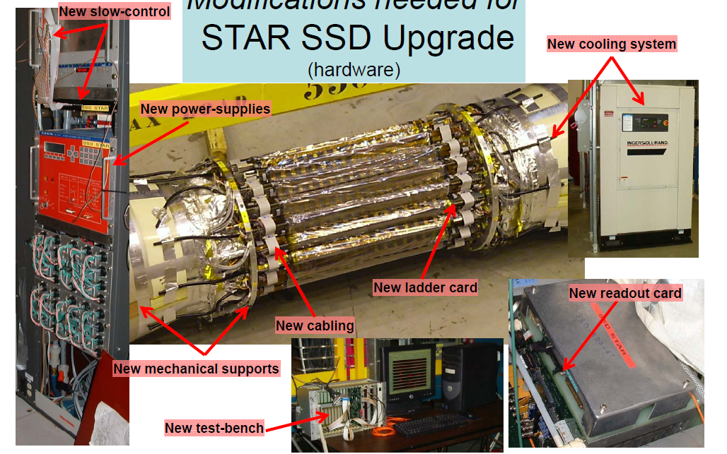
Modifications Needed for the SSD Upgrade
Use existing SSD silicon sensors
Upgrade readout from 200 Hz to 1 kHz
Improve reliability of sub-systems

Slide 25
SSD WBS
1.4.1 Mechanics
1.4.2 Electronics
  1.4.2.1 Ladder Board
  1.4.2.2 RDO Board
  1.4.2.3 DAQ Board
1.4.3 Detector Assembly
  1.4.3.1 Survey
  1.4.3.2 OSC Assembly
1.4.4 Infrastructure
  1.4.4.1 Cables
  1.4.4.2 Power Supply
  1.4.4.3 Cooling
  1.4.4.4 Slow Controls
  1.4.4.5 FPGA Software
The Work Breakdown Structure reflects the elements shown on the previous page

Slide 26
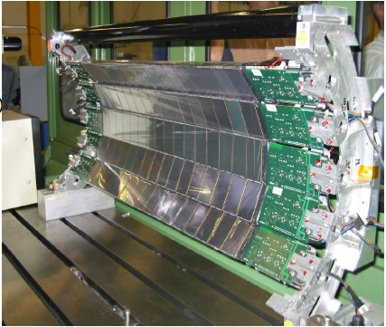
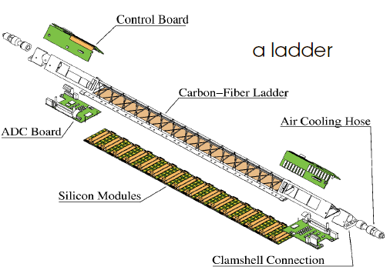
We kept the SSD, it is a beautiful detector!
The SSD is thin
  1% - double sided Si
The SSD lies at an ideal radius
  22 cm - midway between IP and IFC
The SSD has excellent resolution
  (rumor says better than design)
Replacing the SSD was not an option
  too expensive

Slide 27
Getting a Boost from the TPC
The TPC provides good but not excellent resolution at the vertex
  ~ 1 mm
The TPC provides an excellent angular constraint on the path of a predicted track segment
  This is very powerful. It gives a parallel beam with the addition of MCS from the IFC
The best thing we can do is to put a pin-hole in front of the parallel beam track from the TPC
  This is the purpose of the SSD and IST
The SSD and IST do not need extreme resolution. Instead, they maintain the parallel beam and don’t let it spread out
  MCS limited
  The PXL does the rest of the work
OFC
TPC
IFC
MCS Cone
VTX
The Gift of the TPC

