Slide 1
A Brief Review of the 5 Posters for QM that have a
Correlations and Fluctuations Theme
Jim Thomas
3/25/2009

Slide 2
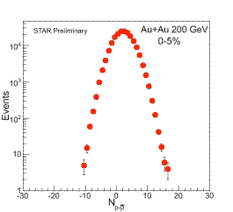
Search for the QCD Critical Point …
Search for the QCD Critical Point Through Kurtosis of Net-Proton Event-by-Event Multiplicity Distributions in the STAR Experiment at RHIC
  Bedangadas Mohanty
Looking for large fluctuations in critical parameters near the QCD critical point – this is a warm up exercise for our low energy scan since you don’t really expect the critical point to occur at 200 GeV
  A great project for a student to latch onto because Bedanga will have pioneered all the hard bits …
The ideal probe – event by event multiplicity
Fluctuations for net baryons … related to
correlation lengths in the plasma
Two problems
  Deviations from the mean are related to the correlation lengths in the plasma … but we are dealing with finite systems (space < 6 fm, time < 3 fm)
  We can’t measure all of the baryons (neutrons, lambdas, etc.)

Slide 3
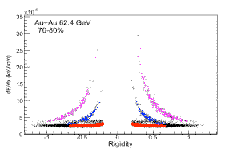
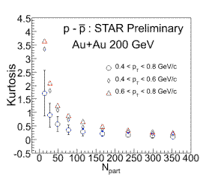
Search for the QCD Critical Point
Solutions
  Use higher moments to amplify the significance of the fluctuations
    Mean, Variance, Skewness & Kertosis
  Use protons
    Theoretical justification given for why
    protons represent the mean behavior
    of all baryons
    STAR can do proton PID very well
Results
  Smooth monotonic behavior at 200 GeV
  In good agreement with Hijing & URQMD
  Discover that factorial moments are a
  beautiful observables that overcome issues
  with event by event acceptance corrections
  Wait till the low energy scan!

Slide 4
Issues and Comments
Specific comments on this poster
  Excellent work
  Figures may be too small, even after expanding 5x
General comment: Moments, skewness, and kertosis are exotic ideas for a poster audience
  The good thing about a poster session is that you have plenty of time to explain exotic ideas
  The bad thing is that you won’t have a blackboard (i.e. you must communicate without equations unless written on poster)
  The really bad thing about a poster session is that the audience won’t stop (when you are not there) to view a poster in which they don’t understand the vocabulary
  So, I encourage all poster presenters to explain their posters as clearly as Bedanga does in oral conversation
    We are a lot dumber than you think

Slide 5
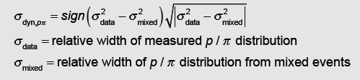
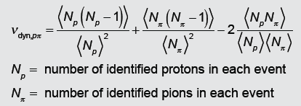
p/π Fluctuations in Au-Au Collisions
p/π Fluctuations in Au-Au Collisions
(s_{NN}^{1/2} = 20, 62.4, 130, and 200 GeV in terms of the variable σ_{dyn})
Gary Westfall
Two measures of fluctuations
  σ_{dyn} as used by NA49
  ν_{dyn} ( where, under certain conditions, ν_{dyn} = σ²_{dyn} )

Slide 6
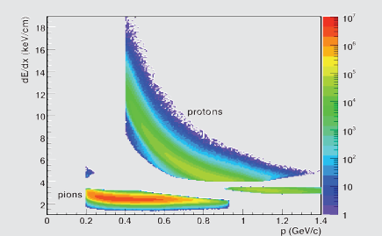
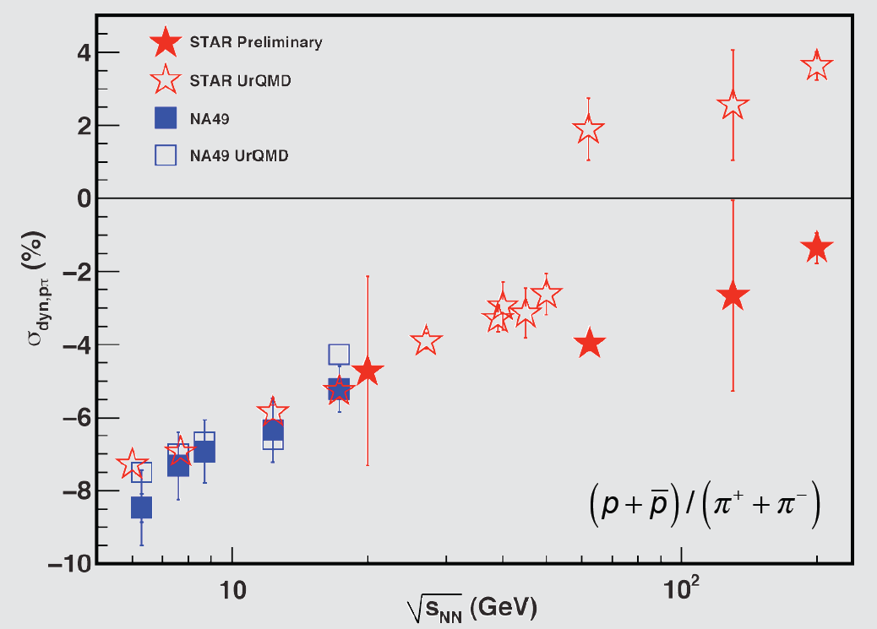
p/π Fluctuations in Au-Au Collisions
PID: A STAR asset …
yet we still a problem
(Wait till we have TOF data!)
The p/pi fluctuations observed by STAR scale smoothly with energy from the NA49 results.
UrQMD correctly predicts the p/pi fluctuations results from NA49 but over-predict the STAR results.

Slide 7
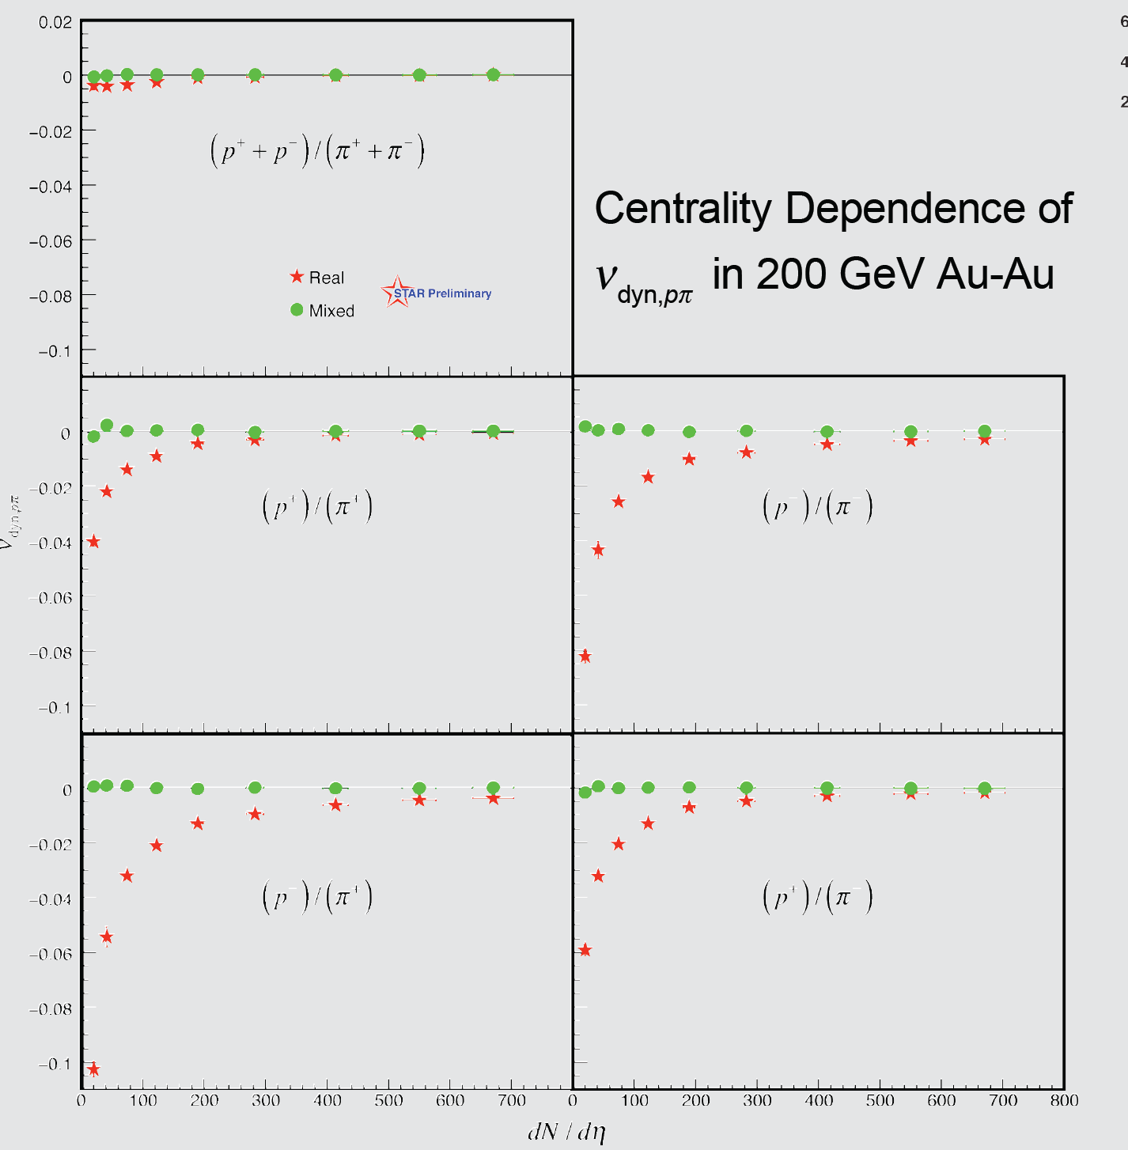
p/π Fluctuations in Au-Au Collisions
ν_{dyn,pπ} for summed charges and separated charges is negative for 62.4 and 200 GeV Au-Au collisions
ν_{dyn,pπ} for mixed events are always consistent with zero
UrQMD predicts that ν_{dyn,pπ} for summed charges is positive and that ν_{dyn,pπ} for separated charges is negative
Negative fluctuations mean that there are a lot resonances that decay into p + π such as the delta and lambda.
K π p data presented in the poster, too.

Slide 8
Event-by-Event p/K Fluctuations …
Event-by-Event p/K Fluctuations from A+A Collisions at RHIC
Jian Tian
Motivation
  Get ready for the low energy scan
  We expect to see local density fluctuations near the critical point
    Coalescence model suggests baryons ~ n³, mesons ~ n²
    Baryon / Meson ~ n
  Choose protons and kaon because they have reduced resonance correlations
  Assume that the number of protons is a reliable measure of baryons
The Measurement and the Probe
  σ_{dyn} where

Slide 9
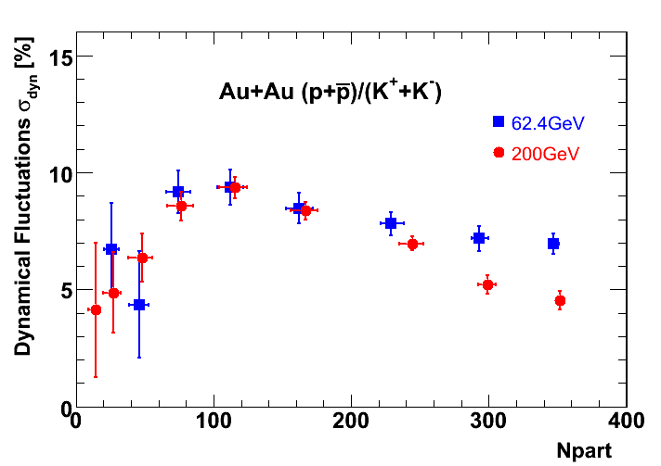
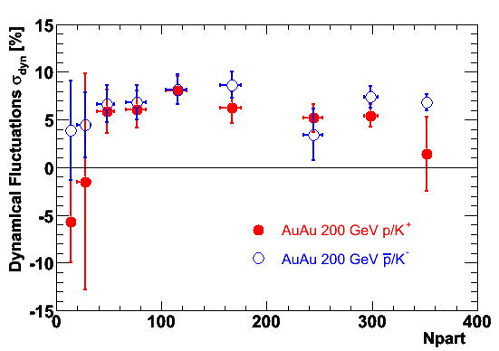
Event-by-Event p/K Fluctuations …
The net proton to Kaon ratio fluctuation has a maximum at mid-centralities for both 200 GeV and 62.4 GeV collisions
62.4 GeV has bigger fluctuations than 200GeV in central collisions
The fluctuation of same charge proton to Kaon ratios are equal within errors, with no obvious centrality dependence.
Future work: investigate resonance effects with AMPT and other models. Different event mixing schemes.
Good tools for the low energy scan

Slide 10
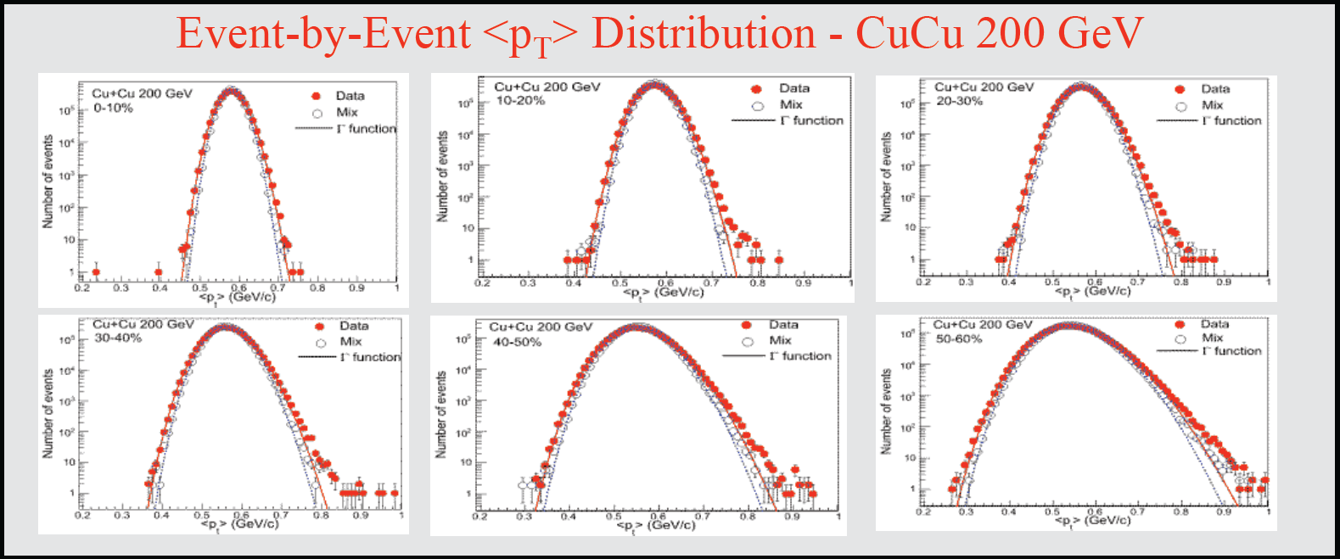
Energy and System Size Dependence …
Energy and System-Size Dependence of p_{T} Fluctuations and Correlations at the STAR Experiment
Cu-Cu collisions at 62.4 and 200 GeV
Madan Aggarwal
Centrality (%)
Cu+Cu 200 GeV
α/n
Cu+Cu 62.4 GeV
α/n
0-10
2.04
2.18
α/n =
μ²/(σ² *<N>)
α/n ~ 2 , follows gamma distribution
10-20
2.08
2.23
20-30
2.08
2.26
30-40
2.11
2.28
40-50
2.12
2.31
50-60
2.13
2.30
<p_{T}> distributions for Cu+Cu collisions are broader than a Gamma distribution, and broader than those for the mixed events indicating the presence of non-statistical fluctuations.

Slide 11
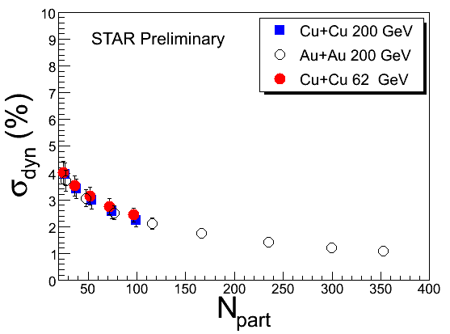
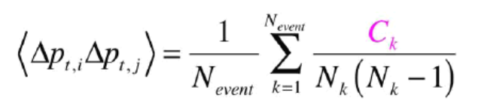
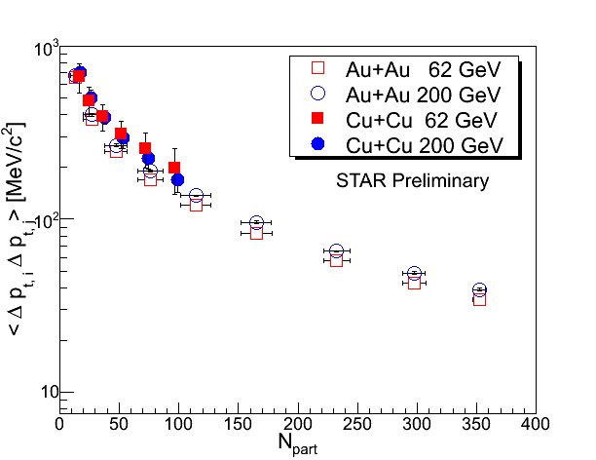
Energy and System Size Dependence …
Dynamical fluctuations in <p_{T}>
σ_{dyn} = √(σ²_{data} - σ²_{mix})‏, where
σ_{data} = relative width of <p_{T}> distribution in data,
σ_{mix} = relative width of <p_{T}> distribution in mixed events,
Dynamical fluctuations are independent of beam energy and system size but decrease for increasing centrality
Two particle transverse momentum correlations
p_{T} correlations decrease with increasing centrality, Δη and Δφ as expected, for Cu+Cu and Au+Au collisions, if the correlations are dominated from particle pairs from same nucleon-nucleon collision

Slide 12
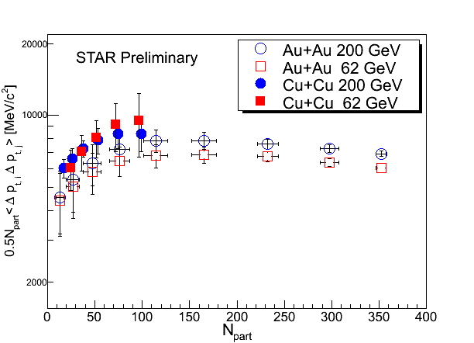
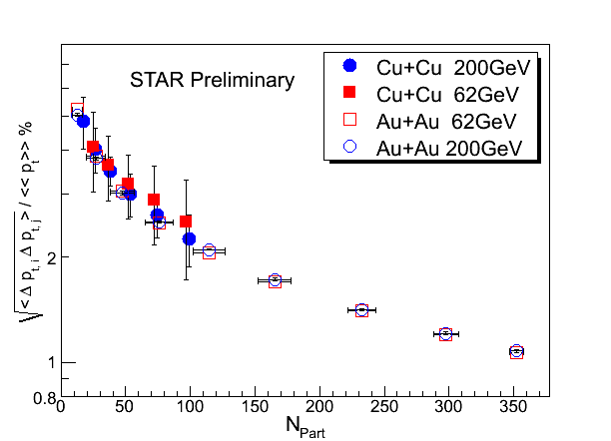
Energy and System Size Dependence …
Correlation scaled by participant pairs shows saturation for Au+Au collisions indicate signs of thermalization.
Correlations scaled by <<p_{T} >> exhibit little or no dependence on the incident energy and system size but decrease with increasing N_{part}
A wealth of fundamental correlation data

Slide 13
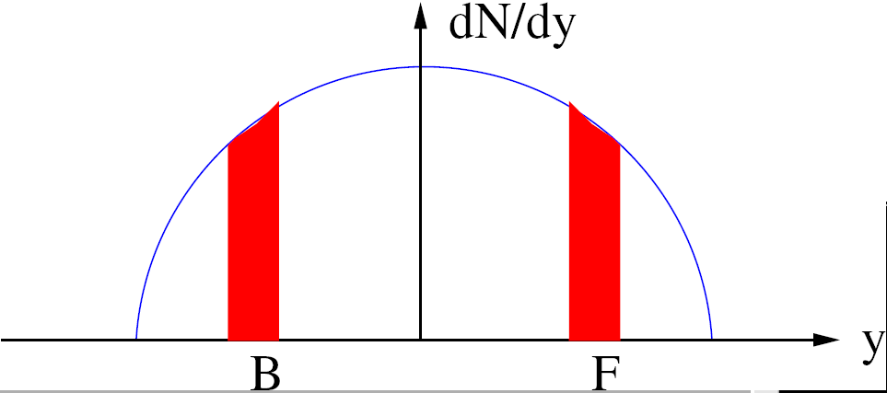
Probing the Early Medium in HI Collisions …
Probing the Early Medium in Heavy Ion Collisions with the Energy and System-Size Dependence of Long-Range Multiplicity Correlations
Brijesh K Srivastava
D²_{ff} characterizes the short range correlations, which is related to the number of particles emitted per cluster
D²_{bf} characterizes the long range correlations (for a gap > 1.0) and is related to the number of sources

Slide 14
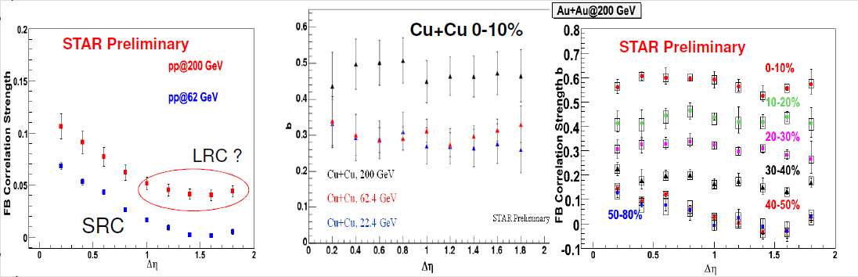
Probing the Early Medium in HI Collisions …
Long Range Correlations are enhanced, relative to pp, in HI collisions
Extensive analyses … the correlation is the same for like sign and unlike sign combinations in central collisions
  Suggests cluster formation
Based on a Color Glass Condensate model, one can argue that the LRC are due to fluctuations in the number of gluons and so originate at very early times in the collision history

