Slide 1
Isobaric Nuclear Systems
A laboratory for studying fundamental nuclear physics
Jim Thomas
Lawrence Berkeley National Laboratory

Slide 2
Outline
What is an isobar?
A valuable tool for studying fundamental nuclear physics
  Non-accelerator based experiments
    Double Beta Decay
  Accelerated beams
    Flow systematics and the Chiral Magnetic Effect
The Chiral Magnetic Effect
  In depth
Accelerated isobaric beams
  CME and the Beam Energy Scan
The future
  An adjustable magnetic field to further explore chiral symmetry restoration in heavy ion collisions
  (A list of a few dirty details that I didn’t talk about)

Slide 3
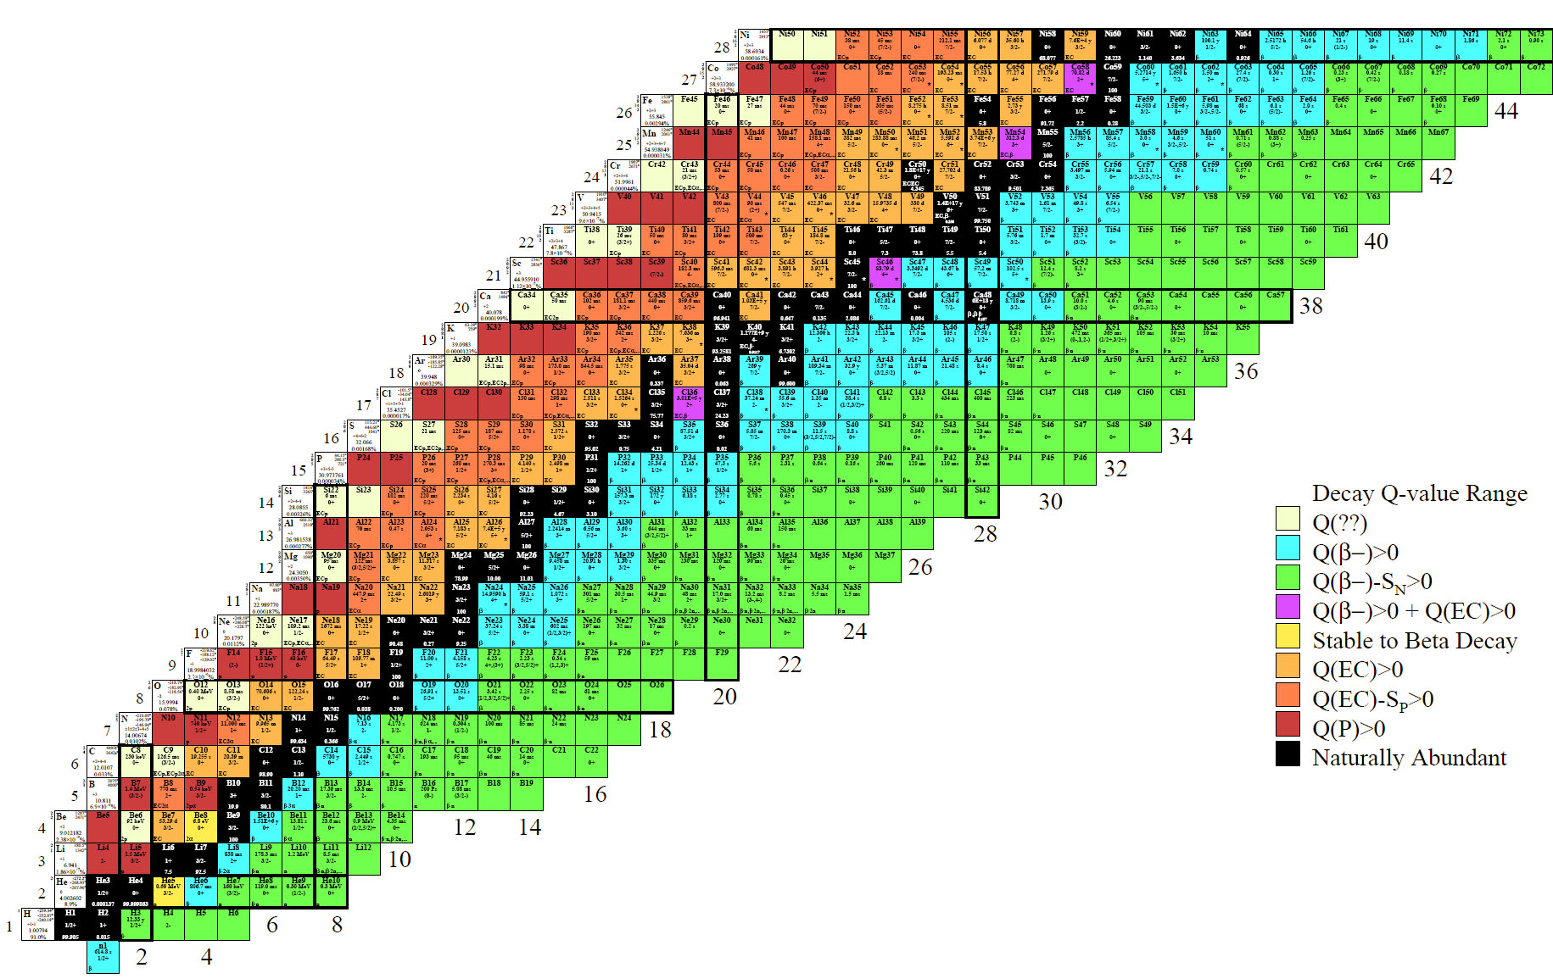
Table of the Isotopes
Isotopes of an element (same proton number) run along a row
Isotones (same neutron number) run in columns
Isobars (same mass number) run along the diagonals
Neutron rich elements on the right
Proton rich elements on the left
The valley of stability runs up the middle

Slide 4
Table of the Isotopes
Radioactive decays occur wherever it is energetically allowed and not forbidden by spin selection rules or forbidden by nuclear matrix elements.
All of these isotope are created by stellar burning and super nova explosions
(except hydrogen)
But, of course, not all are seen on earth

Slide 5

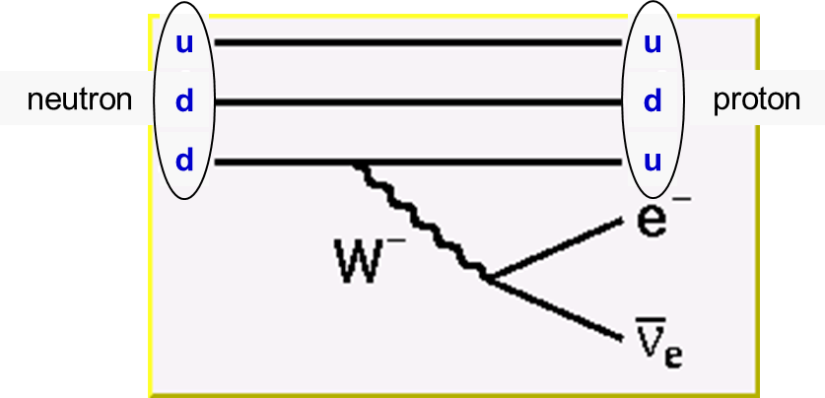
Even the Neutron decays …
A free neutron is not stable and will decay via Beta Decay
  The half life is 614.6 seconds or cτ = 2.65 x 10⁸ km
    about equal to the attention span of a full professor of physics
conserve charge
n
p
+
e
+
conserve baryon number
conserve lepton number
The conversion of a down quark into an up quark proceeds via the emission of a massive intermediate vector boson

Slide 6
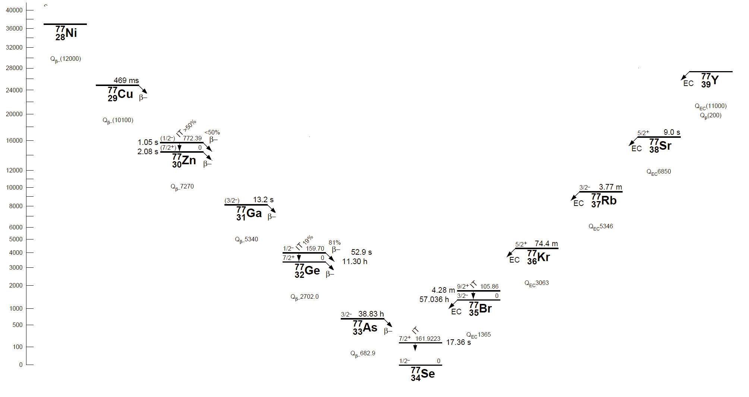
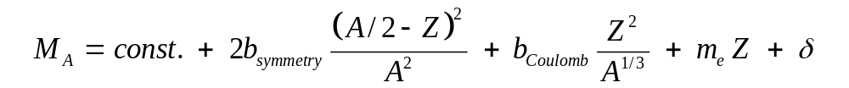
Isobars: The Valley of Stability at A = 77
Note: proton # increases
δ is the pairing energy
= 0 for odd A nuclei
∼ ± 12/A^{½} for odd N, odd Z,
or even N, even Z

Slide 7
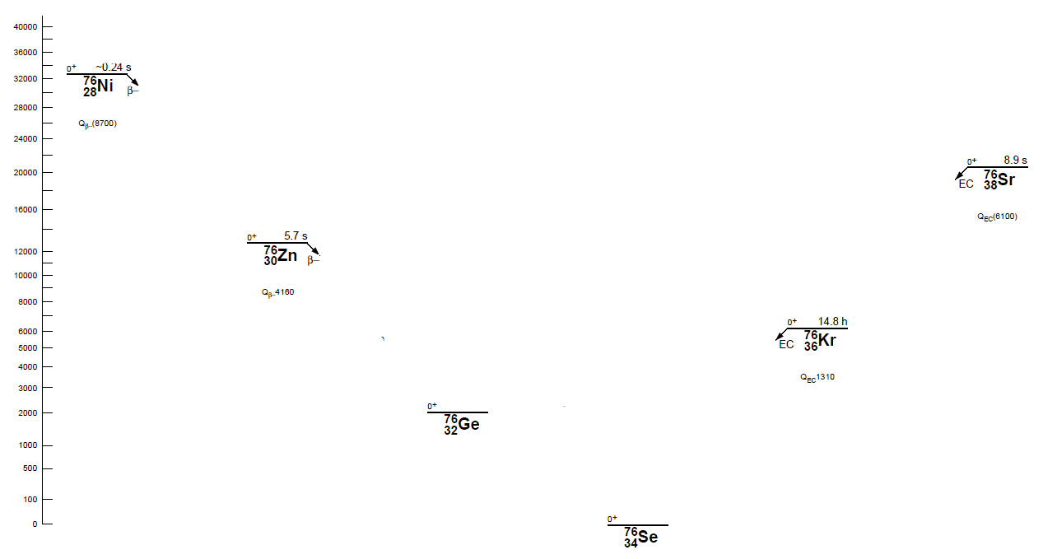
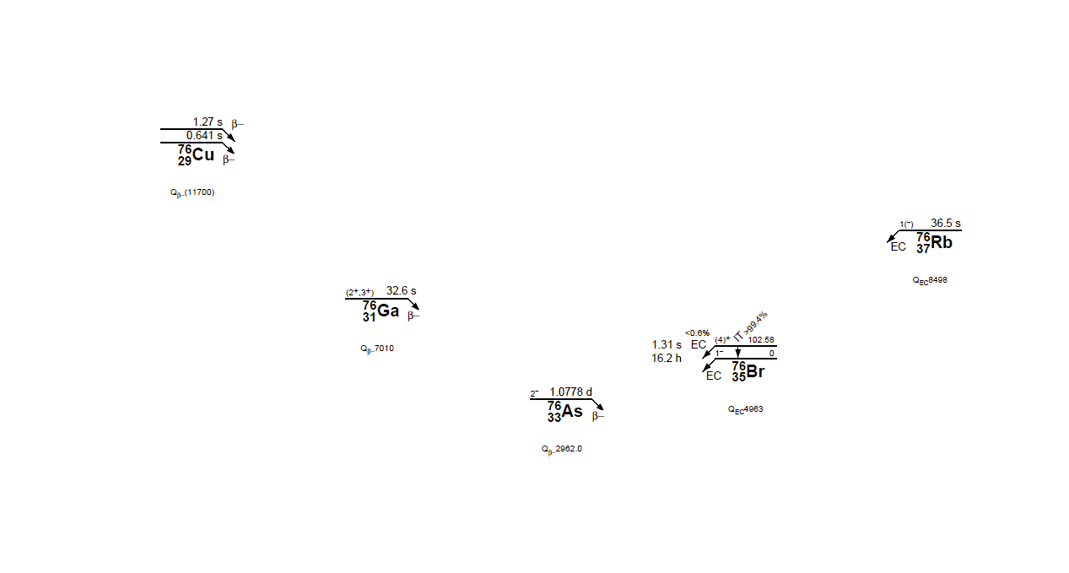
The Pairing of Nucleons is Important (A = 76)
Odd-Odd nuclei
Even-Even nuclei
Stable Isotope
Stable Isotope
The pairing energy, δ, can create a situation where β decay is kinematically forbidden.

Slide 8
Detour regarding Double Beta Decay
    This is too cool to pass up ….

Slide 9

Two neutrons can decay simultaneously …
In QM, it is not necessary to conserve energy (at each step)
n
p
+
e
+
+
n
p
+
e
Zero neutrino double beta decay can occur if the anti-neutrino from one beta decay can be used to stimulate the decay of a second neutron in the same nucleus.
  This process has two electrons in the final state and no neutrinos
  It violates lepton number conservation
To do this, the neutrino must be its own anti-particle (a Majorana particle)
  There must be a solution to the helicity problem, too.
  One solution to this problem is m_{ν}

Slide 10
But Zero Neutrino Double Beta Decay is the prize!
n
p
+
e
+
Mass
+
n
p
+
e
The neutrino is left handed (spin opposite the direction of motion). The anti-neutrino is right handed (spin in the direction of motion).
  They must be identical for 0ν double beta decay to occur
If the ν is massive, then its velocity must be less than c and there exists a frame which is going faster than the ν. If the velocity of the frame exceeds the velocity of the ν then the ν appears to be going the other way in the new frame. In other words, its helicity is flipped.
0ν double beta decay is the smoking gun for a massive neutrino

Slide 11
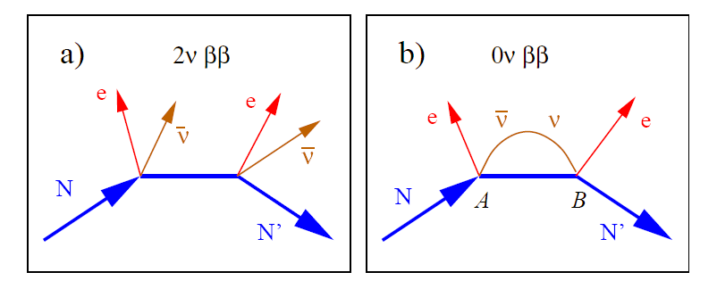
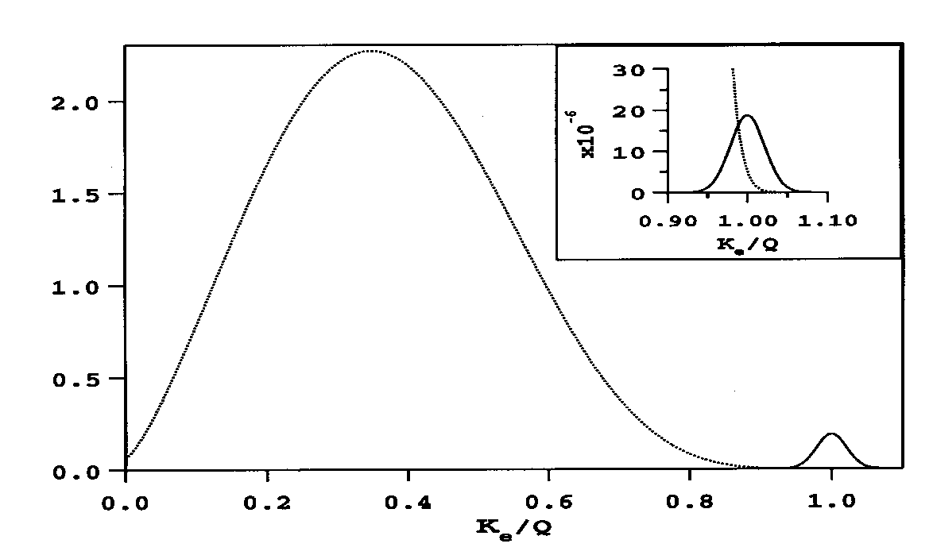
Two Modes of Double Beta Decay, 2ν and 0ν
The two modes can be distinguished by the summed energy of the electrons in the final state.
The 0ν decay is identified as the narrow peak at the kinematic limit of the decay process.
2ν spectrum
0ν peak

Slide 12
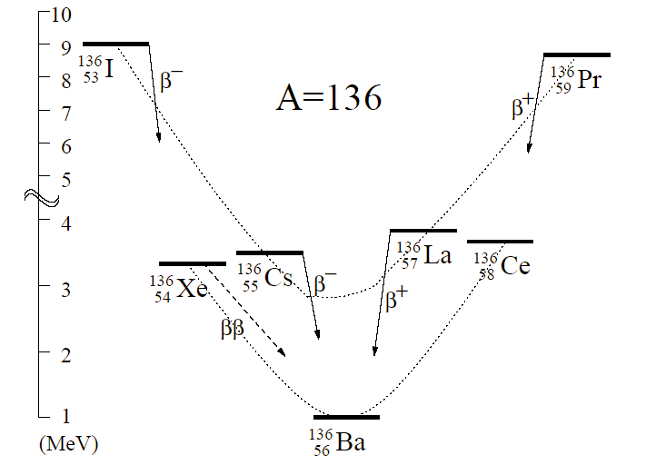
Other Isobars & Double Beta Decay systems
Parabola describing odd-odd nuclei
Gap created by energy released in making pairs of neutrons and/or protons
Stable Isotope
Parabola describing even-even nuclei
Stable Isotope
Except for ββ decay
Stable Isotope
¹³⁶Xe is another double beta decay candidate
Excellent, because ¹³⁶Xe can be the gas in a TPC and TPCs are really good at seeing the track of two electrons

Slide 13
End Detour
The observation of 0ν ββ would:
Determine the absolute mass scale for neutrinos
Demonstrate lepton number violation
Establish the neutrino as a massive Majorana particle
Provide clues to the values of the Majorana phases in the mixing of neutrino eigen states that we actually observe in nature

Slide 14
Accelerated Beams of Isobars
Accelerated beams of isobars are interesting because we can compare two runs using beams with the same mass, nearly the same geometry, but different number of protons in the collision.
For example: Flow systematics, the Chiral Magnetic Effect and the Chiral Magnetic Wave
The first requirement for the use of an accelerated beam is that the isotopes must be stable
There are only 4 stable isobaric systems where the change in Z is greater than 2.
The four candidates with ΔZ = 4 are:
Element Z Mass Abundance
Zr 40 96 2.80%
Mo 42 96 16.68%
Ru 44 96 5.54%
Sn 50 124 5.79%
Te 52 124 4.74%
Xe 54 124 0.09%
Te 52 130 34.50%
Xe 54 130 4.07%
Ba 56 130 0.11%
Xe 54 136 8.86%
Ba 56 136 7.85%
Ce 58 136 0.19%
(They are all ββ systems.)
β β Collaboration
Nemo-3 (2ν mode observed)
First system ever studied … circa 1948!
Nemo-3, Cuore, SNO+ (2ν mode observed)
Exo 200, NEXT, PandaX (2ν mode observed)

Slide 15
Accelerated Beams of Isobars
Accelerated beams of isobars are interesting because we can compare two runs using beams with the same mass, nearly the same shape, but different number of protons in the collision.
For example: Flow systematics, the Chiral Magnetic Effect and the Chiral Magnetic Wave
The first requirement for the use of an accelerated beam is that the isotopes must be stable
There are only 4 stable isobaric systems where the change in Z is greater than 2.
The four candidates with ΔZ = 4 are:
Element Z Mass Abundance
Zr 40 96 2.80%
Mo 42 96 16.68%
Ru 44 96 5.54%
Sn 50 124 5.79%
Te 52 124 4.74%
Xe 54 124 0.09%
Te 52 130 34.50%
Xe 54 130 4.07%
Ba 56 130 0.11%
Xe 54 136 8.86%
Ba 56 136 7.85%
Ce 58 136 0.19%
These are the systems that are preferred by the accelerator people for the simple reason that they are the most abundant selection of isobars
Isotopically separated isotopes can be purchased but we need ~ 1 gram each … so costs add up
STAR is proposing to run ⁹⁶Zr + ⁹⁶Zr collisions and ⁹⁶Ru + ⁹⁶Ru collisions at RHIC in 2018

Slide 16
Why compare ⁹⁶Zr collisions to ⁹⁶Ru collisions?
It allows us to compare two colliding systems with the
  same mass
  (nearly) the same shape and geometry
  but different number of protons (and thus different E and B fields)
Study phenomena as a function of the neutron/proton ratio
  Fundamental physics with excellent control over background effects
Flow, specifically directed flow v₁, has been shown to have a strong n/p ratio dependence at 55 MeV / nucleon
  Due to larger cross section for n-p collisions compare to n-n or p-p
  Pak, Benenson, et al., PRL 78 (1997) 1022 (hadronic dof, non-QGP)
What happens at 200 GeV/nucleon? (QGP dof)
  Sensitivity to the equation of state (EOS)
  Advances in relativistic hydrodynamics
  Study of phenomena that are sensitive to the strong electric and magnetic fields that are created when two nuclei collide – such as CME, Lamba Polarization, perhaps even ultra-peripheral collisions

Slide 17
The Chiral Magnetic Effect
Lets start discussing the Chiral Magnetic Effect
  I like to think of it as Chiral Magnetic Engineering … you will see why
It takes 3 things to make the Chiral Magnetic Effect work
  Chiral Symmetry restoration
  Topological Charge changing transitions in hot QCD
  Strong magnetic fields (10¹⁷ gauss!)

Slide 18
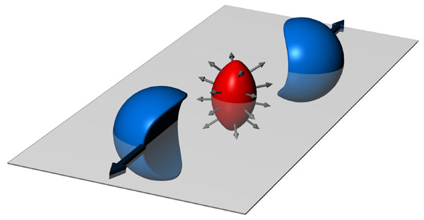
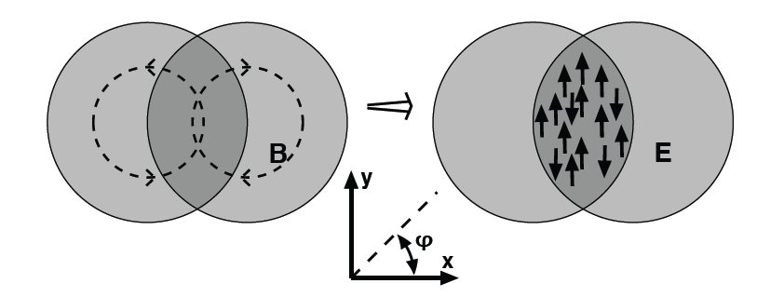
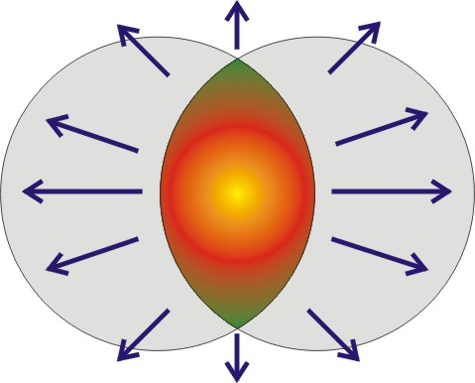
A collision has Angular Momentum and a B field
Electromagnetic charges in motion create an E&M magnetic field (not a color magnetic field)
The magnetic fields can reach 10¹⁸ gauss. Stronger than on the surface of a neutron star.
S. Pratt
Quarks interact with the magnetic field via their spin and magnetic moment
Quarks will align themselves parallel or anti-parallel to the B field direction
The B field is a long range phenomena; it affects every quark in the de-confined system
We can adjust the strength of the B field by changing from ⁹⁶Zr to ⁹⁶Ru collisions

Slide 19
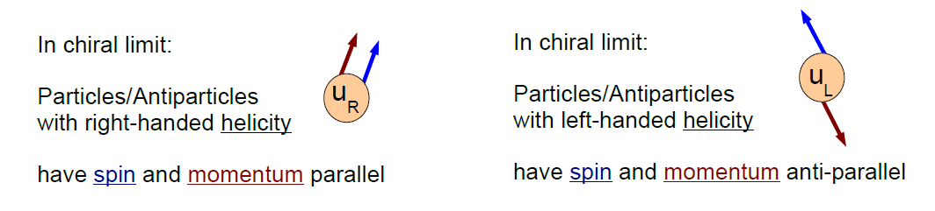
Quarks interact with the B field via their spin
Assume: chiral symmetry is restored in a QGP
Assume: quark masses drop to ~0 after chiral symmetry restoration
Chirality and helicity are the same for massless particles … so in the limit of zero mass, it is easy to define chirality
(not so easy for non-zero mass)
The QCD Lagrangian is chiraly symmetric for massless particles
  The pion is the Goldstone boson for Chiral symmetry
  Chiral symmetry is spontaneously broken & gives mass to hadrons

Slide 20
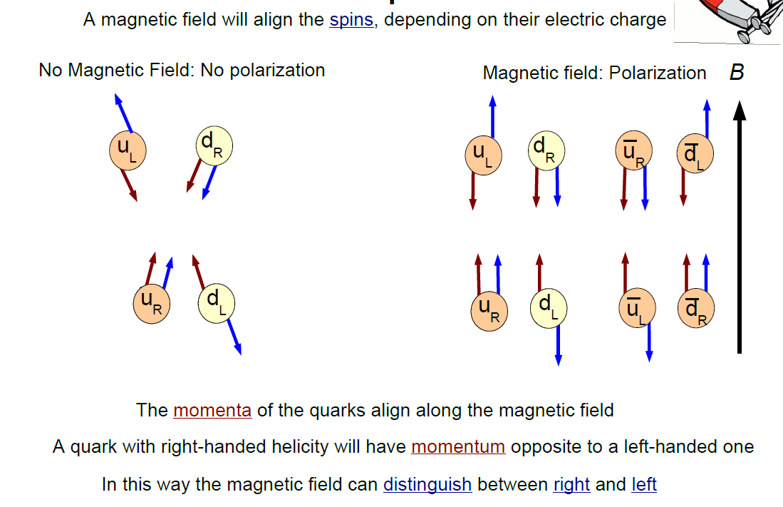

How does the B field affect the Quarks?
Note that charge motion is balanced if number of right and left handed quarks is the same.
H. Warringa

Slide 21
So far …
So far, we have done no useful work with the magnetic field
  But we have done some fascinating nano-engineering
Lets pause for a moment to introduce one more crazy feature of (hot) QCD …

Slide 22
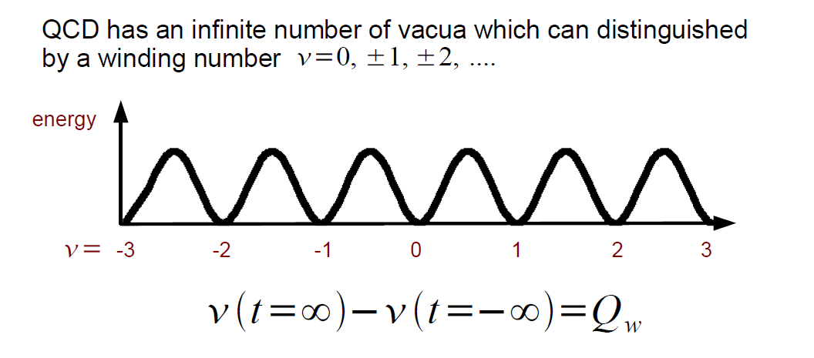

Hot QCD allows for metastable states … lots of them
Moving from one vacuum state to another is the result of changing the topological charge of the system
Topological charge flips helicity and thus counts the difference between the number of right and left handed quarks
Topological charge changing transitions also violate local P and CP conservation
Ground State
sphalerons
instantons
What every experimentalist likes to see in a theory publication …
  “The consequences and magnitude of these effects are subject to experimental study and verification”
    Kharzeev, McLerran, and Warringa arXiv:0711.0950 and
    Nucl. Phys. A803 (2008) 227.
From a humble experimentalist’s point of view … the theory appears to be fully vetted; these CP and P violating domains almost certainly occur in ultra-relativistic HI collisions. The question is whether the effects are large enough to be observed …
Notes:
Topological charge flips helicity of a quark. From right to left, or vice versa.

Slide 23
Topological Charge change flips chirality: L to R
H. Warringa

Slide 24
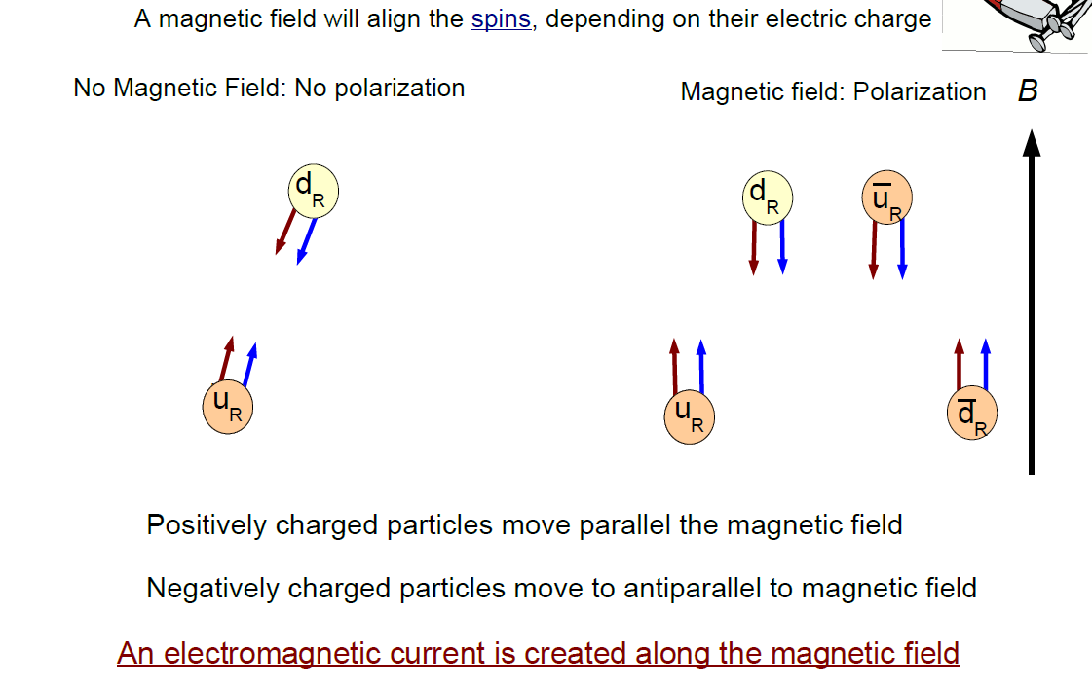
After flipping the helicity of 2 quarks (always 2)
Topological Charge fluctuations create an excess of right, or left handed quarks.
Note that right handed quarks move up or down based on charge.
These results have been reproduced on the Lattice
H. Warringa
Notes:
Topological charge flips helicity

Slide 25
Separation of Charge wrt the reaction plane
If a chirally restored bubble is created in a heavy ion collision, the positively charged quarks will go up … then hadronize … and yield an excess of positive pions above the plane
Unfortunately, it could be just the opposite in the next event depending on the topological charge in the bubble
+
+
+
+
+
+
The signal is manifestly
parity odd ⇒
x ⇒ -x , p ⇒ -p
but the observable will be even
The charge-flow asymmetry is too small to be seen in a single event but may be observable with correlation techniques
+
+
+
-
-
-
-
-
-
-
-
-
Notes:
Charge separation is parity odd. Check the finger physics of saying the signal is manifestly odd because p=-p etc. This is true … Parity (in 3D) is reversal of all momentum components. So signal is parity odd … however, if you change the sign of all charges, then the B field changes too so, overall, the signal is charge even

Slide 26
The hypothesis:
  The Chiral Magnetic Effect will cause a separation of charge, above and below the reaction plane
  If the CME effect occurs in HI collisions, then it would be evidence for local P and CP violation in the strong interaction
  It is the smoking gun for chiral symmetry restoration
A feat of nano-engineering that would make Richard Feyman proud …

Slide 27
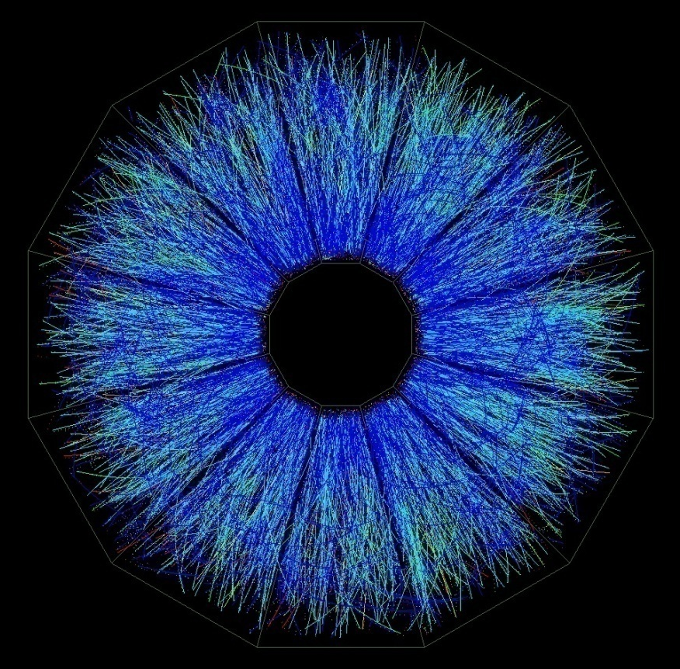
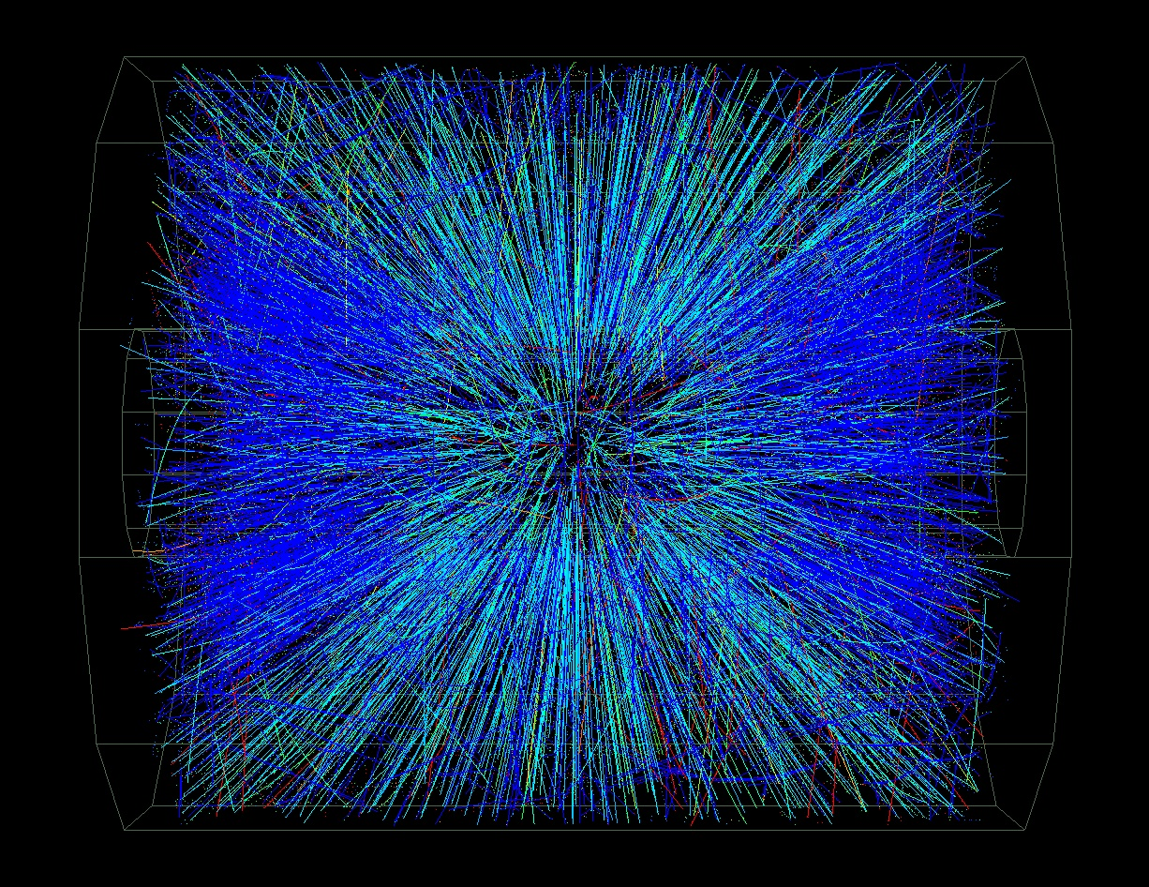
Ultra-Relativistic Nuclear Collisions
Tracking is done by the Main TPC and other detectors
Tracking cuts: normal ‘flow’ cuts
  |η| < 1.0 and -3.9 < η< -2.9 , 0.15 < p_{T} < 2.0 GeV/c
CME analysis is done by looking at the angular distribution of tracks; ignoring mass, energy, and momentum. Only the angle of emission is used.

Slide 28
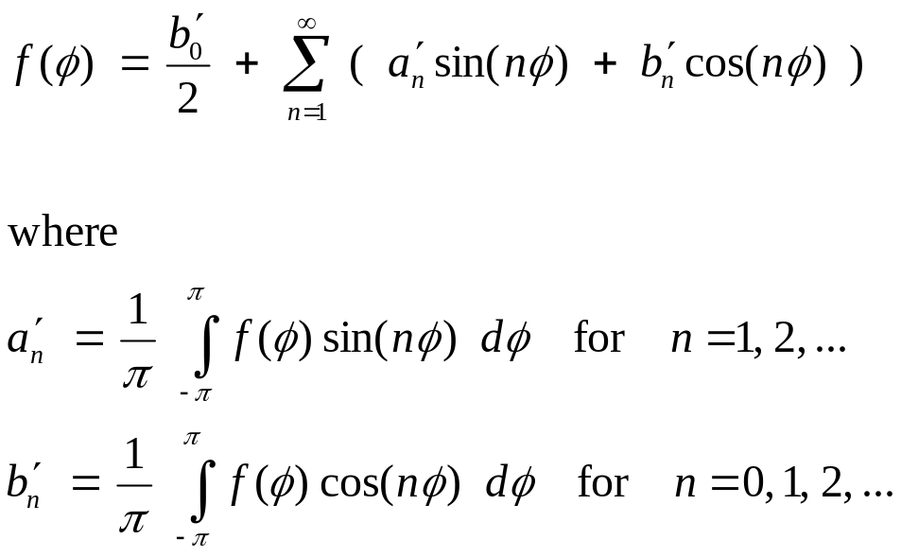
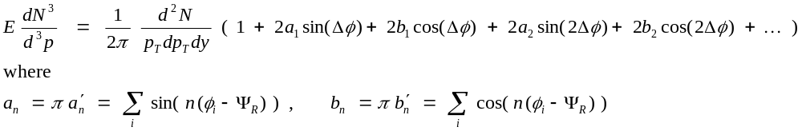
Full Fourier Transform of the Invariant Yield
If we want to test if parity is conserved then we should keep the extra terms
The standard HI flow analysis assumes a = 0 and assigns b_{n} ≡ v_{n}

Slide 29
Analysis Uses Standard Flow Tools
Y_{Lab}
B
p_{β}
p_{α}
Δφ_{β}
Δφ_{α}
Ψ_{RP}
X_{Lab}
Reaction
Plane
The line between the centers of the nuclei and the beam axis define the reaction plane – perpendicular to angular momentum vector and B field

Slide 30
Analysis Uses Standard Flow Tools
Y_{Lab}
B
p_{β}
p_{α}
Δφ_{β}
Δφ_{α}
Ψ_{RP}
X_{Lab}
Reaction
Plane
The line between the centers of the nuclei and the beam axis define the reaction plane – perpendicular to angular momentum vector and B field

Slide 31
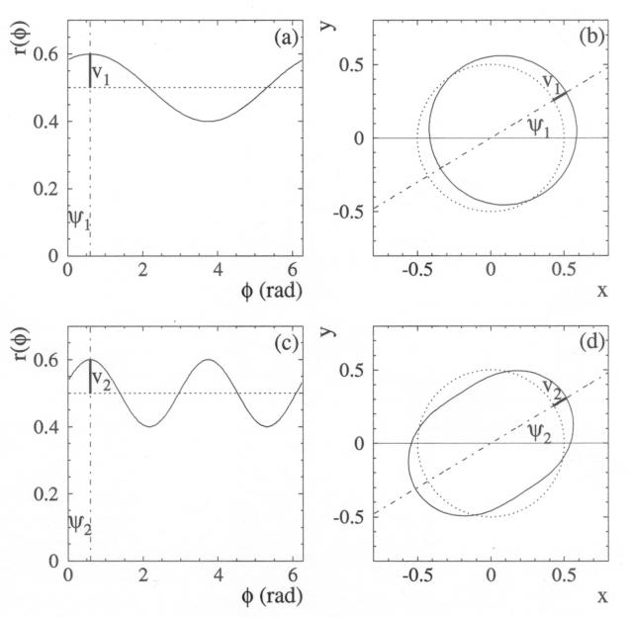
Interpreting Flow – order by order
n=1: Directed Flow has a period of 2π (only one maximum)
  v₁ measures whether the flow goes to the left or right – whether the momentum goes with or against a billiard ball like bounce. For collisions of identical nuclei, symmetry forces v₁ to be an odd function of η
n=2: Elliptic flow has a period of π (two maximums)
  v₂ represents the elliptical shape of the momentum distribution. It is an even function of η for identical nuclei
Perform a Fourier Transform to isolate the coefficients
If parity is conserved, sin() terms drop out
isotropic
parity
non-conserving
directed
elliptic
higher order terms

Slide 32


The Experimental Observable
The coefficients for the Fourier expansion of the invariant yield are
or
  where the average is taken over all particles in the event and ψ_{R} is the known reaction plane angle (e.g. from the FTPC if we are using TPC data)
  The second method is a true two particle correlation (many details left out)
Under certain assumptions v₁ is directed flow
  Note that a ‘normal’ v₁ measurement for pions in a Au-Au reaction has an intrinsic symmetry that suggests weighting by sign(η)
  Don’t do this for CME work: We are looking for charge flow that goes up/down so choose to do the sum without sign(η) weighting and thus the ‘normal’ v₁ will cancel out. (See next bullet). This assumes symmetric η acceptance.
A clever observable: ⟨ cos (φ_{i} + φ_{j} - 2 φ_{k} ) ⟩ … a triple correlation
  Mixed Harmonics:
  Measure (v₁² – a₁²) * v₂ because v₂ is large and it amplifies the parity non-conserving signal, a₁, while preserving reasonable statistical errors.
  The signal is parity odd, but the observable (v₁² – a₁²) * v₂ is even. Best way to measure charge sensitive flow because v₁ ⇒ 0 and (v₁² – a₁²) * v₂ ⇒ -a₁² * v₂

Slide 33
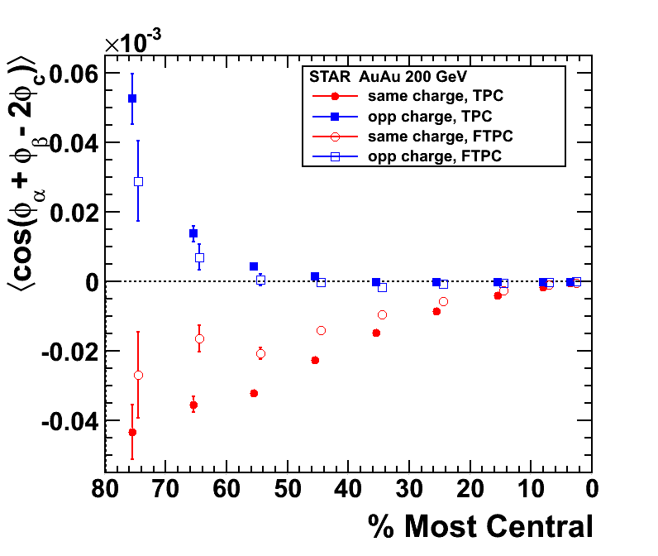
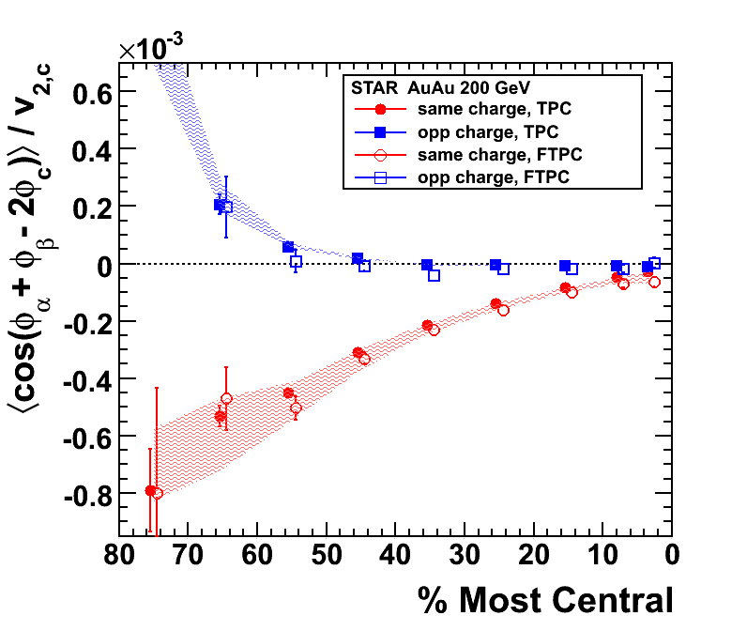
Like Sign and Opposite Sign Correlations
Abelev et al. (STAR Collaboration), PRL 103, 251601 (2009) Abelev et al. (STAR Collaboration), PRC, 81, 054908 (2010)
A charge separation signal appears in the data; independent of how we determine the reaction plane with different estimates of Ψ_{R} (i.e. φ_{c} )
  Signal is present if Ψ_{R} is found with the TPC, FTPC, or even ZDC.
  Systematic errors in panel II, above, cover the range introduced by using v₂{2} or v₂{4} in the calculation
and so is a candidate CME signal
  Same sign a_{i,γ} flow is negative … Opposite sign a_{i,γ} flow is positive
Notes:
Using ZDC-SMD for the (first harmonic) event plane yields similar agreement, though with larger uncertainties.
Center points: obtained using v2{FTPC} … Systematic bands: lower limits - using v2{2}, upper – v2{4}; where v2{4} is not available it is assumed that using v2{FTPC} suppresses non-flow by 50%.

Slide 34
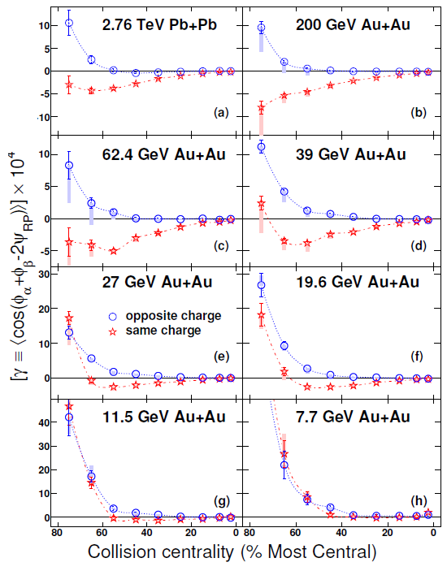
ALICE, STAR and the Beam Energy Scan
The CME effect depends on the formation of a quark-gluon plasma, a strong magnetic field, and the restoration of chiral symmetry
For this reason, we speculate that the signal could be greatly suppressed or completely absent at low collision energies where a QGP may have a significantly shortened lifetime or may not even be formed
The disappearance of the CME signal at low energy may help locate the critical point on the phase diagram for hot nuclear matter
More work is needed, and alternative explanations must be eliminated
Adjusting the B field in these collisions, in a controlled way, is a critical step in this program
arXiv:1608.00982v1 [nucl-th] 2 Aug 2016

Slide 35
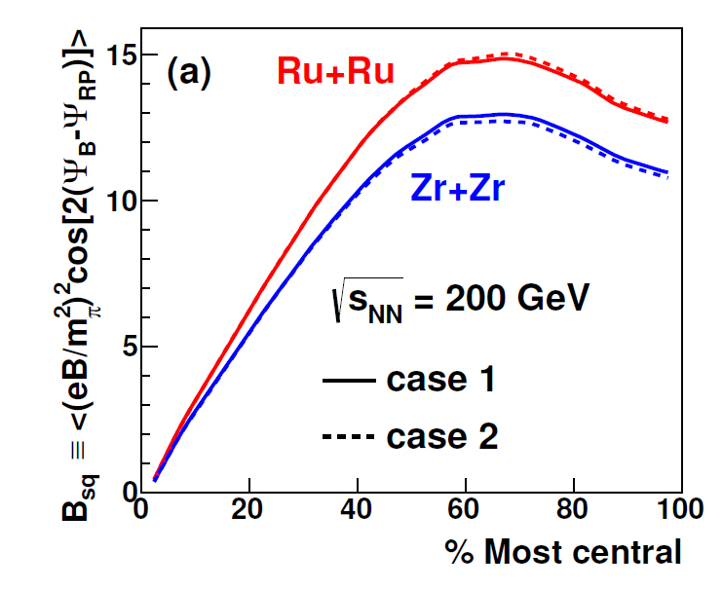
Proposal to run Isobaric Beams in 2018
Report to the Associate Director at RHIC: arXiv:1608.00982v1 [nucl-th] 2 Aug 2016
We have […] investigated the case for colliding nuclear isobars […] and find the case compelling. We recommend that a program of nuclear isobar collisions to isolate the chiral magnetic effect from background sources be placed as a high priority item in the strategy for completing the RHIC mission.

Slide 36
Summary
Nuclear isobars are an amazing laboratory for studying fundamental physics
  Non-accelerator physics (ββ)
  Accelerator physics (flow systematics .vs. n/p ratio, CME)
  Other accelerator topics include Lambda polarization .vs. B field, UPCs, etc.
STAR & ALICE see clear evidence for charge separation in Au-Au, Pb-Pb, Cu-Cu and U-U collisions at 39, 62.4, 200 GeV/A and 2.76 TeV/A
  The signal is not so small … |a| ~ 10⁻² , and is accessible with standard tools
  The signal may go away at lower energies
Charge separation may be an indicator of QGP formation, local Parity Violation, Chiral Symmetry restoration, and very strong B fields
  The beam energy scan may help locate the critical point
We recommend running ⁹⁶Zr and ⁹⁶Ru beams in 2018
  Approximately 500 M events, each, and/or about 3 weeks each
I have not discussed uncertainties in the theory nor alternative explanations for the observed charge separation. See:
Report to the Associate Director at RHIC: arXiv:1608.00982v1 [nucl-th] 2 Aug 2016

Slide 37
Backup Slides

Slide 38
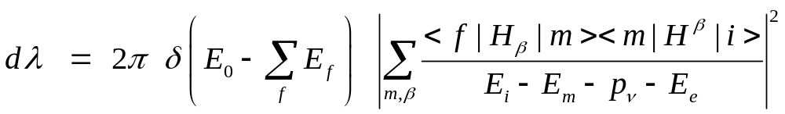
Two neutrons can decay simultaneously …
In QM, it is not necessary to conserve energy (at each step)
n
p
+
e
+
n
p
+
e
+
Two neutrino double beta decay is a 2nd order weak decay
  It is an allowed decay (in terms of spin selection rules)
  It proceeds via virtual states in the intermediate nucleus
It produces two electrons and two neutrinos in the final state
  First discussed by M. Goeppert-Mayer in 1935 and predicted to have a half life > 10²⁰ years. It has been observed in ¹³⁶Xe & more

Slide 39
Energy is conserved when ⁷⁶Ge decays to ⁷⁶Se
Stable Isotope
except for ββ decay
Stable Isotope
2ν double beta decay is an allowed process, just very slow

Slide 40
Uncertainties in our theoretical understanding
Concerning the quantitative understanding of the CME in heavy-ion collisions, the dominant theoretical uncertainties originate from
A) the initial distribution of axial charges (e.g. Sphaleron transitions)
B) the evolution of the magnetic field
C) the dynamics of the CME during the pre-equilibrium stage
D) the uncertainties in the hadronic phase and the freeze-out

Slide 41
Experimental Background – a few words
Our observable is parity even and so may contain effects that are not related to strong parity violation
Structure of correlator allows control of a wide class of backgrounds
As previously noted, the magnitude of v₁ is small and the directed flow terms sum to zero due to our choice to *not* weight the sum by sign(η)
The correlator represents the difference between correlations
projected onto an axis in the reaction plane and an axis perpendicular to the reaction plane
  This removes correlations among particles that are not related to the reaction plane orientation
So a source of background that may persist in the data are particles from a cluster (resonance decay or jet) where the cluster is flowing with respect to the reaction plane
  These studies, and other simulations studies, are a continuing effort
Notes:
This correlator represents the difference between correlations projected onto an axis in the reaction plane and the correlations projected onto an axis that is out-of-plane or perpendicular to the reaction plane. The key advantage of using a difference equation is that it removes all the correlations among particles and that are not related to the reaction plane orientation [16, 17]. As Eq. 4 implies, by using hcos( + − 2RP )i instead of hsin sini, the background to our measurement
of haai is now not Bout, but [Bout − Bin], where Bin is the contribution of the in-plane correlations which are analogous to Bout. Only the parts of such correlations
that depend on azimuthal orientation with respect to the reaction plane remain as backgrounds. Studies of the various physics contributions to [Bout − Bin]
are discussed in detail in Section VII. Note that the contribution given by the term hv1,v1,i can be neglected because directed flow averages to zero in a rapidity region symmetric with respect to mid-rapidity, as used in this analysis, due to the symmetry of the collision, and the contribution due to directed flow fluctuations is very small
Among those are processes in
which particles and are products of a cluster (e.g.
resonance, jet, di-jets) decay, and the cluster itself exhibits
elliptic flow [17, 18] or decays (fragments) differently
when emitted in-plane compared to out-of-plane.

Slide 42
Strength of the Magnetic Fields
arXiv:1608.00982v1 [nucl-th] 2 Aug 2016
Strength of the magnetic field (squared) in ⁹⁶Zr and ⁹⁶Ru collisions measured in terms of the mass of the pion (squared)
Dashed and dotted lines are represent different assumptions about the shape of the nuclei (i.e. not spherical)

Slide 43
Hot QCD is not simply a cold and static theory
You may have heard the Parity is conserved in the strong interaction
Vafa and Witten (‘84) showed that P and CP violation are not possible in QCD (under certain fairly general conditions, with one exception that is not important to us, now)
  Theorem is valid for ground state QCD at zero temperature
  and zero density
Heavy Ion Collisions are not representative of ground state QCD
Conditions that allow for implicit P and CP violation in QCD
  Finite temperature
  Finite density
  Metastable vacua
  Out of equilibrium
  All of these are possible in a heavy ion collisions where, by hypothesis, Axial symmetry and Chiral symmetry are in transition.
Implicit P and CP violation is allowed in (hot) QCD
Notes:
Axial symmetry is exact in the classical lagrangian but it is broken by the quantum theory. (This is called an anomaly if symmetric in classical and broken in the quantum theory). Instantons are a gluon field configuration that are closely related to this anomaly.

Slide 44
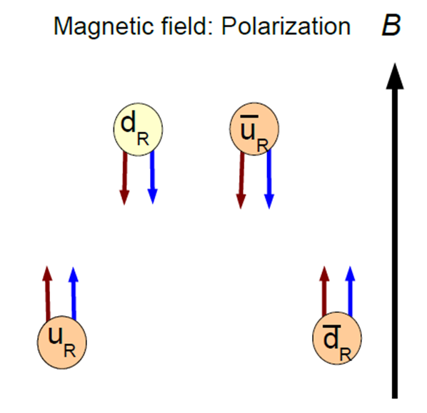
Making particles – neutral mesons won’t flow
Only a specific set of quarks can flow “up” in our example
  Upwards Flow: u, d̅, s̅
  Downwards Flow: u̅, d, s
  Assuming that down and strange
  behave the same way in a B_{EM} field
Meson flow is easy to understand
  Upwards Flow: u d̅ (π⁺), u s̅ (K⁺)
  Downwards Flow: u̅ d (π⁻), u̅ s (K⁻)
  Just by coincidence … neutral mesons fail
  to <flow>, even those combinations that
  coalesce from the vacuum. Event average == 0.
Baryons are trickier … assume that they proceed via a coalescing di-quark and pick up the third quark from the vacuum
  Upwards Flow: u u d (p), u̅ d̅ s̅ (Λ̅⁰ ) , d̅ s̅ s̅ (Ξ̅⁻ ), s̅ s̅ s̅ (Ω̅⁻)
  Downwards Flow: u̅ u̅ d̅ (p̅), u d s (Λ⁰), d s s (Ξ⁻), s s s (Ω⁻)
  Di-quark combinations that coalesce one quark from the vacuum will have event average == 0.
Useful to study other mesons and baryons
Notes:
If someone asks about isospin … the answer is “wow” you have really done your homework. Dima’s 711 paper points out that a topological charge change causes an isospin transition and so the effect is probably limited to pions (plus and minus). However, this result is only valid for Nf=2, and so it is probably OK to say that Strange baryons will flow, too. I am not sure if this is still true if we have two strange quarks … The bottom line is that there are systematic studies with robust theoretical predictions that can be tested. What is written on this page may need modification in light of the isospon flip.

Slide 45
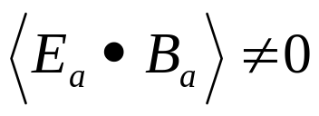
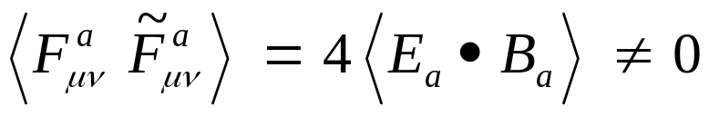
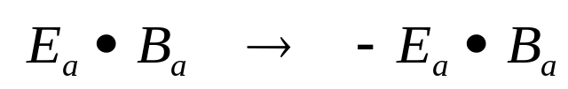
CP Violation – all scenarios involve
If the color B field has a component that is parallel to
the color E field then
and under P and CP transformations
which means that parity and CP symmetries are broken
Finally, gauge field configurations exist with finite action and quantized topological charge
  Q_{w} is the winding number .
These configurations are related to instanton and sphaleron transitions … but that topic is beyond the scope of my talk
Notes:
E is a vector and so is parity even. B is an axial vector and so is parity odd. Both change sign under Charge symmetry. Hence EdotB is C even and P and CP odd.

Slide 46
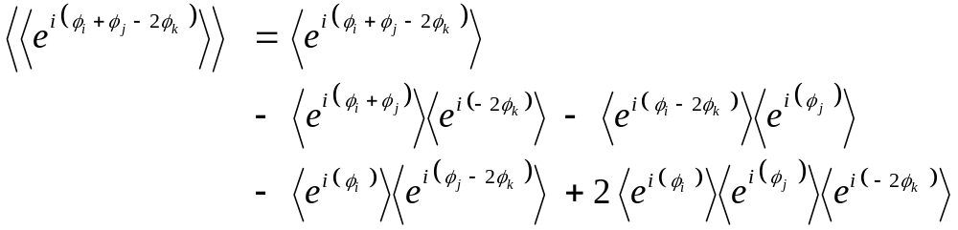
Cumulants and full PID for pions
Note that … ⟨ cos (φ_{i} + φ_{j} - 2 φ_{k} ) ⟩ = Re ⟨ e^{i} ^{(φi + φj - 2 φk )} ⟩
  This is the basis for the cumulant technique
  A powerful tool that allows us to subtract two particles correlations from the three particle correlation that we are trying to measure
  Automatically ‘re-centers’ the data (i.e. acceptance corrections)
So for example:
Test acceptance corrections … but also to test full PID
  All previous analyses were done for all-charged particles
  Now select pions (± 2σ) and reject electrons (± 2σ)
  Goal: to confirm that it is hadrons, not leptons, that show the PV signal

Slide 47


Full Cumulant – Analysis and Results
Real Terms
Imaginary Terms enter via cross-terms to create additional real terms
Acceptance corrections are crucial when doing full PID in STAR

Slide 48
Looking for new physics – Strong Parity Violation
The conventional point of view
  “Parity is conserved in the strong and electromagnetic interactions”
    See, for example, Perkins “Introduction to High Energy Physics”
The less-conventional point of view
  In the vicinity of a deconfining phase transition, the QCD vacuum can possess meta-stable domains leading to P and CP violation.
    See, for example, Kharzeev, Pisarski, and Tytgat PRL 81, 512 (1998).
Thanks to wonderful talks given by Harmen Warringa at BNL, Sergei Voloshin QM2009 and Evan Finch CPOD

Slide 49
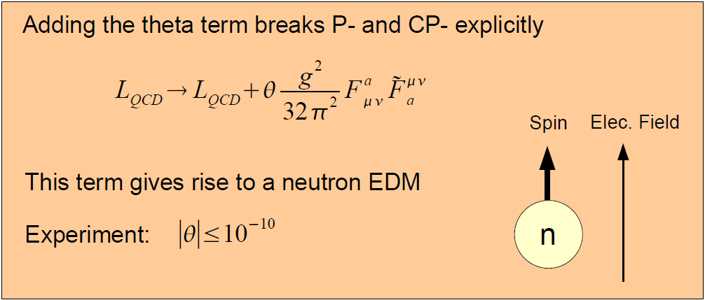
Explicit P and CP violation is allowed in QCD
A very simple addition to the bare QCD Lagrangian is interesting
  L_{QCD} → L_{QCD} + δ L
Why is θ so small?
  Perhaps due to Peccei-Quinn symmetry … which would imply the existence of axions.
An old but still interesting problem …
Notes:
Slide from harmon Warenga’s talk at BNL. Fmunu is the gluonic field tensor in analogy to the Fmunu from electrodynamics. Some authors us Gmunu to avoid confusion. Note that this isn’t really the harmonic oscillator of QCD. That distinction probably belongs to lambda phi**4 theories such as the sigma model.

Slide 50
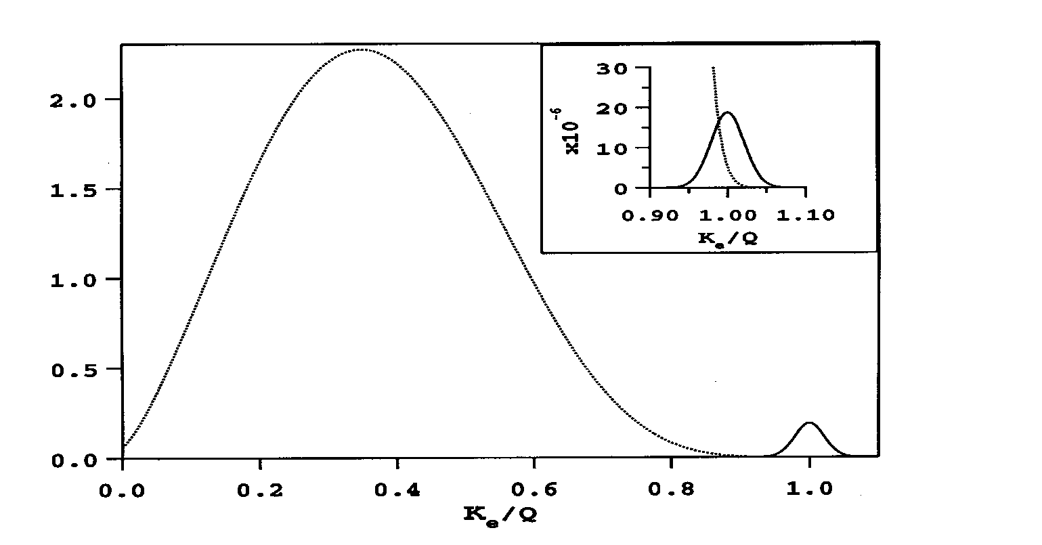
Two ν Double Beta Decay is a 4 Body Process
The summed energy of the 2 electrons in the final state is a broad spectrum that reaches from 0 to T₀ where T₀ is the kinematically allowed endpoint (shown as 1.0 in the figure).
The decay rate depends on T₀¹¹ and so there is great advantage to studying nuclear systems where the decay energy is large (typically a few MeV).

