Slide 1
The STAR Heavy Flavor Tracker
Jim Thomas
Lawrence Berkeley National Laboratory

Slide 2
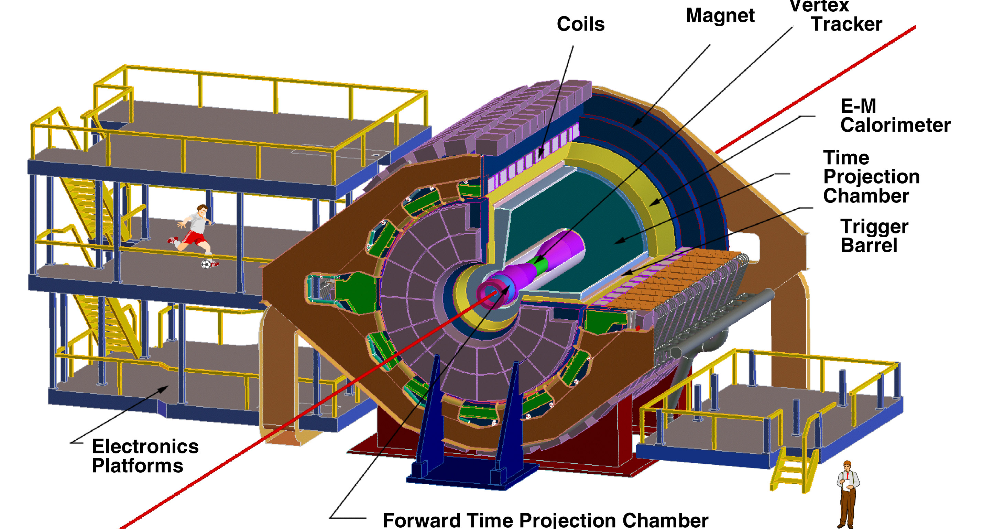
The STAR Detector at RHIC w/ HFT
4 layers of Si at the Vertex
Heavy Flavor
Tracker

Slide 3
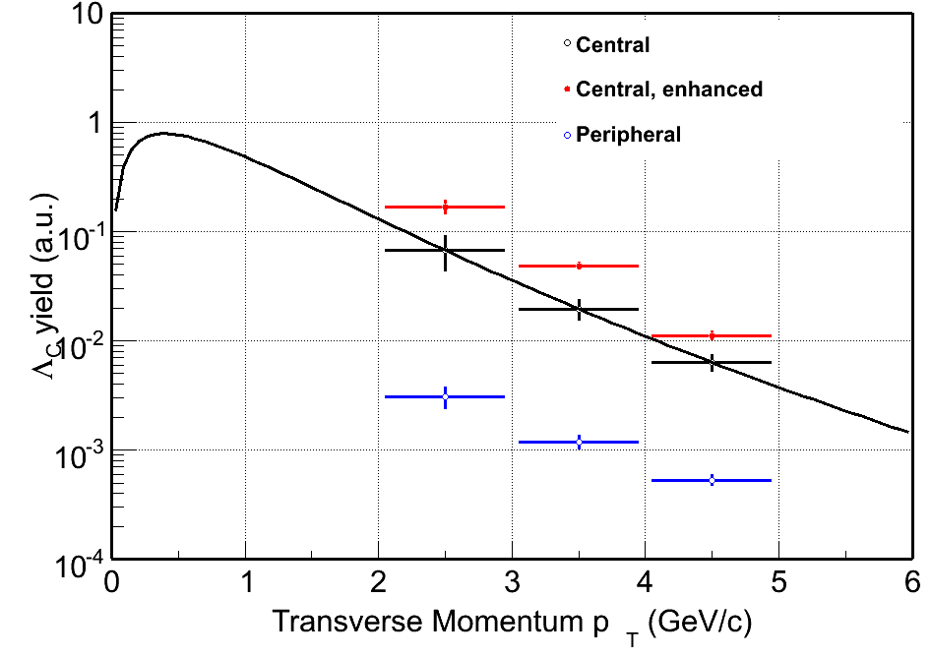
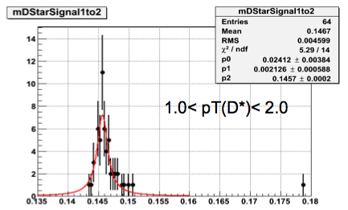
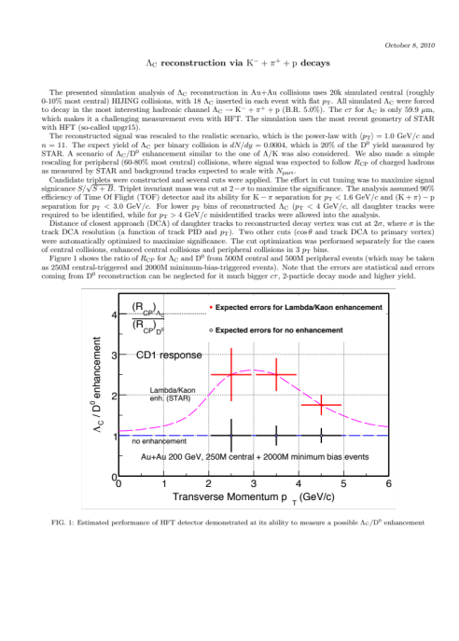
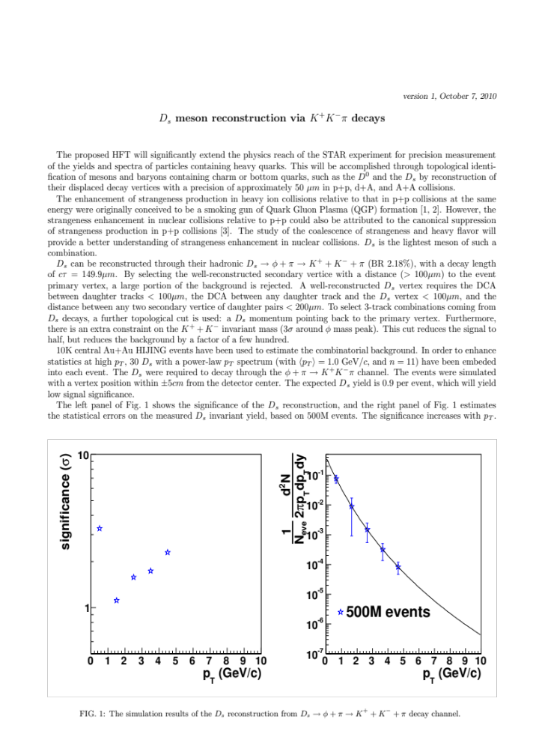
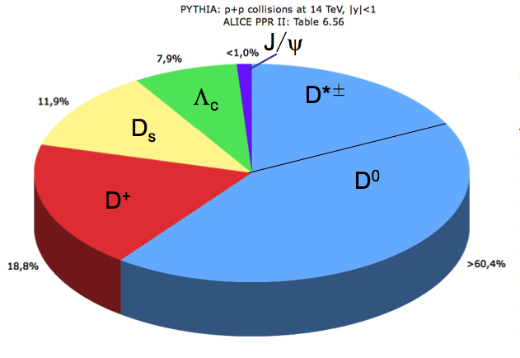
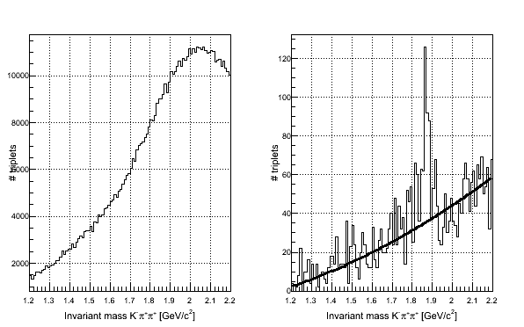
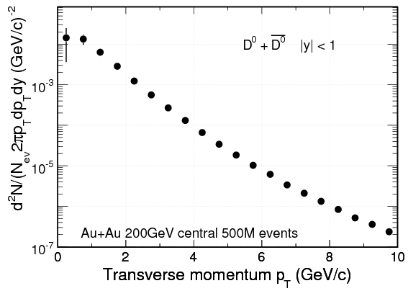
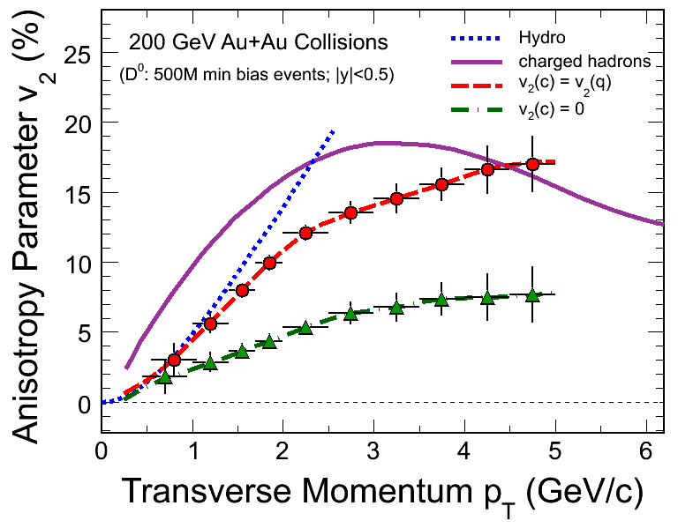
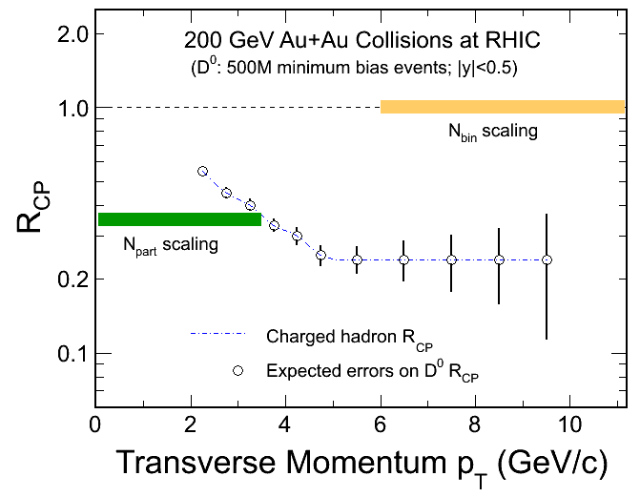
HFT
Charm Capabilities
Full topological reconstruction of open Charm
Detailed flow & R_{AA} studies with identified charm
500 M Event samples, each fits comfortably in a 10 week Run

Slide 4
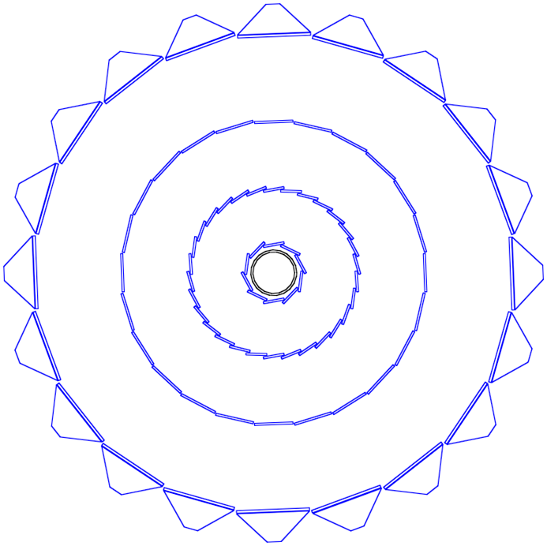
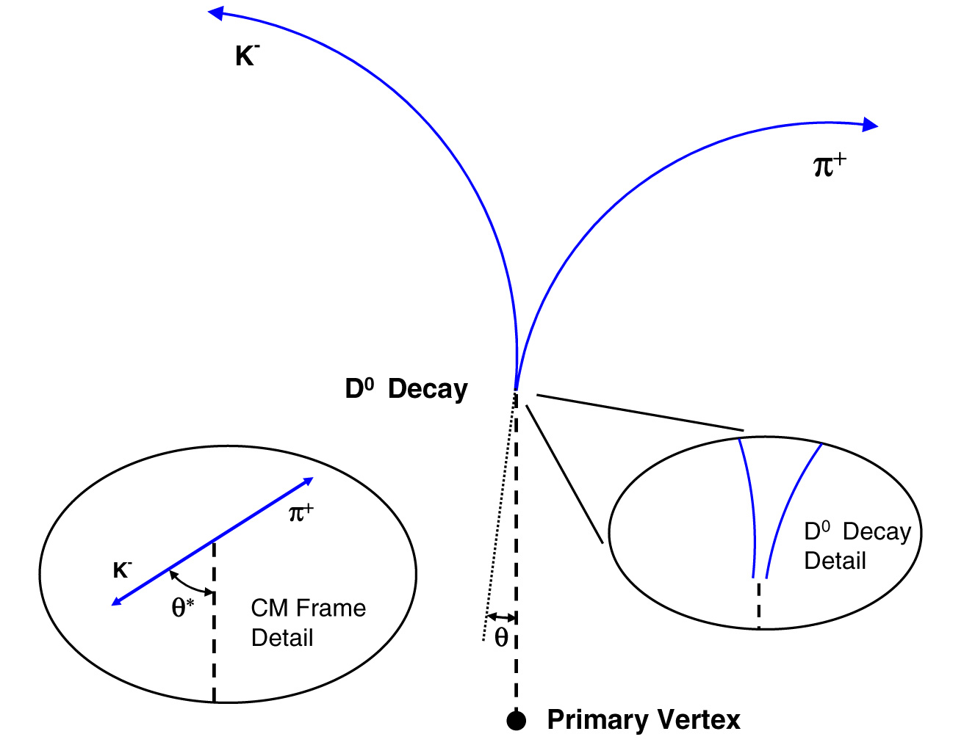
Who, what, when, where, why & how
The Heavy Flavor Tracker provides exquisite resolution near the BP (w/10 μm space points)
The HFT was designed to do the direct topological identification of open charm
SSD
IST
Beampipe
Pixel Detector
30
20
10
50-150 μm
0
-10
-20
-30

Slide 5
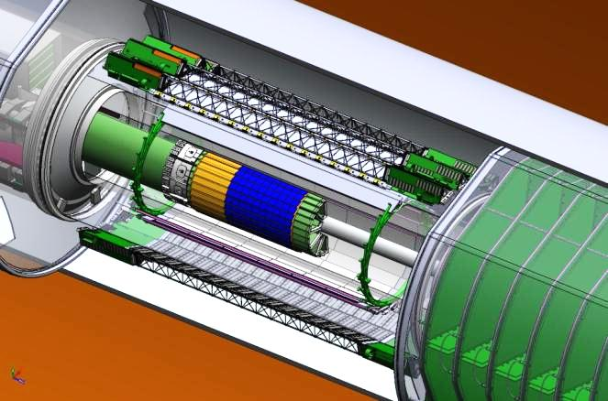
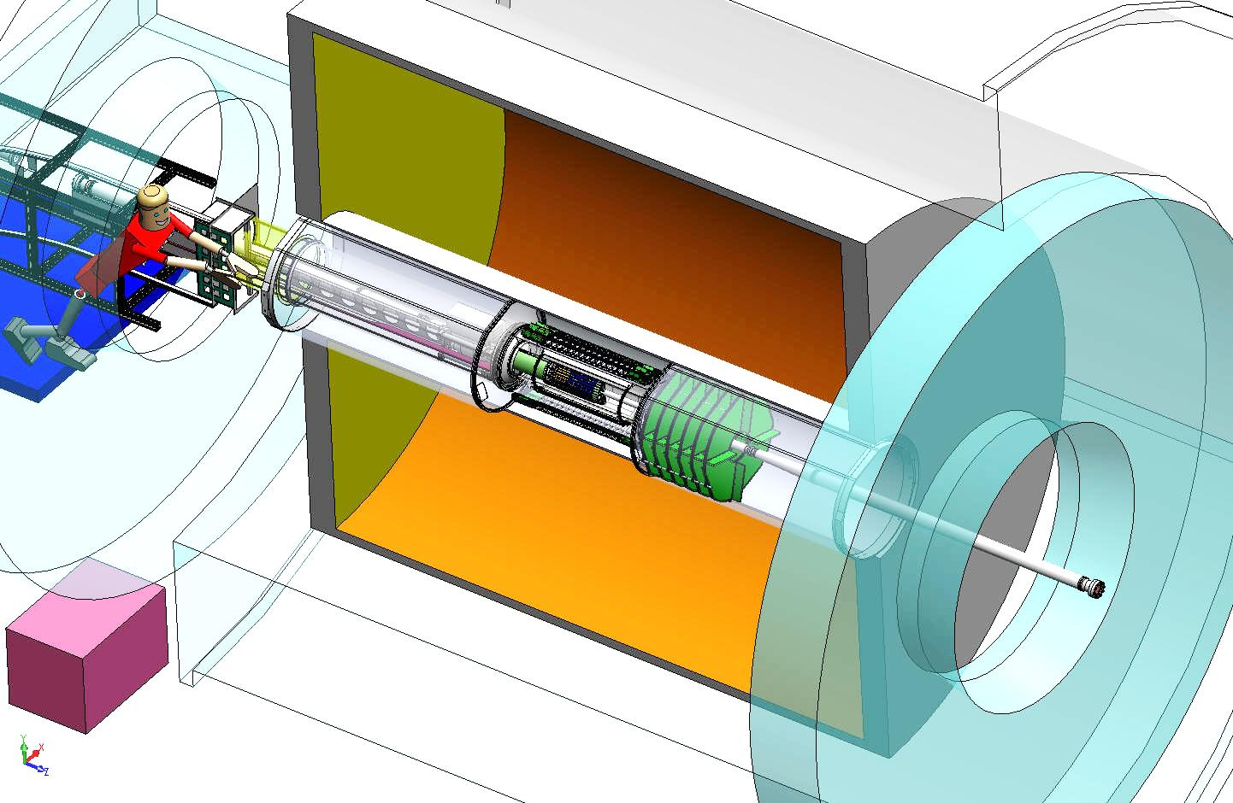
HFT Location in STAR
IFC
Inner Field Cage
OFC
Outer Field Cage
Magnet
End Cap
TPC Volume
A key feature of the STAR Heavy Flavor Tracker is that it is removable in < 1 day while stable to 20 μm … this is unique!
Solenoid

Slide 6
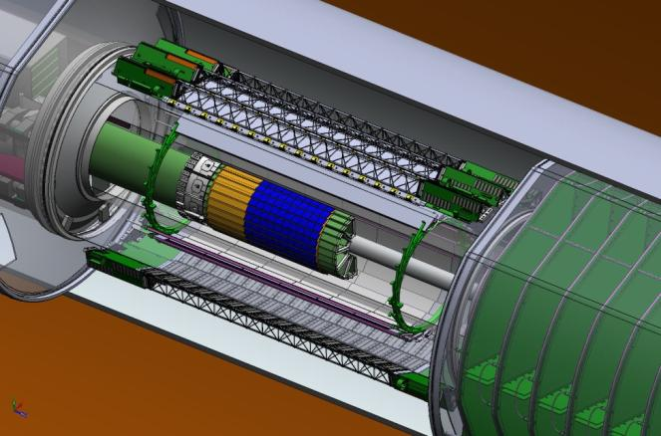
HFT Design & Specifications
HFT
Detector | Radius (cm) | Hit Resolution R/ϕ - Z (μm - μm) | Radiation length
SSD | 22 | 20 / 740 | 1% X₀
IST | 14 | 170 / 1800 | <1.5 %X₀
PIXEL | 8 | 12 / 12 | ~0.4 %X₀
 | 2.5 | 12 / 12 | ~0.4% X₀
SSD
IST
PXL
TPC Full 2π tracking & PID behind the Si
PIXEL
10 sectors, 2 layers (3&1)
20.7 x 20.7 μm pitch
360 million pixels
new monolithic active pixel sensor (MAPS) technology from Strasbourg IPHC
SSD existing single layer detector, double side strips (electronic upgrade)
IST one layer of silicon strips along beam direction, guiding tracks from the SSD through PIXEL detector. - proven strip technology
TPC
~1mm
SSD
~300µm
IST
~250µm
PXL
< 30µm
vertex
6

Slide 7
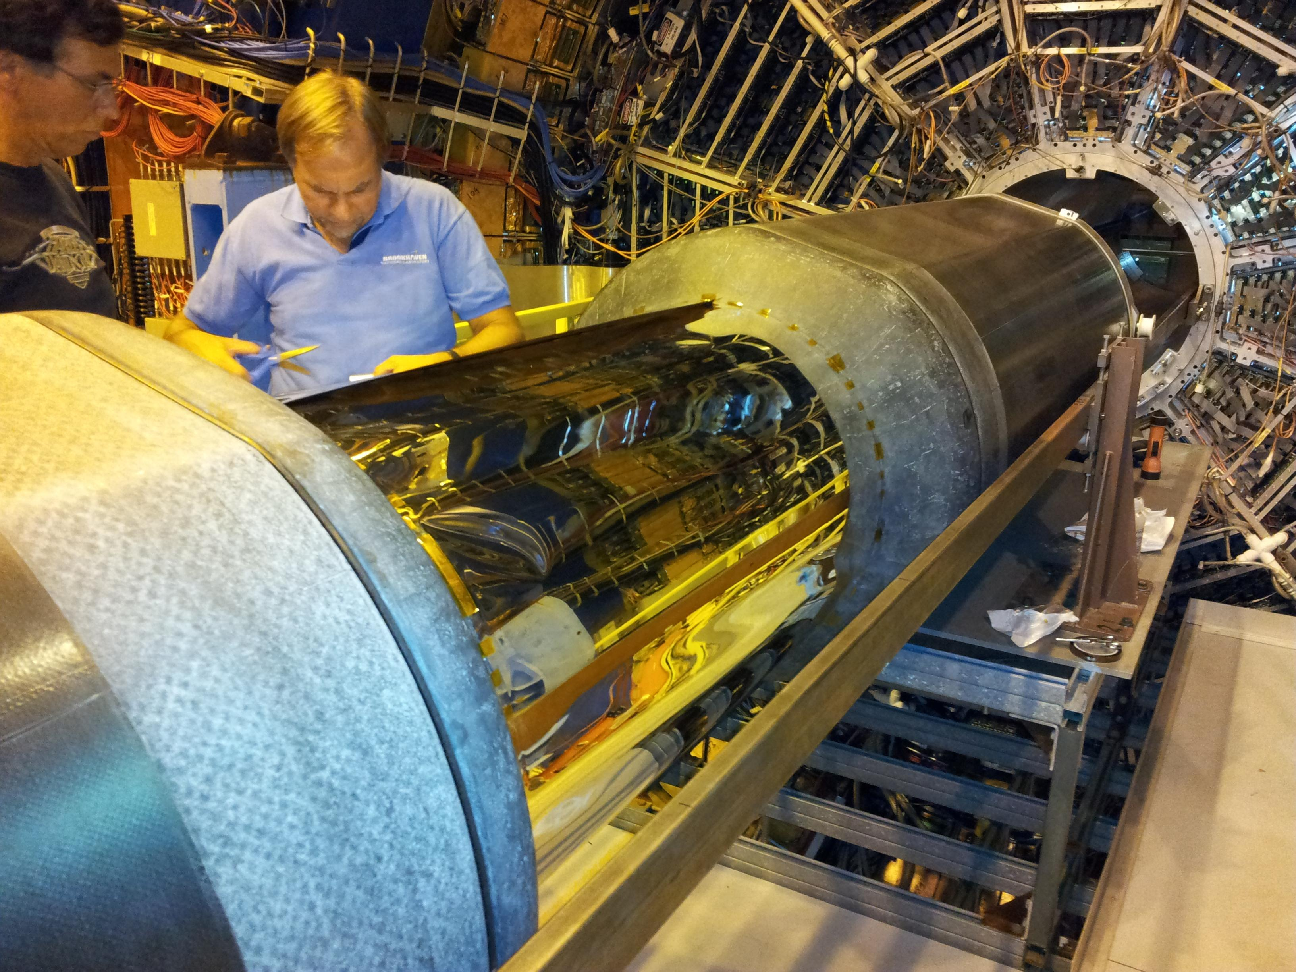
Starting from the outside and working in …
Inner Detector Support (IDS) installed in STAR for Run 12
PXL engineering test w/ 3 sectors scheduled Run 13
HFT (of course) not installed but this is where it will go (note that PXL can go in later :-)
Carbon Fiber composite structures are a Core Competency of the LBNL Engineering Division ⇒ Synergy

Slide 8
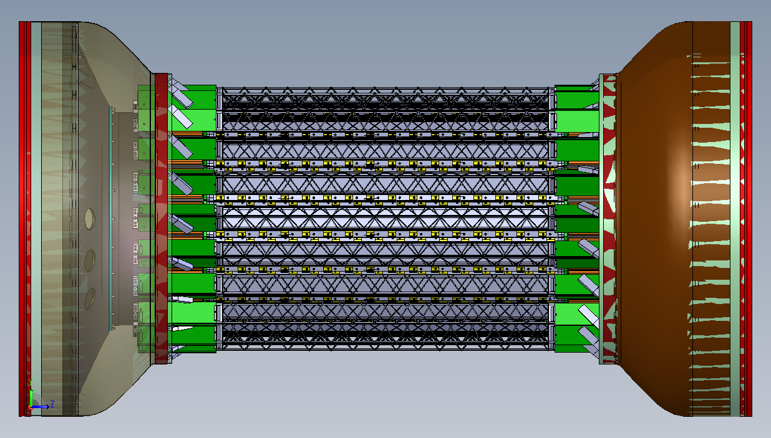
The SSD is an Existing Detector ⇒ Upgrade
Upgrade the electronics, cooling and DAQ to allow for 200 Hz ⇒ 1 kHz
EE and management responsibilities at LBL, ladder board upgrade from Subatech

Slide 9
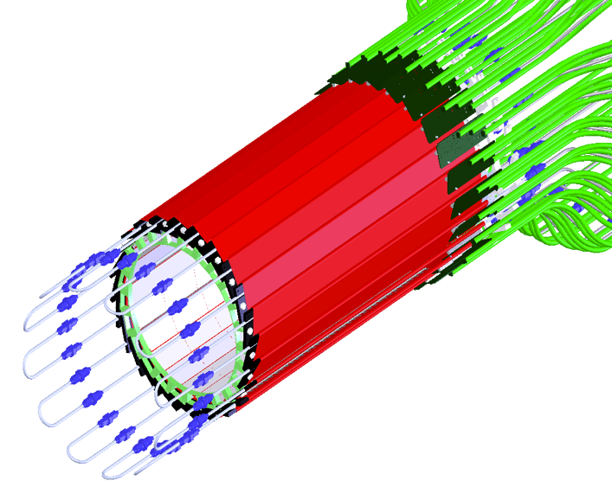
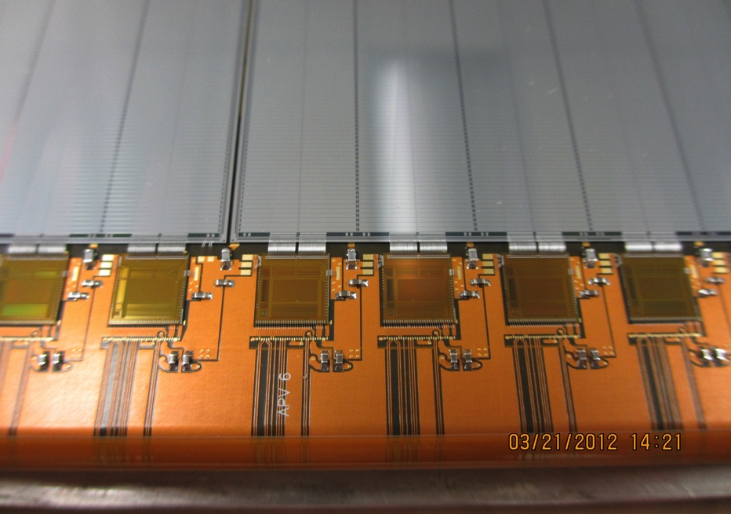
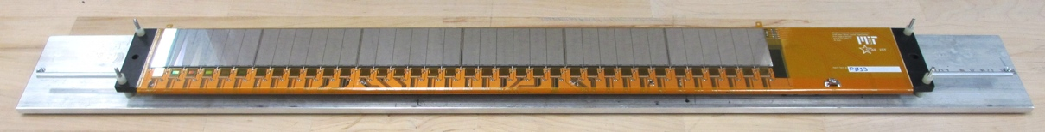
Intermediate Silicon Tracker
LBL Engineering Div staff members are fabricating the IST staves w/experience based on ATLAS Fab and R&D work
Lead by MIT and UIC
Details of wire bonding
24 ladders, liquid cooling.
Prototype Ladder
S:N > 20:1
> 99.9% live channels
9

Slide 10
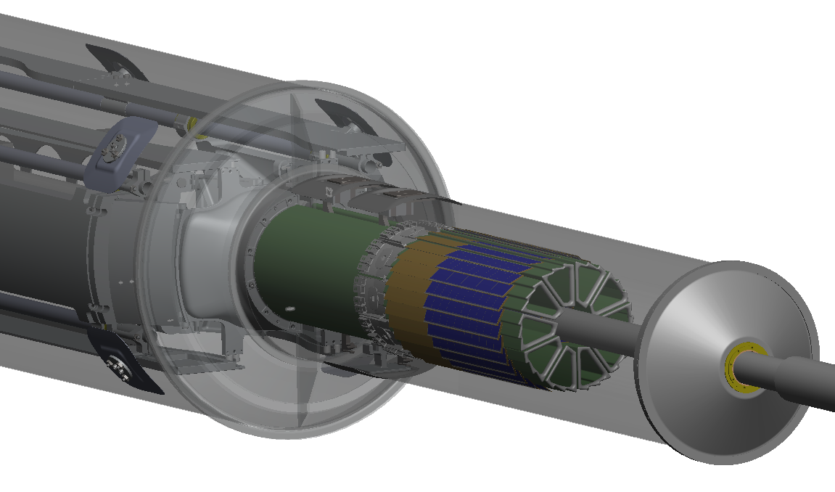
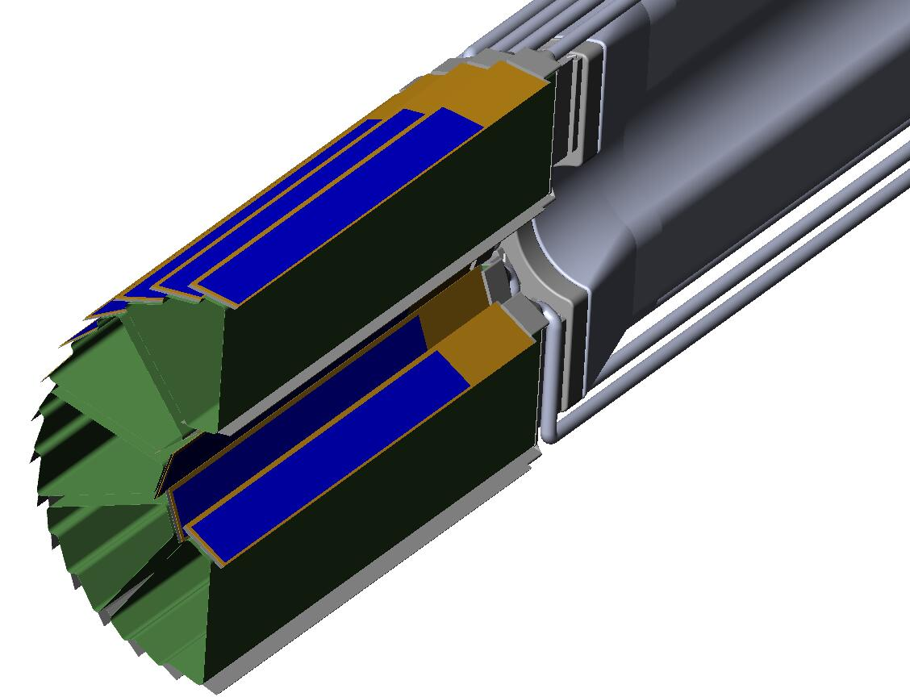
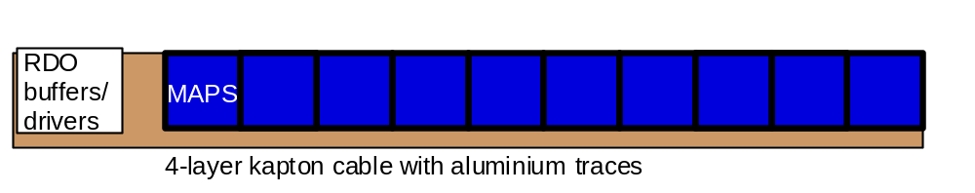
PXL Detector Mechanical Design
Lead by LBL: RNC & Eng. Div.
Mechanical support with kinematic mounts (insertion side)
carbon fiber sector tubes (~ 200 µm thick)
Insertion from one side
2 layers
5 sectors / half (10 sectors total)
4 ladders/sector
Ladder with 10 MAPS sensors (~ 2×2 cm each)
Aluminum conductor Ladder Flex Cable
20 cm

Slide 11
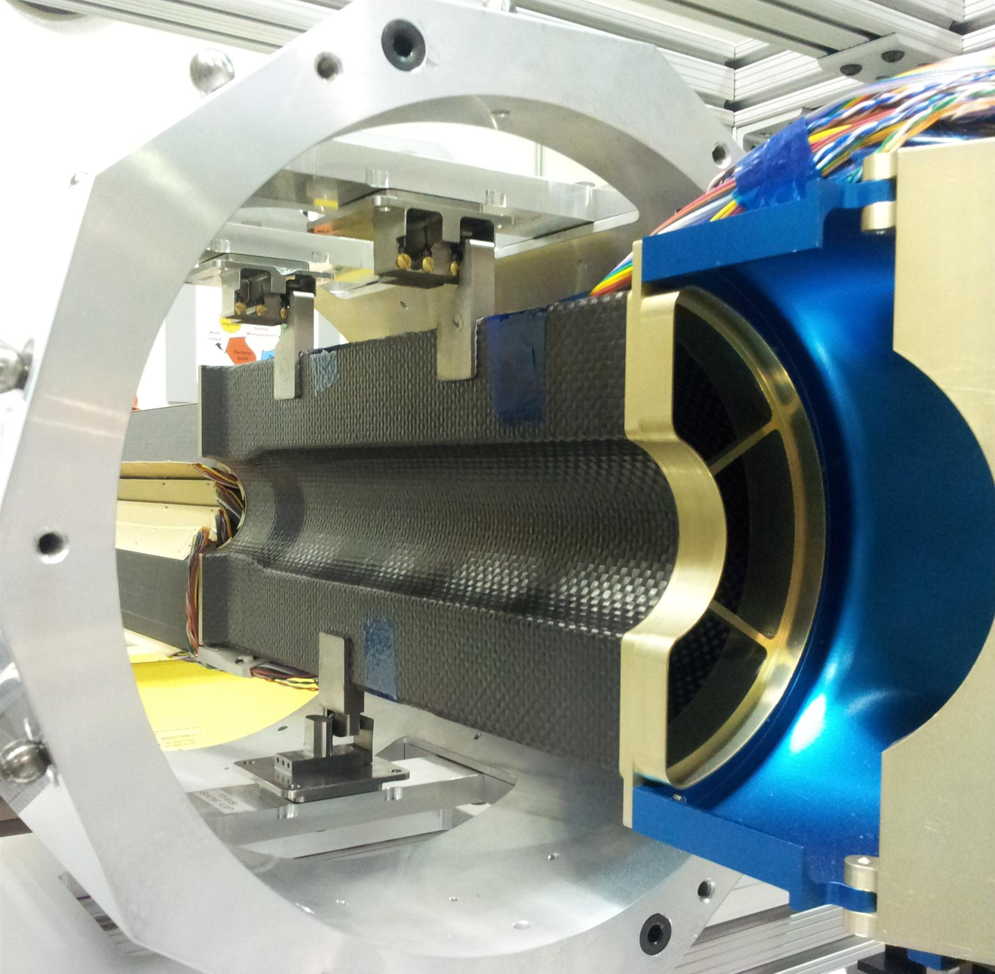
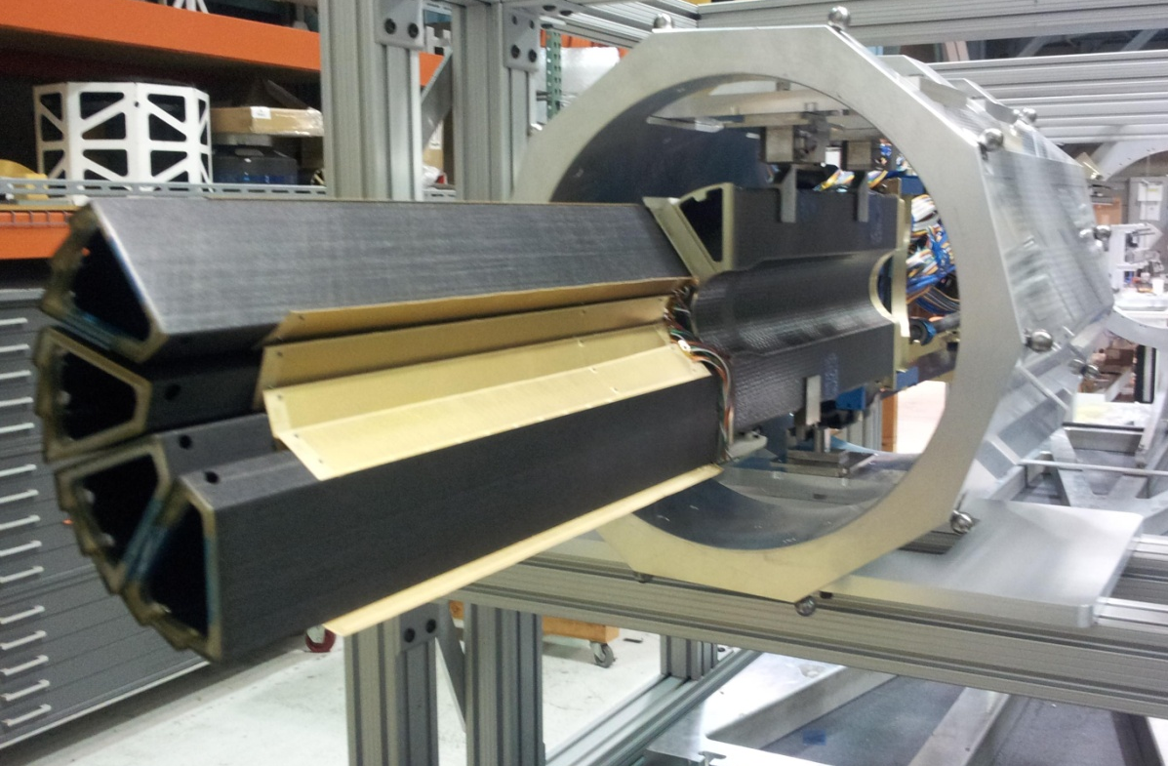
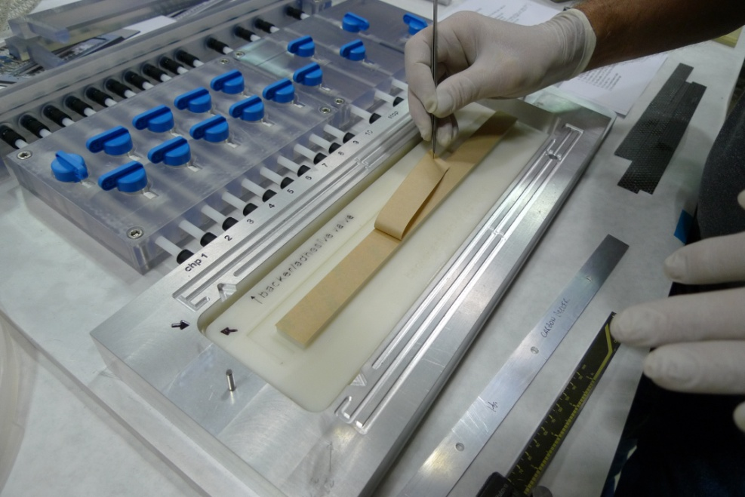
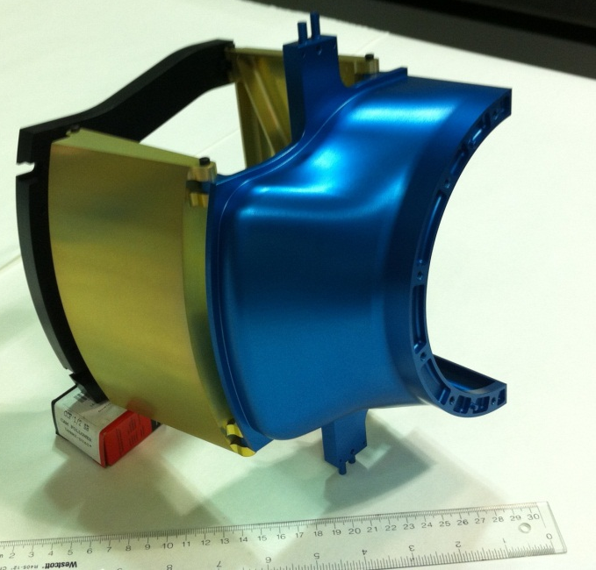
PXL Hardware for Engineering Test in Run13
Dummy ladders shown (heaters to test cooling )
The real ladders with Ultimate chips are under construction

Slide 12
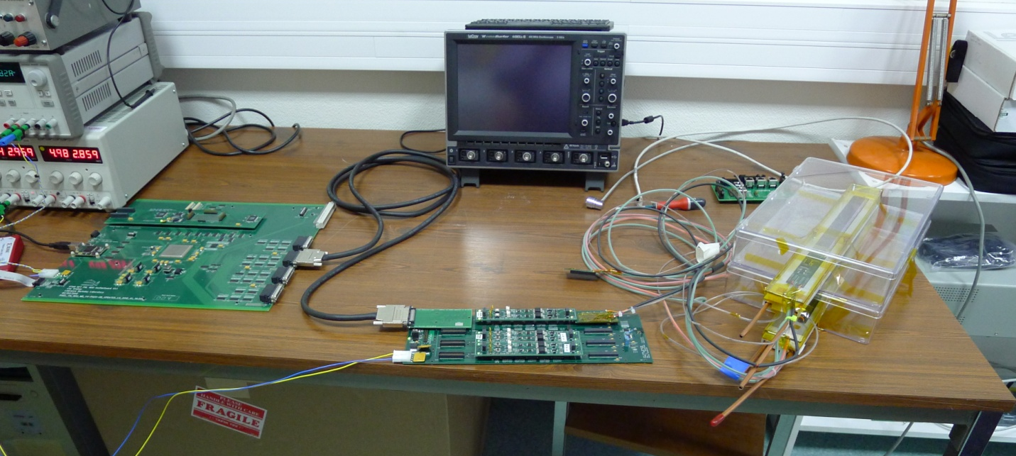
PXL Full Chain Test
RDO
Read Out Board
MTB
Mass Termination Board
Ladder(s)

Slide 13
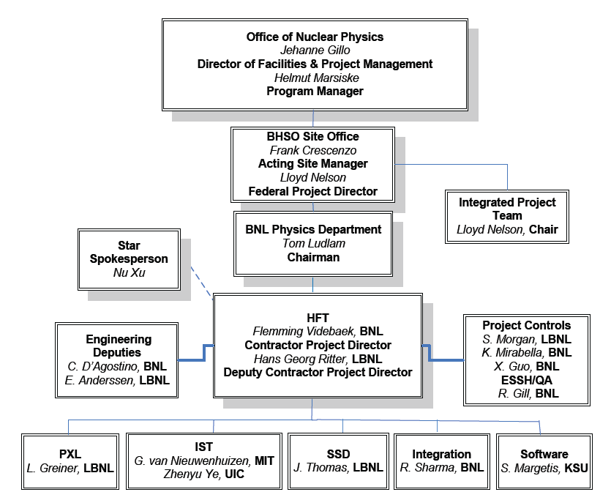
HFT Management

Slide 14
Run Plan and First Physics
HFT 3 sectors in Y13: p+p 500 GeV, Au+Au 15 GeV, Au+Au 200 GeV
  Detector engineering run.
  First look at v₂ and R_{cp} of D via charged daughters and displaced electrons
Full HFT in Y14: >10 weeks Au+Au 200 GeV and p+p 200 GeV
  v₂ and R_{cp} of D/e with high precision. R_{AA} of D/e.
  Correlations: e-D, e-μ (note μ comes via MTD detector)
  B ⇒ J/ψ via displaced electrons
Y15 and beyond … Au+Au 200 GeV and pp 200 GeV high statistics
  Systematic studies of v₂ and R_{AA}, centrality, path length, √S, etc…
  Λ_{c} baryon with sufficient statistics
  Correlations: e-D, e-μ, D-Dbar, …

Slide 15
Summary
The Heavy Flavor Tracker will open a new era of heavy flavor studies at STAR
  Topological reconstruction of open charm
  Displaced vertex resonances & displaced electron studies
Exquisite spatial resolution is possible with the PXL detector
  20.7 μm pixels
  25 μm pointing resolution for pions at 1 GeV/c
The project is on schedule and (under) budget
  $16M project, $8M at LBL
  CD 2/3 approval granted October 2011
  Carbon Fiber components installed for Run 12
  PXL Engineering test run scheduled for Run 13
  Early completion date: HFT installed and tested by October 2013
  Full HFT: PXL plus IST and SSD on track for Run 14
  CD4 is scheduled for July 15, 2015

Slide 16
Backup Slides

Slide 17

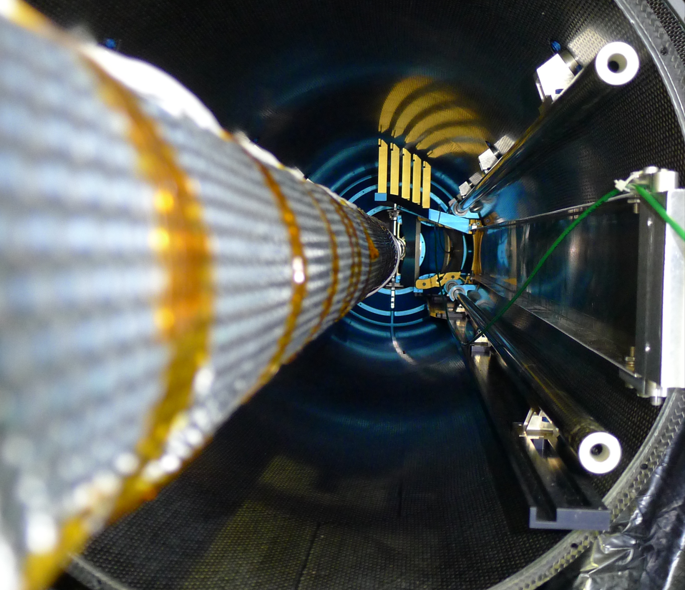

Slide 18
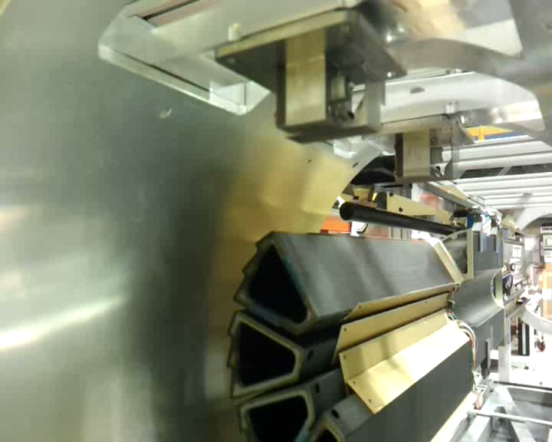

Slide 19
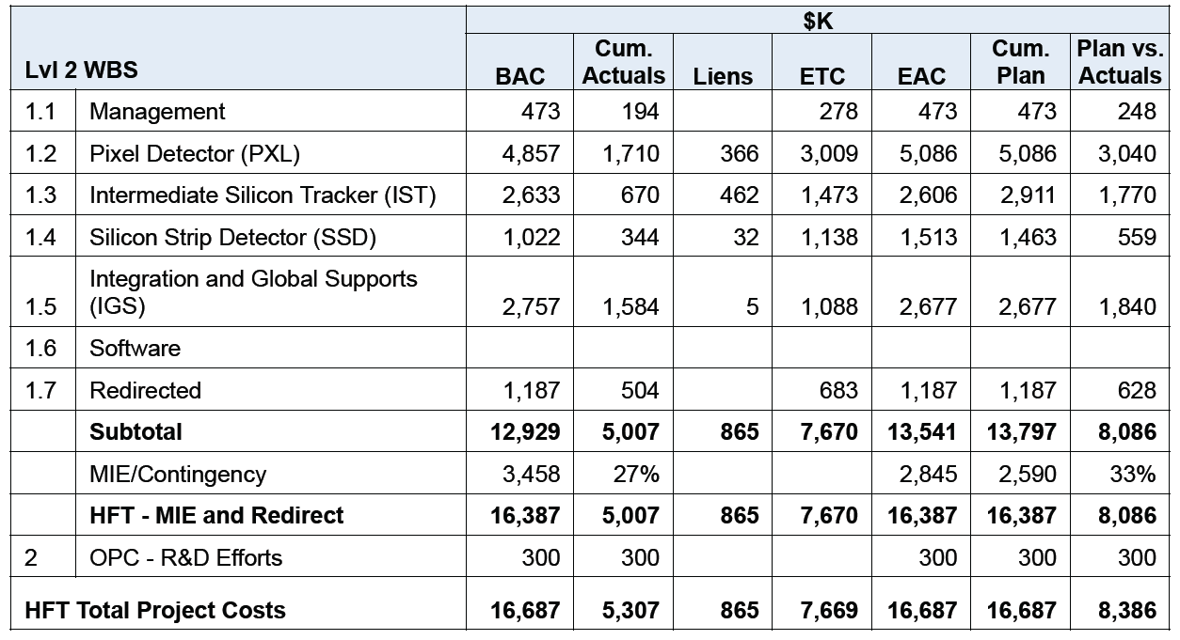
Cost Matrix
$8M of this scope takes place at LBL, currently ~$7M in-house
Contingency is still ~35% of ETC … so a very healthy project

Slide 20
PROJECT STATUS as of Oct 9, 2012
Project Type | MIE
CD-1 | Planned: Q4FY10 | Actual: 8/31/10
CD-2 | Planned: Q4FY11 | Actual: 10/11/11
CD-3 | Planned: Q4FY11 | Actual: 10/11/11
CD-4 | Planned: Q3FY15 | Actual: TBD
TPC Percent Complete | Planned: _59_% | Actual: _38__%
TPC Cost to Date | $5,307K
TPC Committed to Date | $6,172K
TPC | $16,687K (inc. 1,187 redirect)
TEC | $16,387K
Contingency Cost (w/Mgmt Reserve) | $3,458 | _50__% to go
Contingency Schedule on CD-4 | __18__months | _160_% (30 mo to go)
CPI Cumulative | N/A
SPI Cumulative | N/A

Slide 21
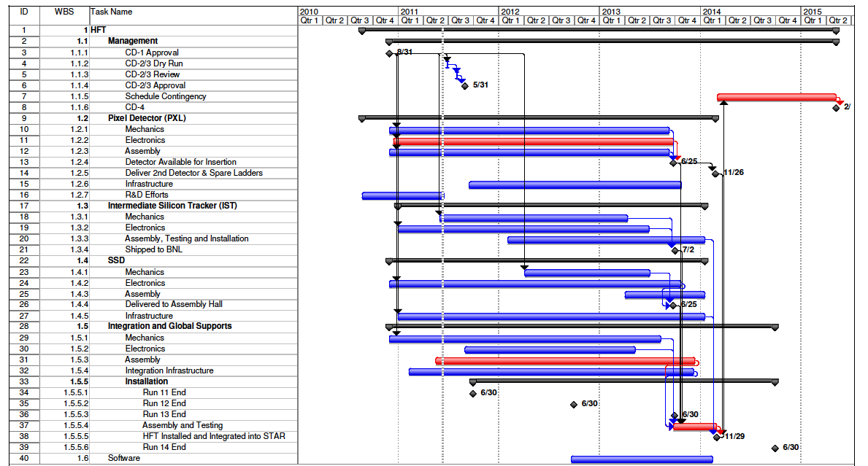
Summary Schedule

Slide 22
DCA resolution performance r-phi and z
GEANT: Realistic detector geometry + Standard STAR tracking
including the pixel pileup hits at RHIC-II luminosity
Goal with Al-based cable (Cu cable -> 55 micron at 750 MeV/c K)
22

Slide 23
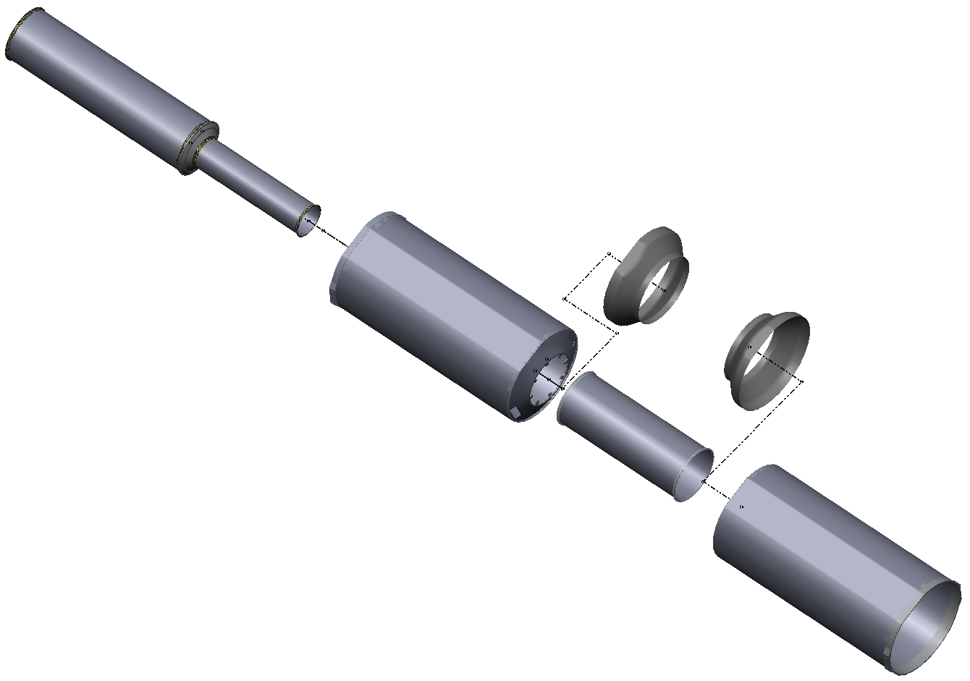
Inner Detector Support (IDS)
IDS
East Support Cylinder
Outer Support Cylinder
West Support Cylinder
PIT
Middle Support Cylinder
PST
MSC
Pixel Insertion Tube
Pixel Support Tube
ESC
Shrouds
Installed for run-12
OSC
Inner Detector Support
WSC
Carbon Fiber Structures provide support for 3 inner detector systems and FGT.
All systems are highly integrated into IDS.

Slide 24
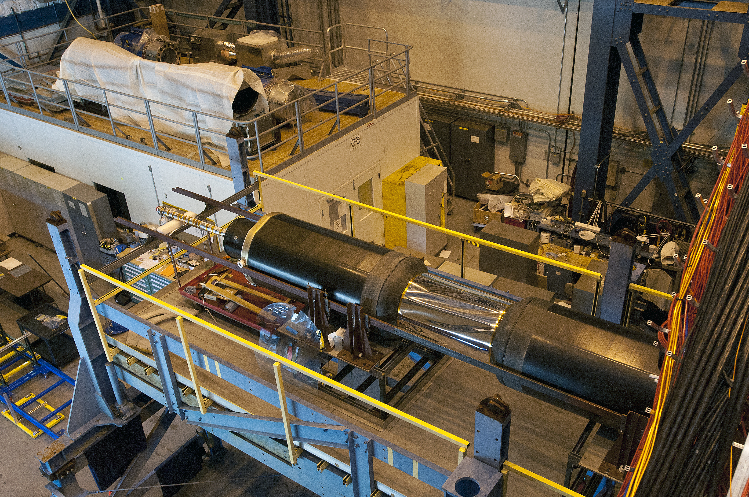
Inner Detector Support Installed – Sept 2012

Slide 25
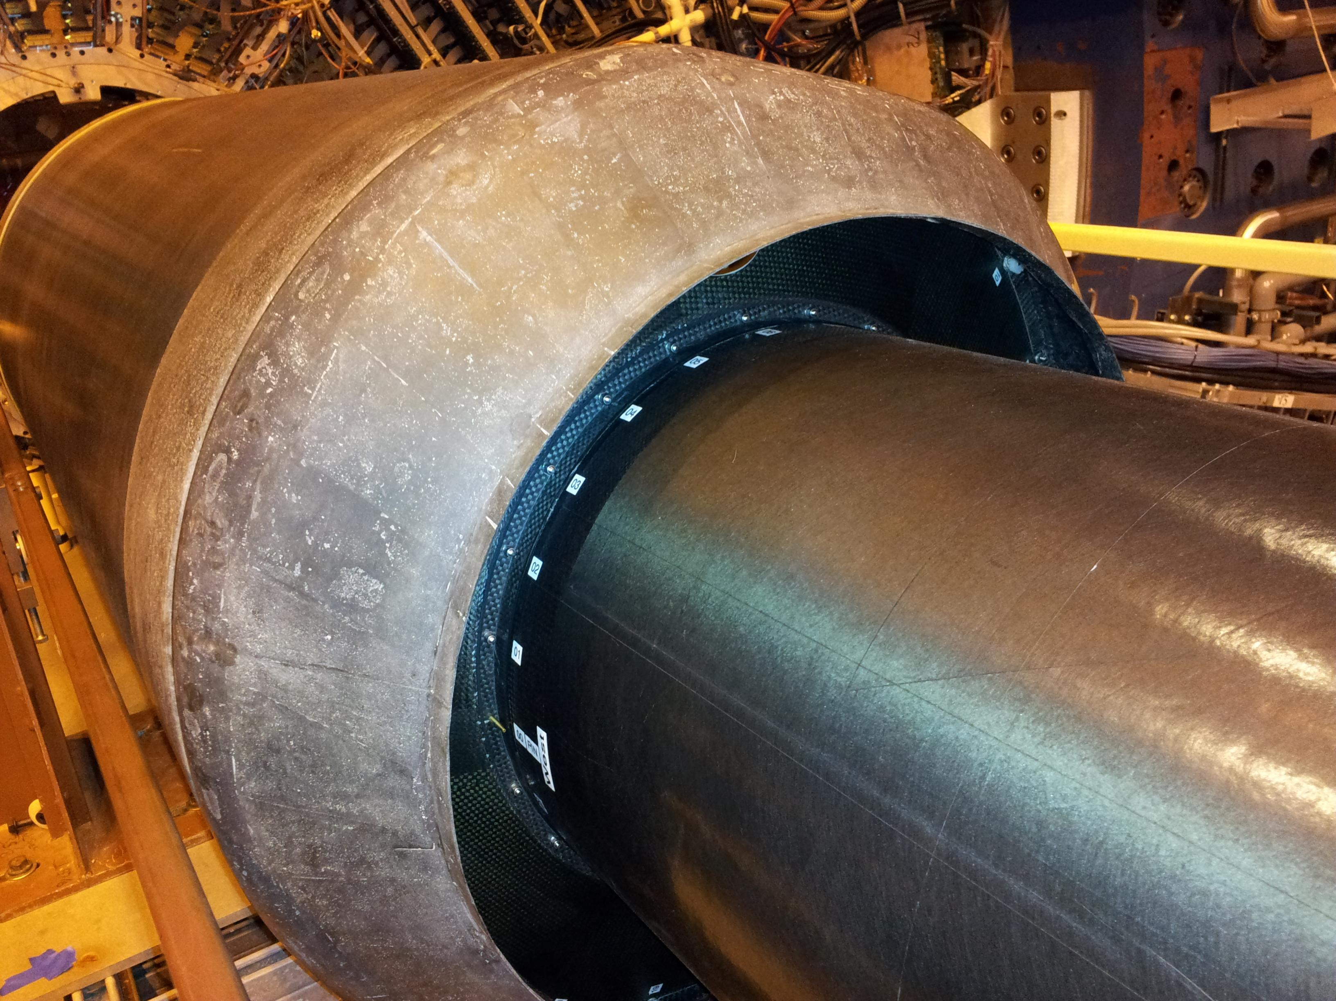
Mechanical Engineering … much is done
Still To Do:
Split the shroud so it is easier to install the SSD ladders
Ladder Mounts
Air in and out for SSD vacuum
Cable routing under the shroud & ESC/WSC
SSD Ladders go here

Slide 26

Electronics – the heart of the SSD upgrade
Ladder cards – 1.4.2.1
RDO (1 of 8) – 1.4.2.2
Slave
FPGA
VME FPGA
Fiber links
VME interface
Slave
FPGA
DAQ – 1.4.2.3
Slave
FPGA
Master FPGA
DAQ interface
DDL
Slave
FPGA
Slave
FPGA
TRG interface
South platform VME crate
Outer support cylinder
DAQ room
Notes:
Ladder cards: one on each end of ladder, each reads out one face of ladder
Fiber links connect ladders to RDO
5 ladder cards – 5 ladder faces
One chip (slave FPGA) is dedicated to processing and buffering data from a single ladder
Master FPGA handles interaction with TRG and DAQ
Link to DAQ PC (DDL) is bidirectional 1.5 Gbps fiber [designed for ALICE @LHC]

Slide 27


Physics – Run-14,15 projections
R_{CP}=a*N10%/N(60-80)%
Assuming D⁰ R_{cp} distribution as charged hadron.
500M Au+Au m.b. events at 200 GeV.
Charm R_{AA}
Energy loss mechanism
Color charge effect
Interaction with QCD matter
Assuming D⁰ v₂ distribution from quark coalescence.
500M Au+Au m.b. events at 200 GeV.
- Charm v₂
Medium thermalization degree
Drag coefficients

Slide 28
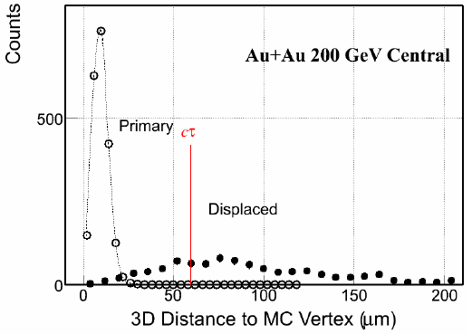
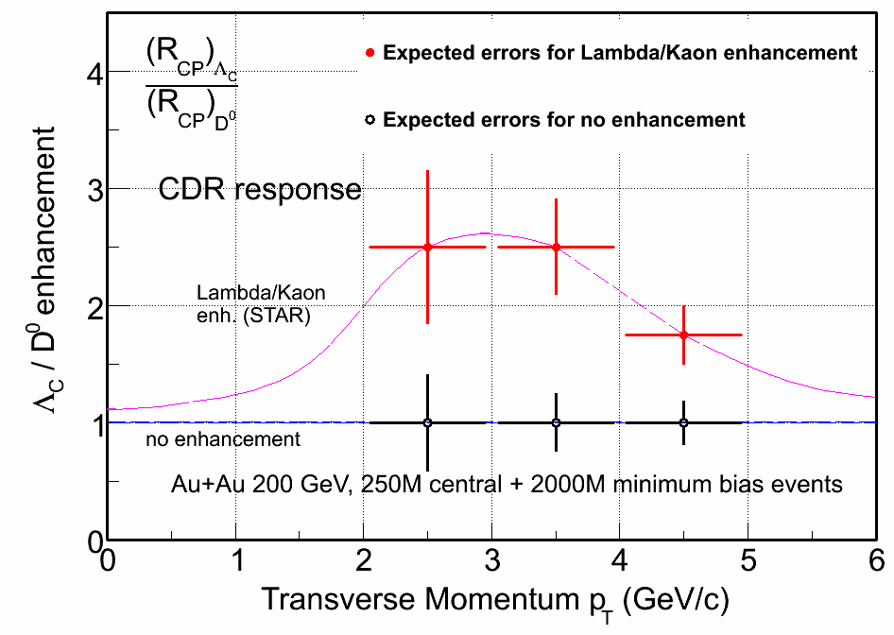
Charmed baryons (Lambda_{c}) – Run-16
Λ_{c}→ p K π Lowest mass charm baryons cτ = 60 μm
Λ_{c}/D enhancement?
0.11 (pp PYTHIA) → 0.4-0.9 (Di-quark correlation in QGP)
S.H. Lee etc. PRL 100, 222301 (2008)
Total charm yield in heavy ion collisions

Slide 29
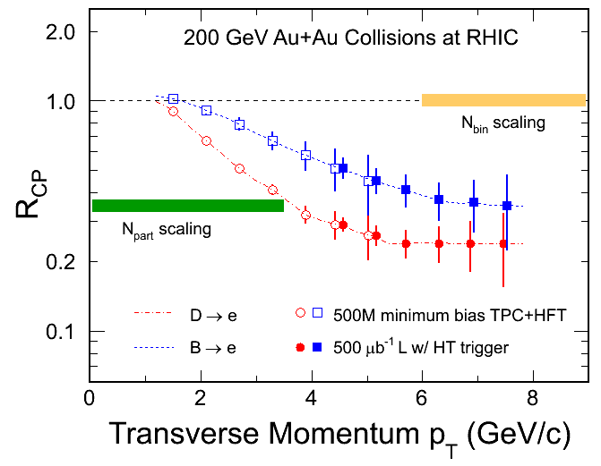
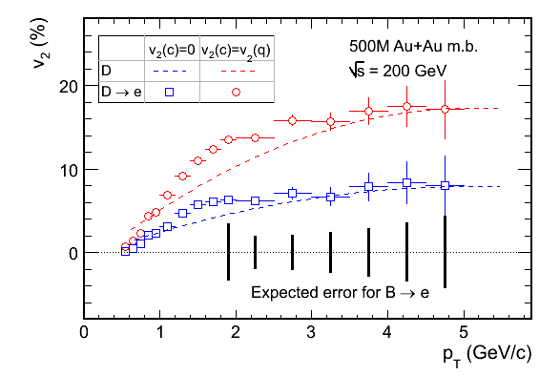
Statistics projection of e_{D}, e_{B} R_{CP} & v₂
Curves: H. van Hees et al. Eur. Phys. J. C61, 799(2009).
(B→e) spectra obtained via the subtraction of charm decay electrons from inclusive NPEs:
- no model dependence, reduced systematic errors.
Unique opportunity for bottom e-loss and flow.
- Charm may not be heavy enough at RHIC, but how is bottom?

Slide 30
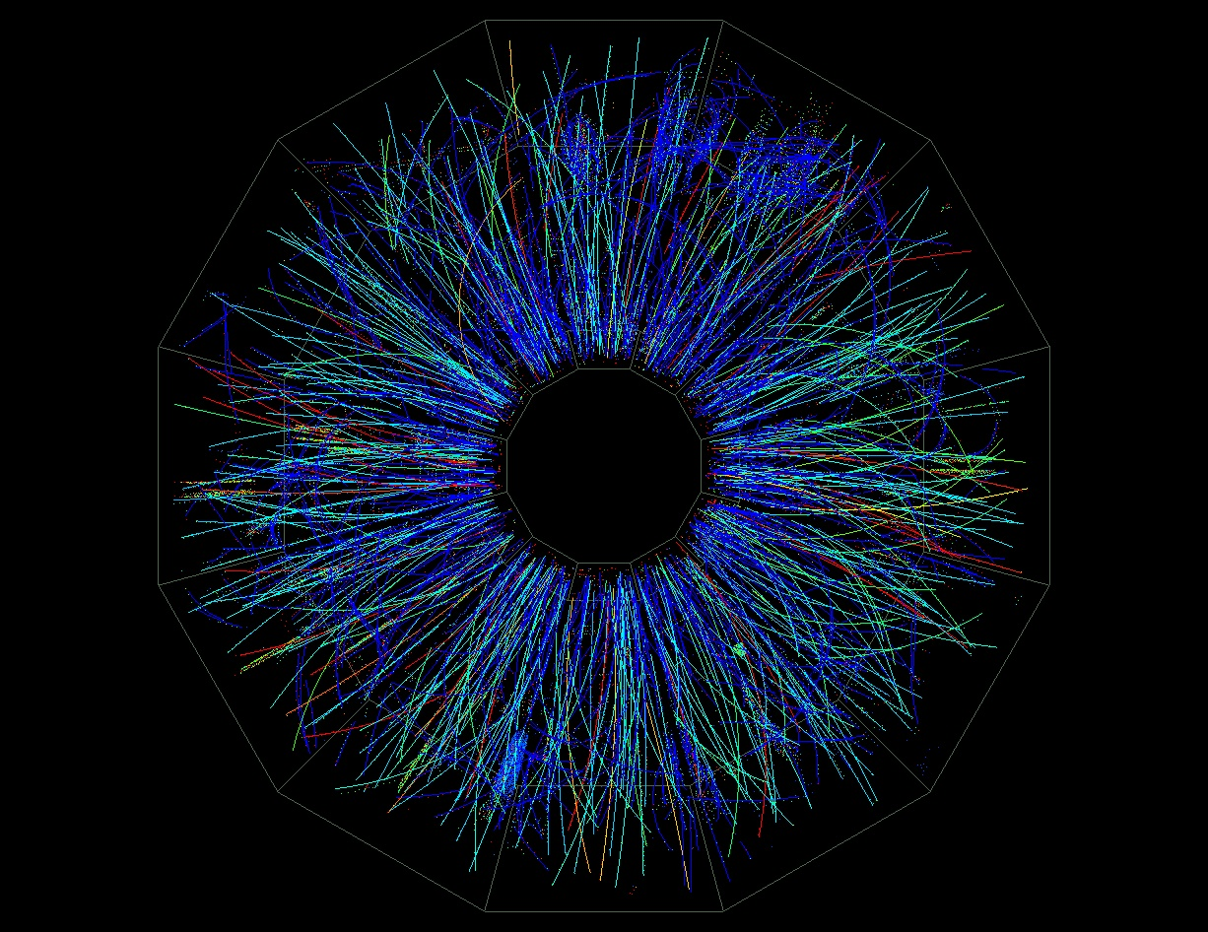
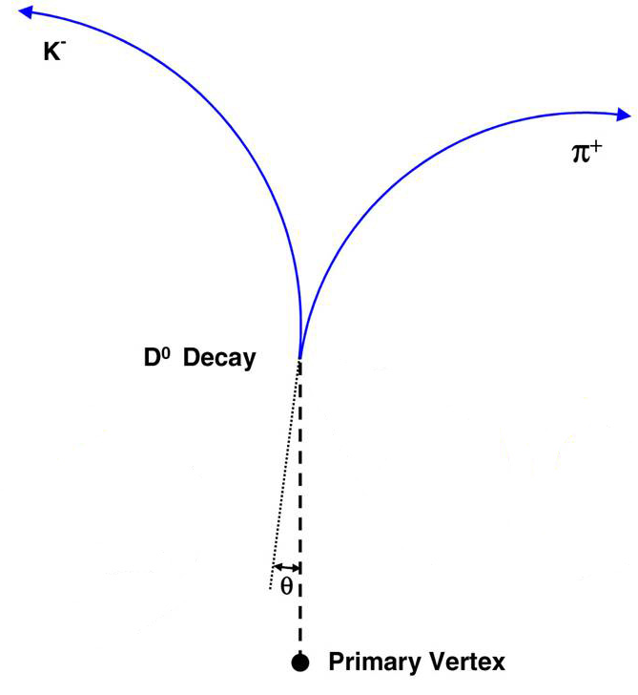
Direct Topological Identification of Open Charm
Goal: Put a high precision detector near the IP to extend the TPC tracks to small radius
50-150 μm
The STAR Heavy Flavor Tracking Upgrade will identify daughters of the decay ( e.g. D⁰ ⇒ K⁻+π⁺ ) and do direct topological reconstruction of open charm hadrons.
No Mixed events, no random background subtraction.

Slide 31
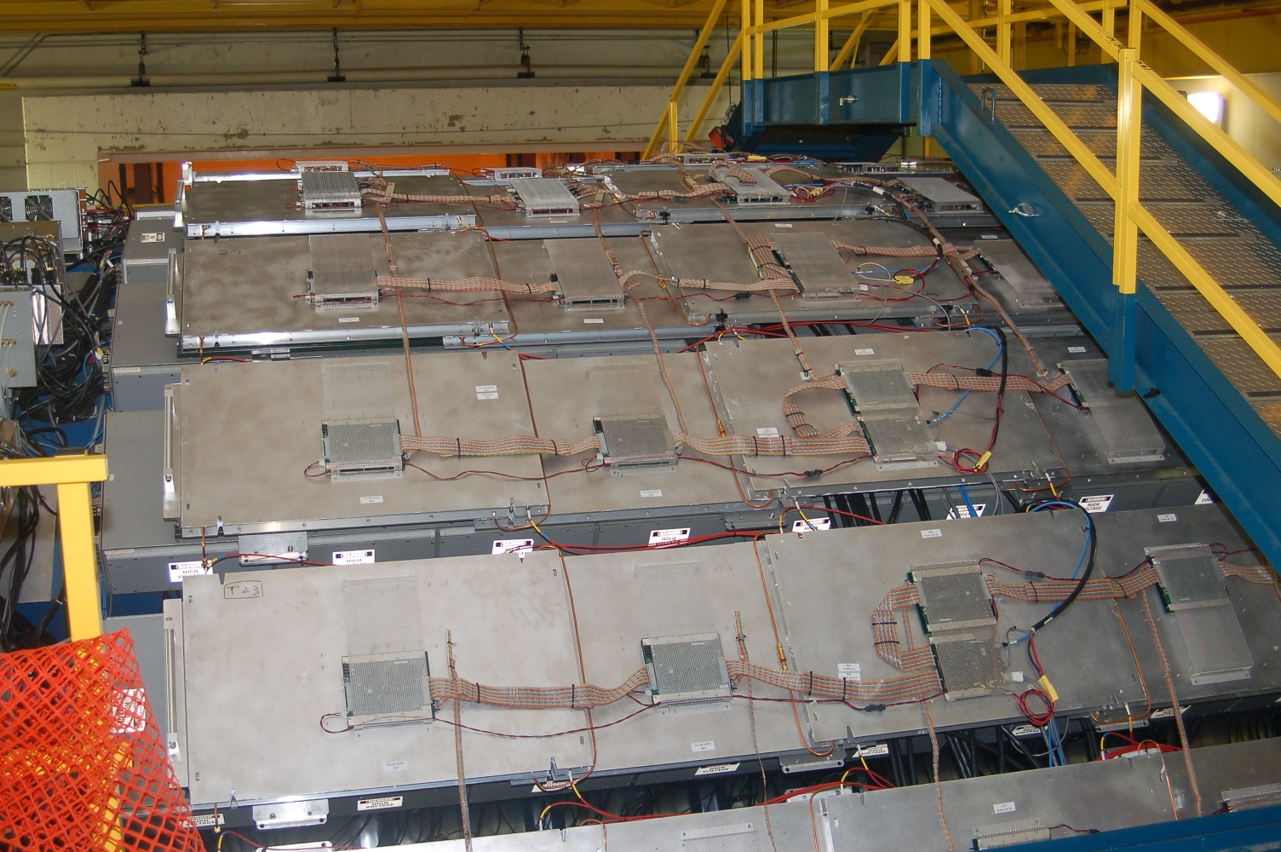
STAR Muon Tracker Detector (MTD)

Slide 32
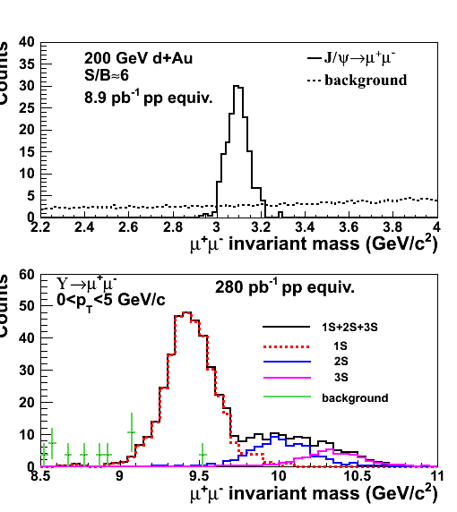
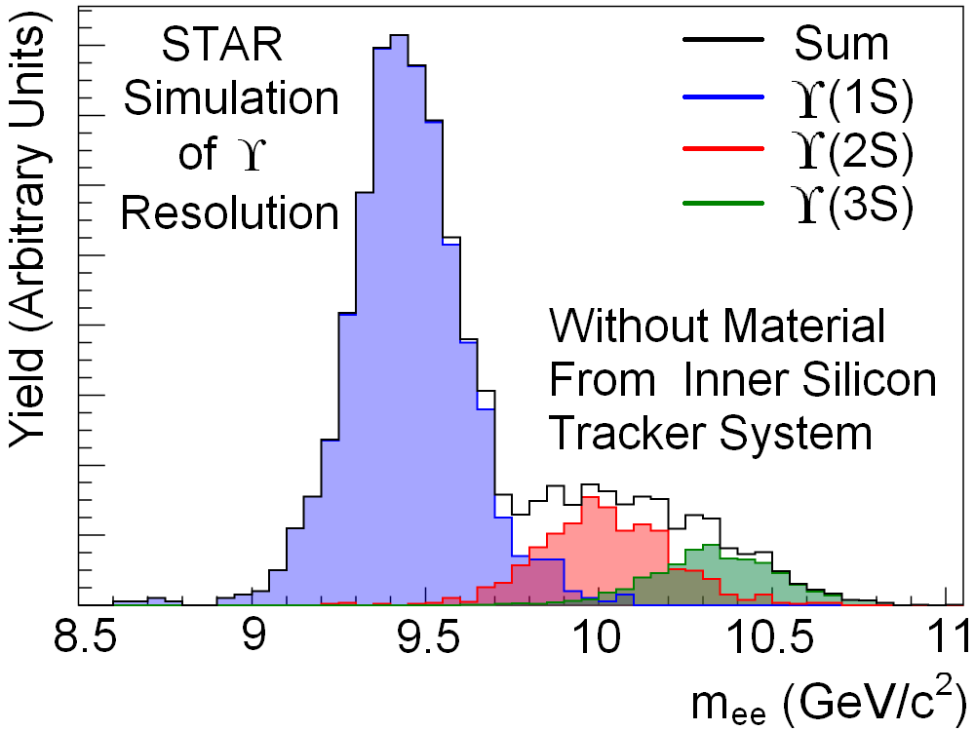
Quarkonium from the MTD
J/ψ: S/B=6 in d+Au and S/B=2 in central Au+Au collisions
Excellent mass resolution: separate different upsilon states
With HFT, study B→J/ψ X; J/ψ→μμ using displaced vertices
Heavy flavor collectivity and color
screening, quarkonia production
mechanisms:
J/ψ R_{AA} and v₂; upsilon R_{AA} …
Z. Xu, BNL LDRD 07-007; L. Ruan et al., Journal of Physics G: Nucl. Part. Phys. 36 (2009) 095001
32

Slide 33
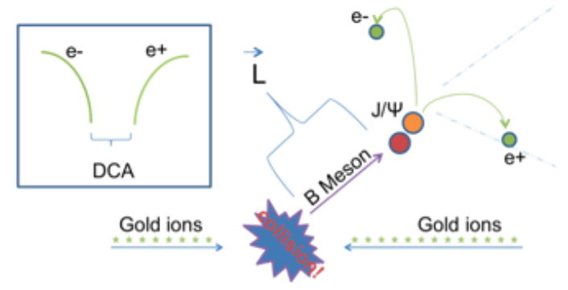
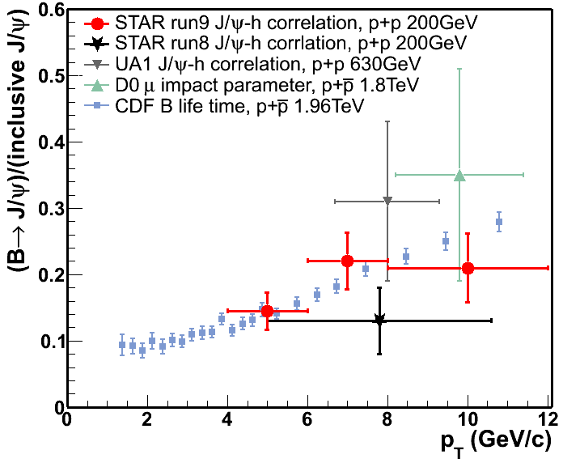
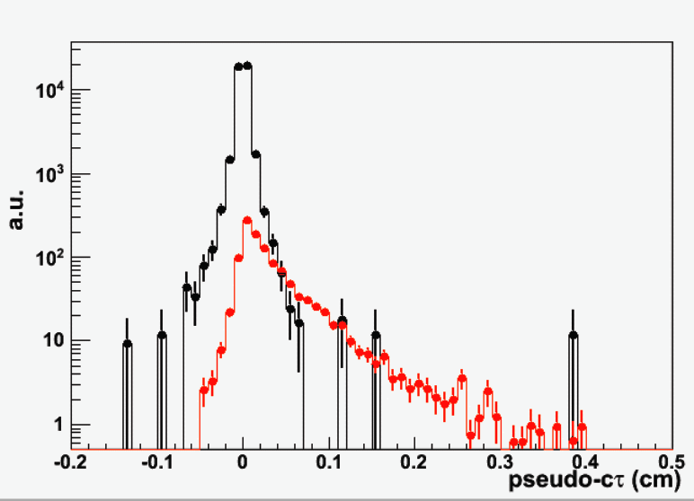
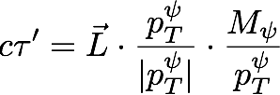
B tagged J/psi
Zebo Tang, NPA 00 (2010) 1.
STAR Preliminary
Prompt
Current measurement via J/ψ -hadron correlation with large uncertainties.
Combine HFT+MTD in di-muon channel
  Separate secondary J/ψ from prompt J/ ψ
  Constrain the bottom production at RHIC
J/ψ from B

Slide 34
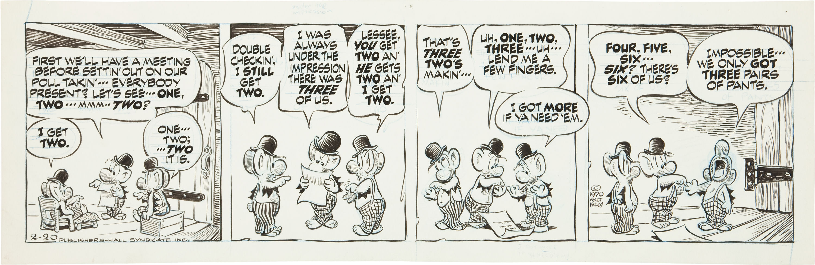
Walt Kelly’s Pogo
The HFT management team employs the latest and most sophisticated Project Management techniques.

