Slide 1
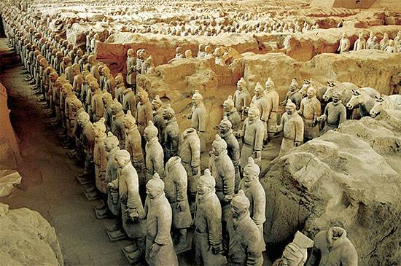
The iTPC Project:
Who, What, When, Where, Why and How
Jim Thomas and a cast of thousands
April 10th, 2017

Slide 2
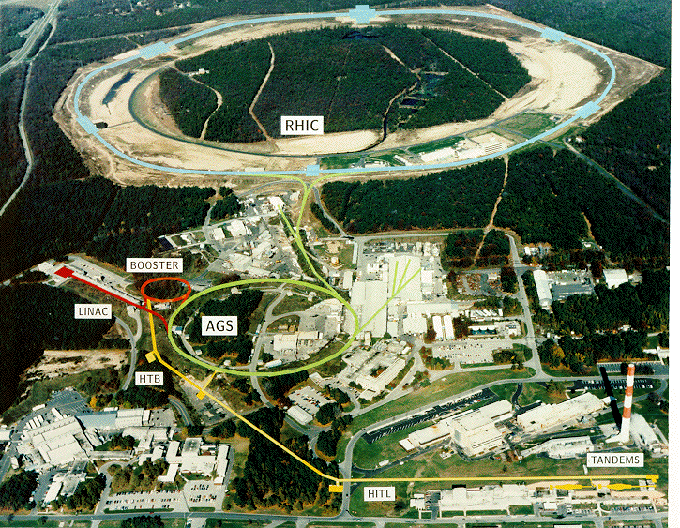

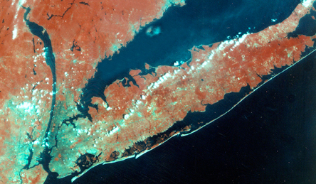
Where: Brookhaven National Laboratory
3.8 km circumference
Two beams of heavy ions colliding (typically Au+Au)
Classic Atom Smasher
Collide Two Mercedes Benz on the hiway: depending on where hubcabs go, we are trying to reconstruct the clock on the dashboard
It’s a program of Microscopy
  How are Atoms and Nuclei put together
The Relativistic Heavy Ion Collider
Cost of operation: $185M / year

Slide 3
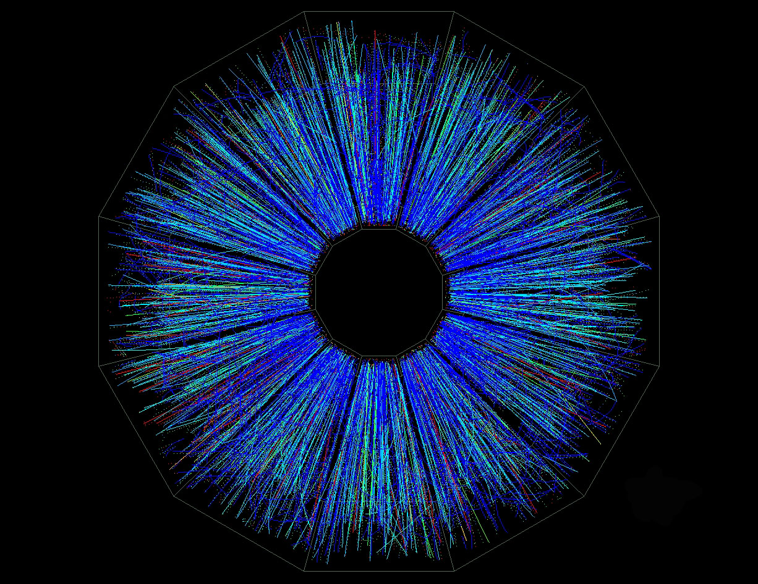
A Typical Collision

Slide 4
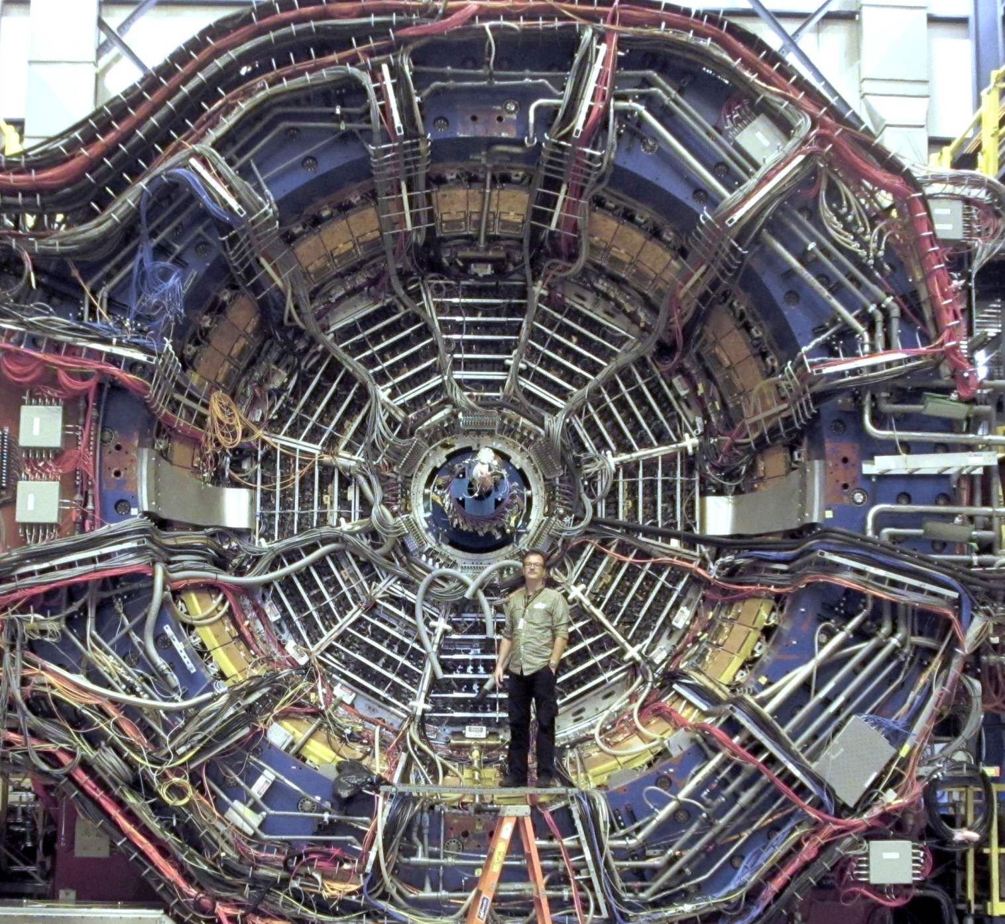
The Imaging Device – The STAR Detector at RHIC
Cylindrical Symmetry
Blue Magnet
Yellow Calorimeters
Grey 12 fold Time Projection Chamber
TPC: 4m x 4m

Slide 5
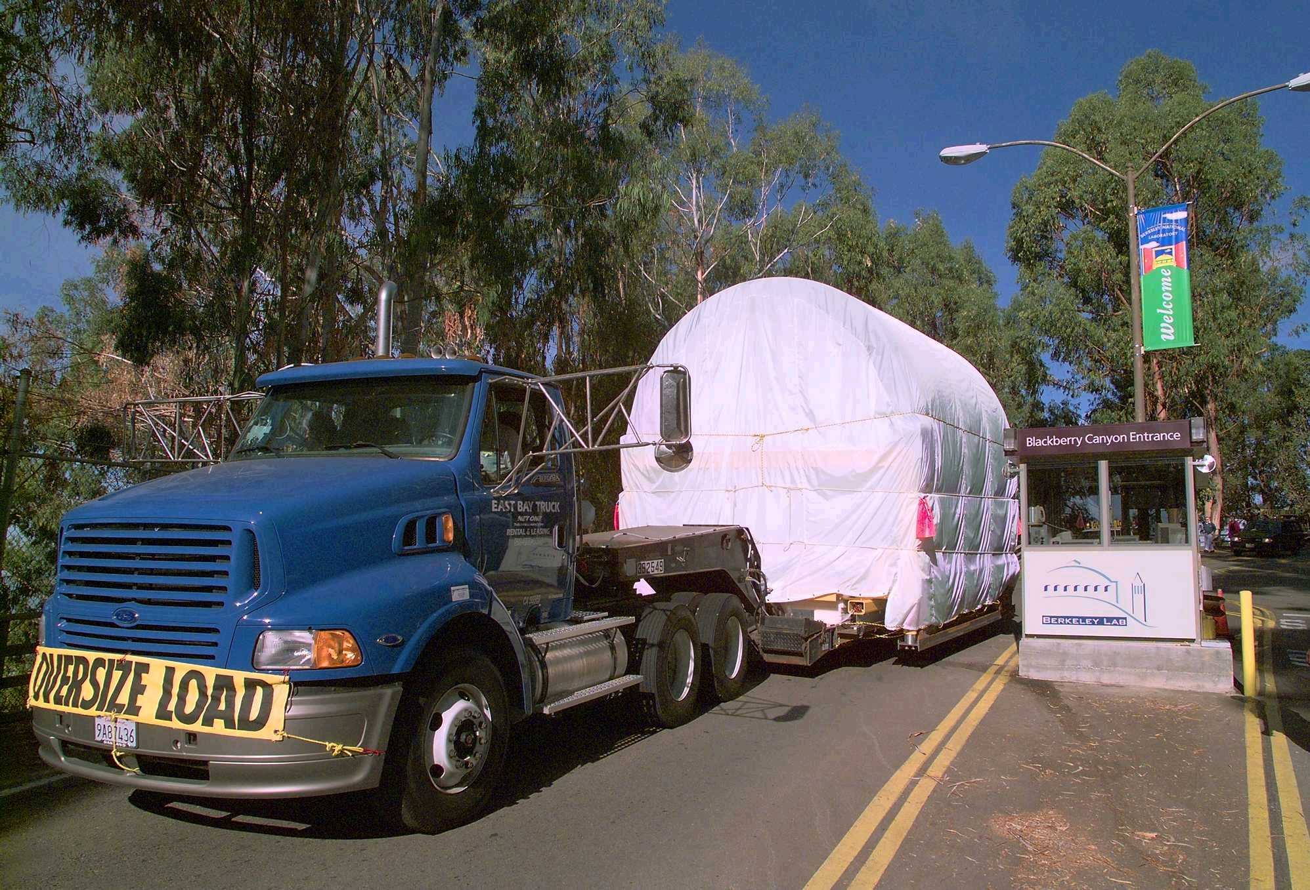
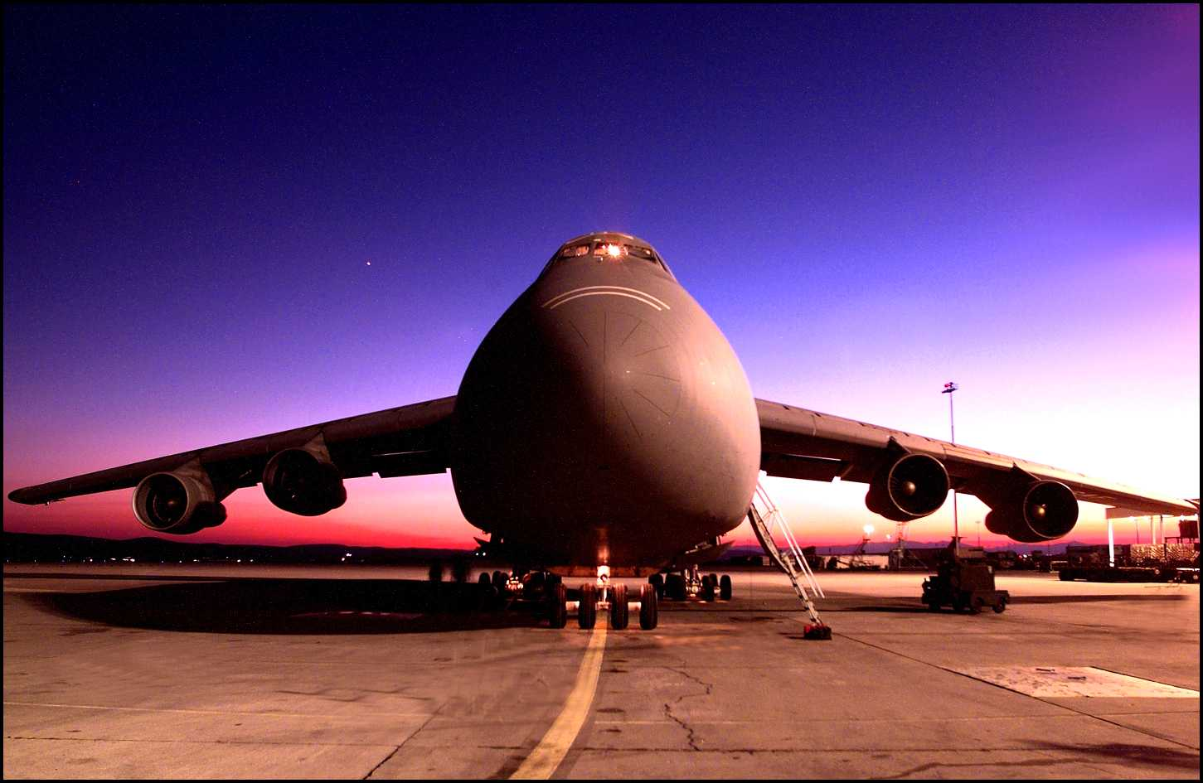
The TPC – Built in Berkeley
Flown to BNL in a C5A
Invented in Berkeley by David Nygren (late 70’s)
This one, the biggest in the world, was built by Howard Wieman and Eric Anderssen (1995)

Slide 6
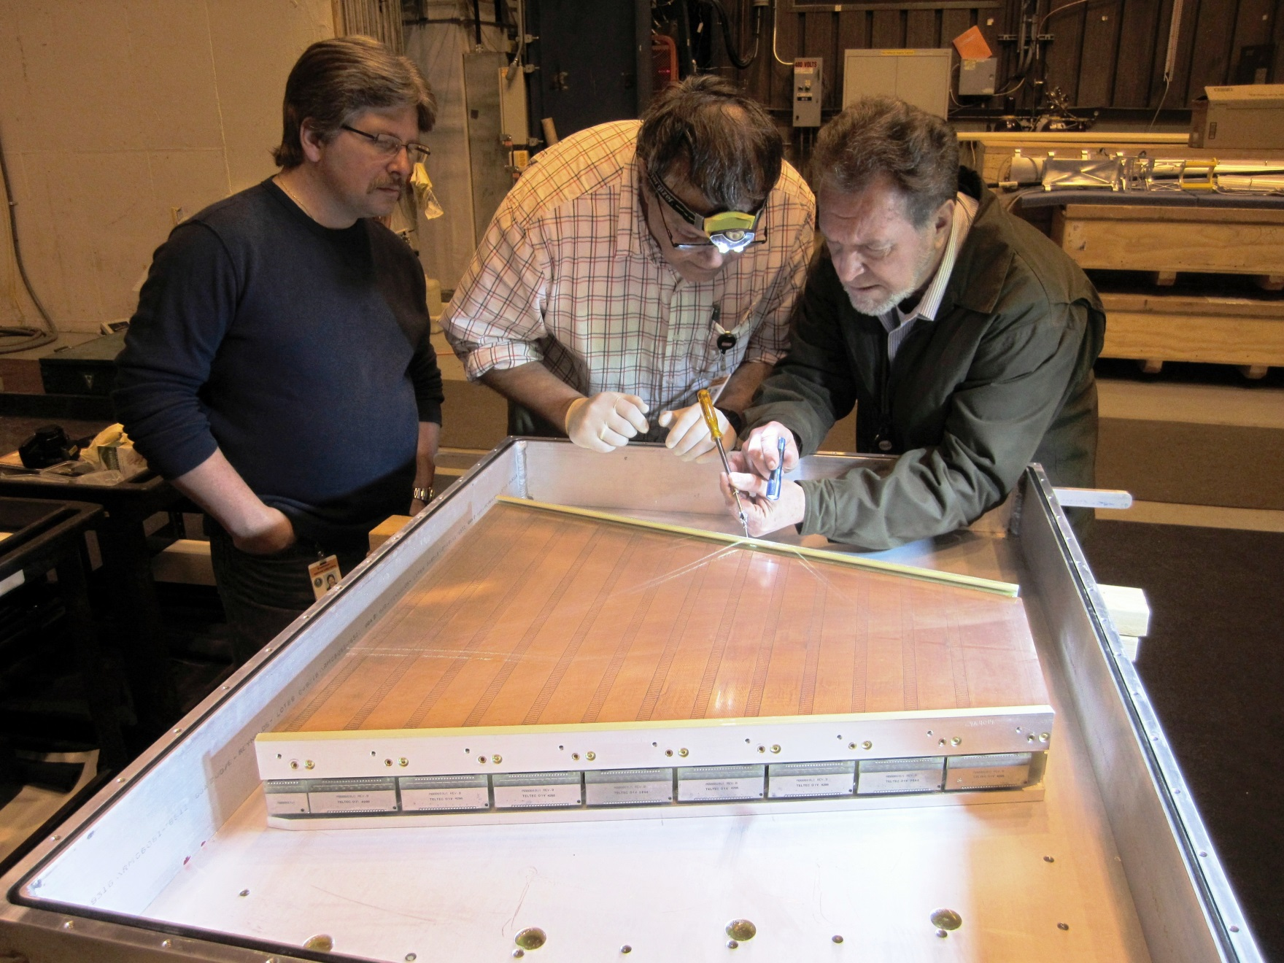
Pixelated read-out using wire chamber & pads
hi

Slide 7
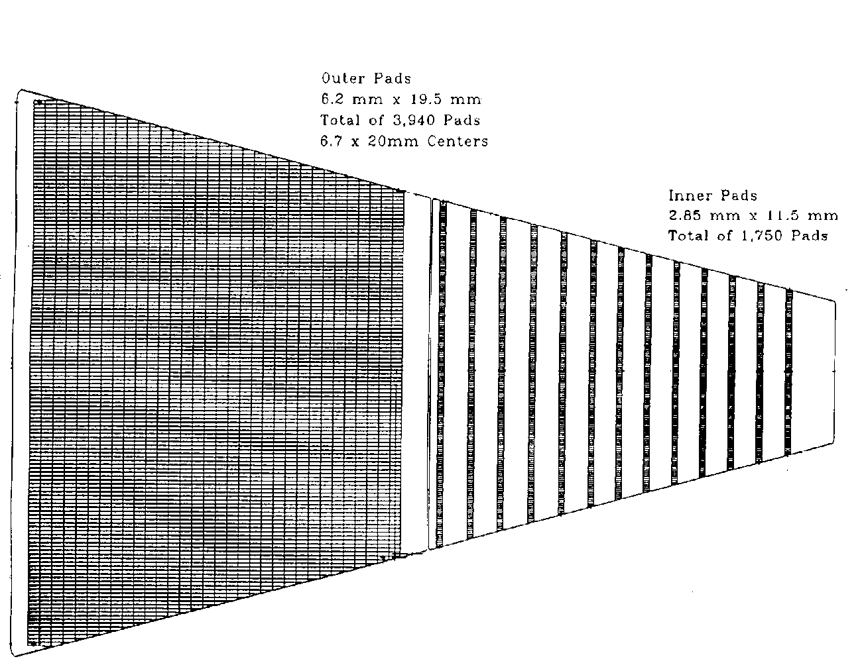
Goal: Hermetic coverage and more Pixels
60 cm
190 cm
Currently, the outer pad plane is hermetic while the inner pad plane is not
  Goal: Add more pad rows on the inner sector, 2X total pad count
The upgrade will provide better momentum resolution, better dE/dx resolution, and improved acceptance at high η

Slide 8
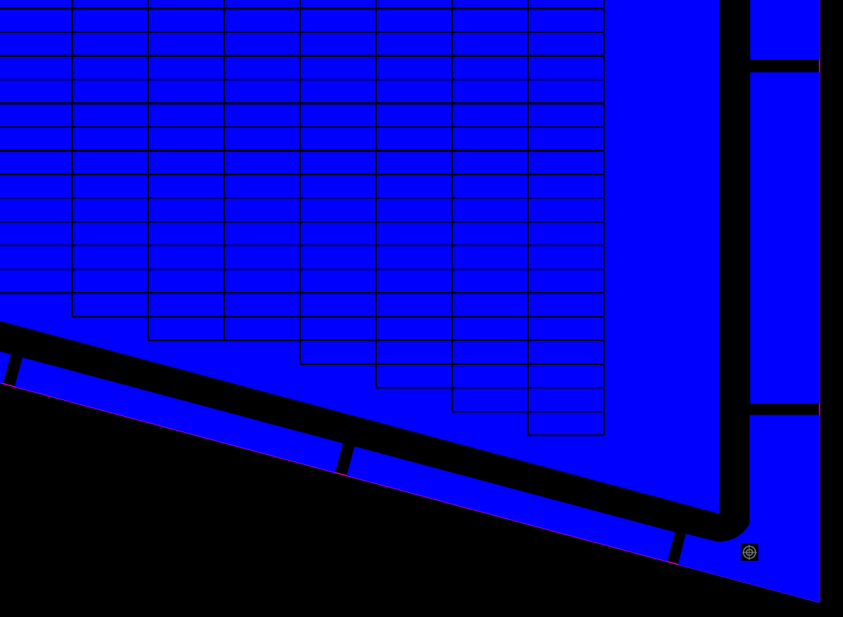
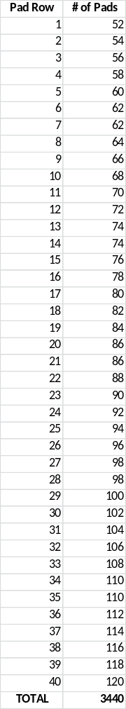
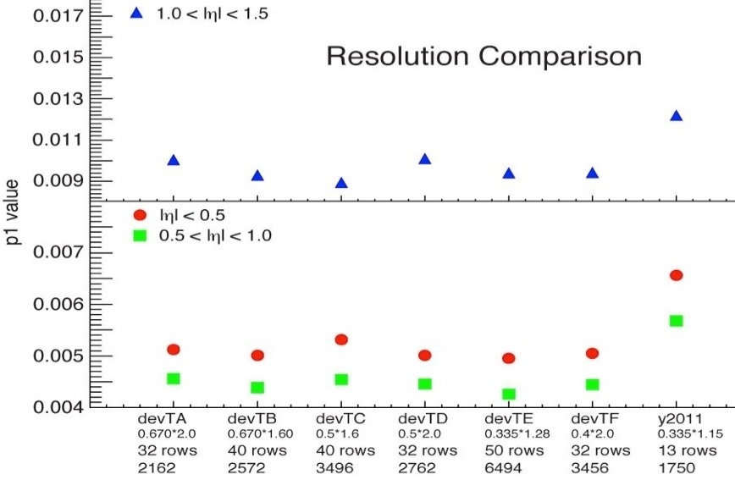
New Pad Plane design and layout
A corner of the new inner pad plane layout design by John Hammond & Bob Scheetz
Row 39
Row 40
Momentum (and spatial) resolution not strongly dependent on pad design within this range … it’s the extra rows that are important

Slide 9
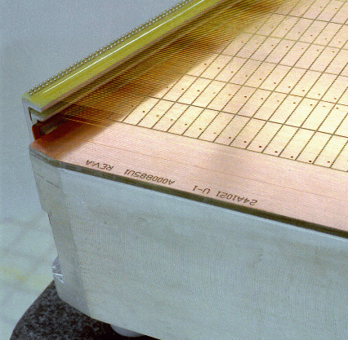
Major Items: Definition & Scope
Wire Mounts for Grids
Wire Planes:
Gated Grid, Cathode Grid, and Anode Grid
Pad Plane with larger pads (5x16 mm) & hermetic coverage
Strongback
Outer Sector, but a good proxy for Inner Sector discussion

Slide 10
Major Tasks
Fabricate, Align and Pin Wire Mounts (BNL & LBL)
Wind wire grids
(Shandong University, China)
Fabricate, QA check
Align (50 μm)
Glue (< 20 μm flat )
& Trim padplane (BNL & LBL)
Fabricate strongback
& inspect (QA) (Outside vendor)
Cut to height, machine
O Ring grooves,
Survey padplane &
Document mech. specs (LBL)

Slide 11
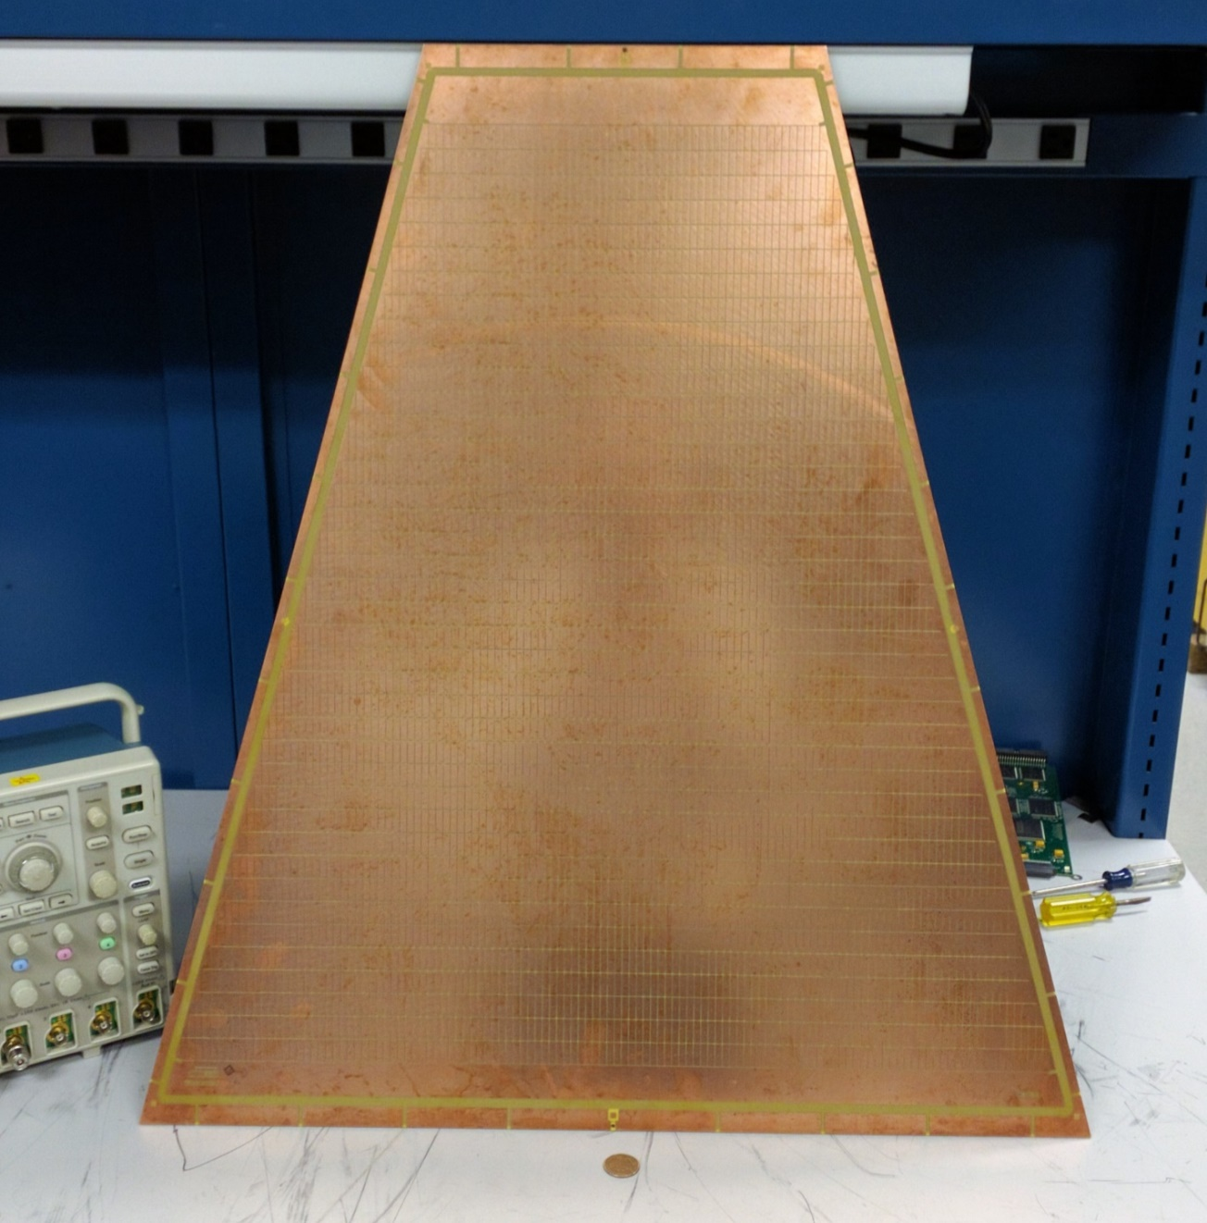
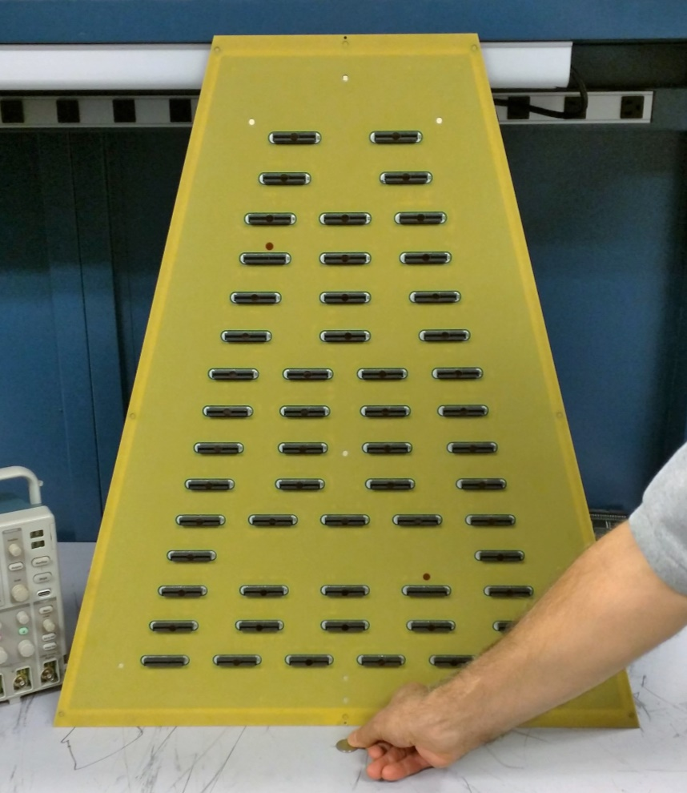
Padplane Prototype undergoing tests at BNL
40 Rows
5x16 pads (mm)
High density connectors (64 channels)
Halogen free materials

Slide 12
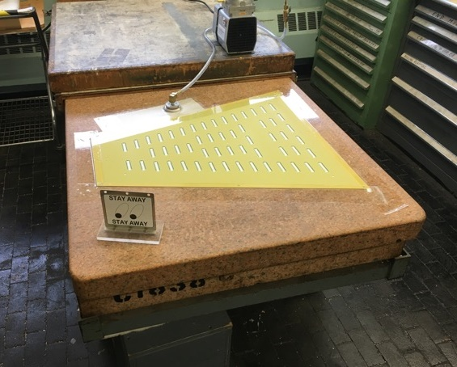
Vacuum Check of Padplane
Vacuum integrity check with prototype padplane
Granite tables typically flat to 5 μm
Use vacuum to hold padplane on table
  while gluing to strongback
Good 09/01/2016

Slide 13
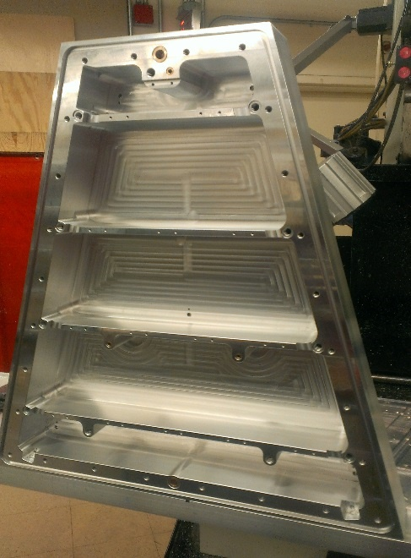
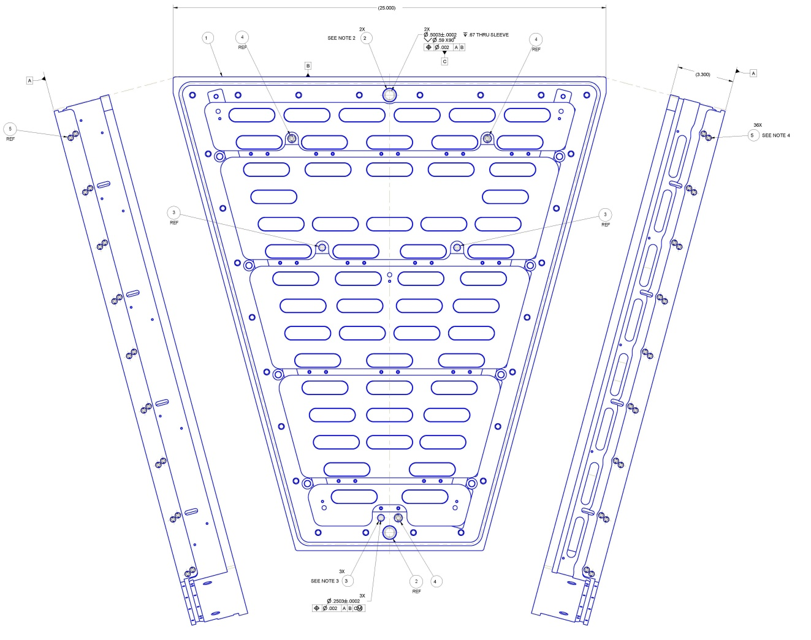
Strongback Construction is Complete 30 of 30
A prototype inner sector strongback is shown during fabrication at the University of Texas (circa 2013). The sector was machined out of a single piece of aluminum. Dimensions are: ~27 inches tall, ~25 inches wide and weight 55 lbs. The sector is viewed from the backside; the side upon which the electronics and cooling manifolds will eventually be mounted. More recently, 30 production strongbacks were completed at IMT Precision Machine, Hayward CA and received on 08/01/2016.

Slide 14
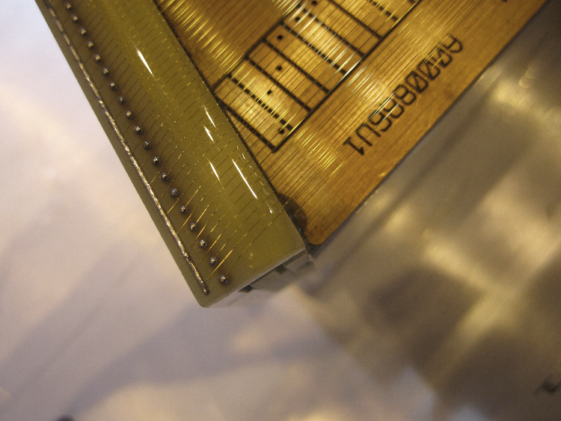
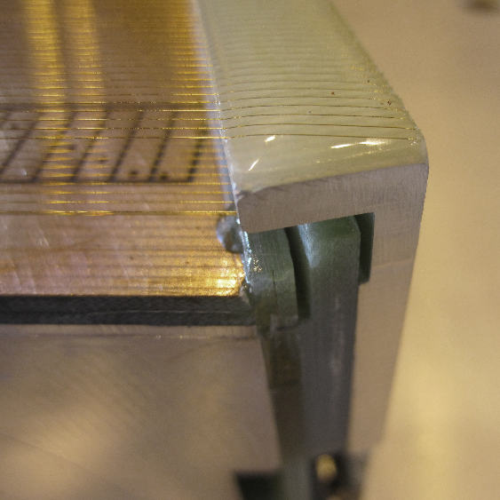
Wiremounts
The Anode wires, Cathode Wires, and Gated Grid wires are mounted on structures attached to the sides of the strongback
  A total of 8 wiremount parts – 4 left, 4 right
  4 of the 8 contain circuit traces and electronic PCB boards (i.e. EE required)
  4 of the 8 are blank G10 boards or Aluminum (with insulator boards)
Construction of the Wiremount parts is complete, final QA in progress
  Bonding of Wiremounts to strongback to be done @ lbl.gov

Slide 15
Work Breakdown
Strongback Fabrication (outside vendor)
Padplane Production (outside vendor)
Padplane QA (BNL, just in time delivery)
Wiremount Production (outside vendor)
Wiremount QA (BNL, just in time delivery)
Padplane Bonding to strongback (LBL)
Wiremount Bonding to strongback (LBL)
Sector Metrology & QA (mechanical) (LBL)
Wire Winding (Shandong Univ., China)
Wire Bonding (Shandong Univ., China)
Wire Tension & QA (tedious) (SDU, China)
⁵⁵Fe Source tests, gain check (BNL)
Installation & Integration w/ TPC (BNL)

Slide 16
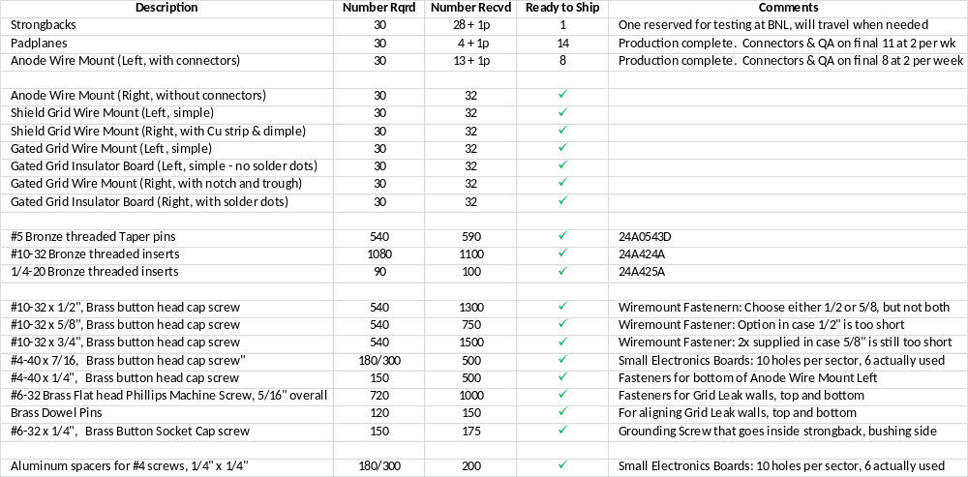
Parts and Pieces @ lbl.gov
All parts in Berkeley, with exceptions noted above
Prototype sets became available at start of Fiscal Year
Production sets became available at start of Calendar Year

Slide 17
Schedule Drivers
Strongbacks
  We went to an outside vendor … they gave us very fast turn around
    Construction & QA complete: survey & quality looks good
    Strongbacks in storage at vendor or at LBL since August
Padplane & Wiremounts
  We went to an outside vendor for basic fabrication of parts. Soldering of connectors and QA are the rate limiting steps
    Construction is complete: as-built-dimensions look good
    8 of 10 parts complete, 2 pieces delivered just-in-time but have surplus
Bonding of padplane and wiremounts to strongbacks has begun
  Tooling complete
  First prototype & QA completed last week (4/7/2017)
Critical Path
  PadPlane and Wiremount bonding is sitting on the critical path
    We are in the spotlight
  One complete sector is needed at BNL in August for installation in Run 18
  All sectors must be completed and installed at BNL by March 2019
    Approximately one week per sector at LBL, 2 weeks per sector at SDU
    These production rates do not include Transportation, QA or Installation

Slide 18
Risk – high level summary
Technical
  Better than 20 μm flatness requirement for PadPlane+Strongback
    A vigorous QA plan is essential
    We have the elements of a good QA plan in place but we need the will and discipline to stick to it
  Shipping & damage in transit
    We have well developed repair procedures ⇒ schedule risk
  Bromine free materials
Schedule
  Minor schedule slips could easily affect the final installation date
    Schedule is tight
    Whenever schedules are tight, sharing manpower becomes a challenge
Management
  Risk of losing Engineering run in ‘18, and/or Physics run in ‘19
  Money is in place - $605K delivered to LBL in August Fin Plan transfer
    Funding for 27 sectors is not a problem
  DOE NP has requested an extension of scope from 27 sectors to 30
    Do we need more money? One of the questions for this review.

Slide 19
Summary
New PadPlanes for the STAR Time Project Chamber
  More Pixels! 40 pad rows in inner sectors, up from 13 rows, full coverage
  Added additional fiducial marks, alignment holes and improved air paths
Strongback is 99% the same as before
  Re-use the existing cooling manifolds (etc.)
  99% perspiration, 1% inspiration. Updated tooling required.
Wires
  Exactly the same as before: same wire count, same composition, same diameters, same tension, same locations, same ABDB board design, etc.
  Same as before … but must be done again for the new strongbacks & pads
Cost and Schedule concerns – its all about the schedule …
  Costs are under control (?). Aided by C-NSF increasing their contributions.
  Very tight schedule. Scheduled wisely but no scheduled float.
  Work in B77A is currently on the project critical path, it would be nice to get out from under the spotlight

Slide 20
Backup Slides

Slide 21
Documentation from the original project
The documentation from the original project (circa 1995) is extremely good
  Engineering drawings for every part (dwg & pdf)
  Electronics drawings for every board (pdf)
  Technicians Notebooks, notes & fully documented procedures
  Procedures well documented, QA plans and Travelers for every sector
  And most important … Jon Wirth (retired) is enthusiastic about participating in the new project ☺
Thus, we are standing on the shoulders of giants (I. Newton, 1676)
  Very little “new” engineering required
    Primarily, translation of old (2D) drawings into modern 3D CAD
  A minimum of new features added (other than additional pad rows)
  PadPlanes and Strongback fab is primarily a technical project
  Archeology required to establish precise technical procedures
    The Archeology project was time consuming but is now complete
As much as possible, we are doing what was done before using the same materials & techniques

Slide 22
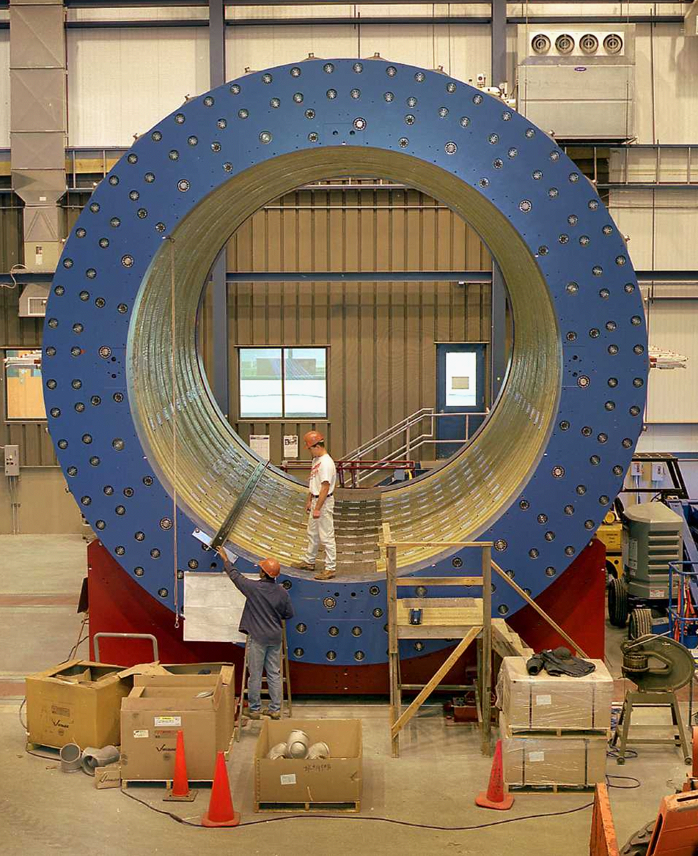
STAR without the TPC
The TPC is the heart of STAR

Slide 23
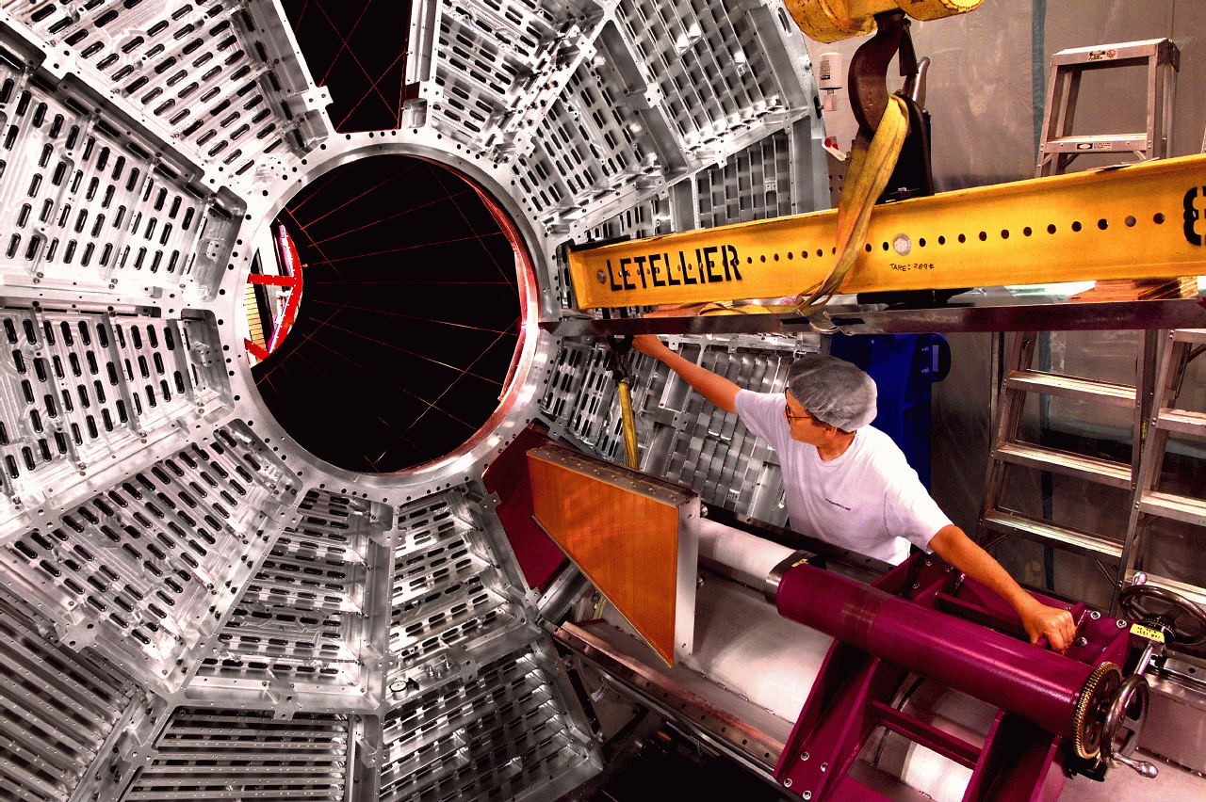
Sector Insertion – special tools required

Slide 24
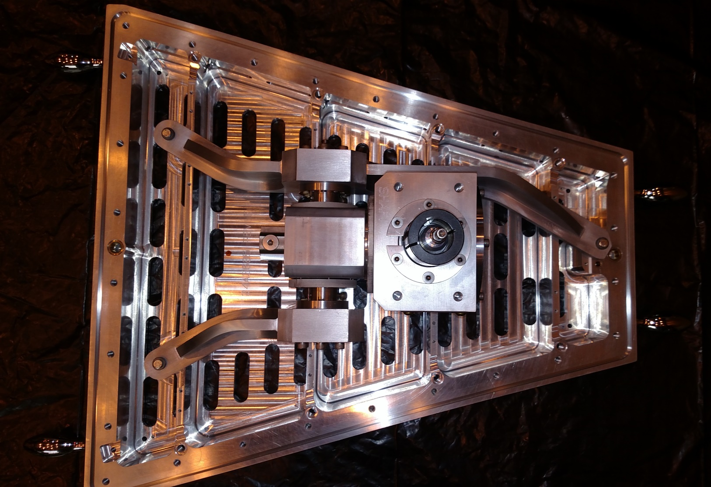
BNL Sector Insertion Tool
h

Slide 25
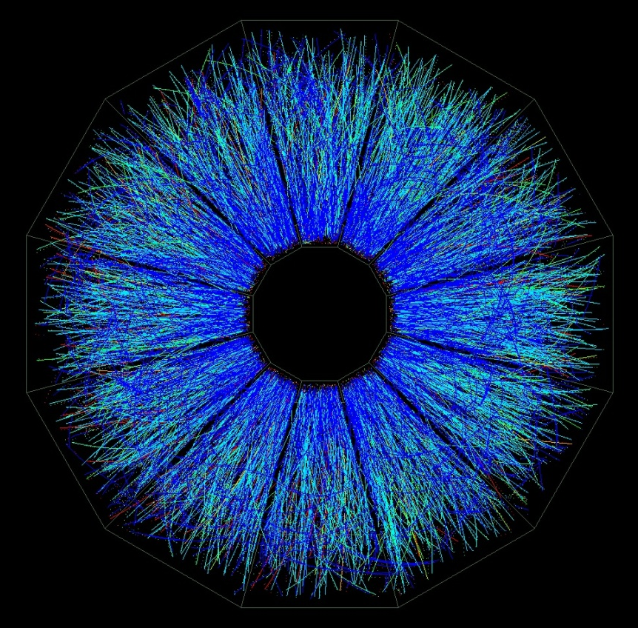
A Typical Collision

Slide 26
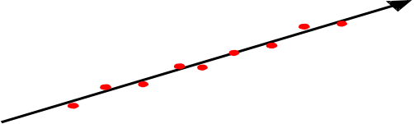
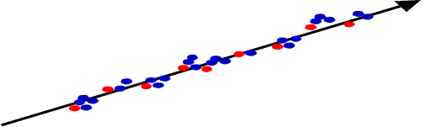

Ionization of gases
Fast charged particles ionize the atoms of a gas.
Often the resulting primary electron will have enough kinetic energy to ionize other atoms.
Primary ionization
Total ionization
10 - 40 pairs/cm
ΔE/pair ~ 25 eV
Assume detector, 1 cm thick, filled with Ar gas:
1 cm
~ 100 e-ion pairs
100 electron-ion pairs are not easy to detect!
Noise of amplifier ≈ 1000 e⁻ (ENC) !
We need to increase the number of e-ion pairs.

Slide 27
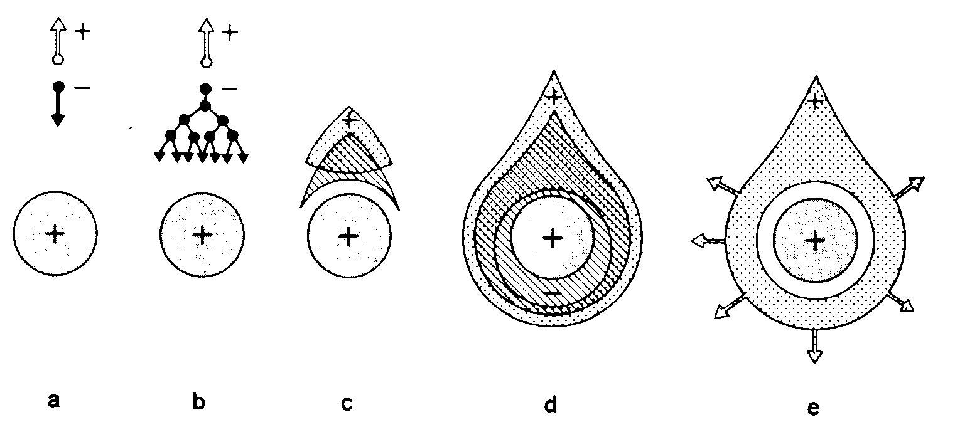
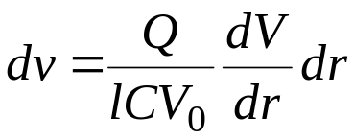
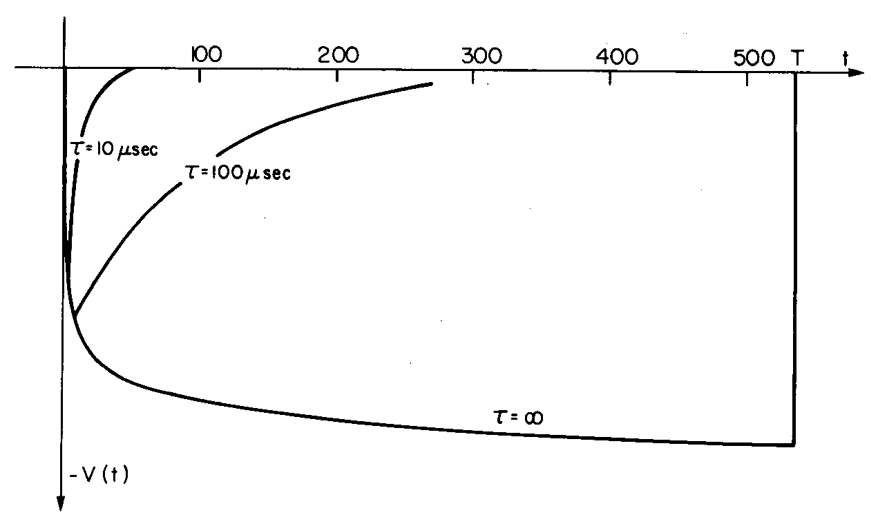
Signal Formation - Proportional Counter
(F. Sauli, CERN 77-09)
Avalanches form within a few radii of the wire and within t < 1 ns!
Signal induction both on anode and cathode due to moving charges (both electrons and ions).
Electrons are collected on the anode wire, (i.e. dr is small, only a few μm). Electrons contribute only very little to detected signal (few %).
(F. Sauli, CERN 77-09)
Ions have to drift back to cathode, i.e. dr is big. Signal duration limited by total ion drift time !
We need electronic signal differentiation to limit dead time.

Slide 28
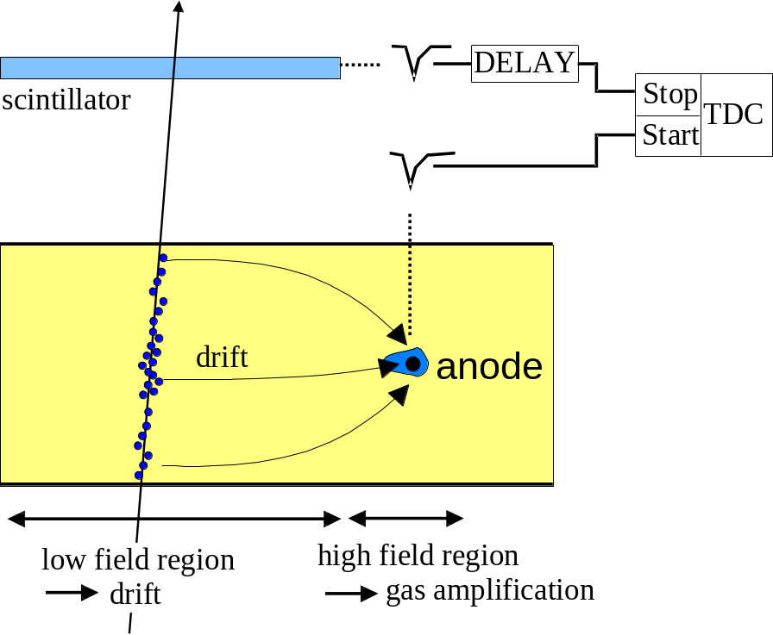
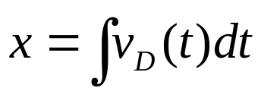
The 3rd Dimension: Timing Differences with Drift Chambers
Drift Chambers :
Reduced numbers of readout channels
Distance between wires typically 5-10cm giving around 1-2 μs drift-time
Resolution of 50-100μm achieved limited by field uniformity and diffusion
Perhaps problems with occupancy of tracks in one cell.
x
Measure arrival time of electrons at sense wire relative to a time t₀.
(First studies: T. Bressani, G. Charpak, D. Rahm, C. Zupancic, 1969
First operation drift chamber: A.H. Walenta, J. Heintze, B. Schürlein, NIM 92 (1971) 373)
In P10 Gas (90% Ar, 10% CH₄), the drift velocity is about 5 cm/μsec

Slide 29
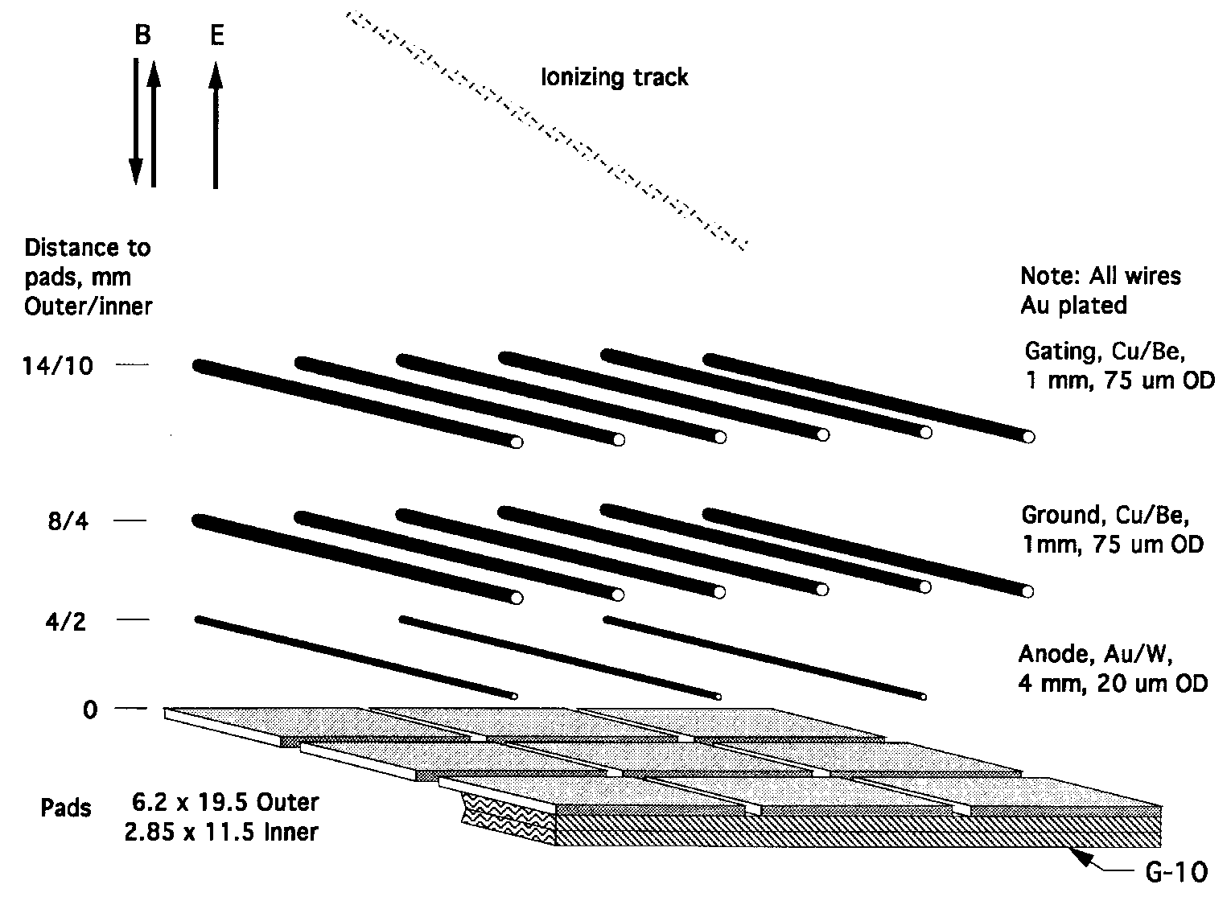
Sector Wire Geometry – special notes
Wires are phase locked to the pad locations. 4 wires located over each pad row. We can probably tolerate a phase shift of 100 microns.
Ground wires placed directly over the Anode wires to limit sparking to pad plane.

Slide 30
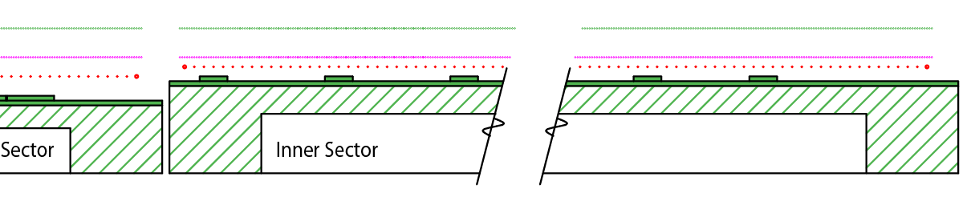
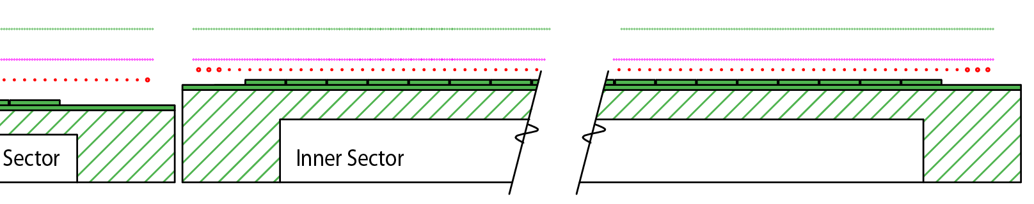
40 Pad Rows fit perfectly with the existing grid
(Old)
Anode wires spaced 4 mm apart (horizontally), Ground Shield and Gated grids spaced 1 mm apart
(New)
No need to change grid; wire locations remain the same
No need to add more ABDB or wire mount channels (good)
Identical pad response function on both ends of grid

Slide 31
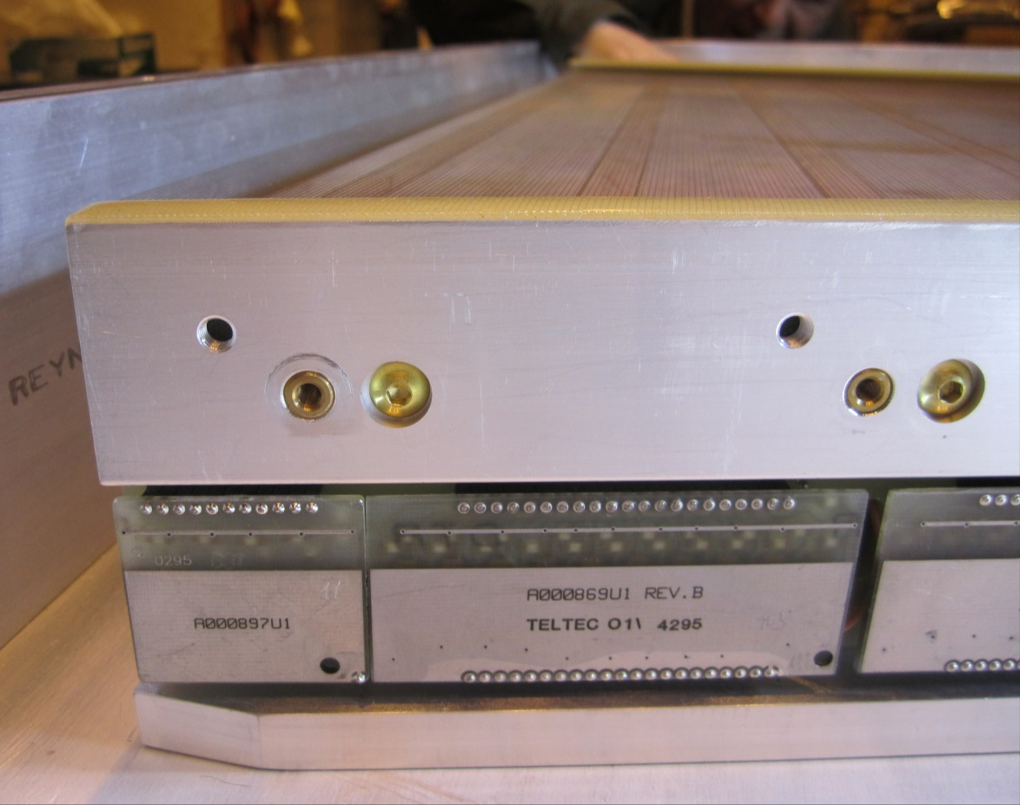
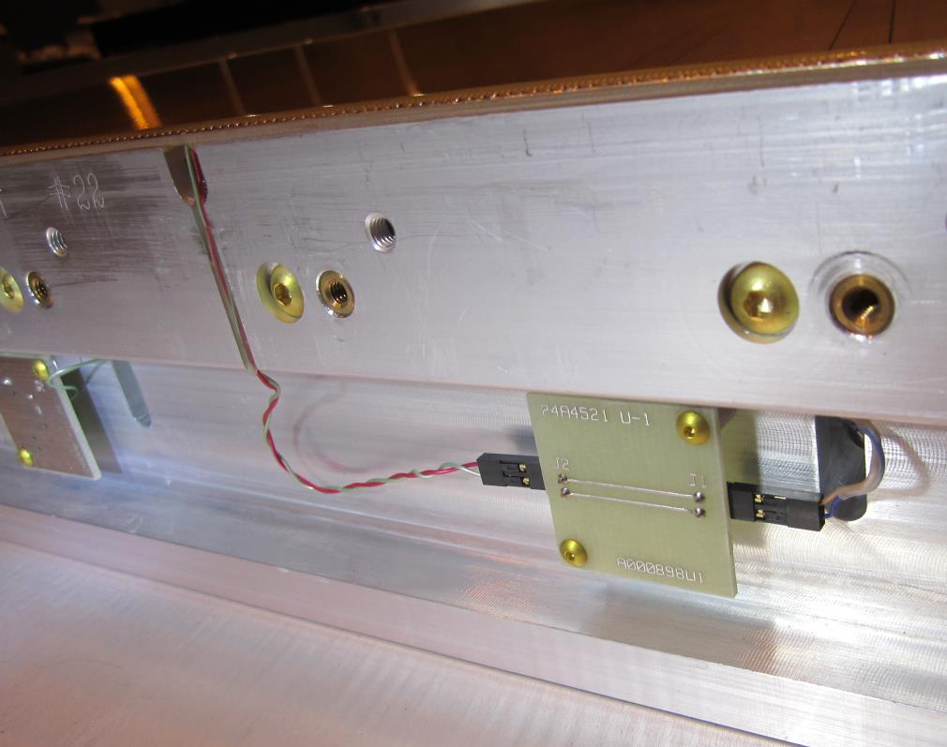
Electronics on sides – all Bromine Free boards
Careful choice of materials required to avoid electro-negative contamination
PadPlane
Electronics Boards
Epoxy
Solder (flux)

Slide 32
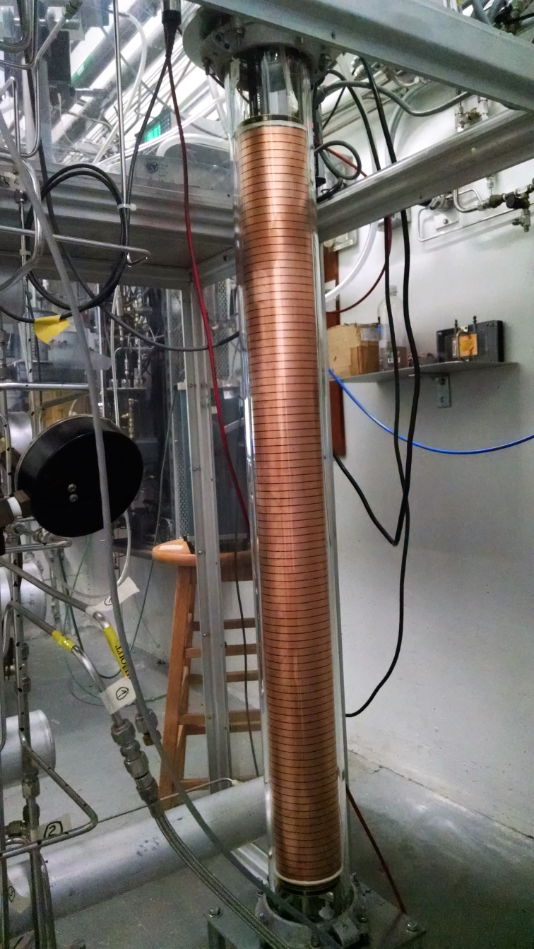
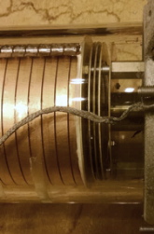
The “LBL Canary Chamber”
Previously used for PEP-4, EOS, STAR & EXO
How to measure electronegative impurities in gas due to materials contamination?
  Drift e⁻ through 1 m of TPC gas (P10)
  Gas circulates through sample chambers & drift volume
Sample chambers and control systems not shown
Now installed and working at BNL 09/05/2016
  Tests will start this week
  e.g. Padplane, ABDB & wiremount boards
Fe-55
E
Fe-55
MWPC

Slide 33
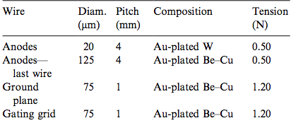
Parameters for the old and new sectors
Item | Inner | Outer | iTPC | Comment
Pad Pitch (center to center) | 3.35 x 12 | 6.70 x 20 | 5.0 x 16 | mm
Isolation gap between pads | 0.5 | 0.5 | 0.5 | mm
Pad Size | 2.85 x 11.5 | 6.20 x 19.5 | 4.5 x 15.5 | mm
Number of Pads | 1750 | 3940 | 3496
Anode to pad plane spacing | 2 | 4 | 2 | mm
Anode voltage | 1170 V | 1390 V | ~ 1120 V | 20:1 S/N
Anode Gas Gain | 3770 | 1230 | ~ 2000 | nominal
Anode Wire diameter | 20 μm | 20 μm | 20 μm | Au plated W
Anode Wire pitch | 4 | 4 | 4 | mm
Anode Wires phase locked to pad location | 3 wires, #2 over center | 5 wires, #3 over center | 4 wires, over center | grp centered over the pad
Pad Plane & wire planes must be flat to better than 20 μm to keep dE/dx resolution uniform to 1%

Slide 34
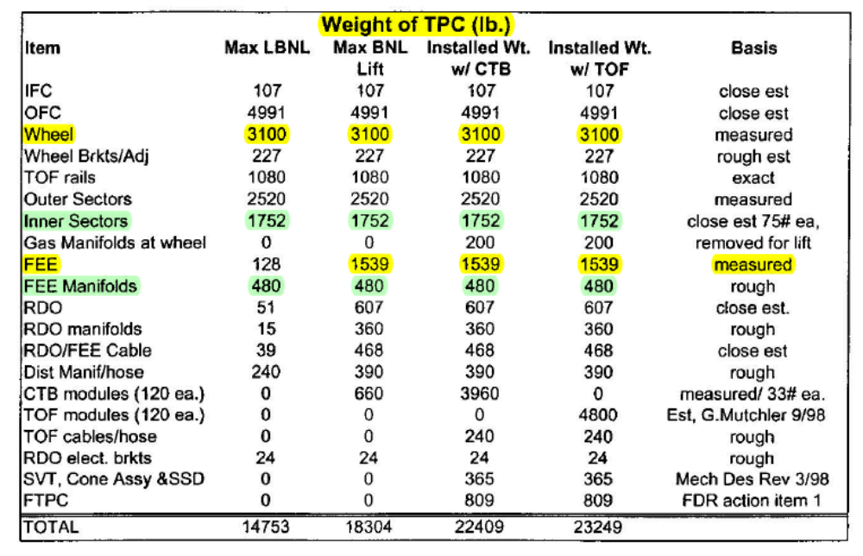
Critical Dimensions for the TPC
Item | Dimension | Comment
Length of the TPC | 420 cm | Two halves, 210 cm long
Outer Diameter of the drift volume | 400 cm | 200 cm radius
Inner Diameter of the drift volume | 100 cm | 50 cm radius
Distance: cathode to ground plane | 209.3 cm | Each side
Cathode | 400 cm diameter | At the center of the TPC
Cathode potential | 28 kV | typical
Drift gas | P10: 90% Ar, 10% CH₄ | He-Ethane as an option
Drift Velocity | 5.45 cm/μsec | typical
Transverse diffusion (σ) | 230 μm/√cm | 135 V/cm & 0.5 T
Longitudinal diffusion (σ) | 360 μm/√cm | 135 V/cm & 0.5 T
Magnetic Field | 0, ±0.25 T, ±0.5 T | Solenoidal

Slide 35
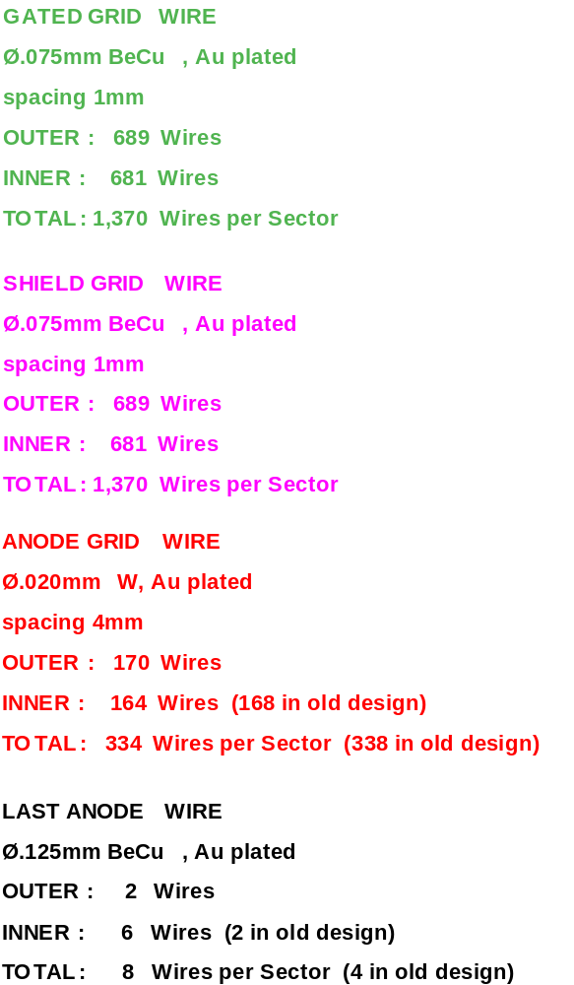
Location of Wires and Pads
Radius (Y) | Description
0.00 | Center of STAR Detector (vtx)
498.80 | Bottom of Full size PC Board
512.70 | Tertiary Fiducial L & R
519.05 | Strongback Bottom Edge
530.00 | Gated Grid Wire 1
531.00 | Gated Grid Wire 2
532.00 | Anode Wire 1 & GG W-3
536.00 | Anode Wire 2 & GG W-7
540.00 | Anode Wire 3 & GG W-11
540.25 | Secondary Fiducial
544.00 | Anode Wire 4 & GG W-15
548.00 | Anode Wire 5 & GG W-19
558.00 | Pad Row 1 - Center
574.00 | Pad Row 2 - Center
1166.00 | Pad Row 39 - Center
1179.45 | Primary Fiducial
1182.00 | Pad Row 40 - Center
1192.00 | Anode Wire 166 & GG W-663
1196.00 | Anode Wire 167 & GG W-667
1200.00 | Anode Wire 168 & GG W-671
1204.00 | Anode Wire 169 & GG W-675
1204.85 | Alternate Primary Fiducial
1208.00 | Anode Wire 170 & GG W-679
1209.00 | Gated Grid Wire 680
1210.00 | Gated Grid Wire 681
1214.32 | Strongback Top Edge
1220.67 | Tertiary Fiducial L & R
1235.42 | Top of Full size PC Board
References: LBL Drawings 24A055, 24A373, 24A374
Repeat pad rows every 16 mm
Wire Locations are the same as before except for the replacement of 6 thin anode wires with larger diameter anode wires (0.020 mm ⇒ 0.125 mm)

Slide 36
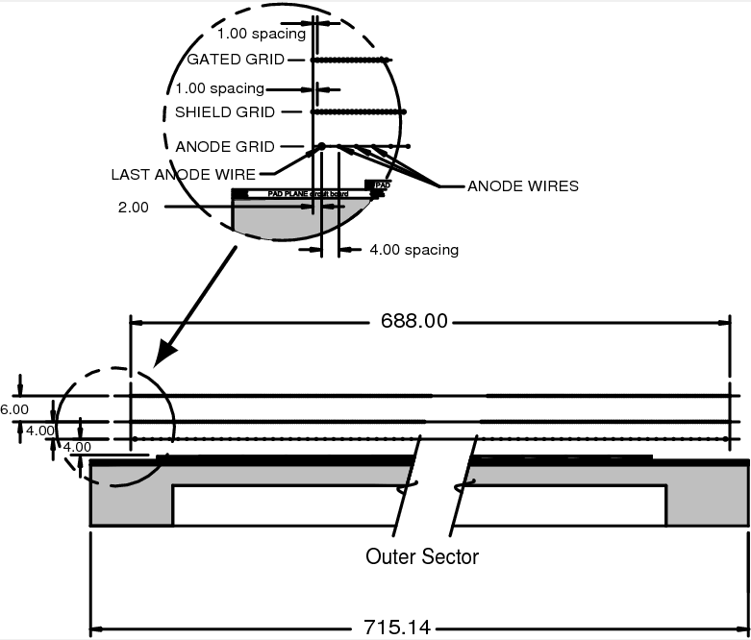
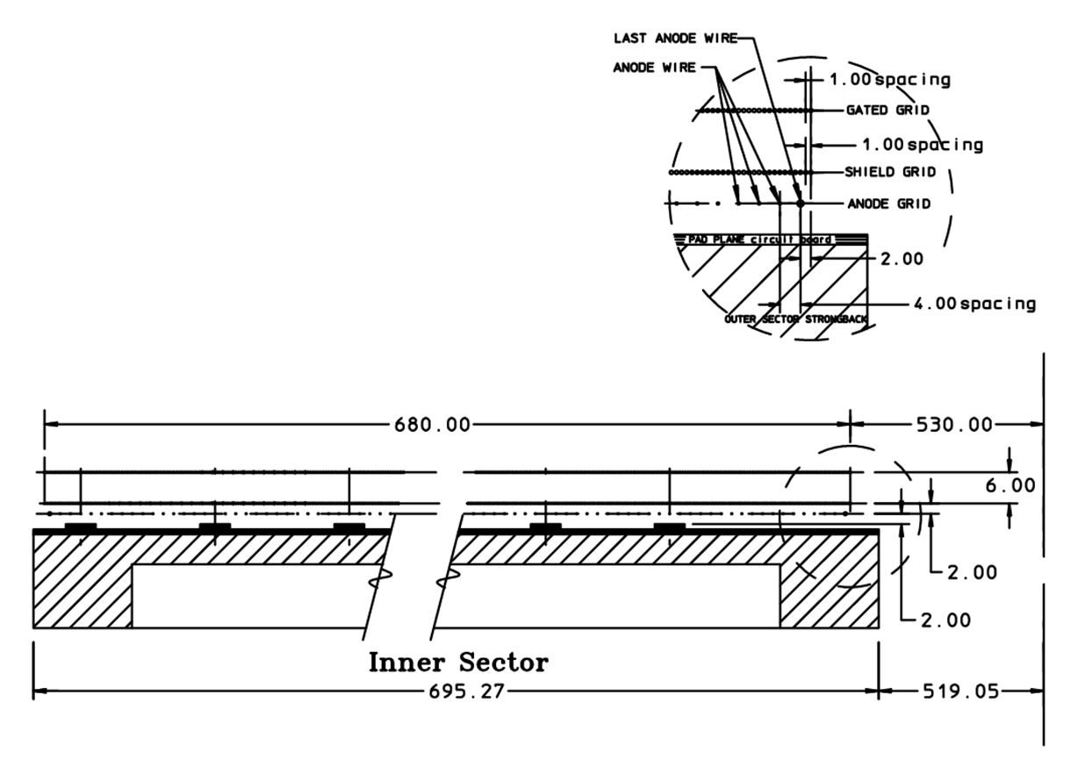
Inner sector detail

Slide 37
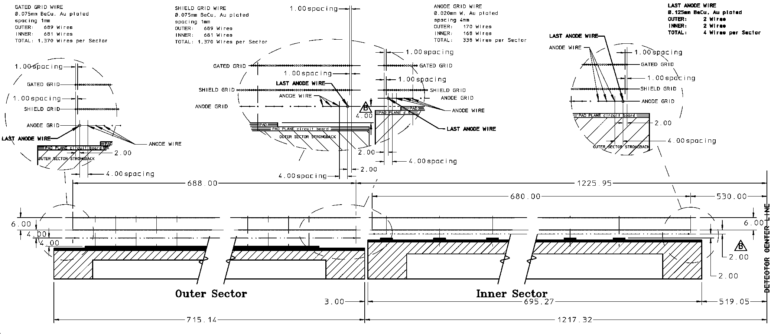
Inner / Outer sector detail
Note that inner and outer pad planes are not at the same height
Pad plane to wire grid heights not the same (4/4/6 vs 2/2/6)
3 mm gap between sectors, this is an issue during installation

Slide 38
Average mass distributions ( ±10°, 1.5 < η < 2.0 )
FEE | 3.60 %
FEE mounting bracket | 3.45 %
FEE rib | 0.45 %
FEE socket | 0.15 %
Cooling manifold | 3.25 %
RDO card | 0.90 %
Ribs | 2.70 %
Sector G10 | 0.45 %
Sector Aluminum | 3.20 %
Cables | ~1% (estimate)
FEE sub Total | 7.65%
Total | 19.15%
Table 6: The average radiation length budget for the components associated with a TPC inner sector (circa 1993) averaged over the fiducial volume of the sector. The average takes out the lumps in the mass distribution (for better or worse) but also illustrates how the budget for the Al on the front face compares to the electronics and cooling budget. The sector data have been averaged over a range from 1.5 < η < 2.0 and -10 < φ < 10 degrees. Geant simulations courtesy of Irakli Chakaberia.

