Slide 1
New PadPlane Connector Locations for the FEE electronics cards
August 14th, 2015

Slide 2
News
John Hammond and Bob Scheetz have finished laying out the new padplane
  Many thanks!!
Connector locations for the FEE cards are shifted, slightly, and slots are wider compared to the previous (circa 1995) locations
Changes
  Delete 30 locations from previous total of 55
  Add 3 new locations on the centerline
  New total: 25 + 3 = 28
  Connector locations remain the same in one dimension, but in the other dimension they all move down by 0.221”
    “Down” means toward the narrow end of sector
  Slots are to be made wider by 0.225”

Slide 3
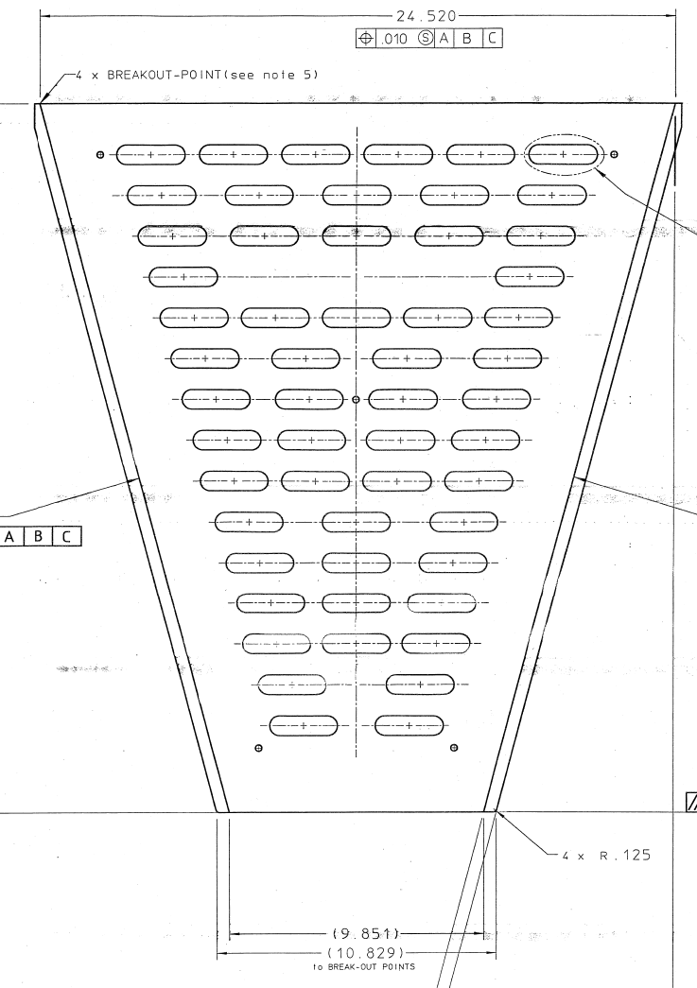
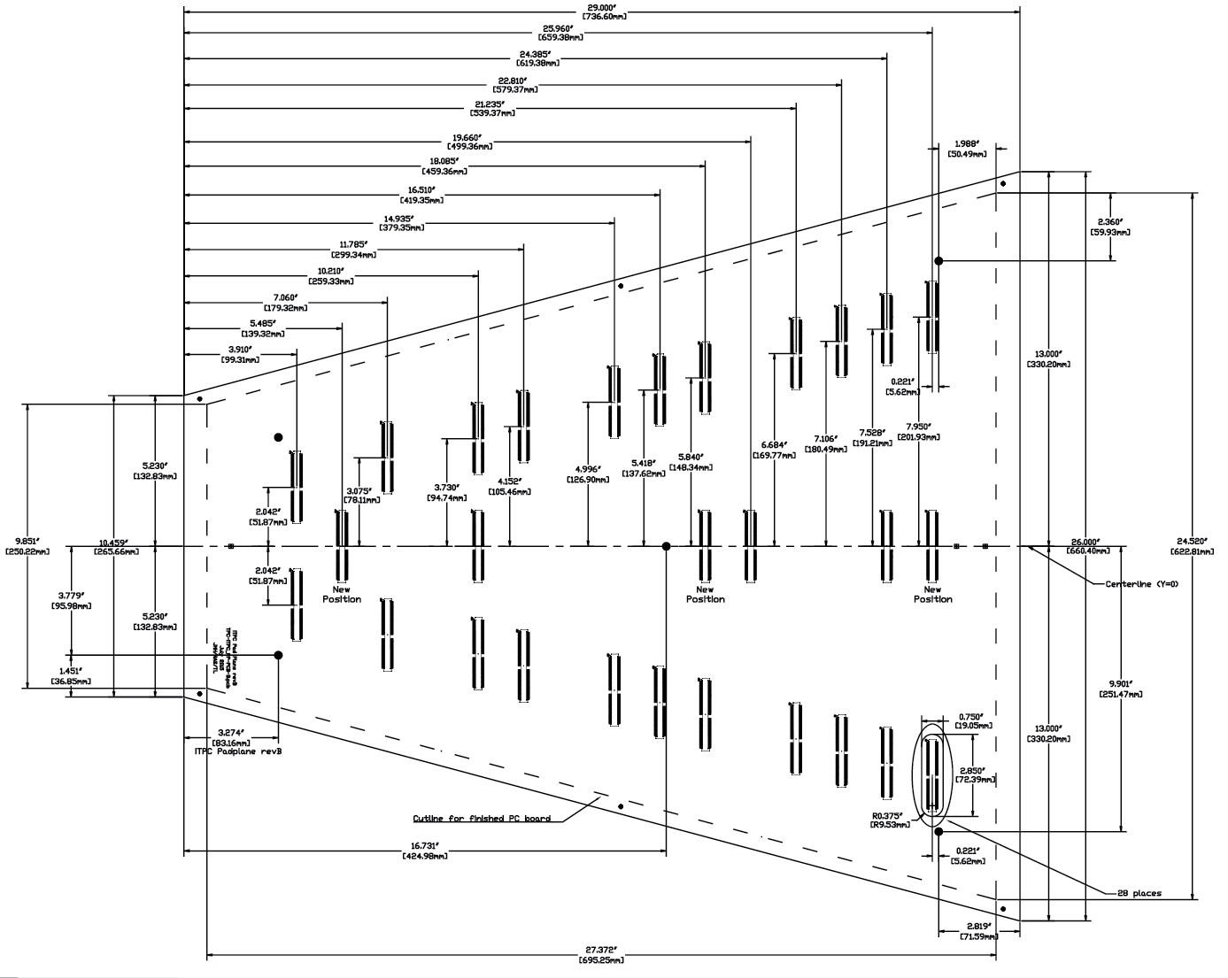
Old Compared to New

Slide 4
Old Compared to New
1 2 3 4 5 6
7 8 9 10 11
12 13 14 15 16
17 18
19 20 21 22 23
24 25 26 27
28 29 30 31
32 33 34 35
36 37 38 39
40 41 42
43 44 45
46 47 48
49 50 51
52 53
54 55

Slide 5
Add and Delete Slots
Delete Add
  2, 3, 4, 5 -- 3.5
  8, 10
  13, 14, 15
  19, 20, 22, 23
  25, 26 -- 25.5
  29, 30
  33, 34
  36, 37, 38, 39
  41
  46, 47, 48
  50
  52, 53 -- 52.5
1 2 3 4 5 6
7 8 9 10 11
12 13 14 15 16
17 18
19 20 21 22 23
24 25 26 27
28 29 30 31
32 33 34 35
36 37 38 39
40 41 42
43 44 45
46 47 48
49 50 51
52 53
54 55

Slide 6
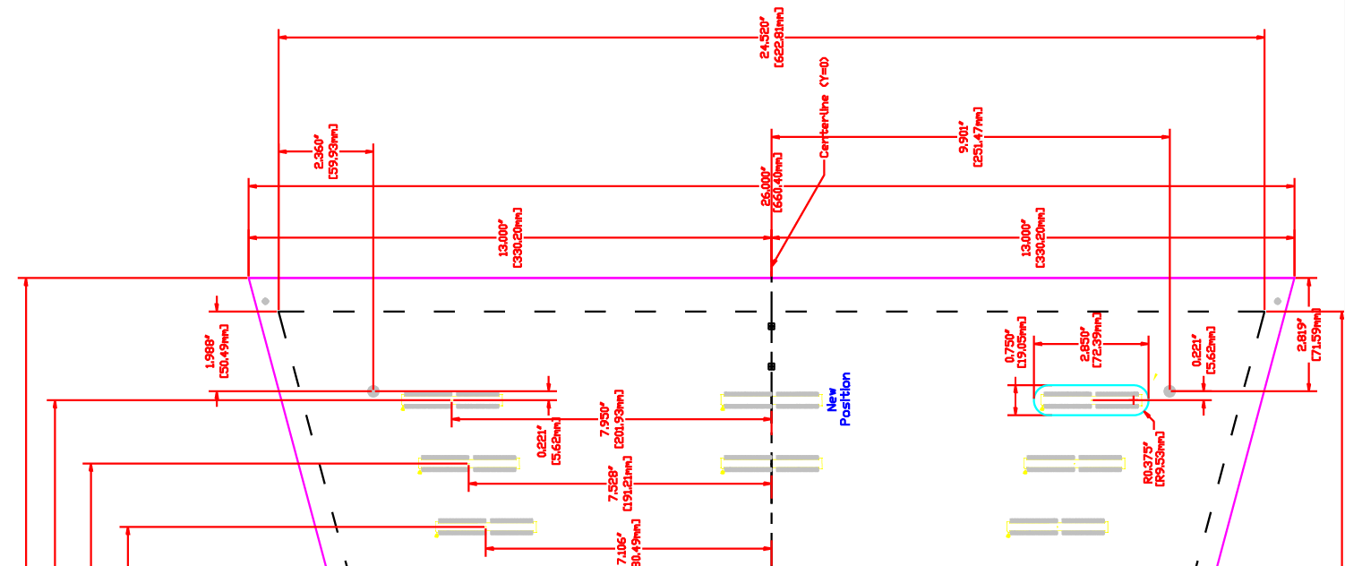
Shift and Widen Slots
Horizontal distance from centerline remains the same for all slots
New slots go on the centerline (3 total)
All slots (including new slots) are shifted down by 0.221” compared to positions and rows on drawing 24A368D (circa 1995)
All slots (including new slots) are 0.225” wider (total width = 2.850”)

Slide 7
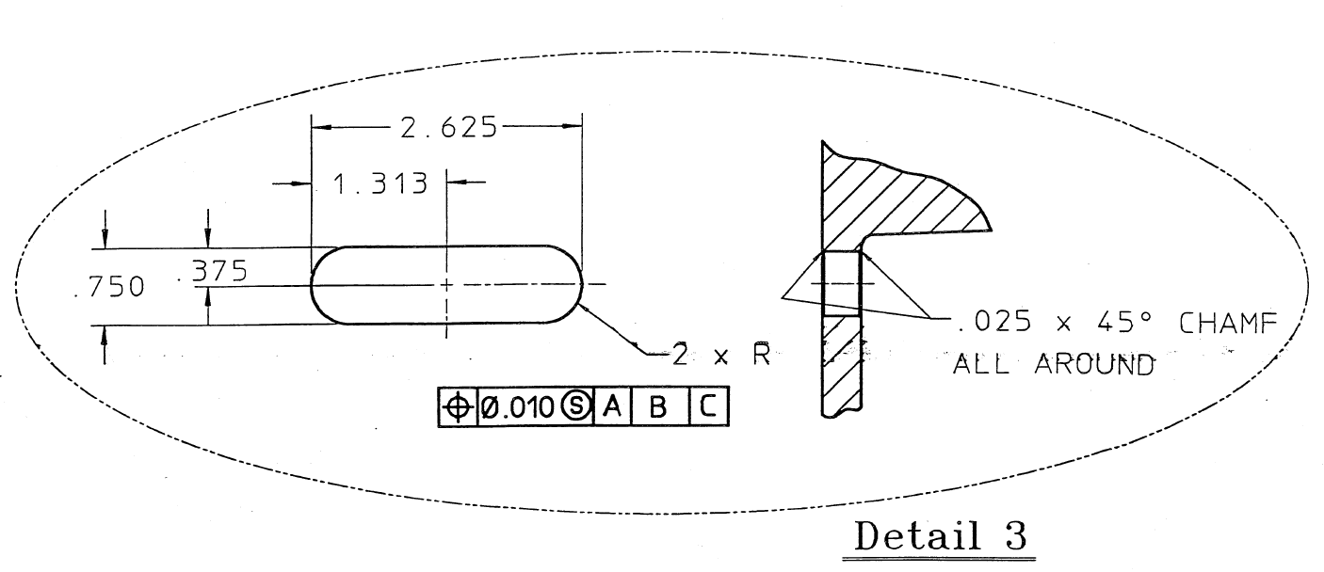
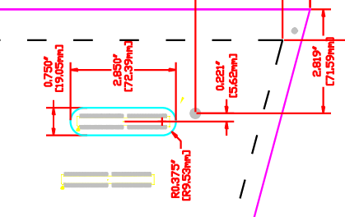
Slot Detail
Old Slot Detail from
LBL Drawing 24A368D
(circa 1995)
The connectors for the new electronics cards fit in the slots. The old cards used a right angle connector while the new cards will use a card-edge connector which is wider and necessarily shifted down slightly.
New Slot Detail

Slide 8
Connector Locations on the New PadPlane
Pdf and Dwg drawings available
http://rnc.lbl.gov/~jhthomas/public/iTPC/PadPlaneProposal/
Note that the padplane, as shown here, is larger than the strongback. The strongback outline is shown by the dashed line.

