Slide 1
Sector Tools – a conversation with Jon Wirth and Eric Anderssen
August 28th, 2015

Slide 2
News
Jon and Eric were willing to share their wisdom with me regarding several strongback machining techniques
  Drilling precision holes for taper pins
  Techniques for routing the edge of a G10 pad plane
These ideas were shared over a nice, long, dinner in Berkeley
This is a record of the things I didn’t know … other people may know these things already … but this is a record for my notebook
Recent change: the padplane will probably be built with G10 (non FR4) rather than the more exotic PFTE boards because G10 is cheaper.

Slide 3
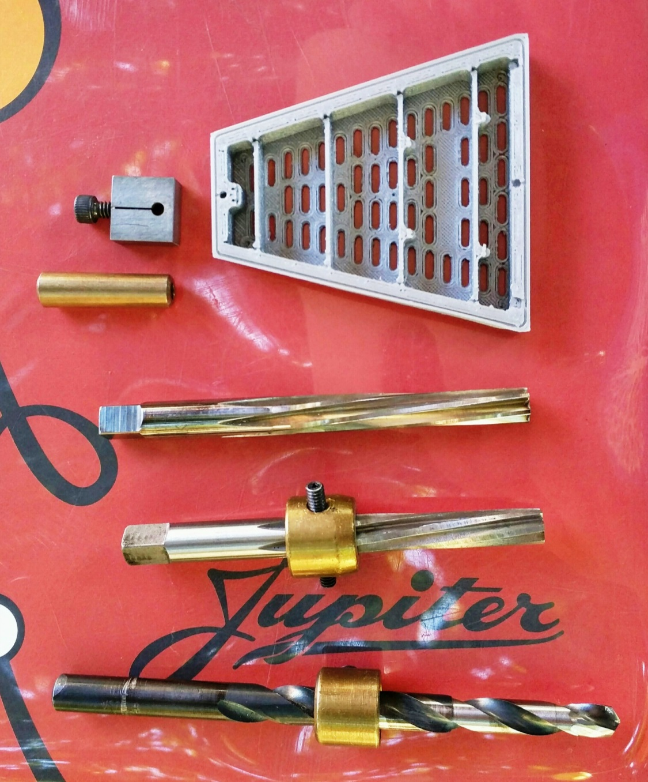
Pin and sector tools
Taper Drill
  First Step: for very course pin hole drilling
  Note that drill is ‘straight’ but was ground to have a taper on the lower end
Course cut Reamer
  Second step
  Machine operated (very rigid drill support e.g.: a milling machine)
Fine cut Reamer
  Third step
  “By hand”
Si-Bronze Pin
  #5 with 8-32 thread
Sector Model
  ~ 1/10 scale
Tooling ball lock
  Screw expands the block

Slide 4
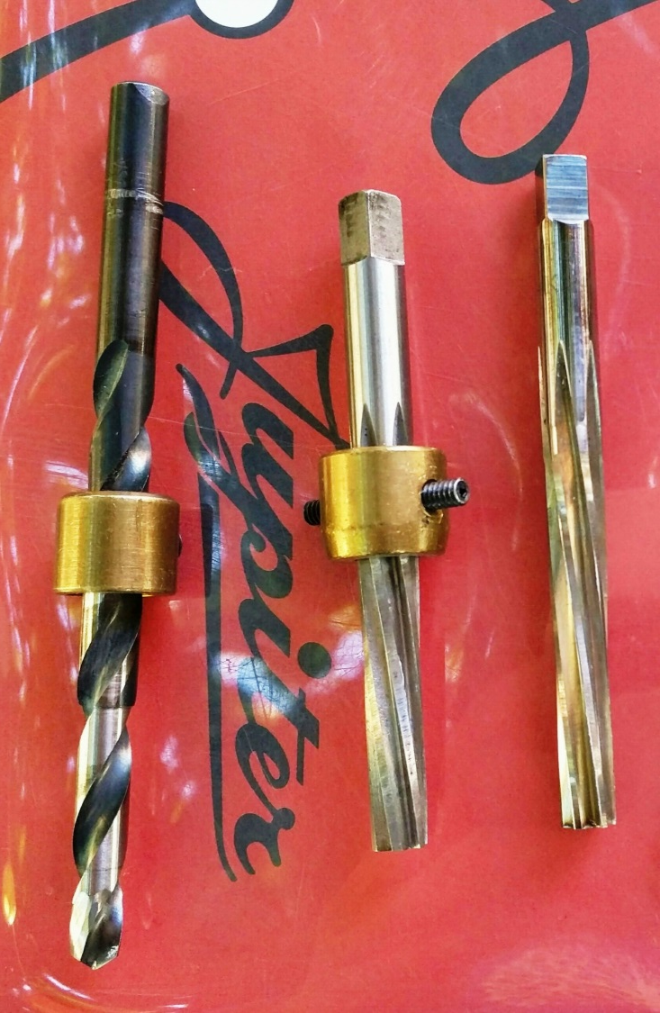
Drilling the #5 pin hole
Advice from Jon based on past experience
  Drill an undersize hole (with the ground drill) this will give you a ‘very course’ dimension for the hole. Drill was sized to accommodate the minor diameter of the course reamer.
  Then use a tapered reamer to make a ‘course’ cut in the hole. Make gentle cuts and repeat the operation several times to clear the chips out of the hole.
  Finally, use a ‘fine’ reamer to achieve the final dimensions for the hole. Make several fine cuts to clear the chips out of the hole.
  Multiple finishing reamers will be required due to wear from the wiremount G10
The brass collar is used as a depth gauge to prevent the reamer from going too deep.
  Visual reference, only. Brass should not make contact with strongback surface.
  Note that the course tapered drill is ground with a grinding wheel. Start with a straight drill. This takes practice to get it right. The transition from silver to dark color on the body of the drill marks the beginning of the tapered portion of the drill. The dark portion is the normal drill diameter, silver is tapered.

Slide 5
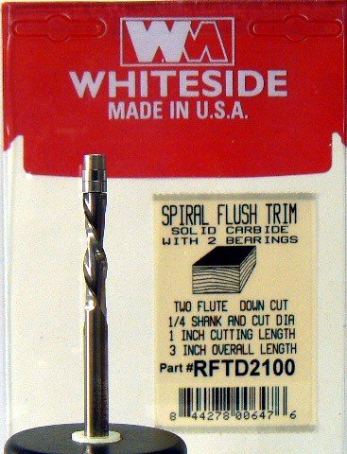
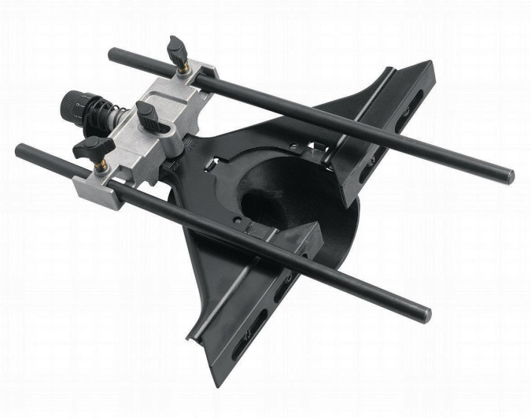

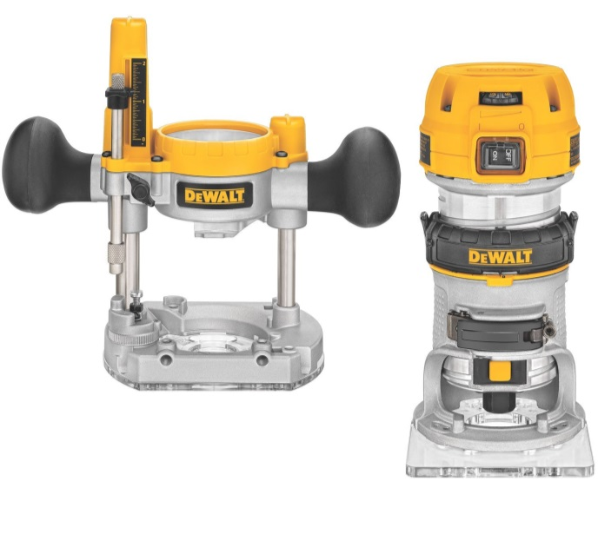
Routers & Accessories
8785A44
http://www.amazon.com/DEWALT-DW6913-Router-Adjustment-Adaptor/dp/B00002232W/ref=pd_sim_469_5?ie=UTF8&refRID=04HE8GWW1BV11K3PN1H0
http://www.amazon.com/DEWALT-DWP611PK-Torque-Variable-Compact/dp/B0049ZFUK2/ref=sr_1_3?ie=UTF8&qid=1440960829&sr=8-3&keywords=dewalt+router+dw618b3
  http://www.amazon.com/Whiteside-Router-Bits-RFTD2100-Diameter/dp/B0012JI88E/ref=pd_bxgy_469_text_y

Slide 6
General Tooling Remarks Routing the PadPlane
Routing the edges of the padplane, after they are glued to the strongback, can be accomplished with a fiberglass router bit such as McMaster Carr 8785A44. ¼” diameter is good.
A custom router base is (probably) required because it is hard to find bottom bearing router bits for fiberglass
  It may also be possible to use a more common “fluted” bit with a bottom bearing. But recommend using a down-cutting bit (the spiral of the bit pushes the board down while cutting) to prevent lifting the board off the pad plane and possibly breaking the glue joint.
  http://www.amazon.com/Whiteside-Router-Bits-RFTD2100-Diameter/dp/B0012JI88E/ref=pd_bxgy_469_text_y
Routing should be done in two or more steps. Put a piece of high quality tape (NOT masking tape) on the side of the strongback to create a rough cut that is within about 0.010” from the final dimension. Then cut a second time without the tape (using a fresh/sharp router bit) to achieve a precisely flush edge.
  2 rough cuts, then 2 final cuts
The router bits, when used with G10, get dull and should be replaced often.
A vacuum attachment is required to catch the G10 dust (hazardous to humans)

Slide 7
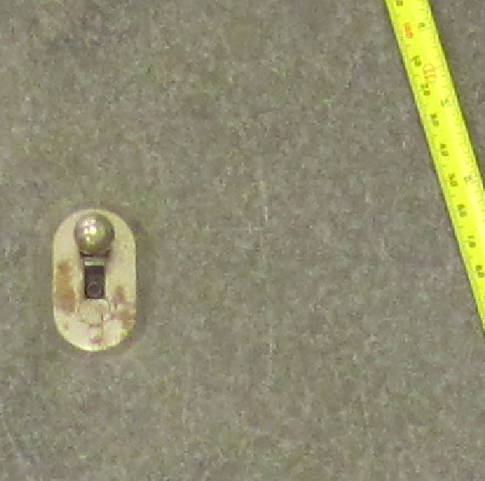
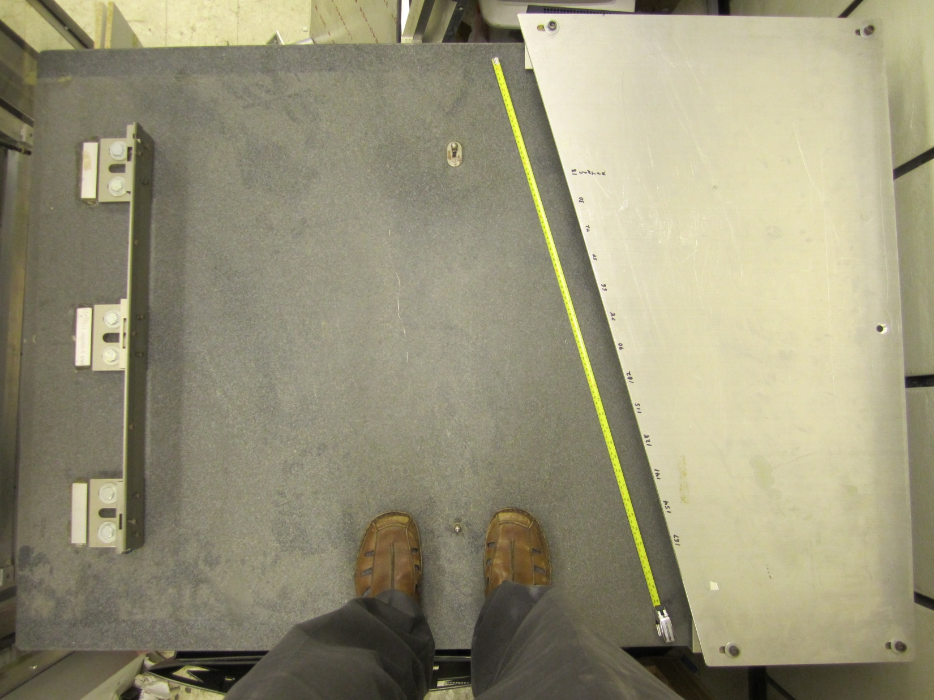
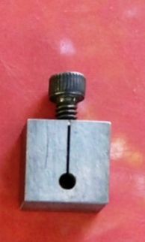
Tooling Ball Lock
t
Screw expands the block and locks the tooling ball in place.
The tooling ball has “flats” ground into it’s cylindrical base.

Slide 8
Notes about screws and threads
It is useful to have a #8-32 tap available in the shop just in case one of the #5 taper pins has a bad thread (inside).
Plan to send #8-32 screws and an #8-32 tap to Shandong U.
Send 10-32 screws for wire mounts, and ¼-20 bolts for spider mounts. (what head, what length?)
We will also need a set of English screws to attach electronics boards to the sides of the sectors

Slide 9
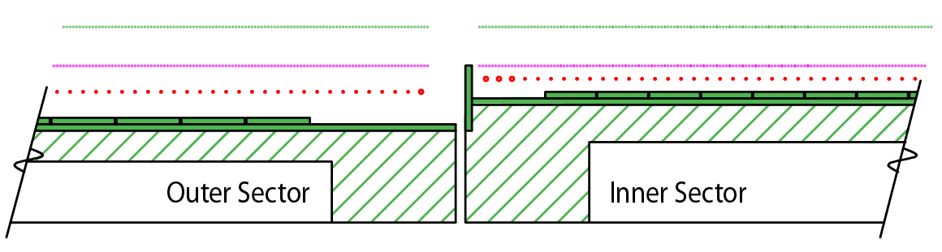
Wires to the Wall to prevent Grid Leak
We plan to put a wall between the inner and outer sectors
Notch the edge of the inner sector to allow for bonding (or bolting) of 1/16 inch thick PCB to the inner sector (Notch 0.070” deep, < 1” tall)
Scientific design not complete … but very likely will require an external voltage supply to bias a portion of the wall (perhaps a strip, or two, of Cu)
There is one spare HV connector per sector
Design Consideration: put a groove under the Wall to allow a cable to run from the spare connector to the connection point on the wall.
  Groove may go full length under the wall and around the corner to the HV connector. Two grooves to allow for possibility of two cables (?).
  Change PadPlane ground-plane layout to reflect new routing pattern w/notch

