Slide 1
A proposal to close the Grid Leak
“it will never die”
Yuri Fysiak, Jim Thomas & Gene VanBuren
Eric Anderssen, Howard Wieman & Jon Wirth
9/26/2015

Slide 2
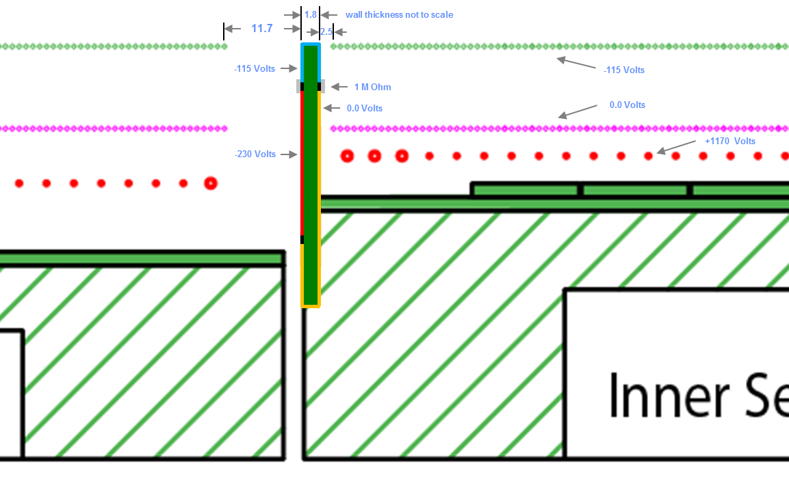
Proposal 1 to close the “Grid Leak”
Wall is 1.8 mm thick Printed Circuit Board with Cu on both sides
Grey bumps are 1 M Ohm type 603 surface mount resistors
-115 Volts matches the GG voltage when it is “open”
-230 Volts provided by external power supply, -115 V provided by resistors to 0 Volts

Slide 3
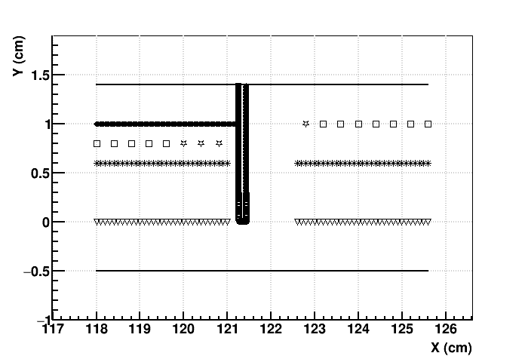
Yuri’s Simulation Geometry
Outer Pad Plane
Inner Pad Plane
Fat Anode Wire
20 μm Anode wires
Ground Grid wires
Gated Grid wires
Central Membrane
Pad Plane on top, Central Membrane at bottom
Rotate ME views 180° around an axis coming out of the page
Electrons float up, Ions fall down
Note that Central Membrane is only 5 mm from the GG

Slide 4
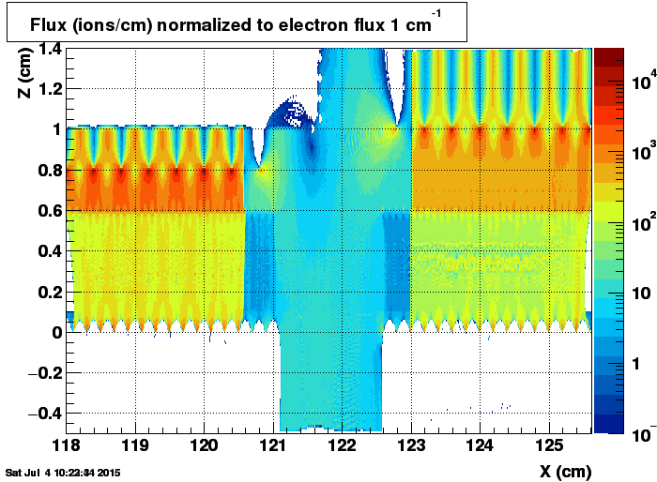
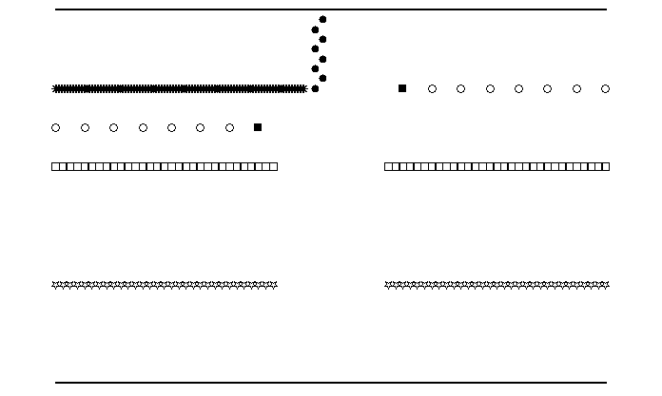
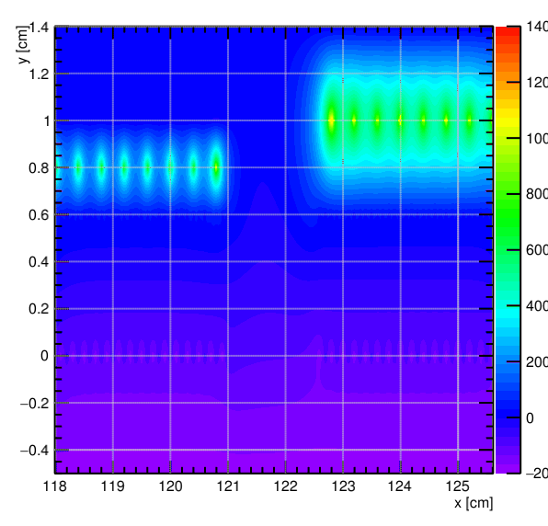
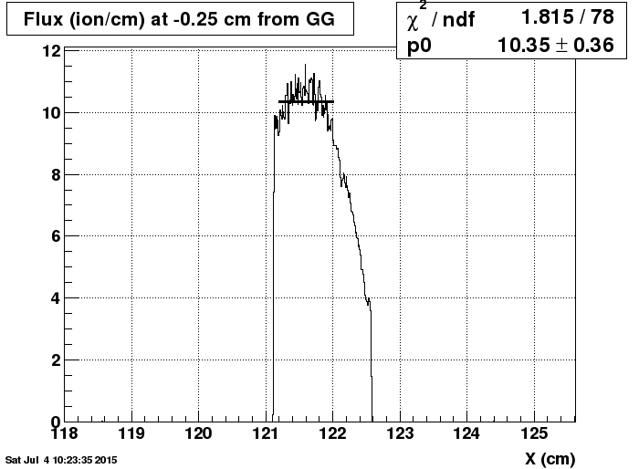
Normal Geometry: No Wall
Geometry
Grid Leak
Ion Flux
1 e⁻/cm in,
~10 ions/cm out
Equipotential Lines

Slide 5
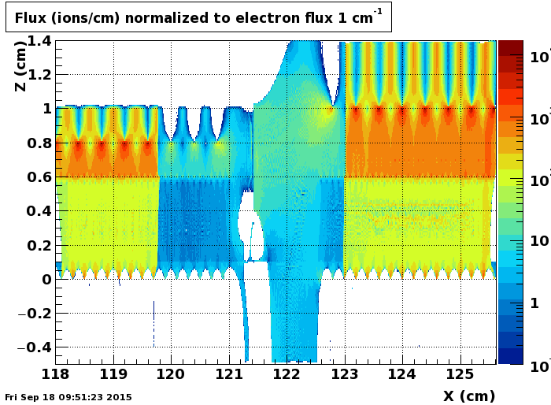
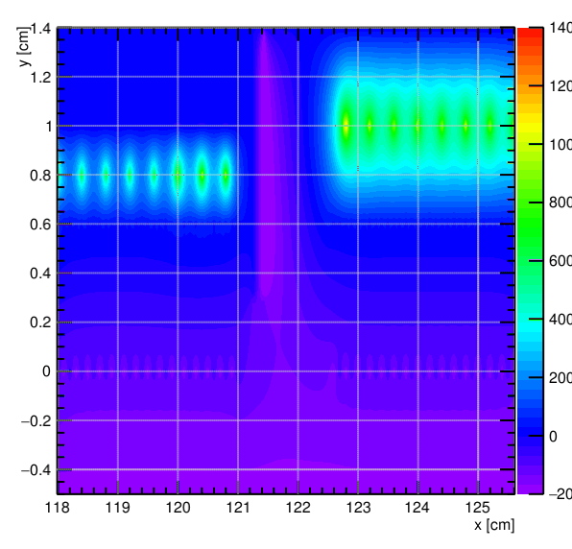
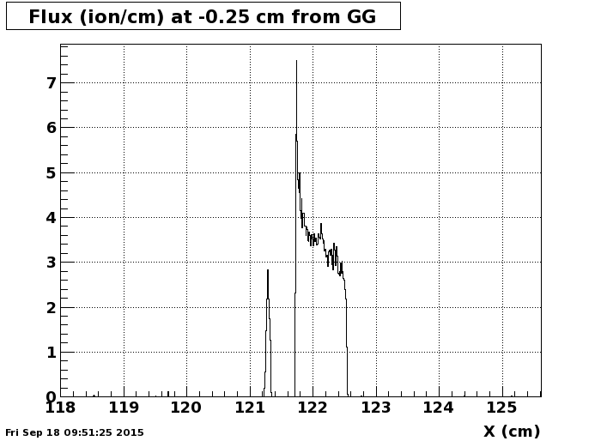
-230 volts on outside of wall

Slide 6
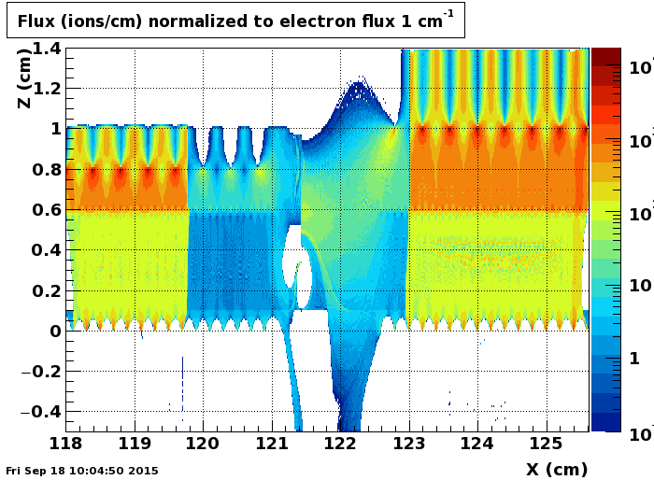
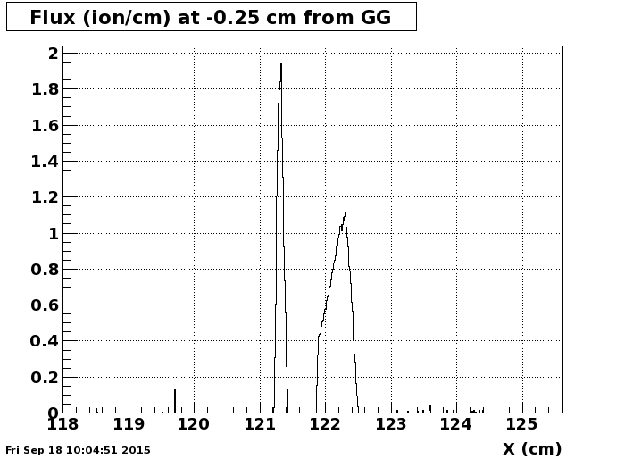
-690 Volts on outside of wall

Slide 7
Proposal 1: Conclusions
A Biased wall will work
Order of magnitude decrease of Ion Flux can be achieved
~700 volts required to do a good job
Note that equipotential lines (lower right panels) guide the ions to the wall
Mechanical Engineering is achievable
  Requires 0.070” deep notch in top and bottom of inner sector so 1/16” G10 wall can be glued or screwed in place
  Requires modest change in routing of Pad Plane, perhaps want to redesign ground plane on Pad Plane to reflect new routing pattern
  One bias connector available on inner sector, have to run cable down existing groove on side (under pulser and GG boards)
  Need to route bias cable around the corner of the sector to access wall
  Want to do this on both top and bottom of Inner Sector (grid leak in both places)

Slide 8
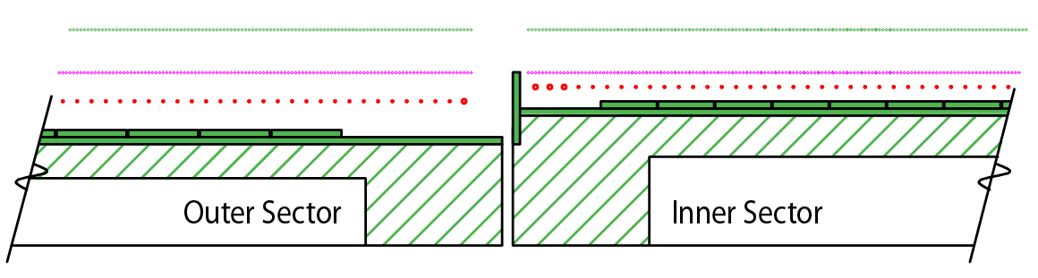
Proposal 2 to close the “Grid Leak”
11.7
1.8
2.5
2.0
2.0
-115 Volts
0.0 Volts
+1170 Volts
0.0 Volts
0.0 Volts

Slide 9
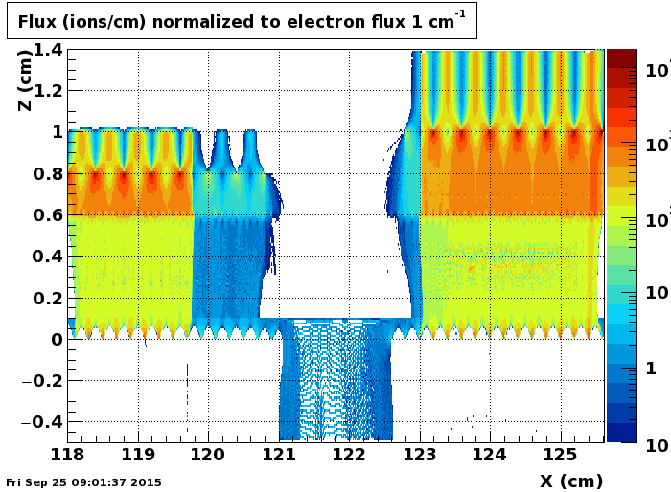
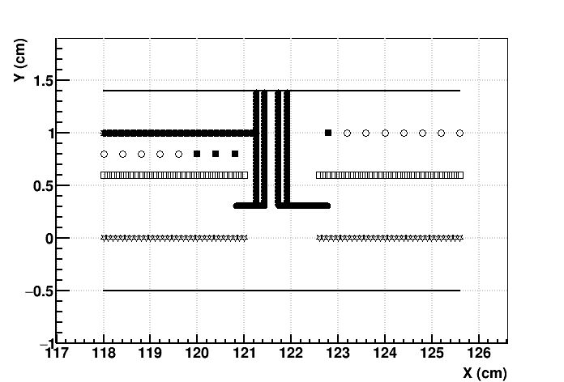
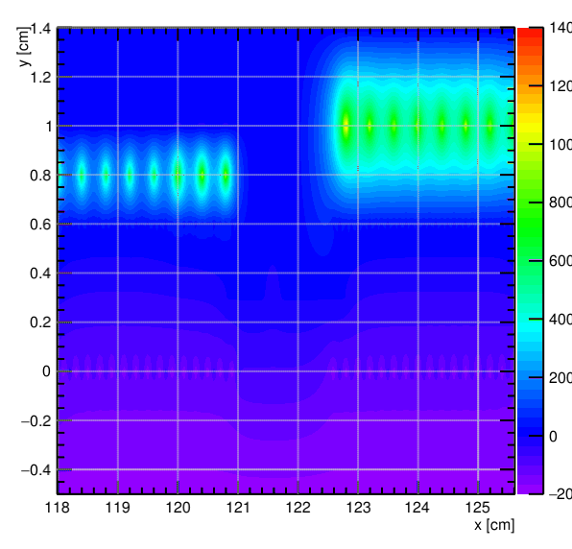
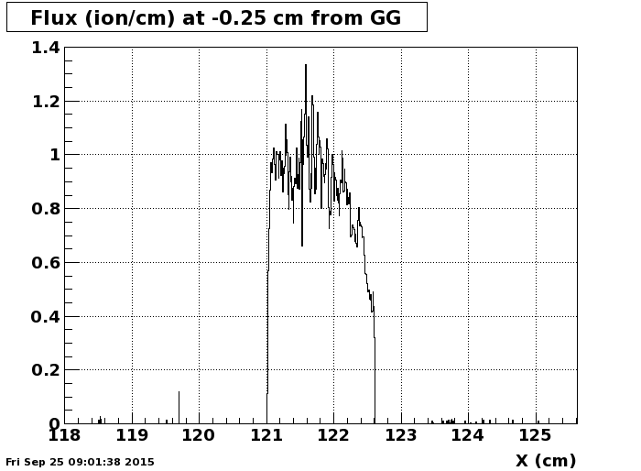
Grounded fingers between the grids: Inner & Outer Sectors!

Slide 10
Proposal 2: Conclusions
Grounded Fingers will work – very simple conceptual design
Order of magnitude decrease of Ion Flux can be achieved
However, this solution requires changes to the outer sectors while still installed inside the TPC
  Hands, heads, and tools inside the TPC! Epoxy, too.
  Careful fixturing may make this solution possible
  Engineering required, Risk analysis required
Mechanical Engineering is achievable
  Requires 0.070” deep notch in top and bottom of inner sector so 1/16” G10 wall can be glued or screwed in place
  Requires modest change in routing of Pad Plane, perhaps want to redesign ground plane on Pad Plane to reflect new routing pattern
A careful analysis of the equipotential lines (lower right panel) suggests that a river of ions flows very close to the GG and out the gap
  The grid leak will never completely die … the river of ions will exist as long as there is a physical gap between the inner and outer gated grids

Slide 11
Grand Conclusion
Further work is needed before we can decide upon which solution is best: Biased Wall or Fingers between the grids
  Is it reasonable to put ~700 volts on a wall near the wires?
  Engineering design & Fixturing required for “Finger” solution
  Risk analysis required for both proposals
Both designs can/should be further optimized
  But is seems unlikely that we can kill the grid leak substantially more than a factor of 10 below the current design
The Mechanical Engineering design for the Strongback is the same for both of these solutions
  We should add a 0.070” notch on the top and bottom sides of the inner sector to accommodate a 1/16” G10 (or Cu) Wall
  Assume that we will run a cable to bias the wall, but we may not use it
I believe the Mechanical Engineering design of the strongback is complete. We can now proceed with final drawings and fabrication of prototypes (JT).

Slide 12
Backup Slides

Slide 13
Proposal 3 to close the “Grid Leak”
11.7
1.8
2.5
2.0
-115 Volts
0.0 Volts
+1170 Volts
0.0 Volts
0.0 Volts
Try this solution at 40 volts. This is the other end of the swing of the GG (as is 190). The advantage of 40 volts is that wall terminates 2 to 3 mm above the ground grid.

Slide 14
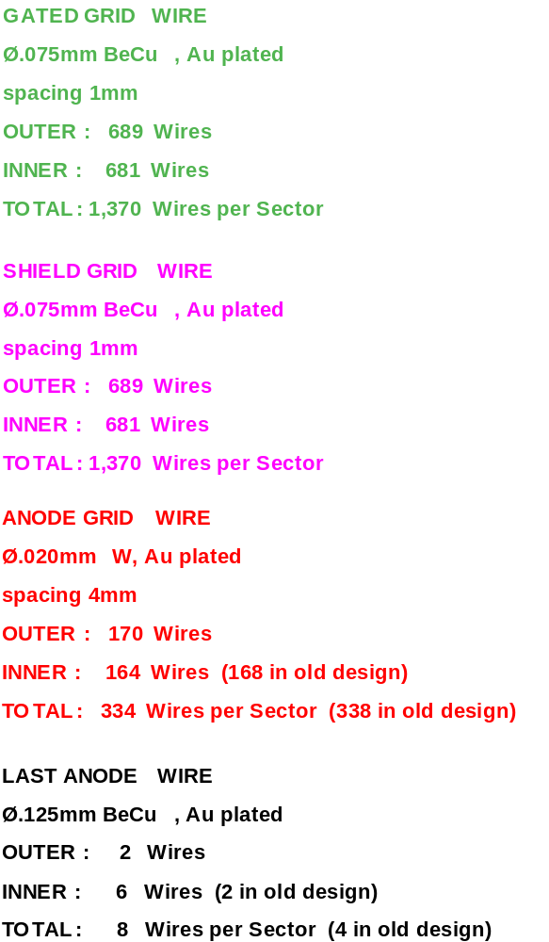
Location of Wires and Pads
Radius (Y) | Description
0.00 | Center of STAR Detector (vtx)
498.80 | Bottom of Full size PC Board
512.70 | Tertiary Fiducial L & R
519.05 | Strongback Bottom Edge
530.00 | Gated Grid Wire 1
531.00 | Gated Grid Wire 2
532.00 | Anode Wire 1 & GG W-3
536.00 | Anode Wire 2 & GG W-7
540.00 | Anode Wire 3 & GG W-11
540.25 | Secondary Fiducial
544.00 | Anode Wire 4 & GG W-15
548.00 | Anode Wire 5 & GG W-19
558.00 | Pad Row 1 - Center
574.00 | Pad Row 2 - Center
1166.00 | Pad Row 39 - Center
1179.45 | Primary Fiducial
1182.00 | Pad Row 40 - Center
1192.00 | Anode Wire 166 & GG W-663
1196.00 | Anode Wire 167 & GG W-667
1200.00 | Anode Wire 168 & GG W-671
1204.00 | Anode Wire 169 & GG W-675
1204.85 | Alternate Primary Fiducial
1208.00 | Anode Wire 170 & GG W-679
1209.00 | Gated Grid Wire 680
1210.00 | Gated Grid Wire 681
1214.32 | Strongback Top Edge
1220.67 | Tertiary Fiducial L & R
1235.42 | Top of Full size PC Board
References: LBL Drawings 24A055, 24A373, 24A374
Repeat pad rows every 16 mm
Wire Locations are the same as before except for the replacement of 6 thin anode wires with larger diameter anode wires (0.020 mm ⇒ 0.125 mm)

Slide 15
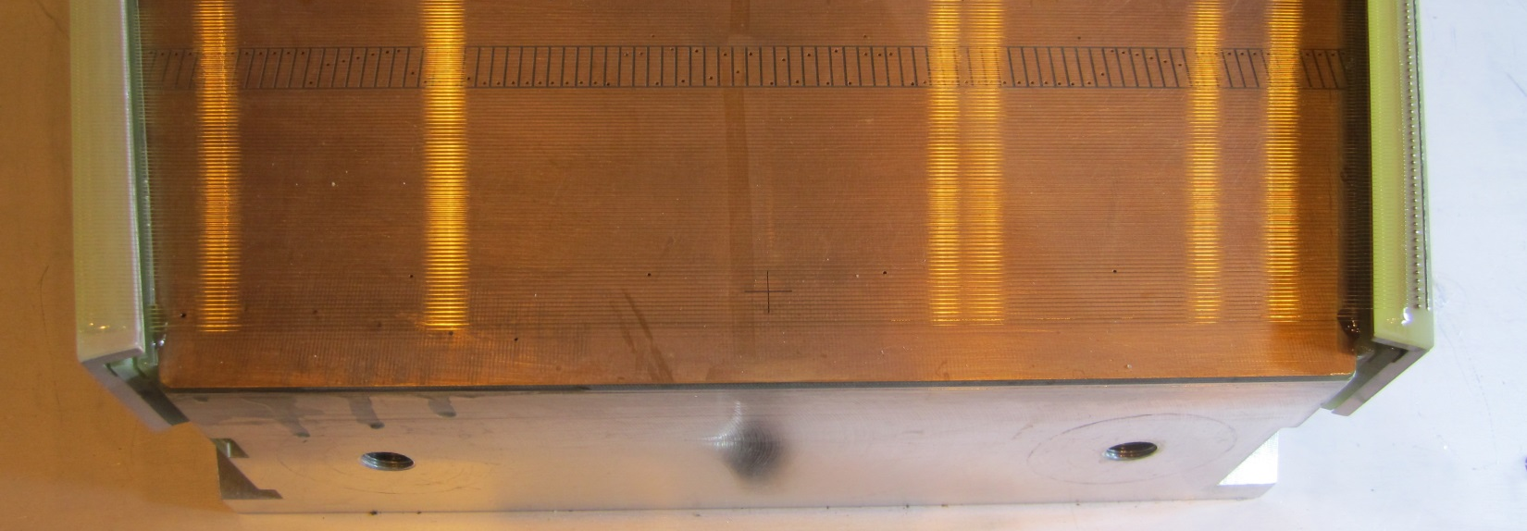
Inner Inner solution – first impressions
Inner inner solution will be more complex because distance from edge of strongback to wires is greater. Perhaps use the outer solution, fingers between ground plane and GG, at 40 volts. Now we can use a notch and a fat wall (1/4”) and or fingers between the grids.

Slide 16
Inner Inner Solution #2
A metal wall at ground potential
The main part of the wall is “fat”, but fastens to the strongback in the same way that the inner/outer grid leak walls attach
“Free Machining” Brass
Needs simulation to prove it works … but very likely it will work if the wall is close enough to the wires.

