Slide 1
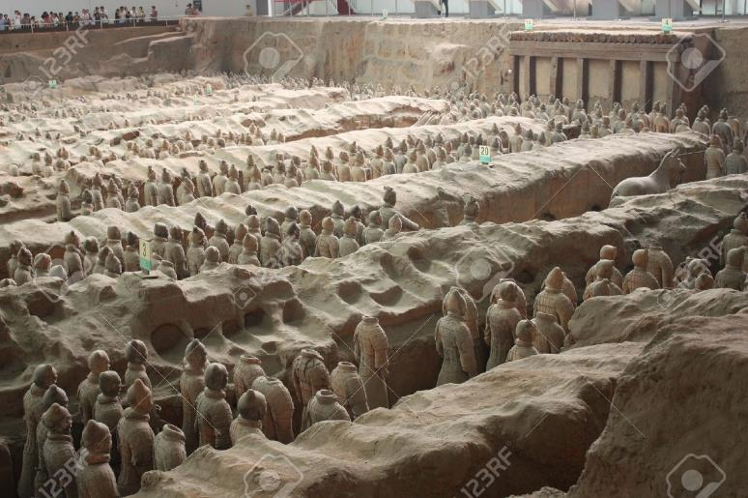
The STAR iTPC Upgrade – status and news
Jim Thomas, and a cast of thousands
March 15th, 2016
I was not able to find a picture of a cast of thousands, but I was able to find a picture of a thousand casts

Slide 2
Who, what, when, where, why and how
Who
  BNL, CTU Prague, Kent State, LBL, NPI Prague, SDU Shandong, SINAP Shanghai, UC Davis, UTA, USTC Hefei
What
  Upgrade the inner sectors of the STAR TPC to increase rapidity coverage and improve tracking and dE/dx at forward rapidities
When
  Proposed to BNL in 2011, presented to Tribble Committee in 2012
  Funding to STAR this month (maybe), ready to take beam in March 2019
Where
  Key Science Institutions: BNL, Kent, LBL, UC Davis, USTC …
  Key Projects at BNL (electronics & installation), LBL (sector mechanics), SDU (MWPCs)
Why
  Beam Energy Scan in 2019/2020
How
  Make as few changes to the existing apparatus as possible because this is a high risk upgrade due to the limited time left in the schedule
Alex says I’ve been giving the same talk for 5 years. He is correct. If he starts snoring, just poke him gently to stop the noise but don’t wake him up.

Slide 3
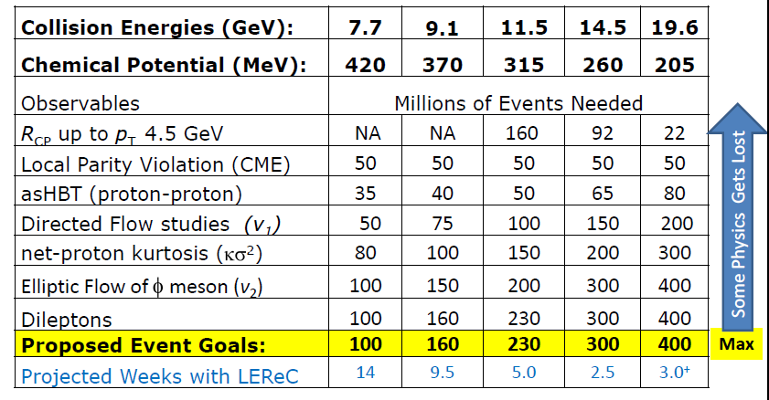
Beam Energy Scan – Topics and Commitment
BESII: an NSAC endorsed milestone in the LRP

Slide 4
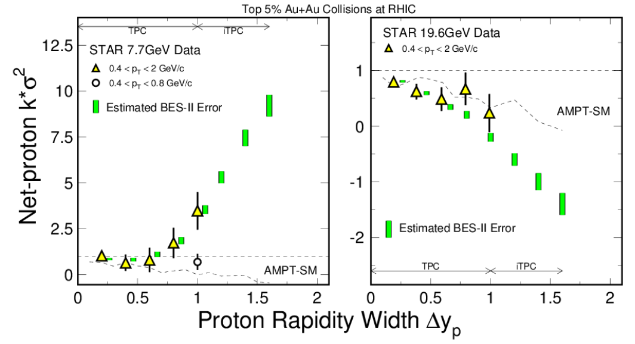
iTPC PID/acceptance needed for net-proton Kurtosis
Money Plot #1
Net proton kurtosis expected to rise as the 4th power of acceptance if Δy_{acc} < y_{corr}
Otherwise the growth is linear … so our results are sensitive to correlation length
Significant measurements at high y are possible due to decrease in error bars
  AMPT simulations shown, significance of measurements wrt theory is important
  Xiaofeng Luo and Misha Stephanov have made important contributions to the theory/experiment interface
    http://landau.phy.uic.edu/~misha/highmom-star/acceptance.pdf

Slide 5
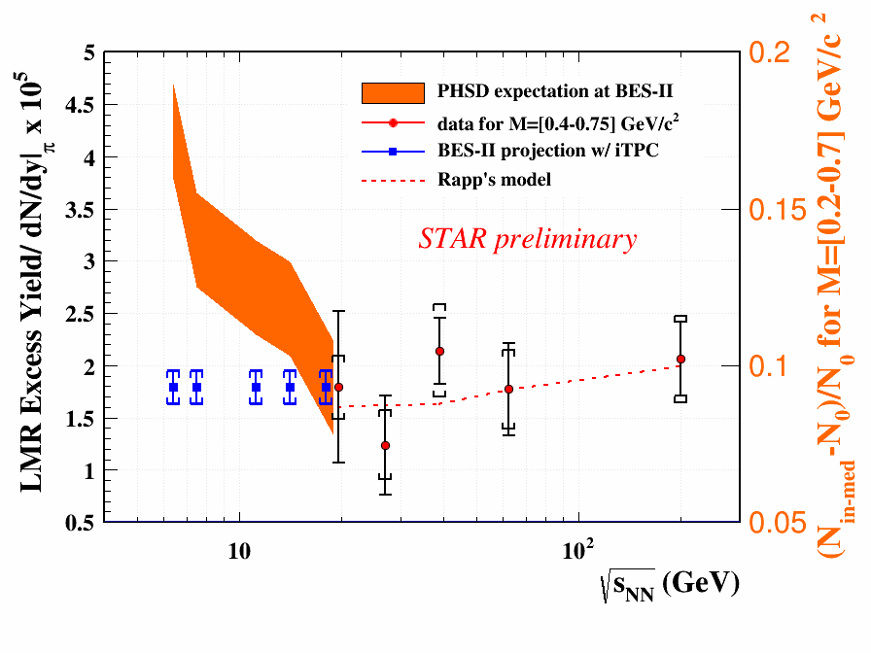
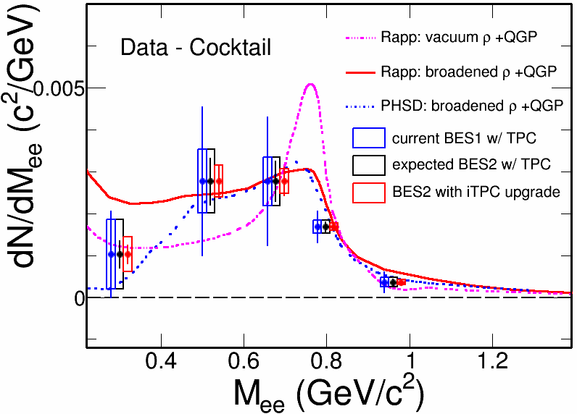
Enable Di-Electron Measurements
Money Plot #2
Systematic study of di-electron continuum from √𝑆_{𝑁𝑁} = 7.7 – 19.6 GeV
  Vector meson suppression due to (possible) Chiral symmetry restoration
Inner Time Projection Chamber (iTPC) upgrade: reduce systematic error of the background (important), and improves acceptance for signal at 0.4 < M_{ee} < 0.7
Distinguish models with different ρ-meson broadening mechanisms (e.g. Rapp’s method vs. PHSD)
Study the total baryon density effect on LMR excess … projected error bars shown

Slide 6
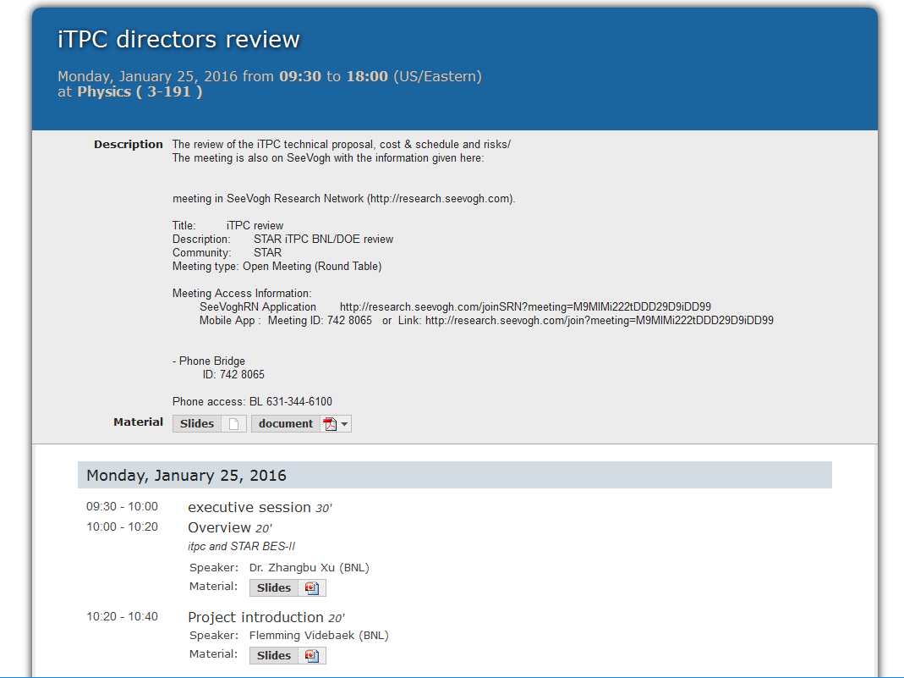
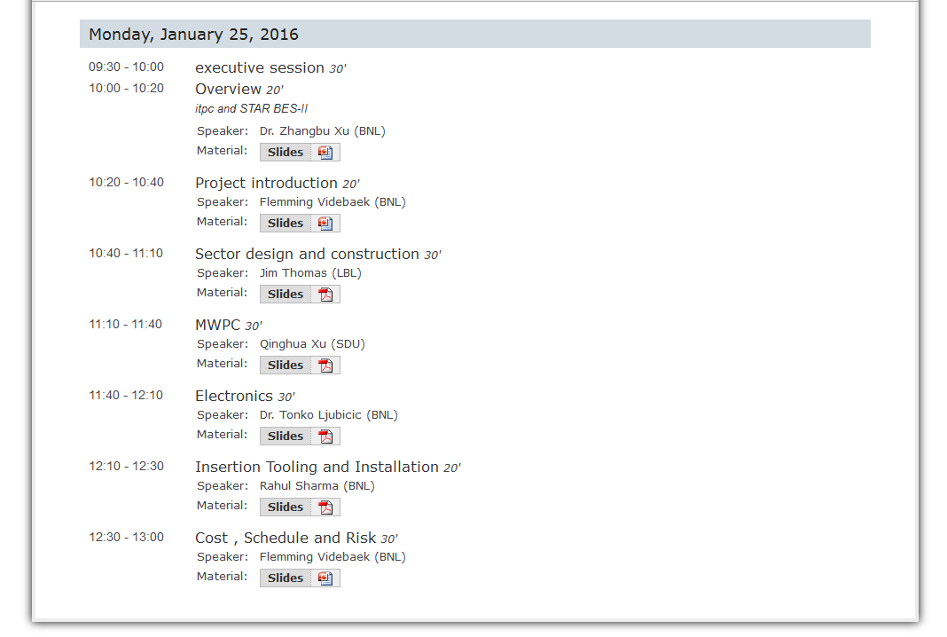
Recent Reviews and Publications
iTPC Short Summary
  https://drupal.star.bnl.gov/STAR/system/files/Summary_September14th_iTPC_final.pdf
iTPC Proposal and CDR
  STAR Note SN0629
  https://drupal.star.bnl.gov/STAR/starnotes/public/sn0619
Technical Design Report
  STAR Note SN0644
  https://drupal.star.bnl.gov/STAR/starnotes/public/sn0644
Cost and Schedule review
  https://indico.bnl.gov/conferenceDisplay.py?confId=1711

Slide 7
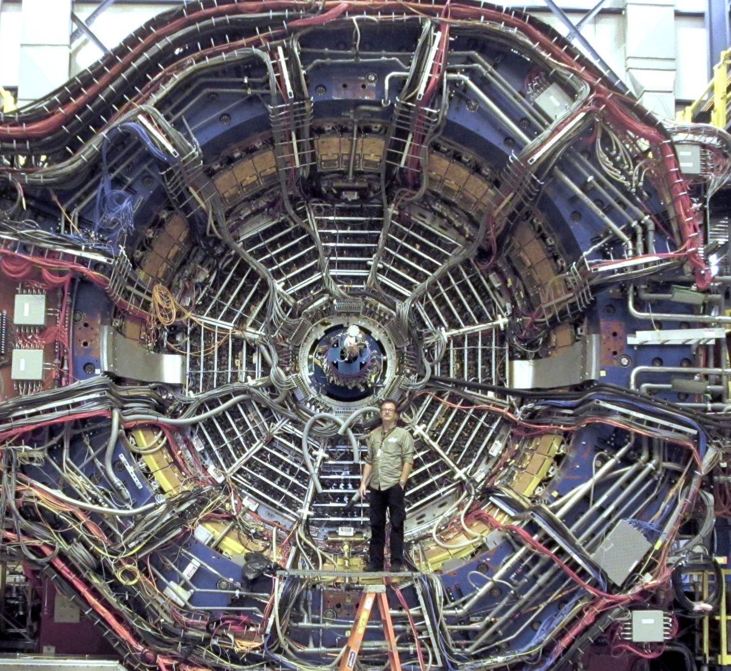
The STAR Detector at RHIC

Slide 8
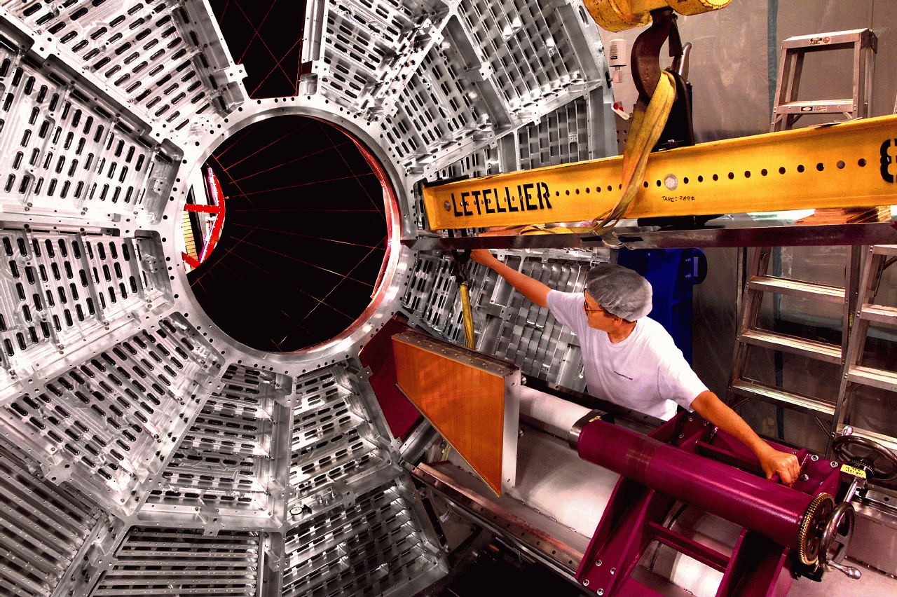
Sector Insertion – special tools required ⇒ BNL

Slide 9
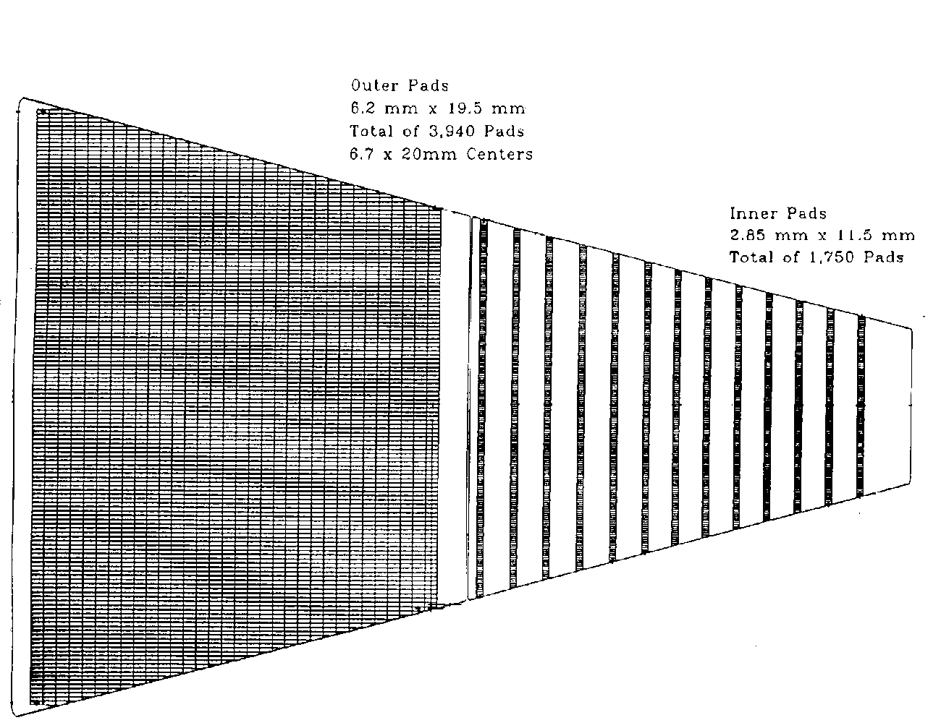
Goal: Hermetic coverage & better acceptance
60 cm
190 cm
Currently, the outer pad plane is hermetic while the inner pad plane is not
  Goal: Add more pad rows on the inner sector, 2X total pad count
The upgrade will provide better momentum resolution, better dE/dx resolution, and improved acceptance at high η

Slide 10
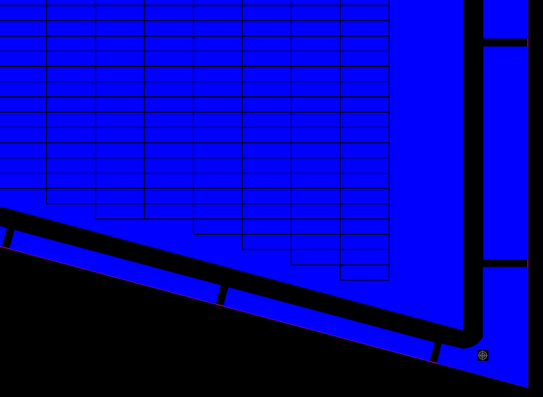
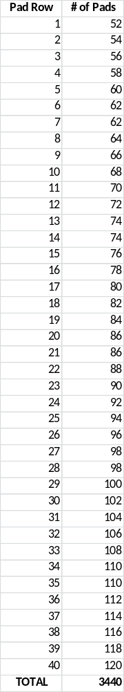
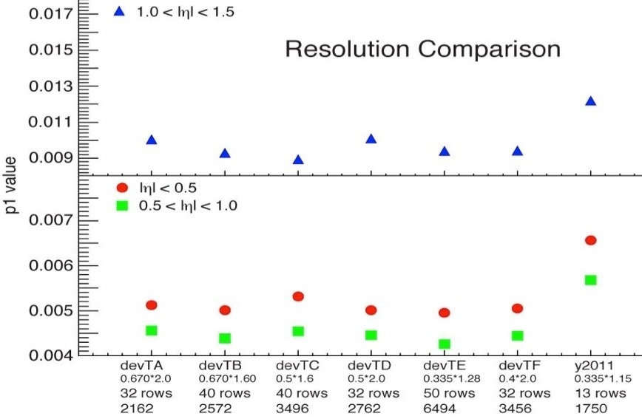
New Pad Plane design and layout
A corner of the new inner pad plane layout
by John Hammond & Bob Scheetz
Row 39
Row 40
Momentum (and spatial) resolution not strongly dependent on pad design within the range studies … it’s the extra rows that are important

Slide 11
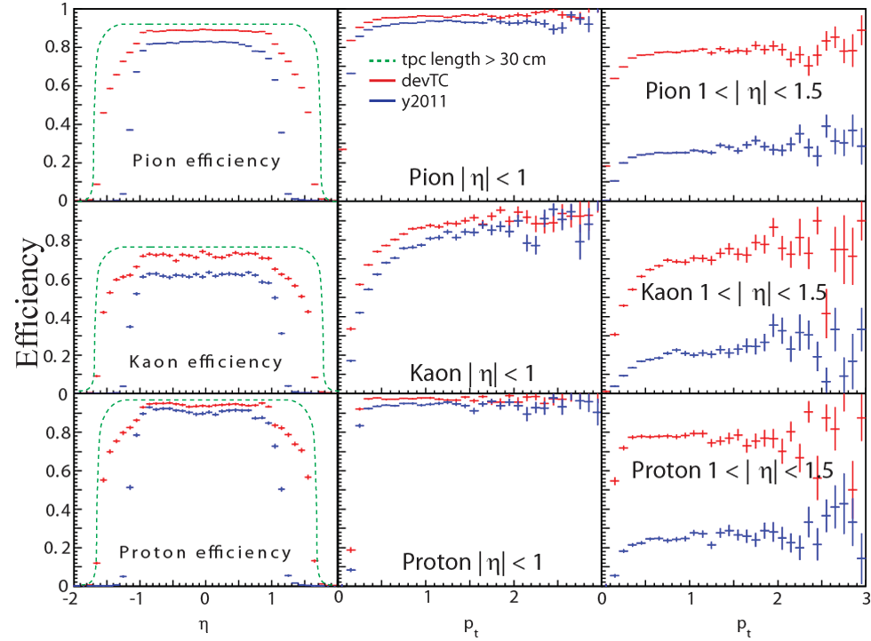
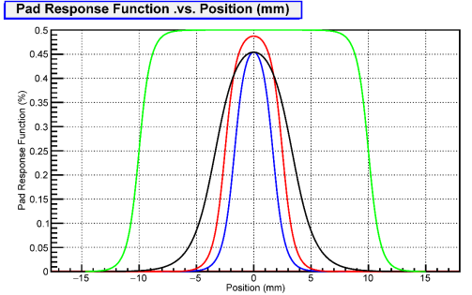
New PadPlane Performance
Efficiency as a function of η and p_{T}
Acceptance increases from |η| < 1 to |η| < 1.5
The pad response function for the outer sector is shown by the black line, the existing inner sector by the blue line, and the proposed inner sector by the red line. The pad spacing is 6.7 mm, 3.35 mm, and 5 mm respectively.

Slide 12
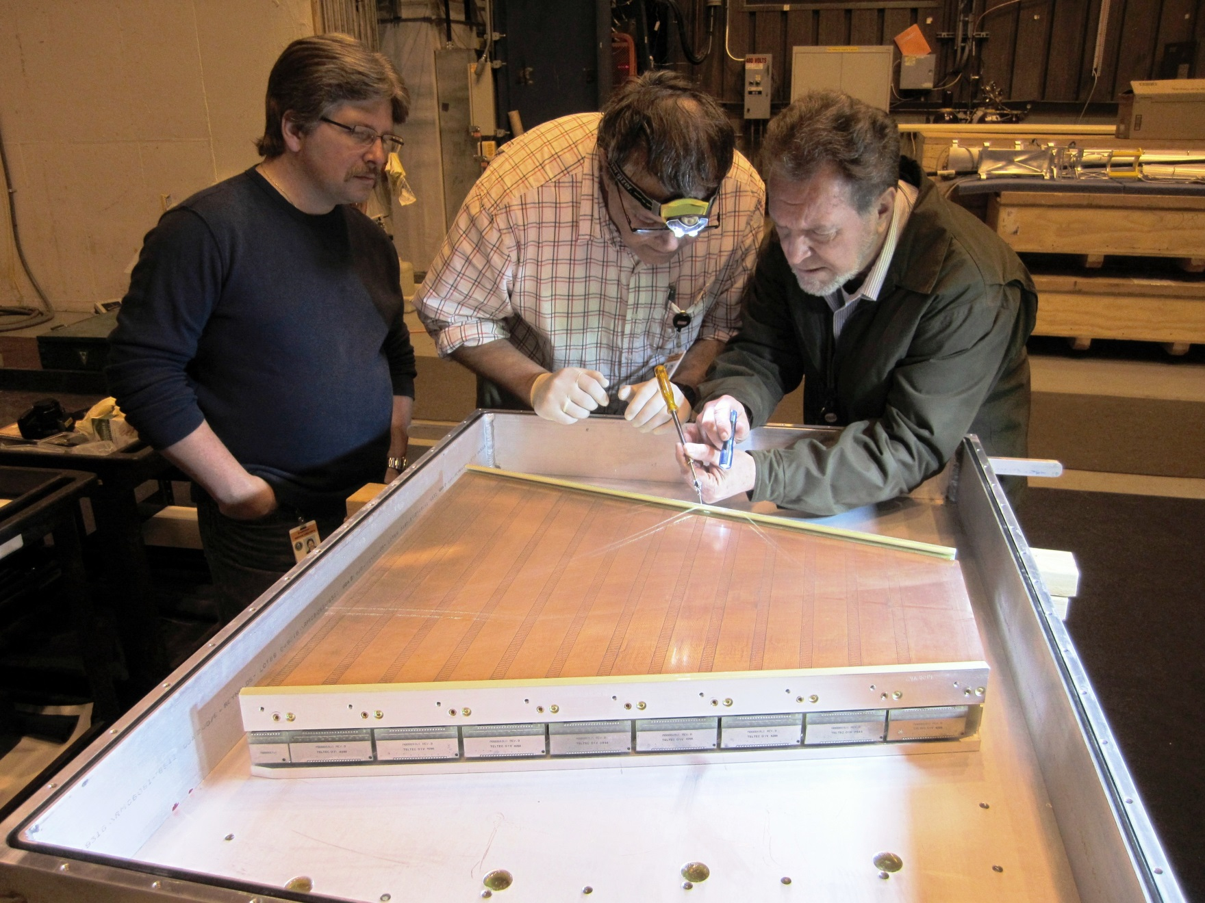
Project Scope: Mechanics, Electronics & MWPCs
hi

Slide 13
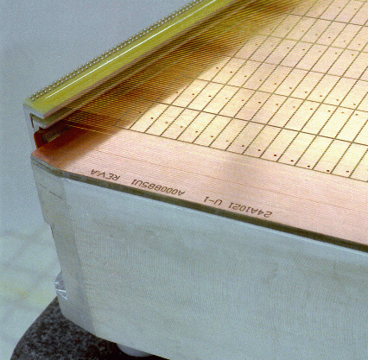
Major Items: Definition & Scope
Wire Mounts for Grids
Wire Planes:
Gated Grind, Cathode Grid, and Ground Grid
Pad Plane with larger (5x16) pads, hermetic coverage
Strongback
Outer Sector, but a good proxy for Inner Sector discussion

Slide 14
Major Mechanical Tasks
Fabricate, Align and Pin Wire Mounts (BNL & LBL)
Wind wire grids
(SDU, see Qinghua Xu’s talk)
Fabricate, QA check
Align (50 μm)
Glue (< 20 μm flat )
& Trim padplane (BNL & LBL)
(See Tonko Ljubicic’s talk)
Fabricate strongback
& inspect (QA) (Outside vendor)
Cut to height, machine
O Ring groove,
Survey padplane &
Document mech. specs (LBL)

Slide 15
Cost Drivers
Padplane & Electronics (BNL)
  $96.4K for Padplanes
  $1.4 M (approximately) for DAQ boards & electronics
Strongback (Outside vendor, BNL procurement)
  $418.9 K
  Two preliminary vendor quotes & initial experience at UT Austin
Assembly of Padplane & Strongbacks (LBL)
  $551.8 k
  Berkeley is the preferred location for the gluing of the PadPlane, and assembly of the Strongback and Wire Mounts
    Close proximity to Engineers and Technicians who previously worked on STAR (circa 1995)
    Nicely integrated Assembly shop, Machine Shop & Survey shop
We are proposing to bring the Assembly work to LBL (primarily work for Eric Anderssen’s group in B77)
This will need active support from NSD in order to succeed

Slide 16
Schedule Drivers relevant to work at LBL
Strongback
  We must go to an outside vendor with multiple machines in order to fabricate the strongbacks
    UT Austin is no longer an option
    6 to 8 weeks (.vs. 1 year), preliminary quotes from outside vendors
Padplane
  Work is being done by STAR Electronics group which is one of the projects greatest strengths. However, sharing the wealth of good manpower is a competitive process. Work has been delayed. (Affects QA and prototyping schedules)
Assembly
  Schedule is fast paced, only ~2 days allowed per sector
  Tooling and time to set up work space
Critical Path
  The PadPlane and the Strongback are simultaneously on the critical path
    Both must be available in Berkeley on August 1st
  Berkeley assembly shops are busy with ALICE upgrade work, already
    Only way to deal with this is to start early and Multi-task

Slide 17
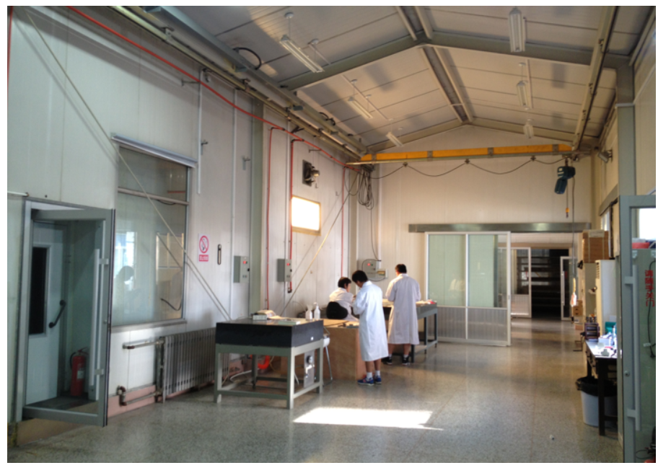
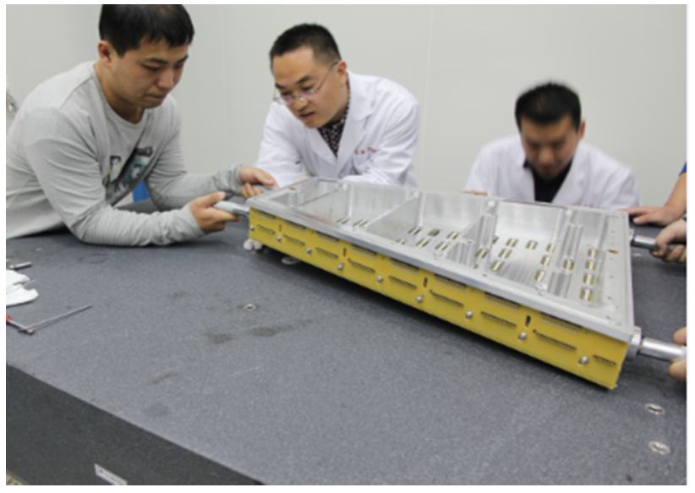
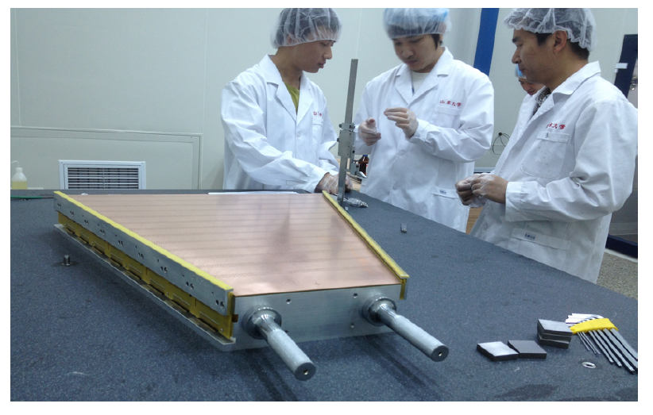
MWPC Production at Shandong University
Qinghua Xu is leading the Shandong University group
iTPC Funded via CNSF & dedicated Labs built
~2 years technical work and lab preparation getting ready for this project
One of the highlights of the iTPC team development

Slide 18
Full Project Summary schedule
Calendar Year |  | 2016 |  |  |  | 2017 |  |  |  | 2018 |  |  |  | 2019
 |  | Q1 | Q2 | Q3 | Q4 | Q1 | Q2 | Q3 | Q4 | Q1 | Q2 | Q3 | Q4 | Q1 | Q2 | Q3 | Q4
Mechanical
padplane
Strongback production
Padplane Assembly
Assemble MWPC
Sector Installation
Electronics
RDO
SAMPA
FEE
Electronics installation
Roll-in and commisioning
Insertion Tool
Current schedule has STAR ready for data taking March 1 2019, with ~1.5 month of commissioning. Key goal of project is to have upgrade complete for Run-19.
Critical path goes through electronics path (SAMPA chips), installation and test, but the mechanical systems are essentially on the critical path, too.
Notes:
Missing electronics

Slide 19
Cost to DOE
Ayk$
WBS |  |  | FY16 | FY17 | FY18 | Conting | Total
1 | Mgt |  | 50.6 | 94.5 | 97.4 | 45.5 | 288.0
2 | Padplane |  | 96.4 | 0.0 | 0.0 | 32.8 | 129.2
3 | Mechanics |  | 949.9 | 228.0 | 14.8 | 250.3 | 1,443.0
4 | Installation |  | 0.0 | 0.0 | 136.4 | 31.2 | 167.6
5 | Electronics |  | 45.7 | 310.3 | 934.3 | 238.4 | 1,528.6
 | Total DOE |  | 1,142.6 | 632.8 | 1,182.8 | 598.1 | 3,556.4
The NSF-China contribution is not included (~$1.0 M US)
The cost of Installation tooling not included (~$650 K US)
Notes:
Contingency

Slide 20
Risk – high level summary
Technical
  Better than 20 μm flatness requirement for PadPlane+Strongback
  Excellent alignment of wires and padplane (20 μm), excellent control over tension on wires
  Bromine free materials
    A vigorous QA plan is essential
    We have the elements of a good QA plan in place but we also need the will to stick to it
Schedule
  We are relying upon the ALICE SAMPA chip for the iTPC electronics
  Pre-production prototype step for Strongbacks (etc) is in jeopardy
    Schedule is tight and so we may be forced to skip traditional steps
  Minor schedule slips can easily eliminate the opportunity to develop tooling and practice our techniques on a prototype
Management
  Major activities must complete this year, requires $$$ quickly
  For example, we haven’t spent any money this fiscal year

Slide 21
Summary
The iTPC upgrade will enable new physics with BES II
  Enhanced Kurtosis measurements
  Enhanced Di-electron measurements
New PadPlane & Faster electronics
  40 pad rows, 5 mm x 16 mm pads (center to center spacing), full coverage
  Increase TPC acceptance from < 1.0 to < 1.5 units of pseudo-rapidity
Strongback is 95% the same as before
  Fix the grid-leak problem
Cost and Schedule concerns
  Very tight schedule. No float.
  We are skipping the “prototype” step for nearly all work in the US
  Final PadPlane, Strongbacks & wire mounts due in Berkeley on August 1st
  Money must move from BNL to LBL very quickly, can it be done?
  Spending large amounts of money – wisely – is hard to do
An upgraded TPC with $500K of new work for NSD and Engineering

Slide 22
Backup Slides

Slide 23
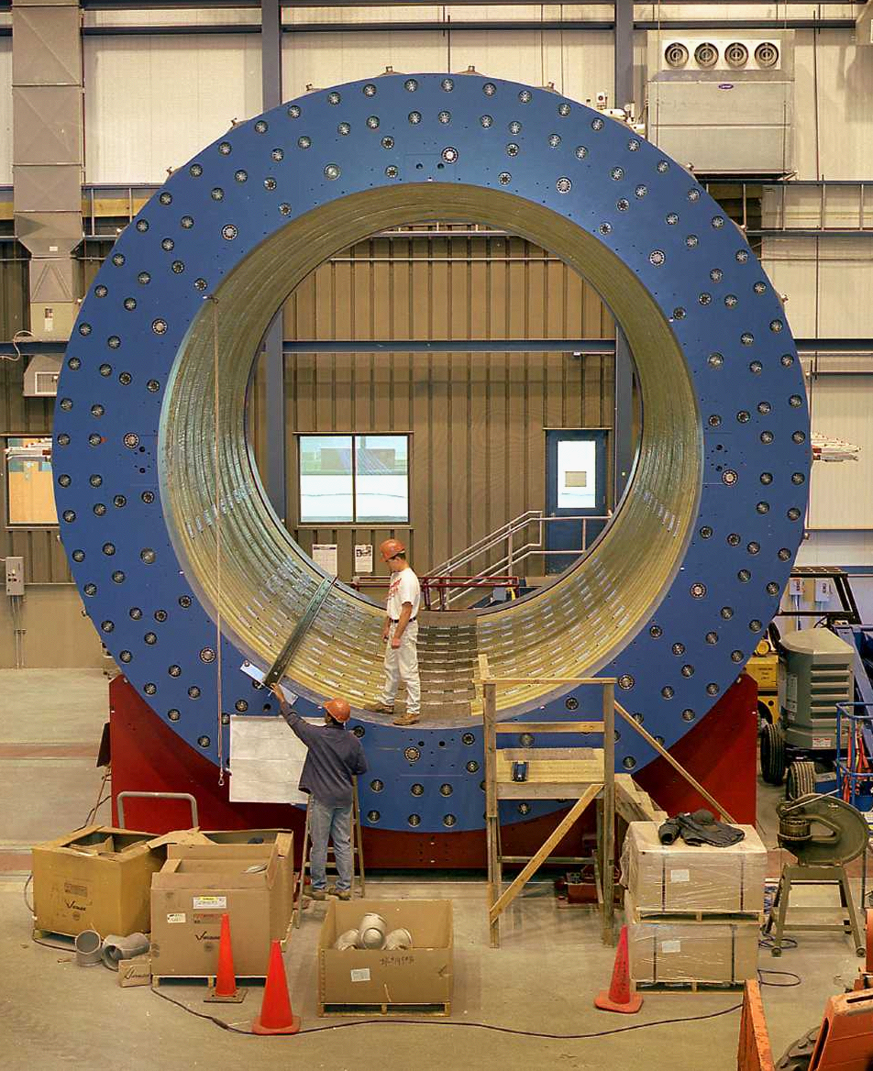
The TPC is the Heart of STAR
STAR without the TPC

Slide 24
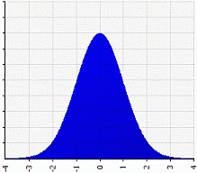
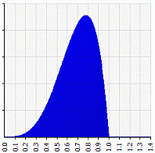
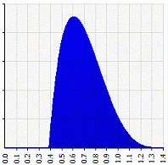
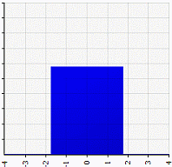
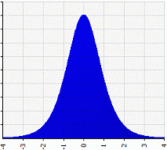
Mean, Variance, Skewness and Kurtosis
Mean
Variance
Skewness
Hi
Transfer from shoulders to center and to extremes
Increasing Kurtosis

Slide 25
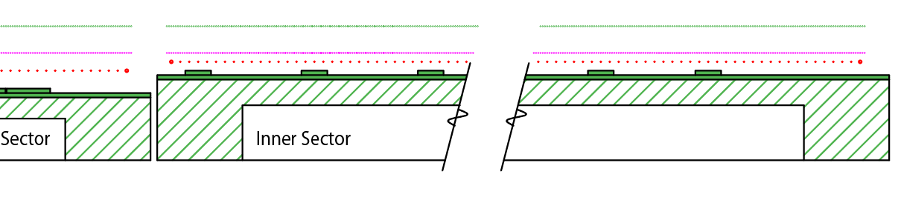
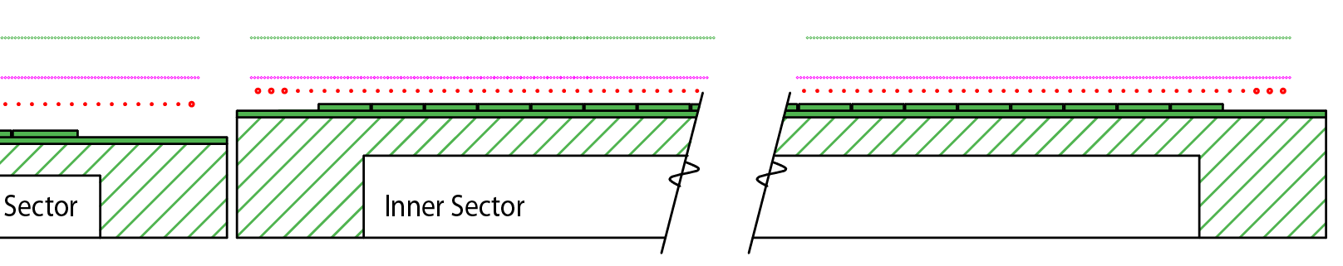
40 Pad Rows fit perfectly with the existing grid
(Old)
Anode wires spaced 4 mm apart (horizontally), Ground Shield and Gated grids spaced 1 mm apart
Remember this region with a gap between the grids… we will come back to it
Identical pad response function on both ends of grid
No need to change grid; wire locations remain the same!
No need to add more ABDB or wire mount channels (good!)

Slide 26
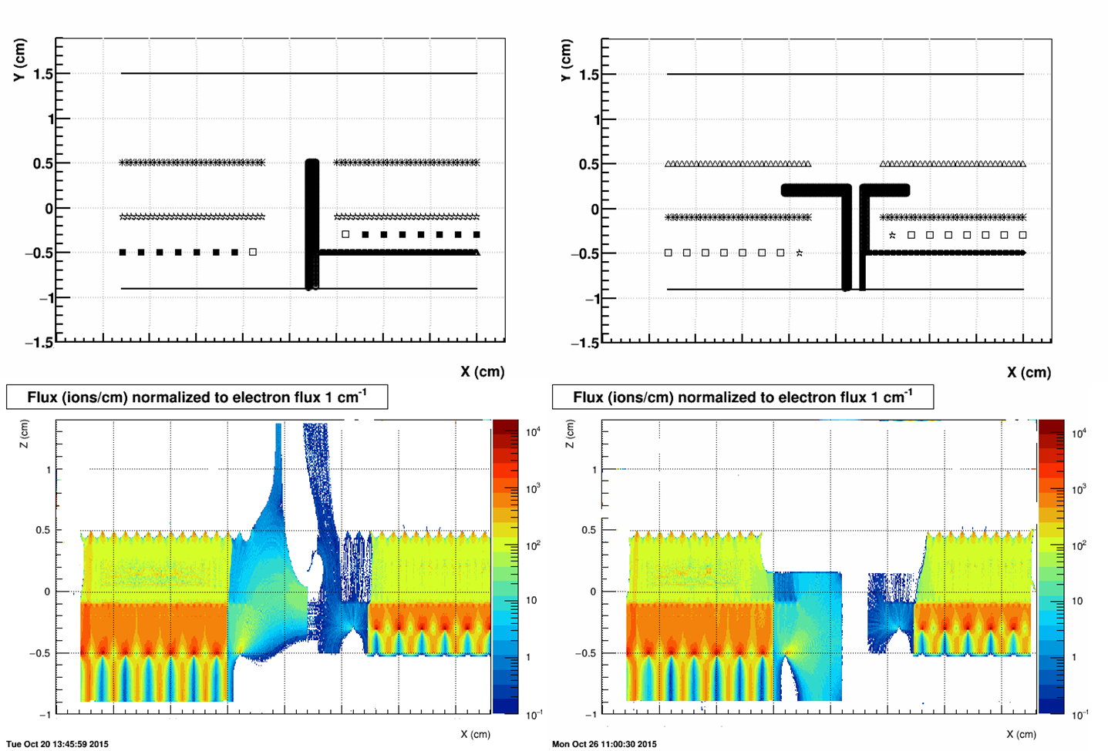
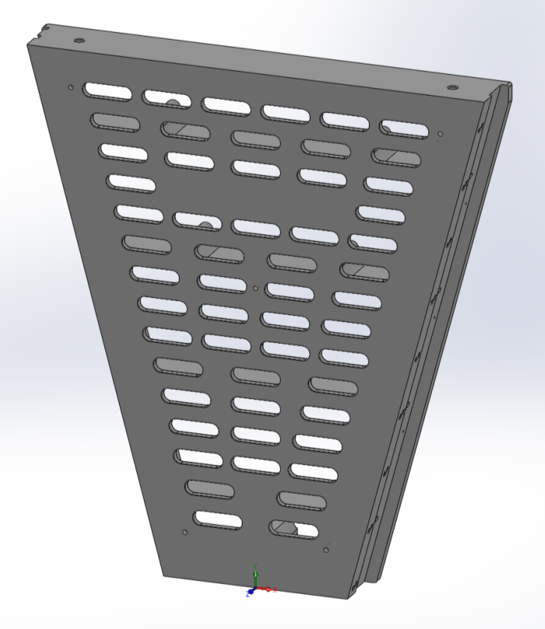
Changes since previous (1995) design
3D CAD design – (lower fabrication & inspection costs)
Slots for electronics move down by 0.221”
Wall to mitigate gridleak problem
GARFIELD simulations of ions flowing away from the STAR TPC anode wires when the Gated Grid is closed. There is a 1.2 cm gap between the Inner and Outer sectors that is not covered by the Gated Grids. This gap allows ions to flow out of the MWPC region and into the tracking volume of the TPC. Putting a -690 volt bias (left panels) on the wall reduces the flow of ions, while the “L” shaped wall (right panels) completely stops the flow of ions. The “L” shaped wall was held at 0 volts in this simulation.
Slots for electronics are lower by 0.221” than previously. Otherwise, the same.

Slide 27
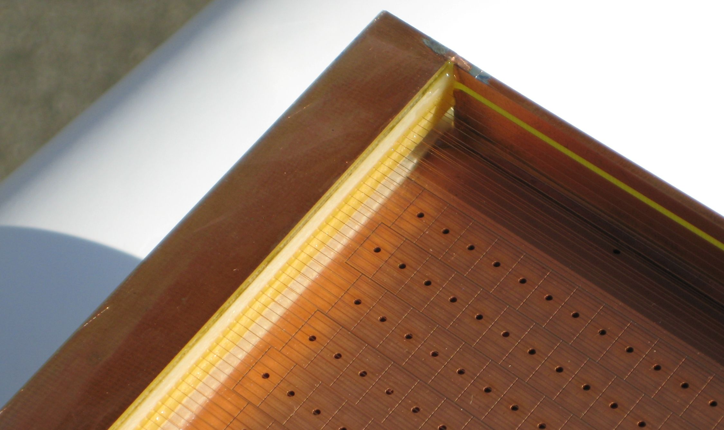
The Alice Solution to the Grid Leak problem
Multiple thick anode wires near the boundaries of the sectors
A wall – to terminate the field lines from the Anode wires with ground potential and “cover” potential (match field gradient)

Slide 28
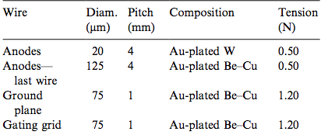
Parameters for the old and new sectors
Item | Inner | Outer | iTPC | Comment
Pad Pitch (center to center) | 3.35 x 12 | 6.70 x 20 | 5.0 x 16 | mm
Isolation gap between pads | 0.5 | 0.5 | 0.5 | mm
Pad Size | 2.85 x 11.5 | 6.20 x 19.5 | 4.5 x 15.5 | mm
Number of Pads | 1750 | 3940 | 3496
Anode to pad plane spacing | 2 | 4 | 2 | mm
Anode voltage | 1170 V | 1390 V | ~ 1120 V | 20:1 S/N
Anode Gas Gain | 3770 | 1230 | ~ 2000 | nominal
Anode Wire diameter | 20 μm | 20 μm | 20 μm | Au plated W
Anode Wire pitch | 4 | 4 | 4 | mm
Anode Wires phase locked to pad location | 3 wires, #2 over center | 5 wires, #3 over center | 4 wires, over center | grp centered over the pad
Pad Plane & wire planes must be flat to better than 20 μm to keep dE/dx resolution uniform to 1%

Slide 29
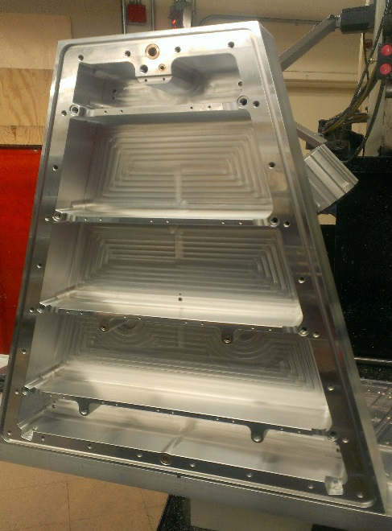
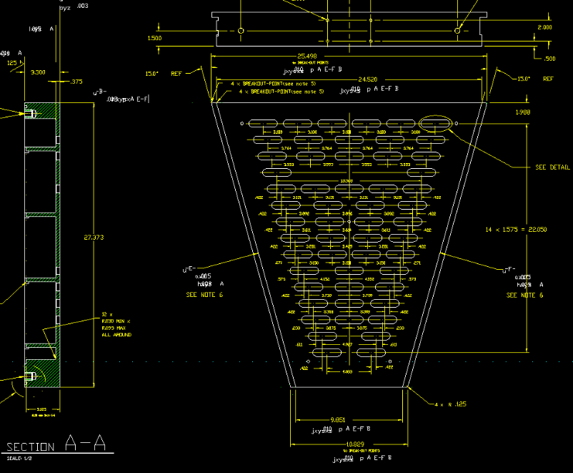
Strongback Construction Prototype
Figure 54: A prototype inner sector strongback is shown during fabrication at the University of Texas (circa 2013). The sector was machined out of a single piece of aluminum. Dimensions are: ~27 inches tall, ~25 inches wide and weight 73 lbs. The sector is viewed from the backside; the side upon which the electronics and cooling manifolds will eventually be mounted.

Slide 30
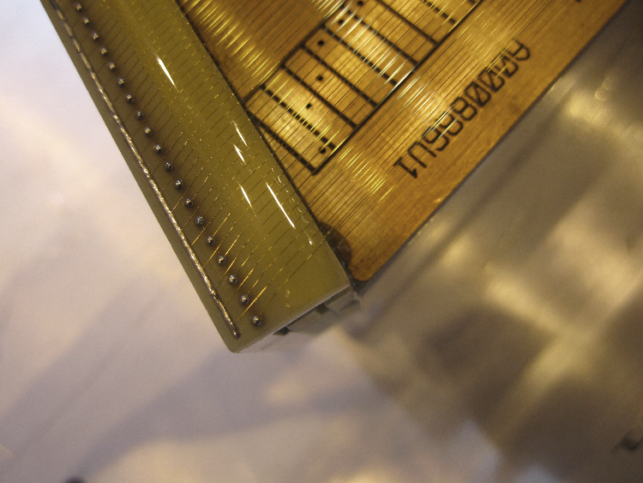
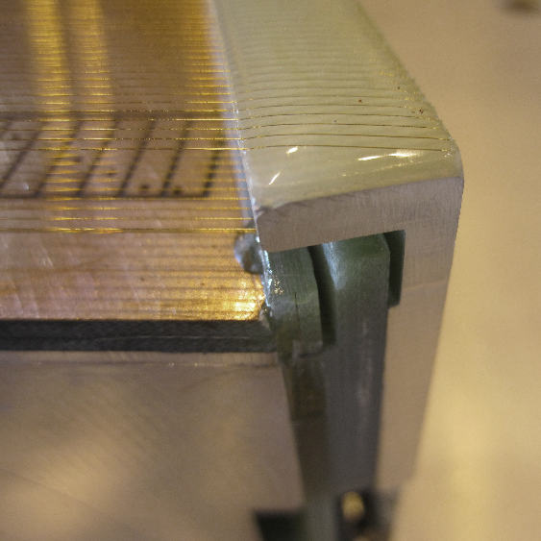
Wire locations near the gap will not change
The location of the wires near the inner/outer gap cannot change
  Position and total number of wires on each plane remains the same
Because … it is not possible to add more wires
  The full extent of the side mounted wire mounts are already used

Slide 31
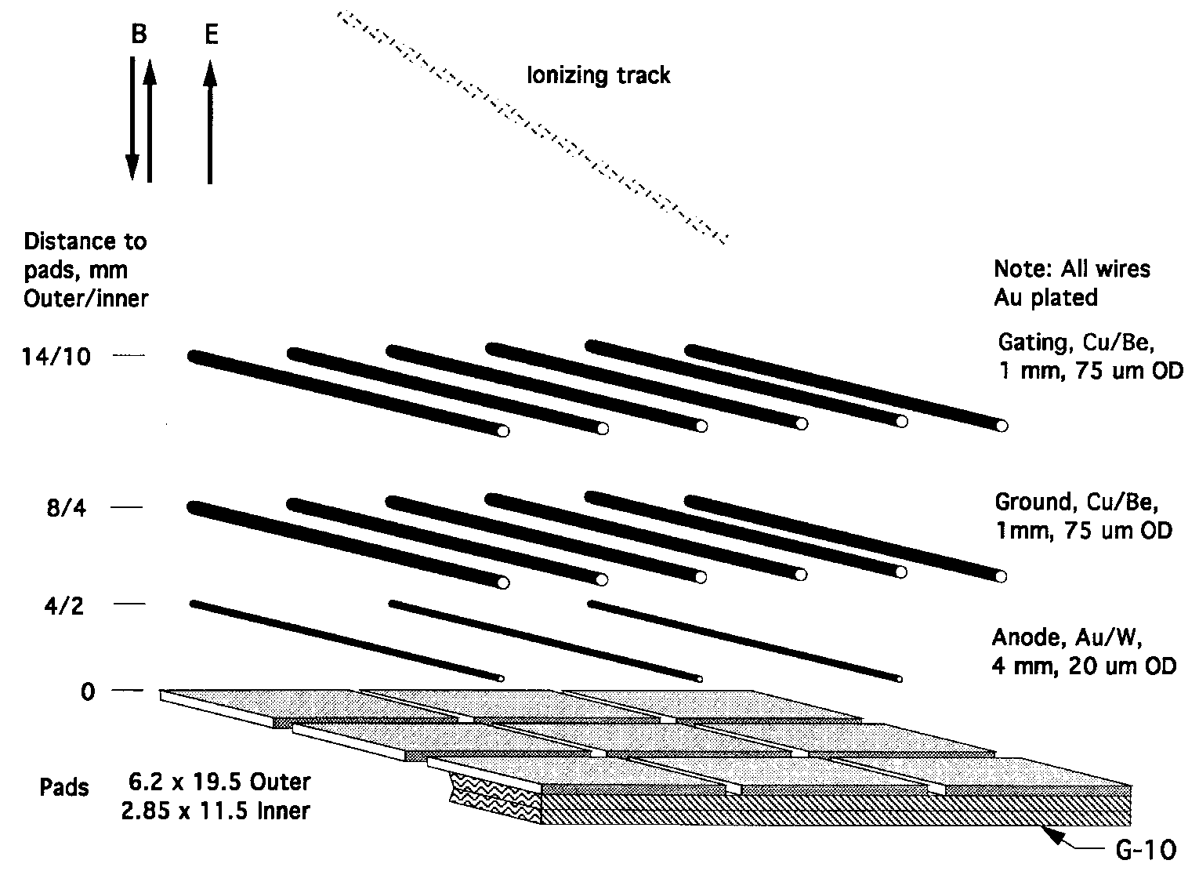
Sector Wire Geometry – special notes
Wires are phase locked to the pad locations. 4 wires located over each pad row. We can probably tolerate a phase shift of 100 microns.
Ground wires placed directly over the Anode wires to limit sparking to pad plane.

Slide 32
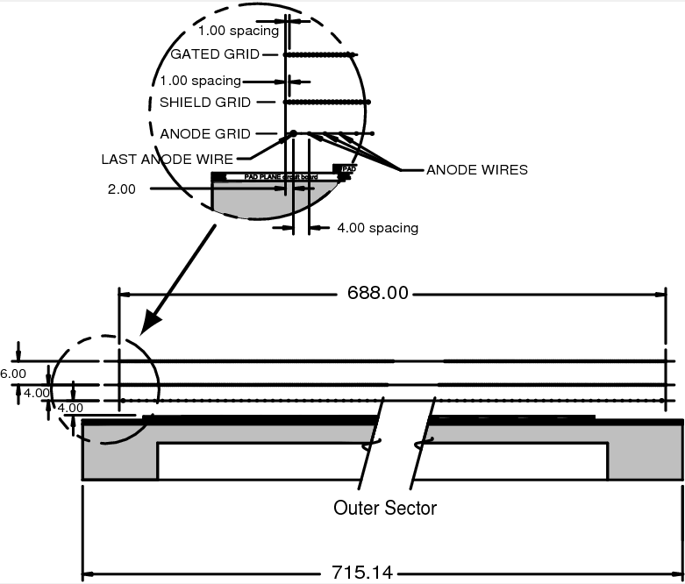
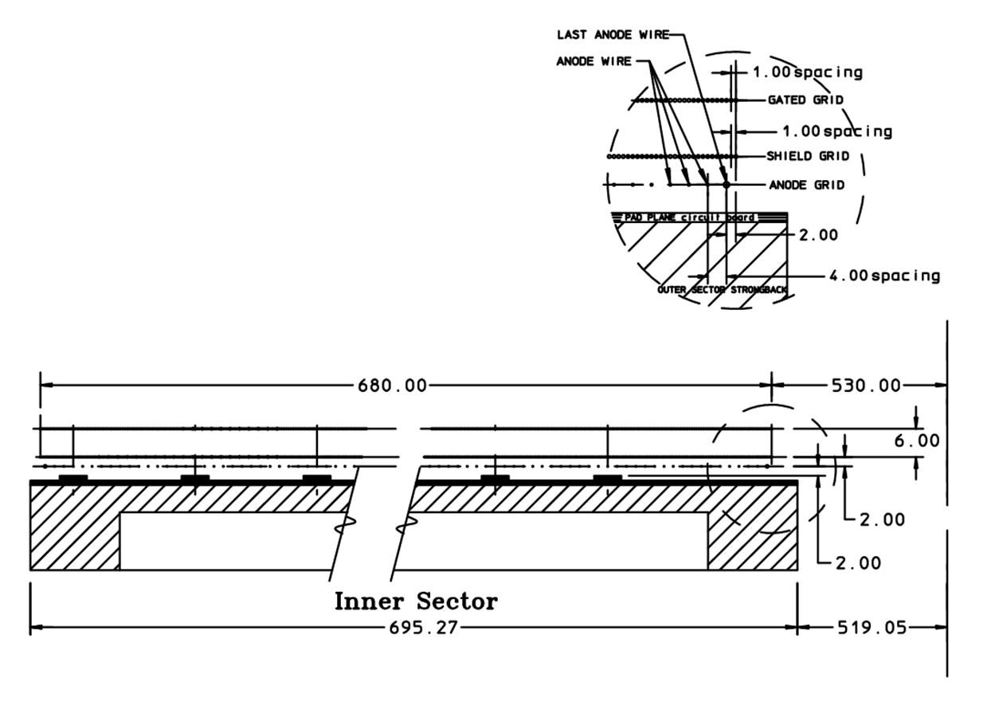
Inner sector detail

Slide 33
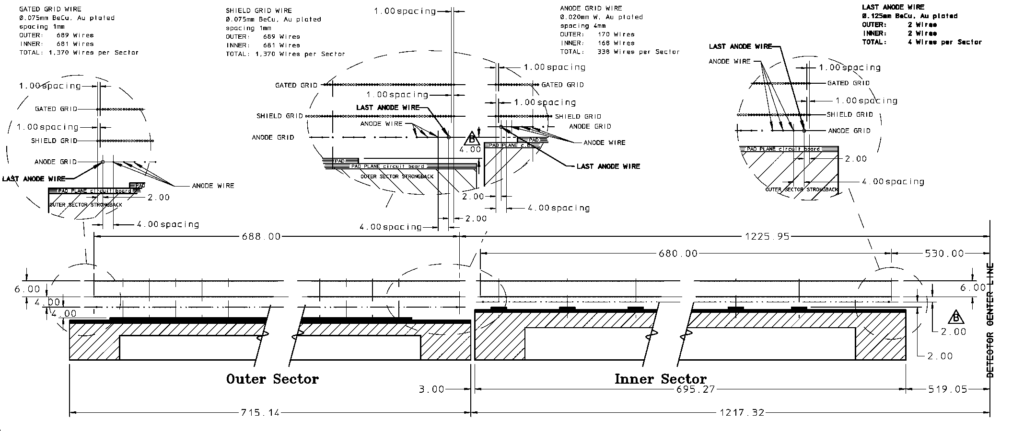
Inner / Outer sector detail
Note that inner and outer pad planes are not at the same height
Pad plane to wire grid heights not the same (4/4/6 vs 2/2/6)
3 mm gap between sectors, this is an issue during installation

Slide 34
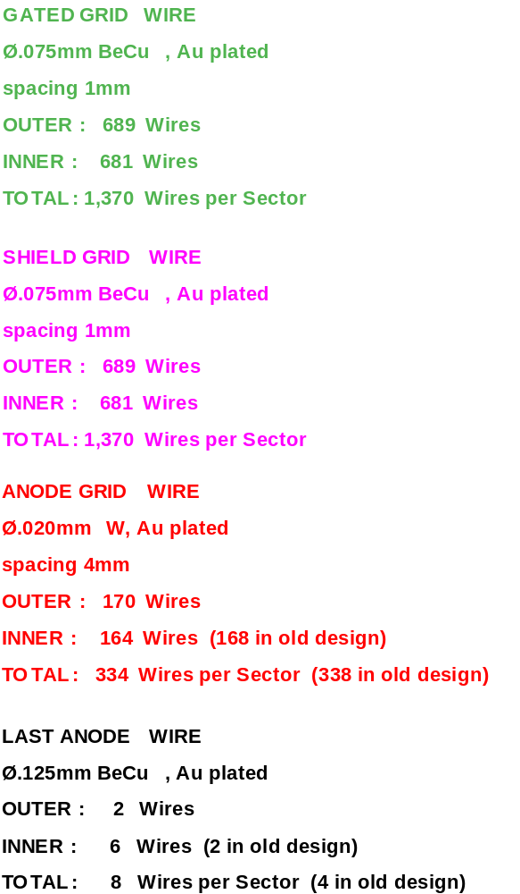
Location of Wires and Pads
Radius (Y) | Description
0.00 | Center of STAR Detector (vtx)
498.80 | Bottom of Full size PC Board
512.70 | Tertiary Fiducial L & R
519.05 | Strongback Bottom Edge
530.00 | Gated Grid Wire 1
531.00 | Gated Grid Wire 2
532.00 | Anode Wire 1 & GG W-3
536.00 | Anode Wire 2 & GG W-7
540.00 | Anode Wire 3 & GG W-11
540.25 | Secondary Fiducial
544.00 | Anode Wire 4 & GG W-15
548.00 | Anode Wire 5 & GG W-19
558.00 | Pad Row 1 - Center
574.00 | Pad Row 2 - Center
1166.00 | Pad Row 39 - Center
1179.45 | Primary Fiducial
1182.00 | Pad Row 40 - Center
1192.00 | Anode Wire 166 & GG W-663
1196.00 | Anode Wire 167 & GG W-667
1200.00 | Anode Wire 168 & GG W-671
1204.00 | Anode Wire 169 & GG W-675
1204.85 | Alternate Primary Fiducial
1208.00 | Anode Wire 170 & GG W-679
1209.00 | Gated Grid Wire 680
1210.00 | Gated Grid Wire 681
1214.32 | Strongback Top Edge
1220.67 | Tertiary Fiducial L & R
1235.42 | Top of Full size PC Board
References: LBL Drawings 24A055, 24A373, 24A374
Repeat pad rows every 16 mm
Wire Locations are the same as before except for the replacement of 6 thin anode wires with larger diameter anode wires (0.020 mm ⇒ 0.125 mm)

Slide 35
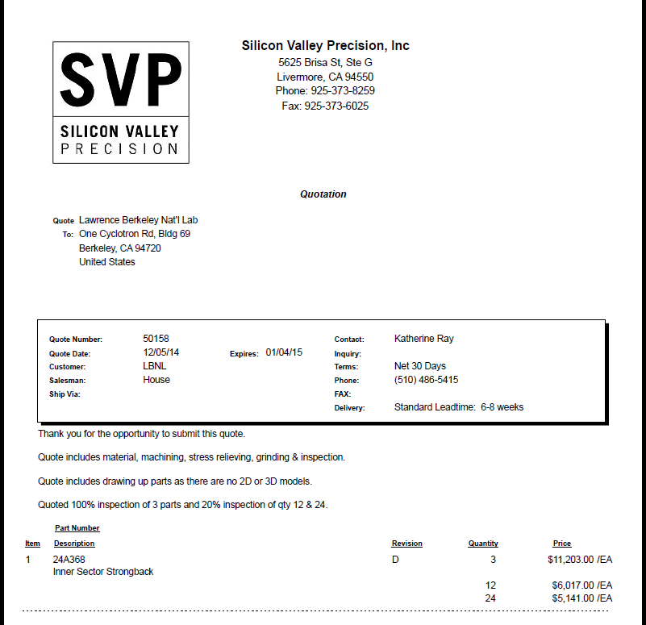
Strongback – Preliminary quotation #1

Slide 36
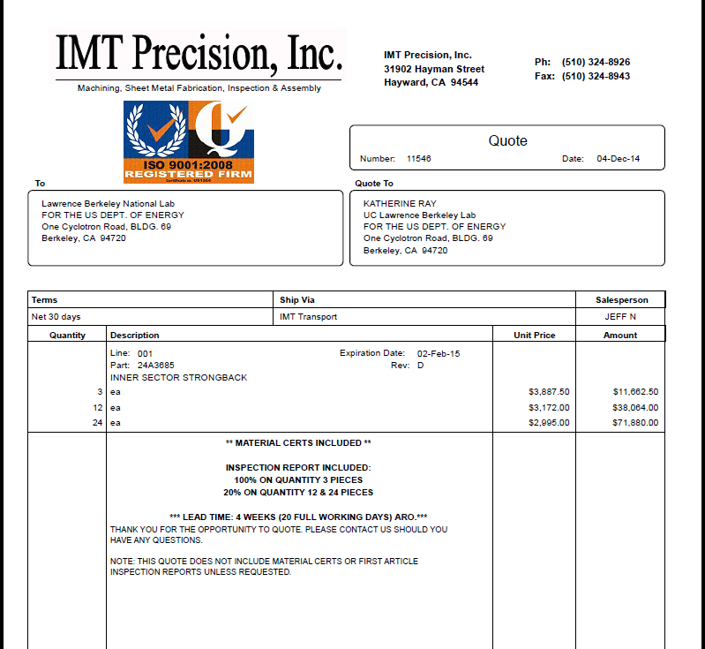
Strongback – Preliminary quotation #2

Slide 37
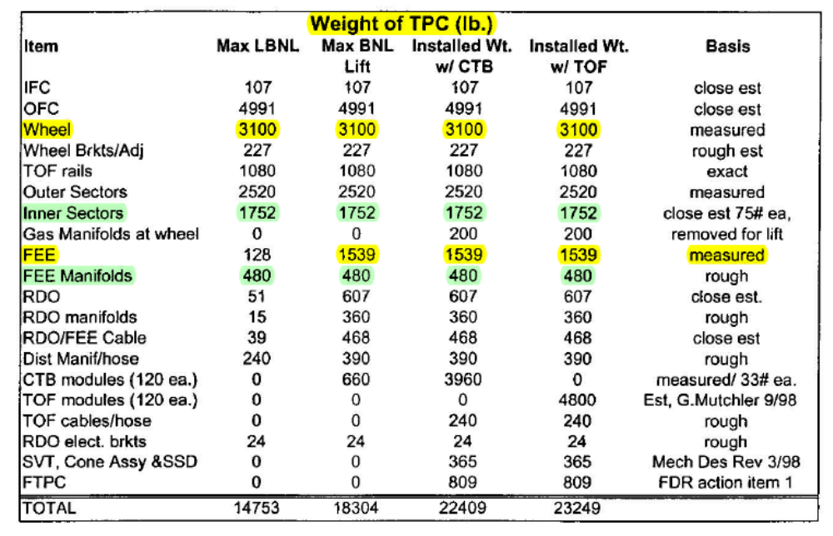
Critical Dimensions for the TPC
Item | Dimension | Comment
Length of the TPC | 420 cm | Two halves, 210 cm long
Outer Diameter of the drift volume | 400 cm | 200 cm radius
Inner Diameter of the drift volume | 100 cm | 50 cm radius
Distance: cathode to ground plane | 209.3 cm | Each side
Cathode | 400 cm diameter | At the center of the TPC
Cathode potential | 28 kV | typical
Drift gas | P10: 90% Ar, 10% CH₄ | He-Ethane as an option
Drift Velocity | 5.45 cm/μsec | typical
Transverse diffusion (σ) | 230 μm/√cm | 135 V/cm & 0.5 T
Longitudinal diffusion (σ) | 360 μm/√cm | 135 V/cm & 0.5 T
Magnetic Field | 0, ±0.25 T, ±0.5 T | Solenoidal

Slide 38
Average mass distributions ( ±10°, 1.5 < η < 2.0 )
FEE | 3.60 %
FEE mounting bracket | 3.45 %
FEE rib | 0.45 %
FEE socket | 0.15 %
Cooling manifold | 3.25 %
RDO card | 0.90 %
Ribs | 2.70 %
Sector G10 | 0.45 %
Sector Aluminum | 3.20 %
Cables | ~1% (estimate)
FEE sub Total | 7.65%
Total | 19.15%
Table 6: The average radiation length budget for the components associated with a TPC inner sector (circa 1993) averaged over the fiducial volume of the sector. The average takes out the lumps in the mass distribution (for better or worse) but also illustrates how the budget for the Al on the front face compares to the electronics and cooling budget. The sector data have been averaged over a range from 1.5 < η < 2.0 and -10 < φ < 10 degrees. Geant simulations courtesy of Irakli Chakaberia.

