Slide 1
iTPC Soldering Notes
Alexei Lebedev & Jon Wirth
with additional notes by Qinghua Xu, Eric Anderssen and Jim Thomas
10/28/2015

Slide 2
Materials (Circa 1995)
We used Metcal soldering stations (such as MX-500 S) and 600°F (315 °C) cartridges.
  http://www.okinternational.com/metcal
  http://www.okinternational.com/hand-soldering-systems/id-MX-500S/NEW_MX-500S_Soldering__Rework_System (???)
Use a tip such as STTC 046.
  http://www.okinternational.com/metcal/english/globalnavigation/products/hand-soldering-systems/tips-and-cartridges/mx-cartridges/sttc-series-bevel
The Metcal has unusually good temperature control at the tip of the soldering gun.
  Make sure to purchase a soldering station that matches your local line voltage (e.g. 220 Volts)
The solder was a lead/tin no-clean type with a non-corrosive flux core such as Cobar-Core 390
  http://www.balverzinn.com/ (???)
  http://www.amazon.de/Miniprobe-Cobar-No-Clean-Sn62Pb36Ag2-Platinen/dp/B00O6716RE
The liquid flux which was used for re-heating a joint (only if necessary) was was made by “Indium”
  http://www.indium.com/flux-and-epoxy/wave-flux/ (???)
  The liquid flux is corrosive so any residue must be removed immediately.
  Eric thinks there may be better fluxes, ask Leo Greiner or Giacomo Contin for 2015 product choices.
Use Reagent Grade Ethyl alcohol from a glass bottle (not a metal can) to clean the solder-pads before soldering and then to clean the solder-pads with wires after soldering. (Medical Grade Alcohol?)
  Use 100% absolute alcohol without any additives or oil or water. Keep it stored in a closed bottle because the alcohol is hygroscopic and will absorb water if left open to the air.

Slide 3
Soldering Procedure (circa 1995)
Wires should be glued to the wire mount boards and epoxy allowed to cure for about 48 hours.
  Check wire tension. It should be ~50 grams for each wire.
After the epoxy has cured, carefully cut wires from the frame (or from the 50 g weight if repairing a single wire). Use small scissors and leave ~ 2-3 cm (1”) of loose wire.
  Don’t cut the wires free from the frame until the epoxy has cured.
Apply a small amount of solder to the gold plated solder pads on the PC board (no wire)
  Solder pads should be cleaned with ethyl alcohol, first.
Re-melt the solder on the pad and submerge the wire in the liquid solder
  Use tape to hold the wire in place over the solder pad. (Or use a pair of tweezers when repairing a single wire.) Use a wooden stick from a cotton swab to hold the wire down while re-melting the solder. Work quickly to preserve the Gold plating on the Tungsten wire. Apply the hot iron to the solder for no more that 3- 4 seconds while simultaneously pushing down on the anode wire so it sinks into the liquid solder. Remove the soldering iron and wait until solder became solid.
Check conductivity between the wire and the traces on PC board. Use the opposite side of the anode wire, on the far side of the sector as one test point, and use the pin in socket where ABDB will be installed as the other test point.
If the contact is OK, carefully cut and trim the anode wires to the proper length
  Trim carefully. Avoid sharp wire ends that might spark. Cover with epoxy if necessary.
Clean solder joints with ethyl alcohol, apply epoxy to protect soldered joint from oxidation.
To repair a solder joint, if the first attempt to solder the wire failed, add a (tiny) dab of liquid flux then reheat the solder and wire. Remove the heat quickly.
  The liquid flux is somewhat corrosive so any residue must be removed immediately.

Slide 4
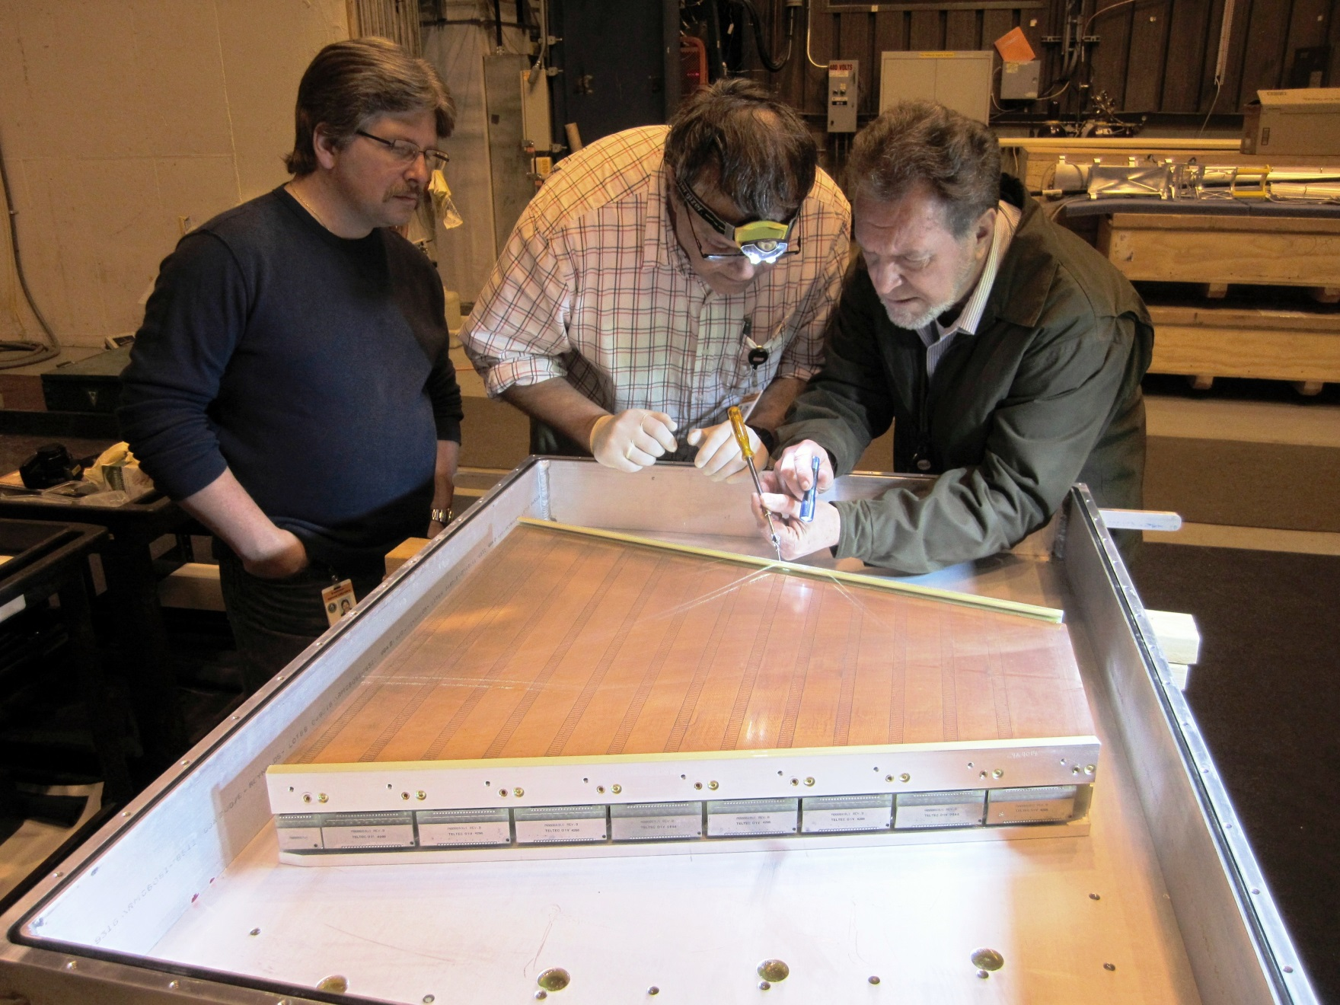
Inner Sector – showing ABDB boards
hi

