Slide 1
New PadPlane Connector Locations for the FEE electronics cards
Note that the August 14th version is obsolete
October 15th, 2015

Slide 2
News
John Hammond and Bob Scheetz have (nearly) finished laying out the new padplane
  Many thanks!!
Connector locations for the FEE cards are shifted, slightly, compared to the previous (circa 1995) locations
Change
  Connector locations remain the same in one dimension, but in the other dimension they all move down by 0.221”
    “Down” means toward the narrow end of sector

Slide 3
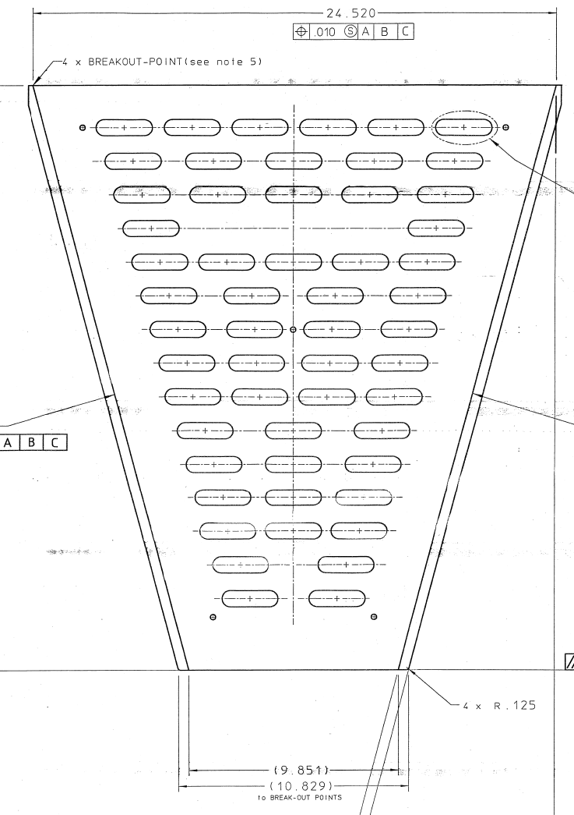
Old Compared to New
55 Slots, same number of slots as before
For all 55 slots, Horizontal distance from centerline remains the same
For all 55 slots, move center of slots down by 0.221”

Slide 4
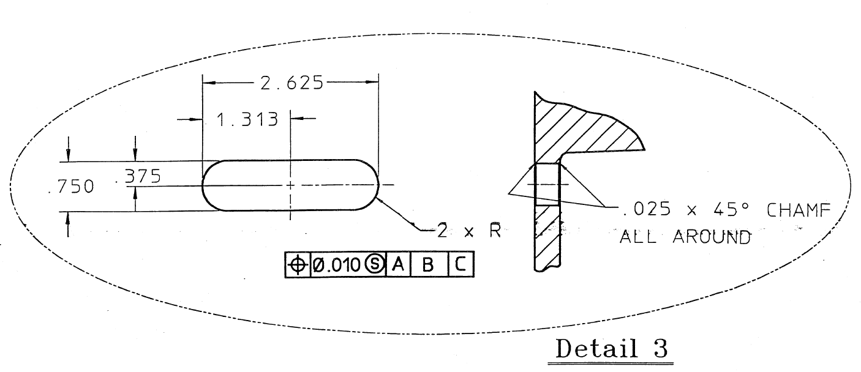
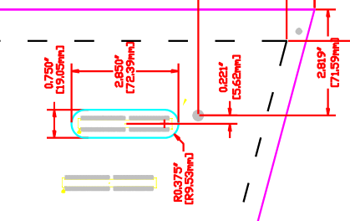
Slot Detail
Slot Detail from
LBL Drawing 24A368D
(circa 1995)
The connectors for the new electronics cards fit in these slots. The old cards had a right angle connector while the new cards will use a card-edge connector. The different style connector means the centerline for the slots must be shifted down slightly.
2.625”
[66.68 mm]
New Slot Detail

