Slide 1
- Distortion Coefficients -
Do they need an update?
Jim Thomas
10/10/2013

Slide 2
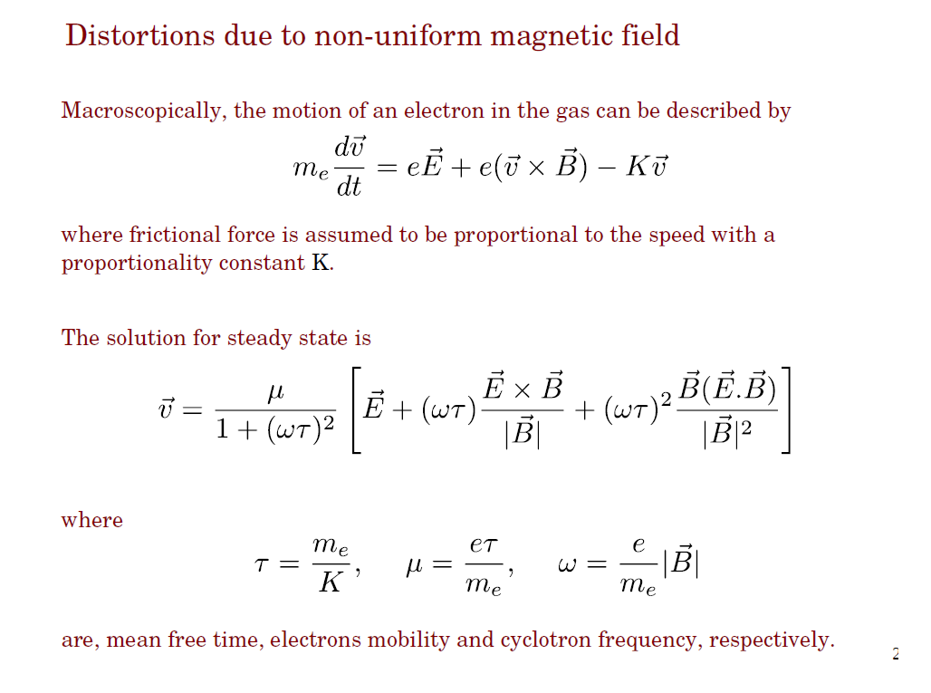
Mustafa’s Work

Slide 3
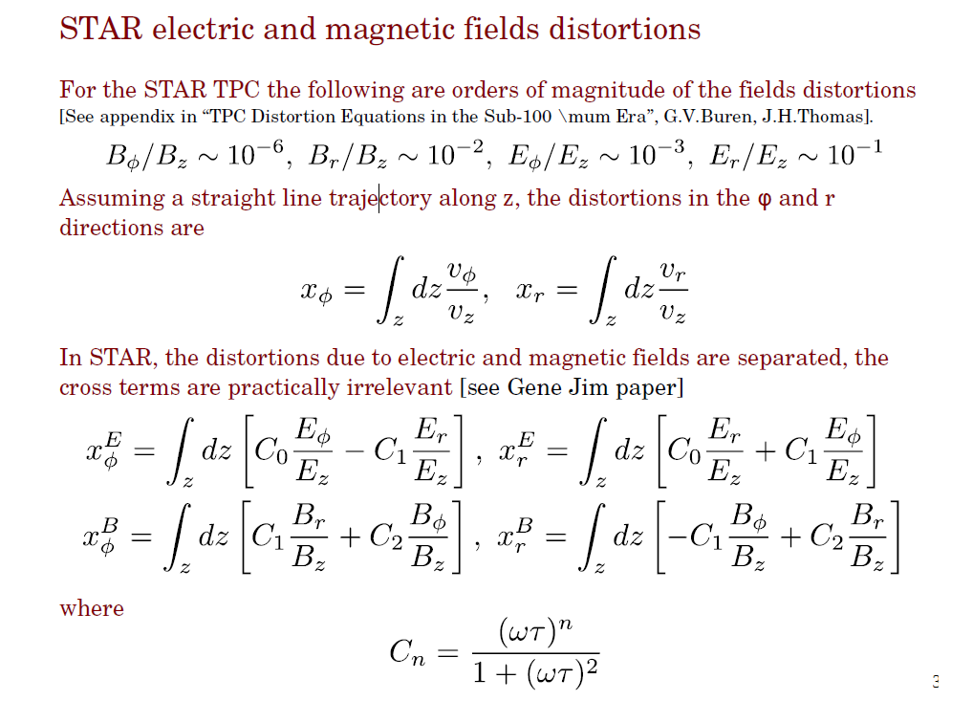

Slide 4
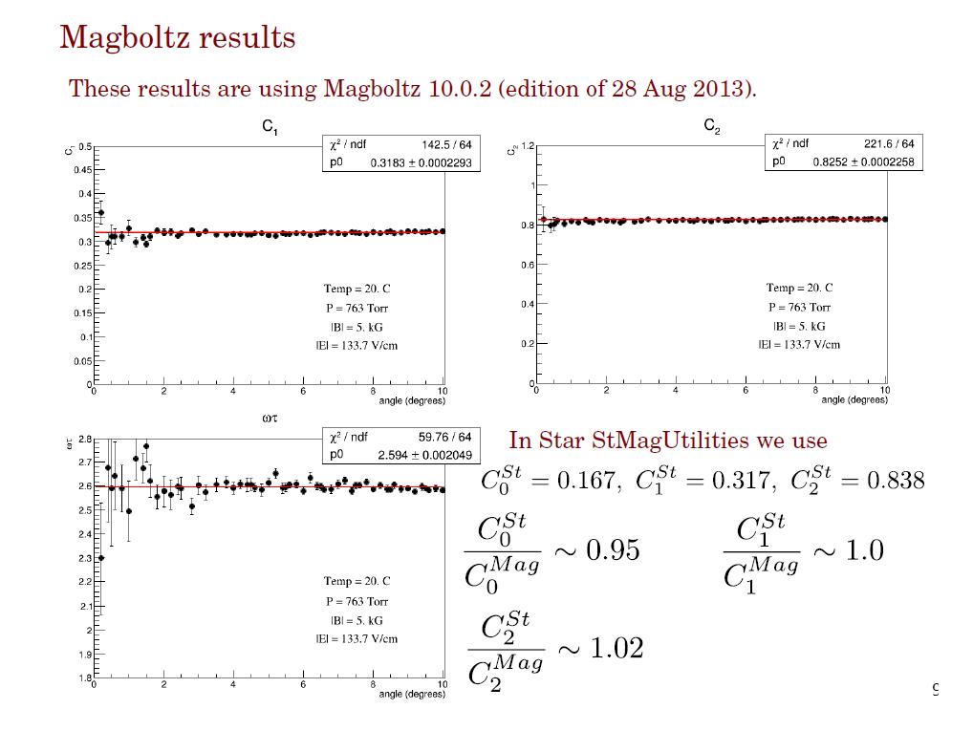
Are these % level deviations important?

Slide 5
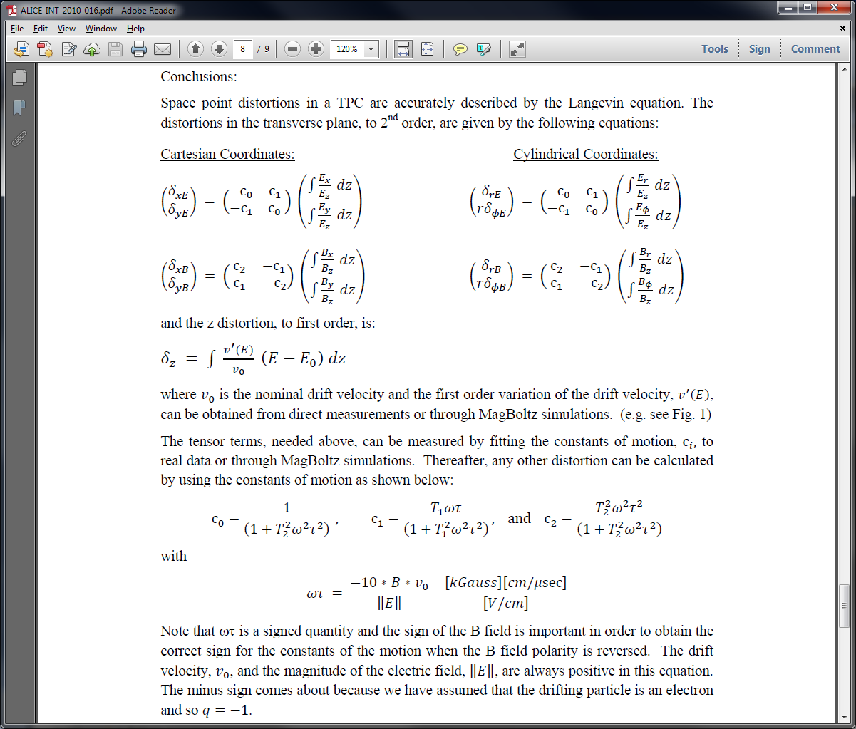
An Alice technical note … (by JT and friends)
Only C₀ and C₂ are uncertain
Typically only radial integrals are large (shorted ring, B field) because φ distortions are small
δ(r•φ) are most important in STAR
Fortunately the uncertainties in C₀ and C₂ only affect radial distortions … where we are not very sensitive

Slide 6
Conclusions
Uncertainty in C₀ affect electric distortions in the radial direction
  We are not very sensitive to radial distortions due to direction of track and due to the discretized location of pads in the radial direction (i.e. we only interpolate along the pad rows)
  C₁ ~ 2*C₀ and so the radial distortions are further suppressed by the magnitude of C₀
Uncertainty in C₂ affect magnetic distortions in the radial direction
  We are not very sensitive to radial distortions due to direction of track and due to the discretized location of pads in the radial direction (i.e. we only interpolate along the pad rows)
  The magnitude of the distortions in radial direction is magnified relative to r•φ distortions … but driven by Bφ distortions which are always small
Conclusion
  5% error on C₀ affects radial distortions, only, and is suppressed relative to r•φ distortions … this does not significantly affect our tracking
  2% error in C₂ does not significantly affect our overall goal of ~2% error

