Slide 1

SSD Performance Summary
Long Zhou and Jim Thomas

Slide 2
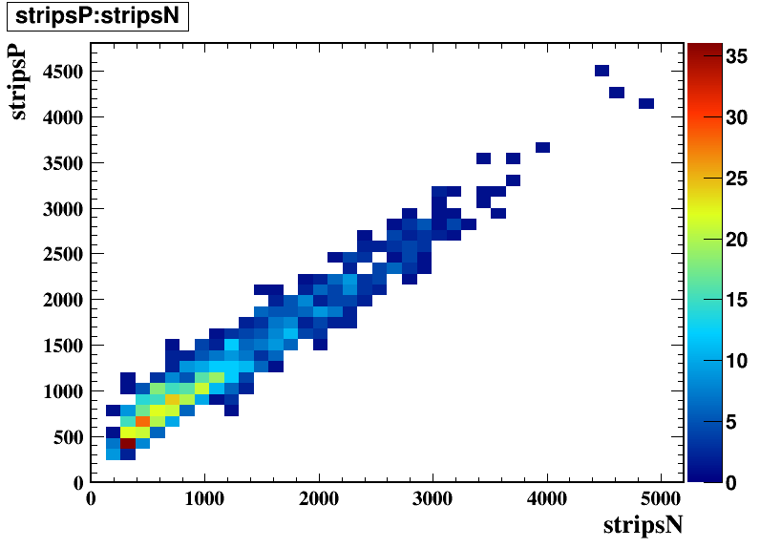
N Side vs P Side fired strips

Slide 3
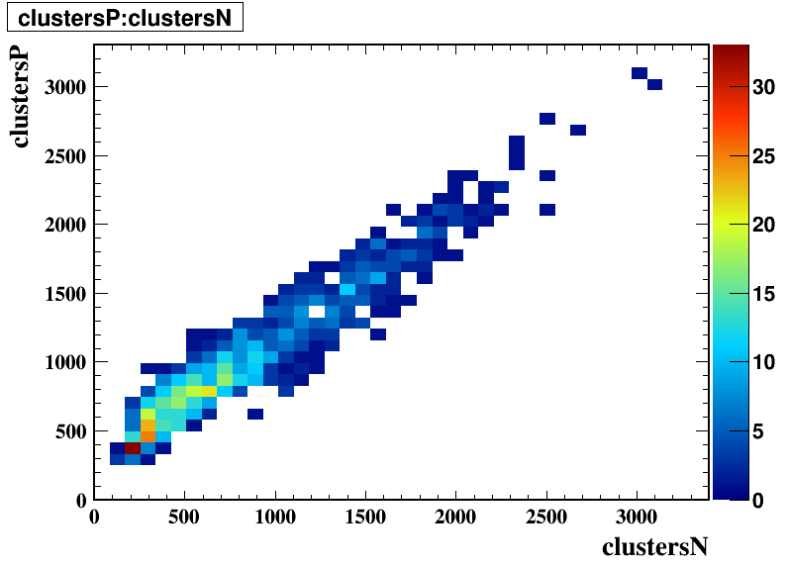
Reconstructed Clusters N side .vs. P side

Slide 4
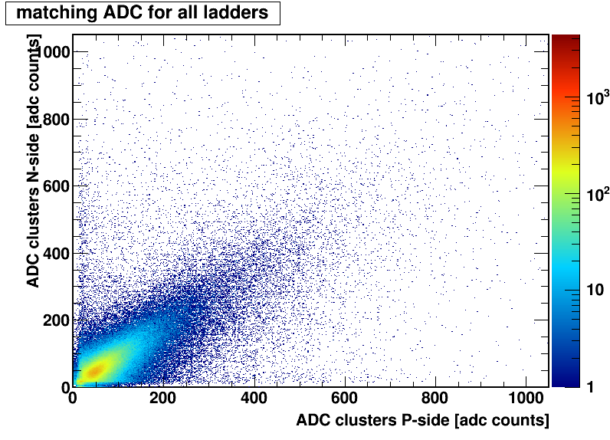
Matching for all ladders

Slide 5
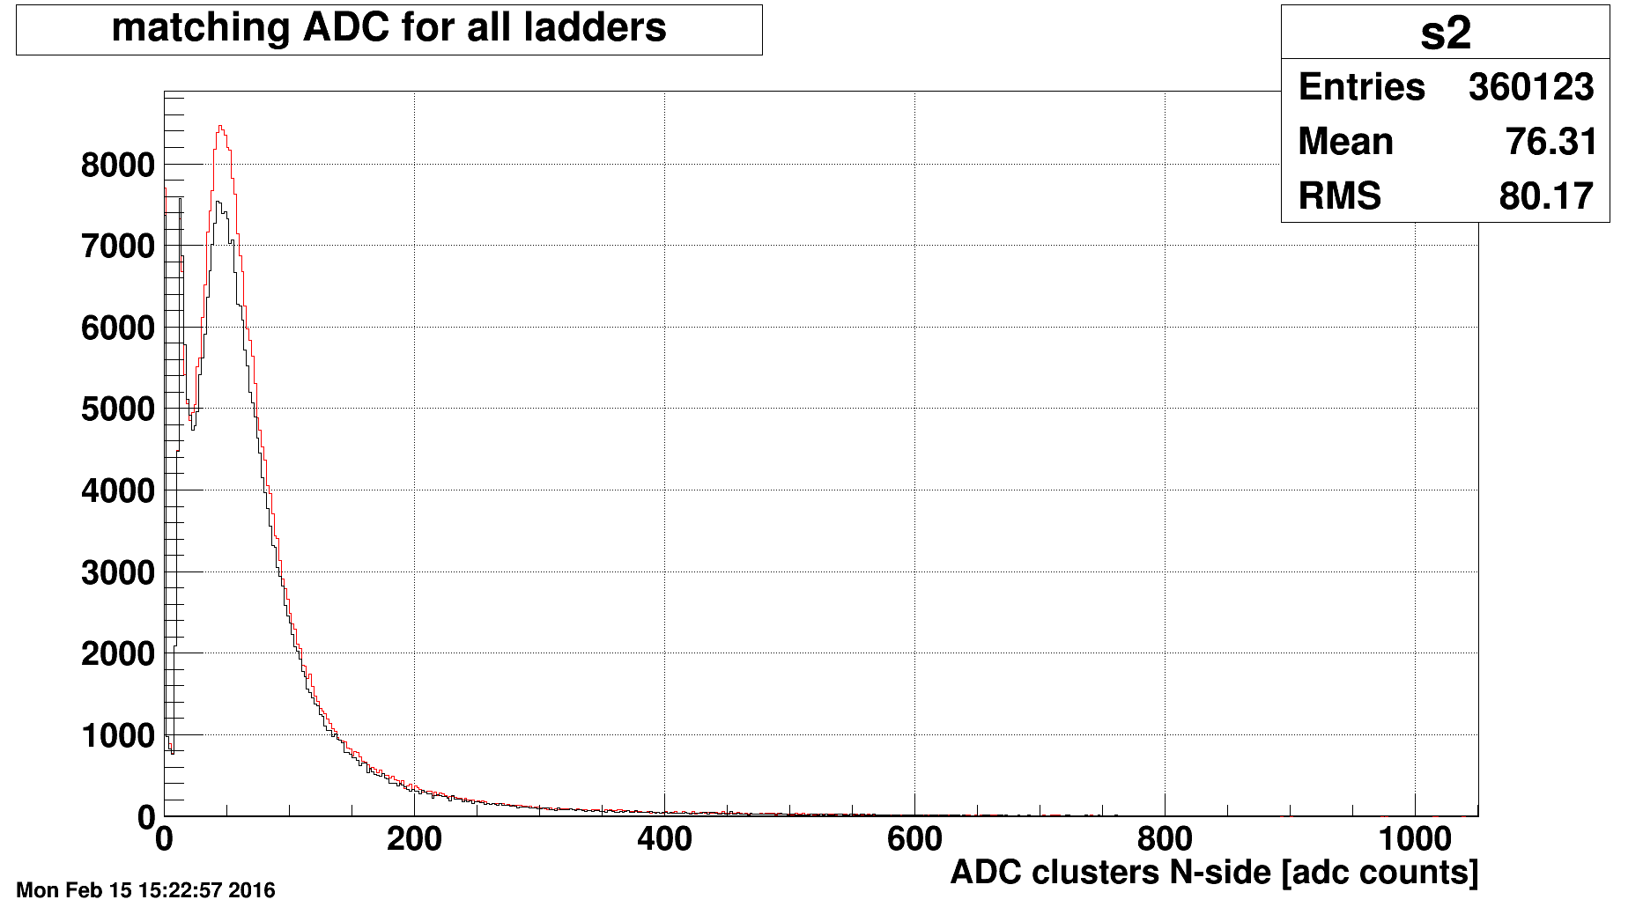
Changing the Internal Busy Setting
Internal Busy = 4000 RHIC Tics (~425 microseconds)
Internal Busy = 3000 RHIC Tics (~320 microseconds)
Note exponential noise curve attached to Landau Curve
Signal to Noise is better at 4000, but 3000 is still very good

Slide 6
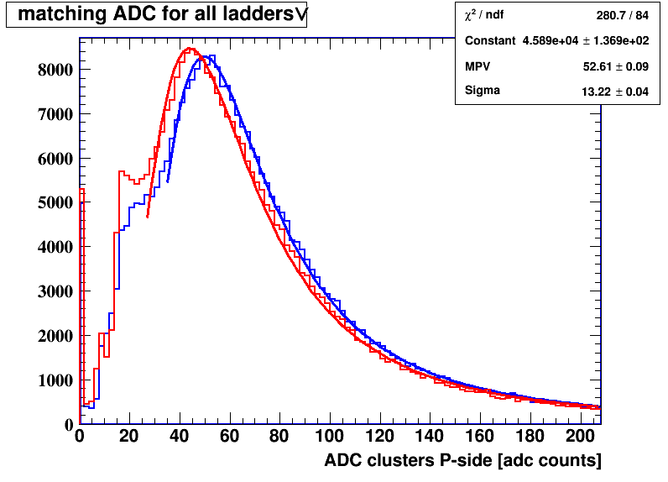
Landau Curve Fits: P side and N side
Landau function fits data nicely, now with tighter cut on the noise
Threshold = N*Sigma + Constant, N = 3 Constant = 4 ADC counts

Slide 7
Backup slides

Slide 8
Common Mode Algorithm to find A128 <avg>
Select 2 channels using mean = 0 and cut ± 280 counts
  Accept first 2 channels that are within 0 ± 280, calculate mean
Select 4 channels using mean = mean(2c) and cut ± 140 counts
  Accept next 4 channels that are within mean(2c) ± 140, calculate new mean
Select 8 channels using mean = mean(4c) and cut ± 70 counts
  Accept next 8 channels that are within mean(4c) ± 70, calculate new mean
Select 16 channels using mean = mean(8c) and cut ± 35 counts
  Accept next 16 channels, calculate mean, etc. but now keep data in sum
Select 16 more channels using mean = mean(16c) and cut ± 25 counts
  Accept next 16 channels, calculate mean, etc. but now keep data in sum
Select 32 more channels using mean = mean(32c) and cut ± 15 counts
  Accept next 32 channels, calculate mean, etc., using most recent 32+16+16 = 64 channels to calculate the final mean value
78 channels required (80 if we skip first and last channels)
  if 78 (80) good channels cannot be found then mark A128 as bad
binary
linear

