Slide 1
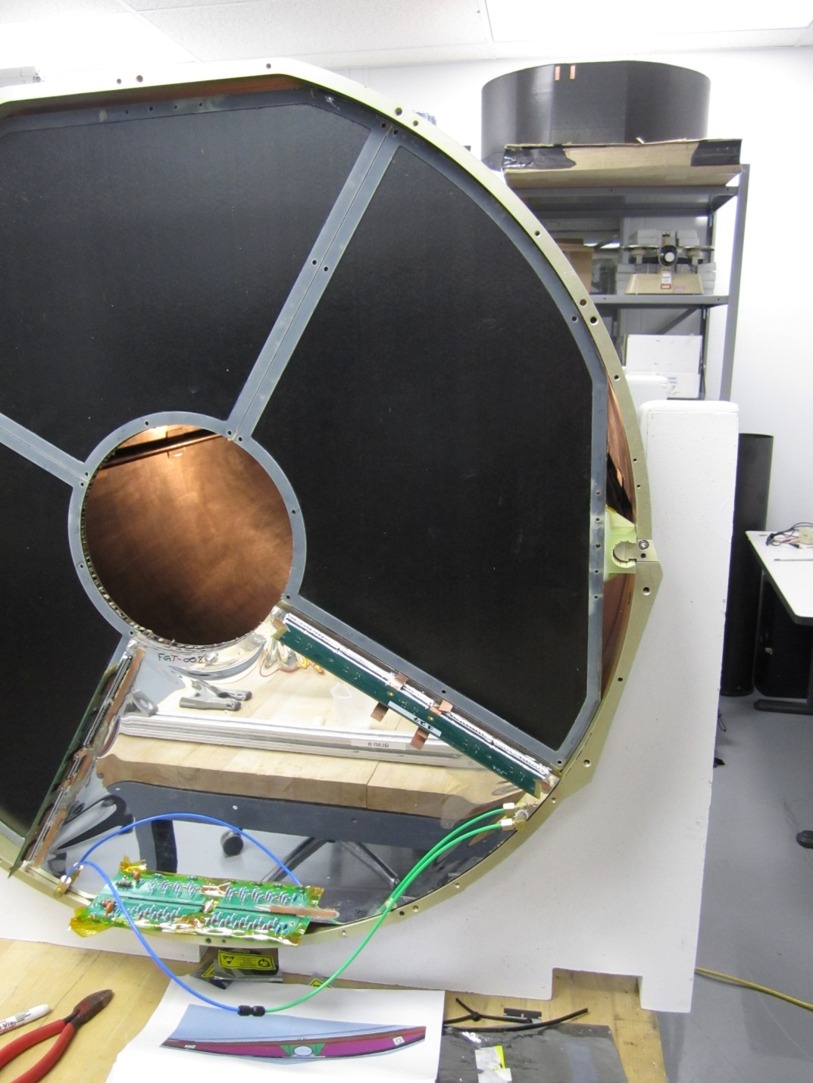
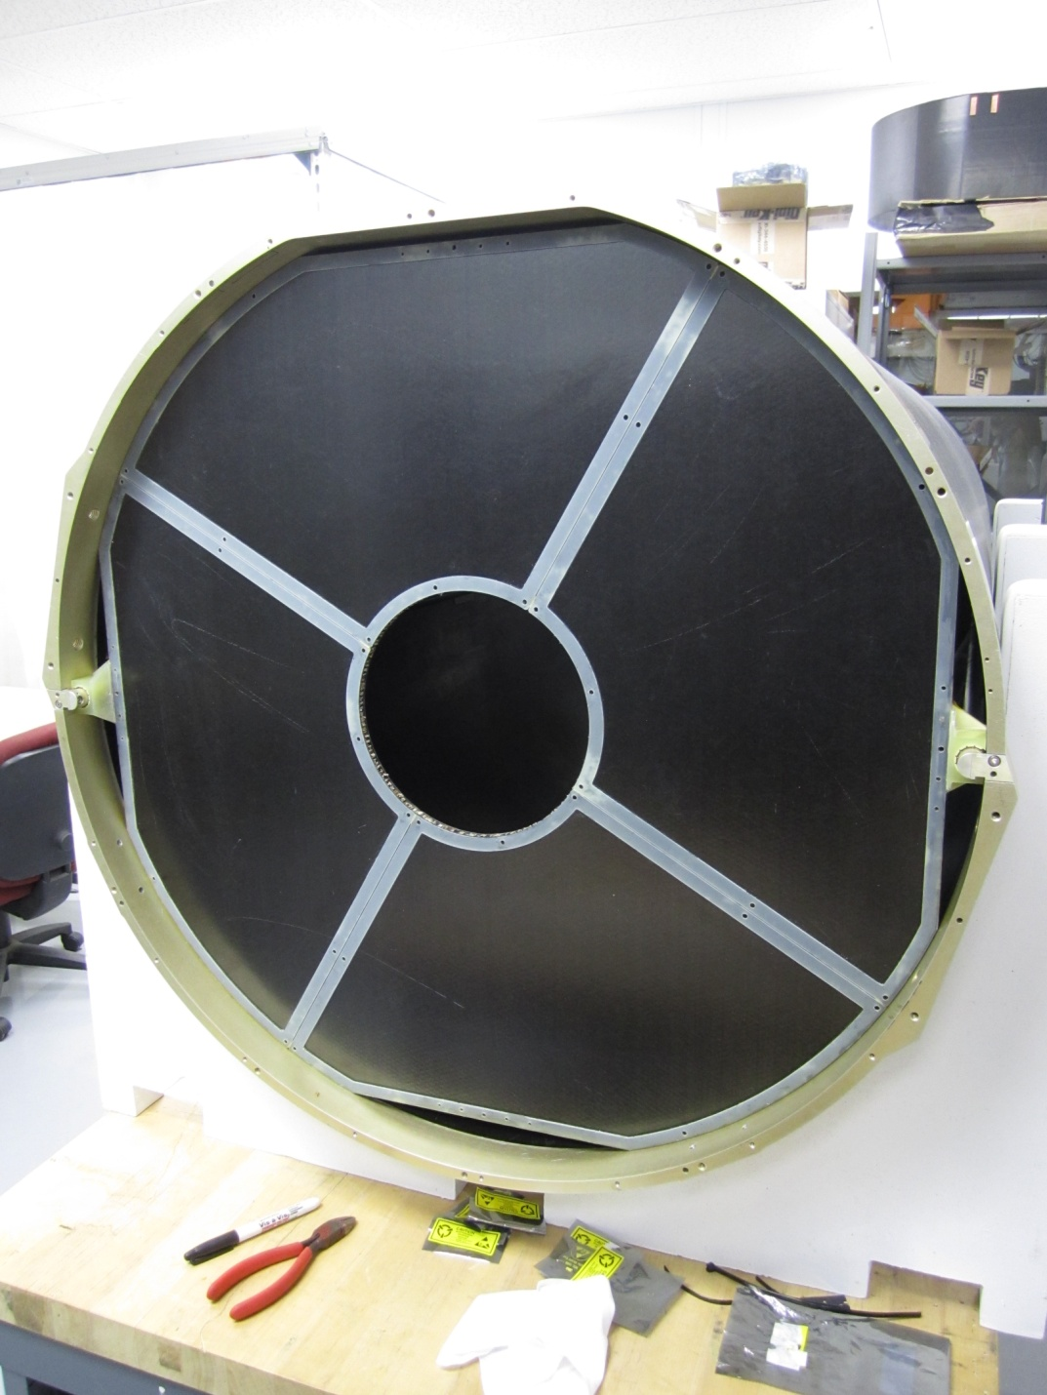
FGT installation disks … viewed from the back (From West end looking in towards vertex). SSD cables go in the spaces above and below the rails on the left and right. Four spaces available.

Slide 2
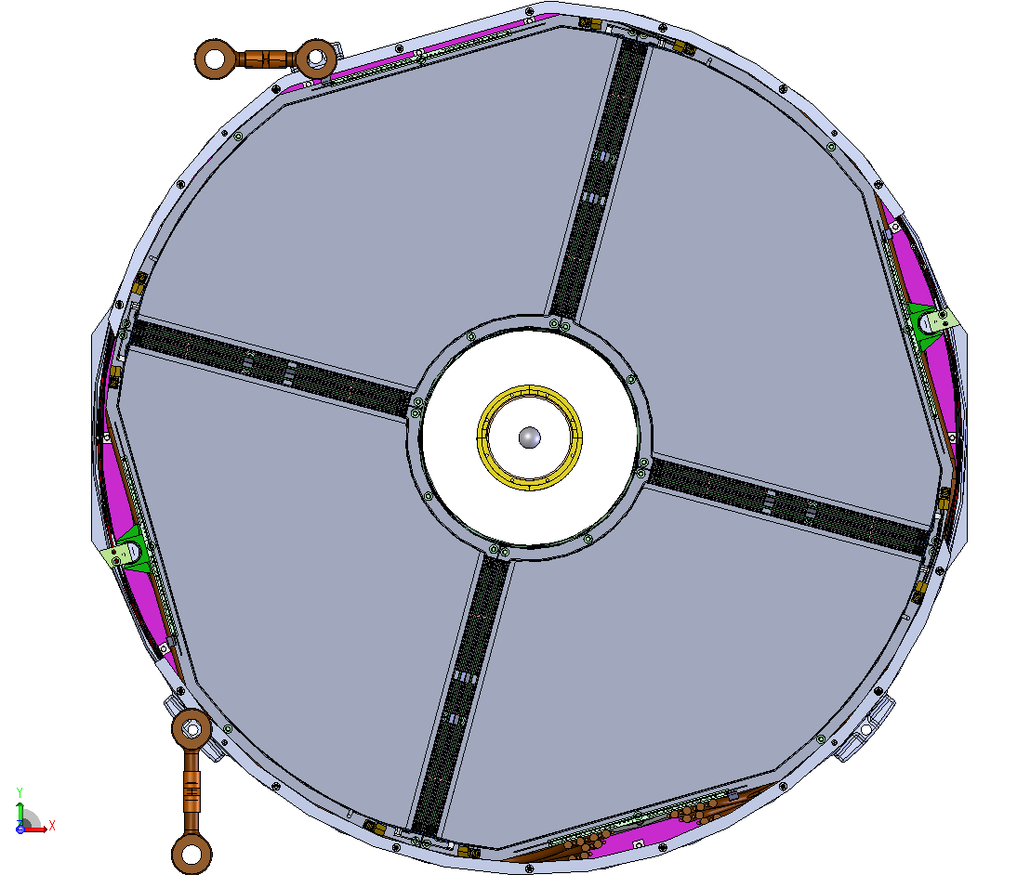
Note funny angle of rotation. This is true and correct.
Engineering drawing of the installed FGT disks. (From WE to vtx.) FGT cables go at the bottom, TPC resistor chain occupies space outside the cone at the top. SSD cables go left and right … around the rails.

Slide 3
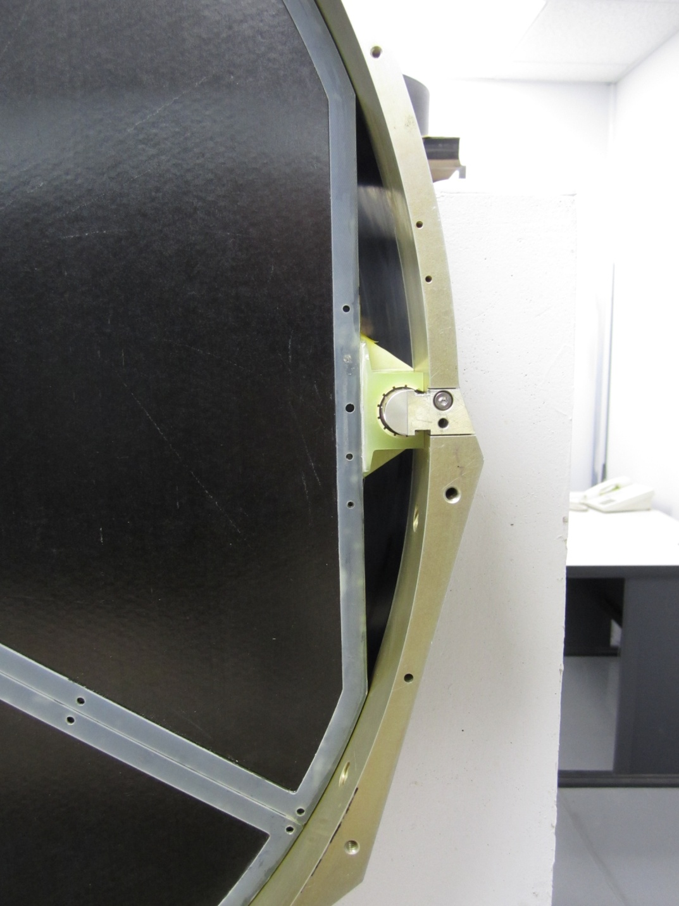
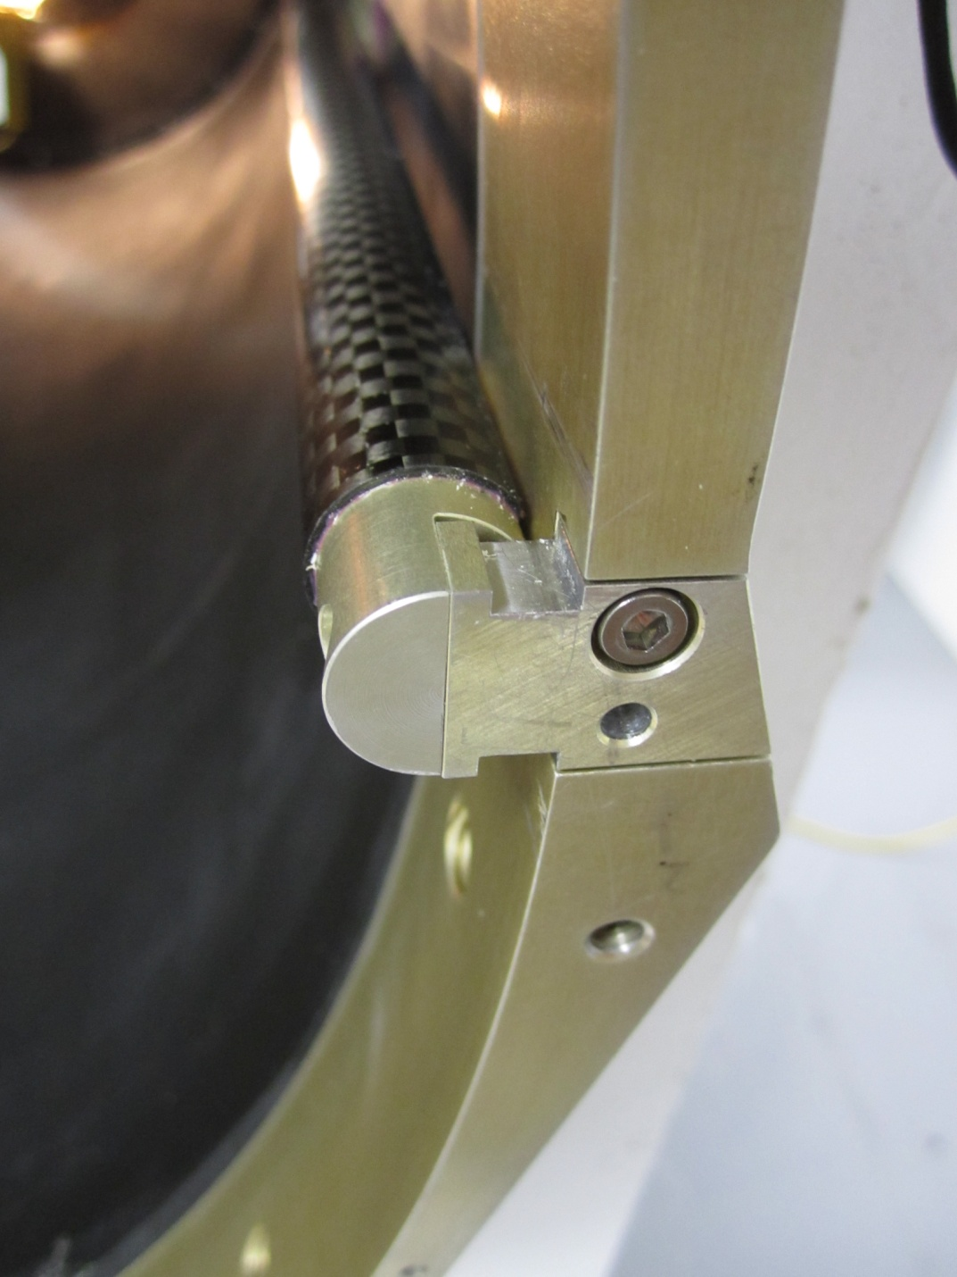
Space around the slider and rail is to be used for the SSD cables.
Detail about rail as it goes into the cone. Rail is 2 cm in diameter.

Slide 4
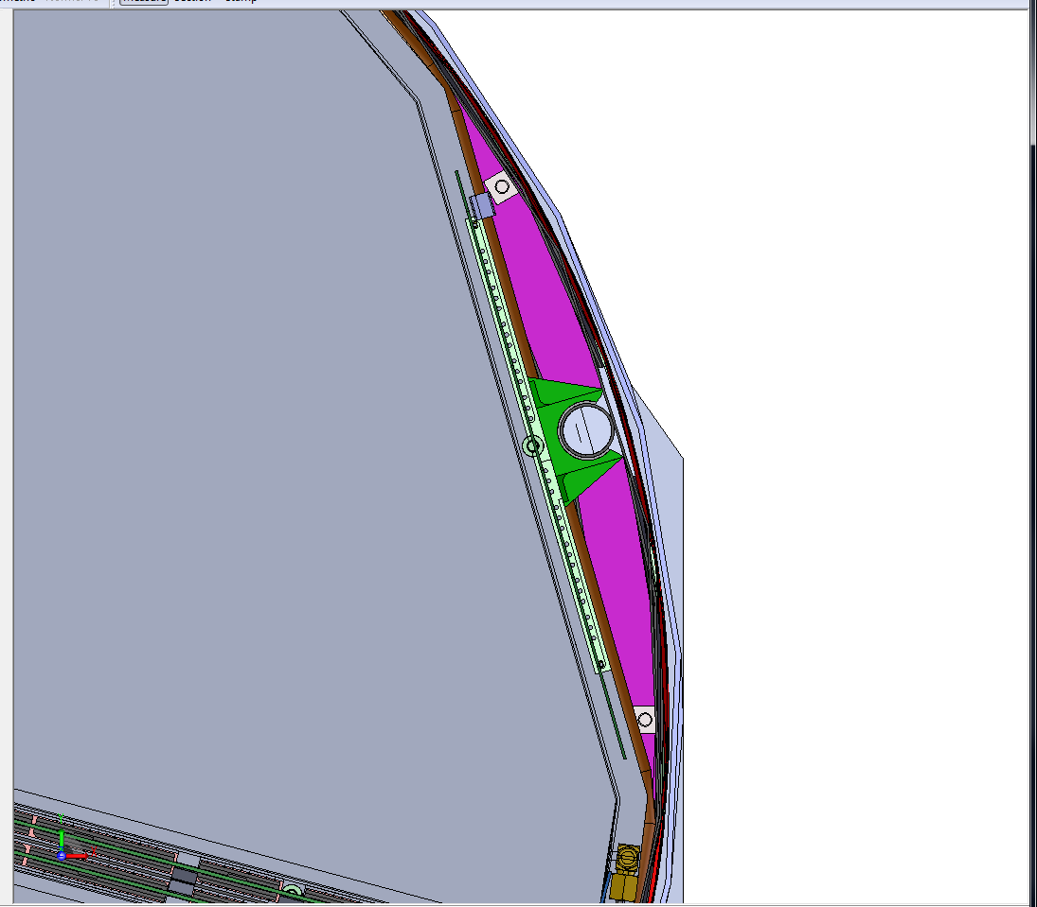
Engineering drawing of the disk, rail and slider; in true orientation.

Slide 5
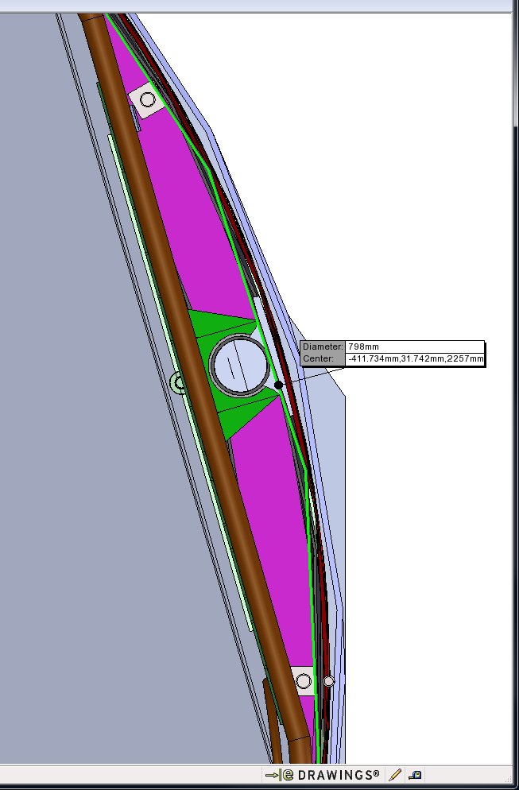
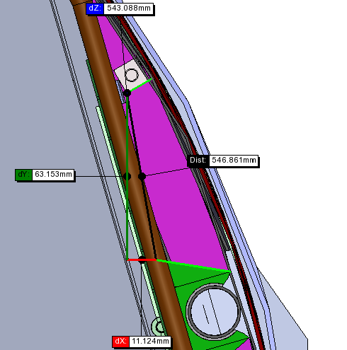


Slide 6
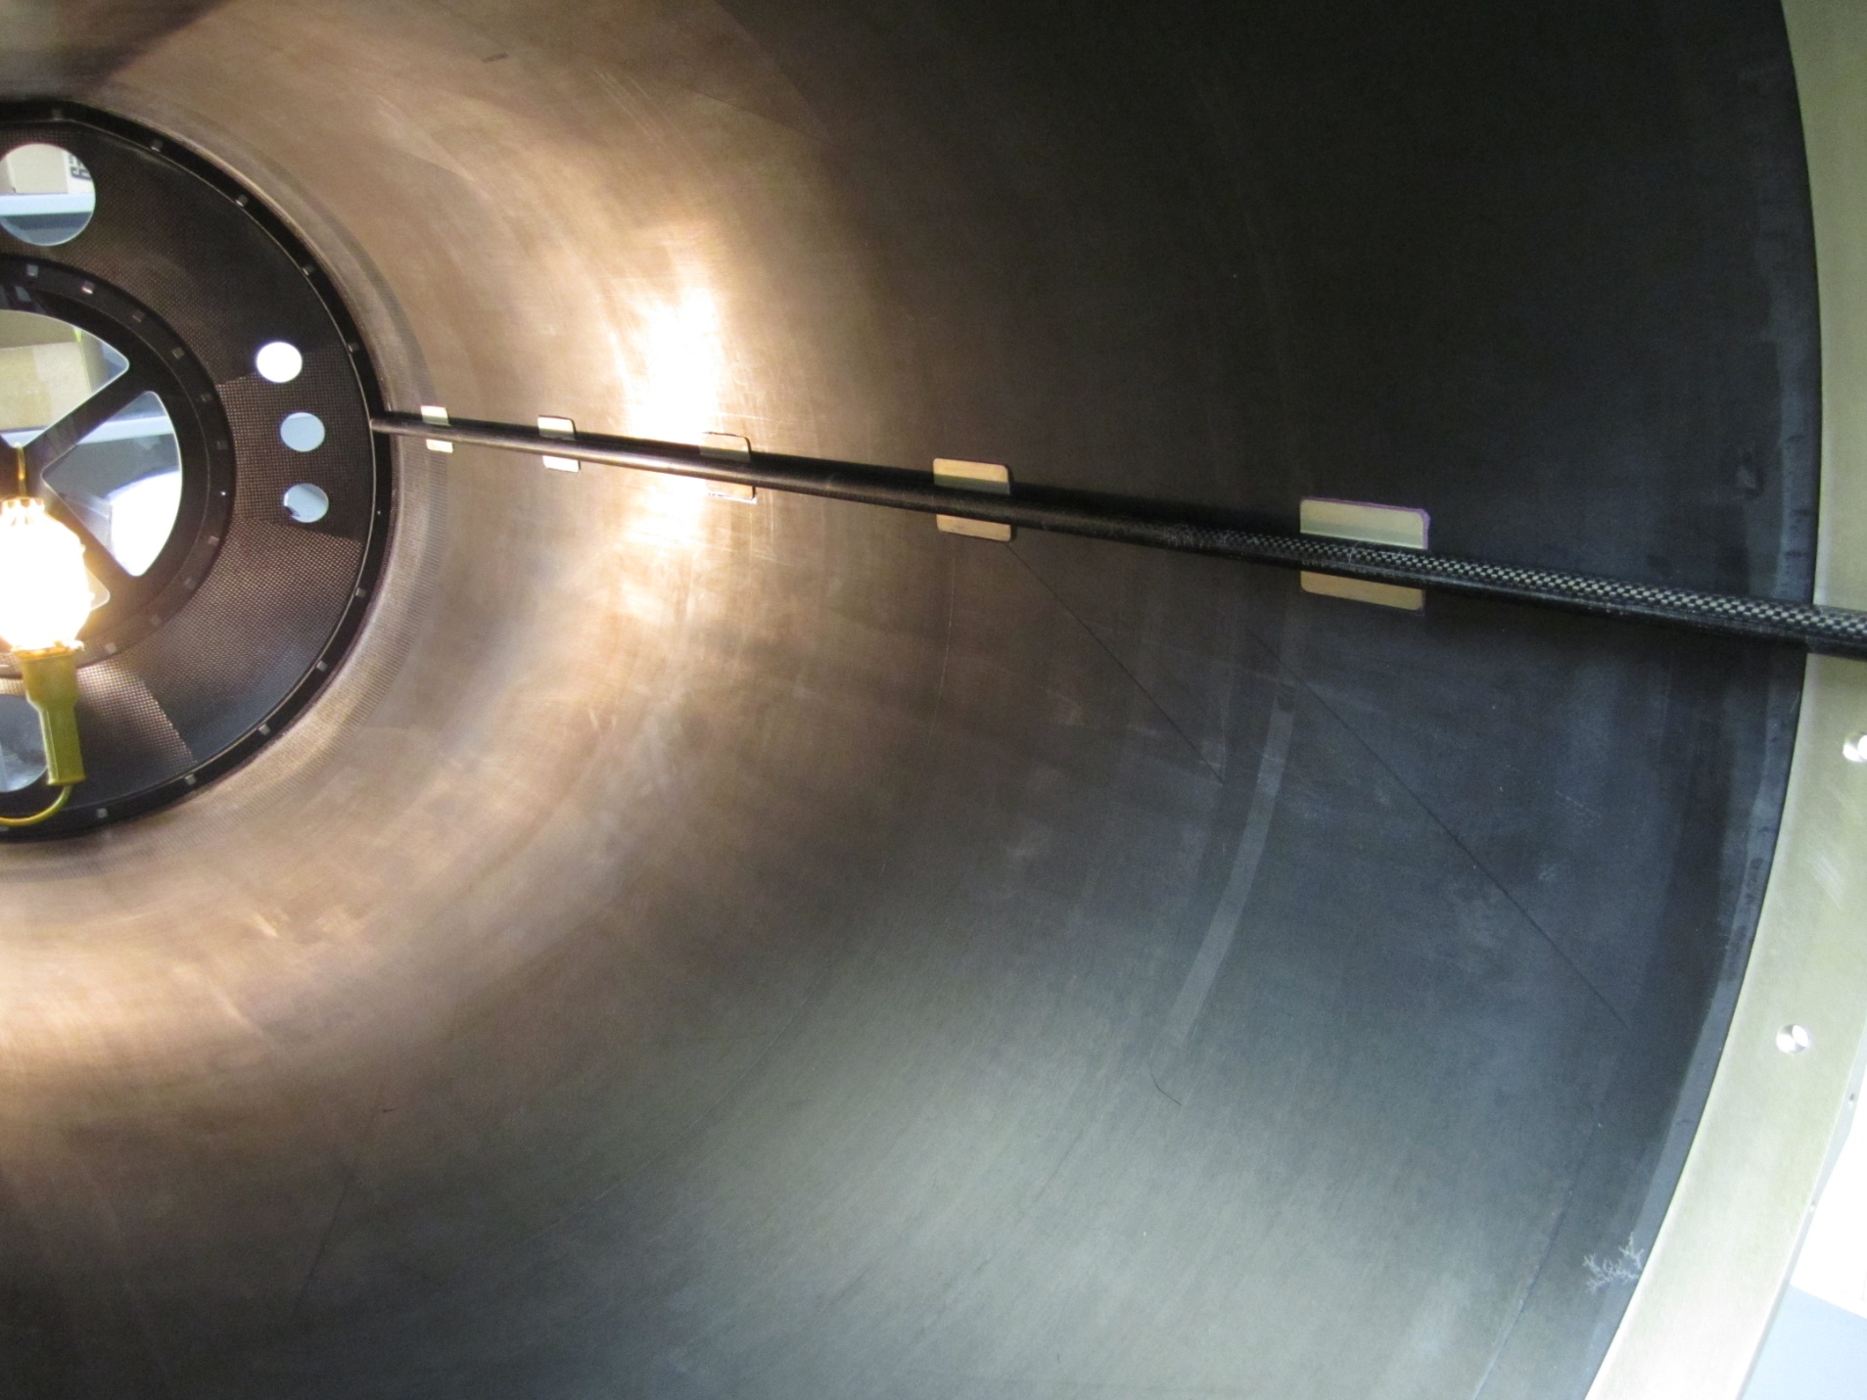
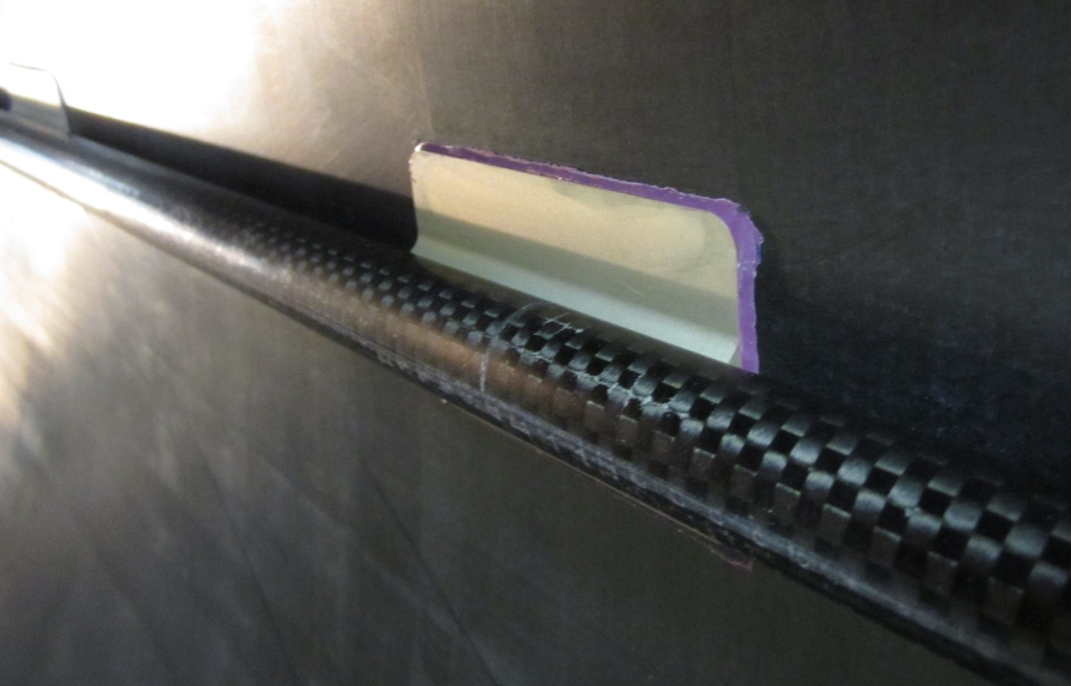
View inside the cone without FGT disks. SSD cables run along the rail in the space immediately above and below the rail. Cable trays are a good idea ??

Slide 7
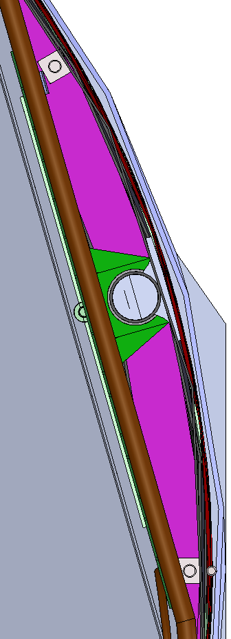
Approx. full size (if printed) drawing of the space for the SSD LV, HV, and optical fibers. The guide rail is 2 cm in diameter. Note that the brown and green components slides back and forth as the FGT disks are installed or de-installed. We must stay within the purple zone and also maintain a suitable stay clear distance from the moving parts. (e.g. the FGT disks have a fair amount of epoxy on the outside edges to and so they are larger than specifications.) Slider is larger than shown. SEE NEXT PAGE !!
We have two sides to work with … one on the left and one on the right hand side of the FGT.
For a rough rule of thumb, we could build four cable trays for the SSD cables that have dimensions of 1.25 cm x 5.5 cm on each side of the rail, however, it will have to be a bit triangular in shape, not square. So a total cross-sectional area of 27.5 cm**2 for 20 cables and 20 fibers. Since the cable tray, itself, will eat up some of this space, it looks like we have ~ 1 cm**2 for each ladder. This includes LV, HV, and optical fiber.

Slide 8
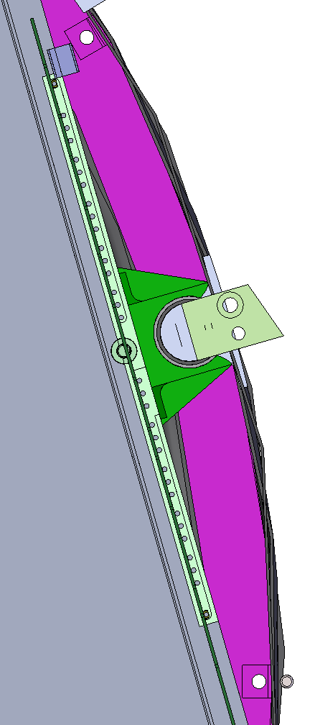
A better picture of the working area (without cables and cooling for FGT disks. We need a 5 mm stay clear zone away from the FGT disks (gray) in order to avoid these cables and so forth. Our cable tray will be in the purple part of the picture and can glue directly to the outer C fiber cylinder. But also note that this drawing does not correspond to the as-built dimensions. The actual slider (dark green) is larger. It is 65 mm across the base, 34 mm across the top (in which the 2 cm rail resides) and is 24 mm tall. I have tried to sketch the actual dimensions into the diagram with solid black lines, stay clear zone with dashed lines.
With 5 mm stay clear on all surfaces, we have space for a triangular cable tray that is max 6.5 cm long, and 1.5 cm high at its maximum height, tapering down to slightly less than 1 cm on the narrow end. After allowing space for glue, and the walls of the cable tray, we should have 20-25 cm**2 of clear space for a group of 5 power cables and 5 fiber optic pairs. We will need four of these cable trays for all 20 ladders.
  Jason estimates that there is 10 cm of space in front of the most forward FGT disk and therefore no problem routing SSD cables through transition cone and into the SSD cable trays (so he says :-)
    (Note: the brown rising moon behind the slider is actually part of the cone near the vertex … far from the west end. It can be ignored as far as FGT disks and SSD cables are concerned.)

Slide 9
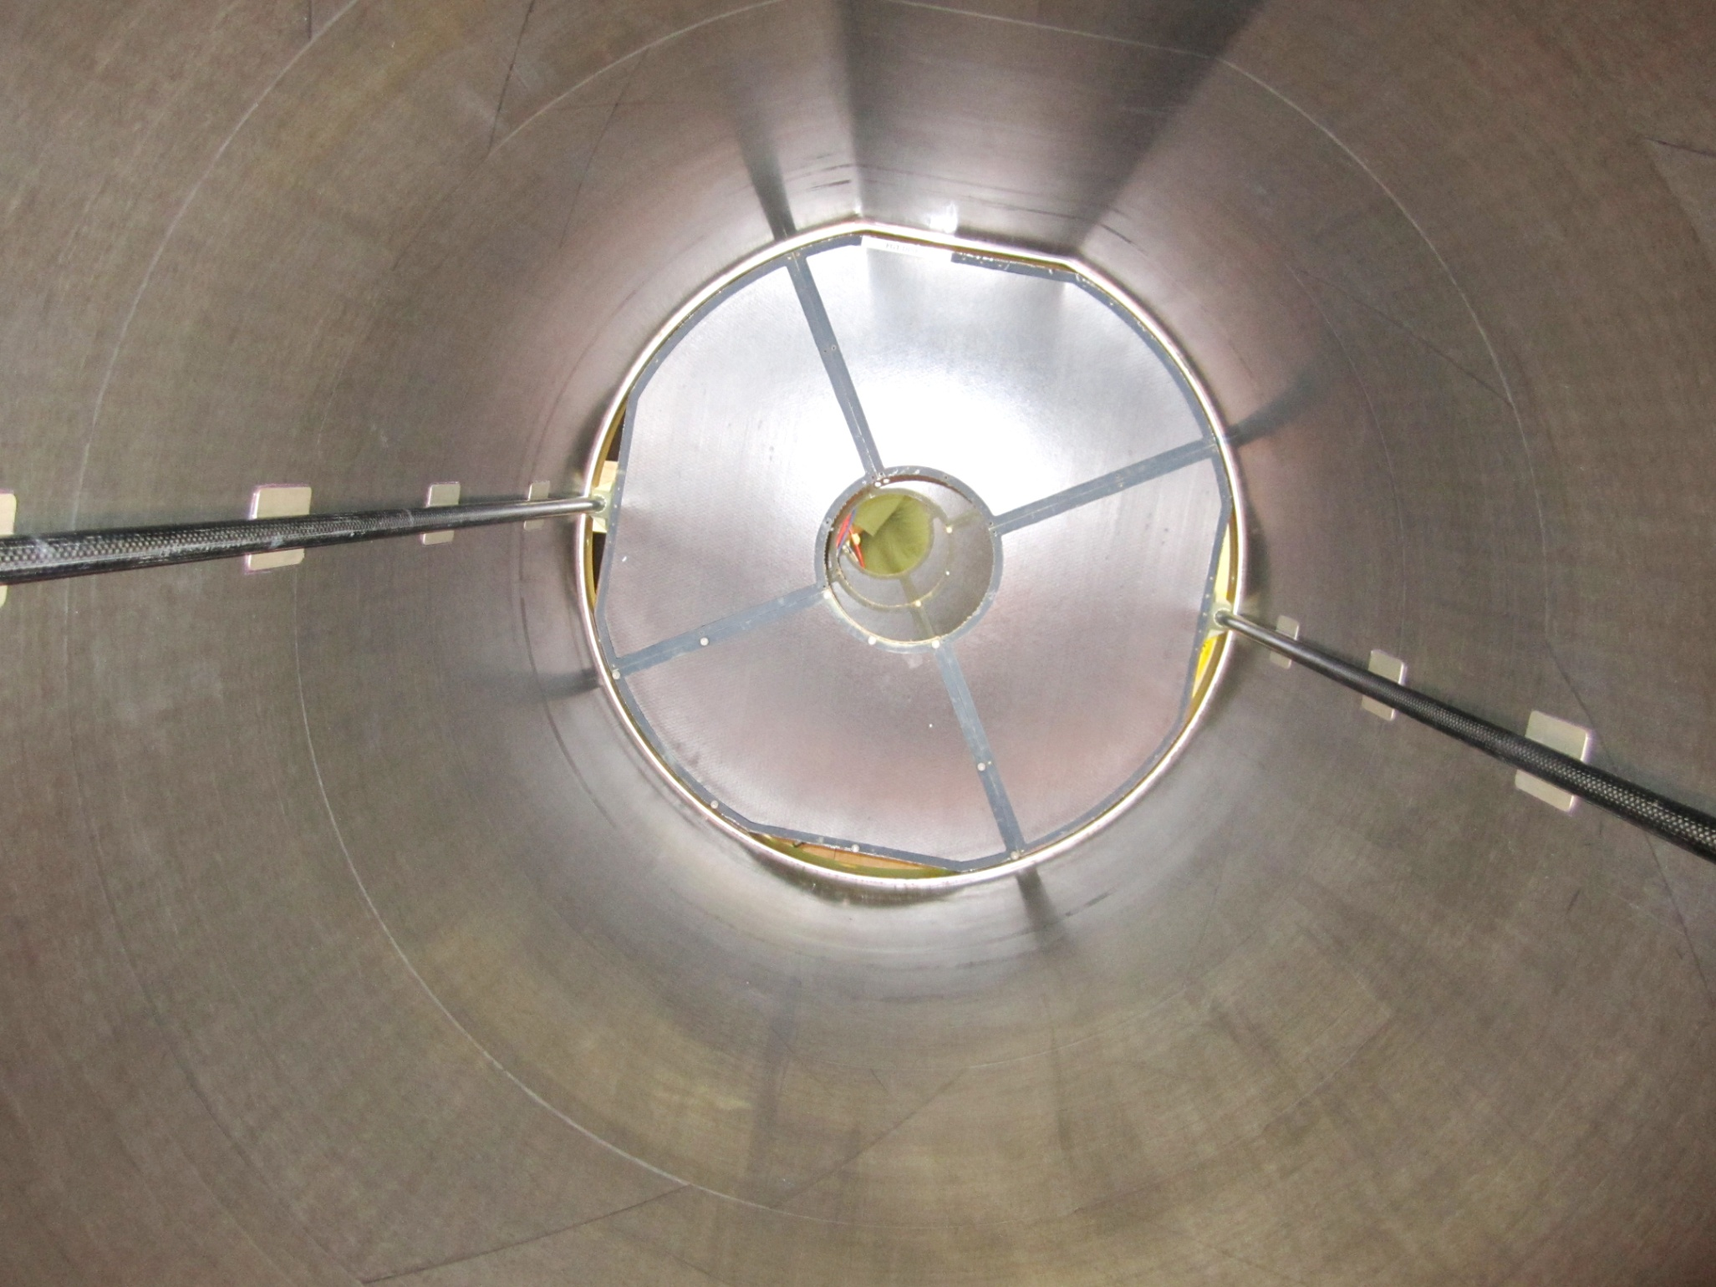
View from the vertex position, looking out. One FGT disk is installed at the West entrance to the cone.

