Slide 1
Mass termination board (MTBv2.0) full power test
Outline:
Test setup
Power consumption
Single ladder vs. full power test
Summary

Slide 2
Test setup (1)
Production ladder power consumption:
  ~2 A => ~1.3 A VDA + ~0.7 A VDD
Ladder emulation:
  V_analog 3.3V @ 2.2 Ω + 0.2 Ω
  V_digital 3.3V @ 4.7 Ω
VDA
0.2 Ω
sense
2.2 Ω
GND

Slide 3
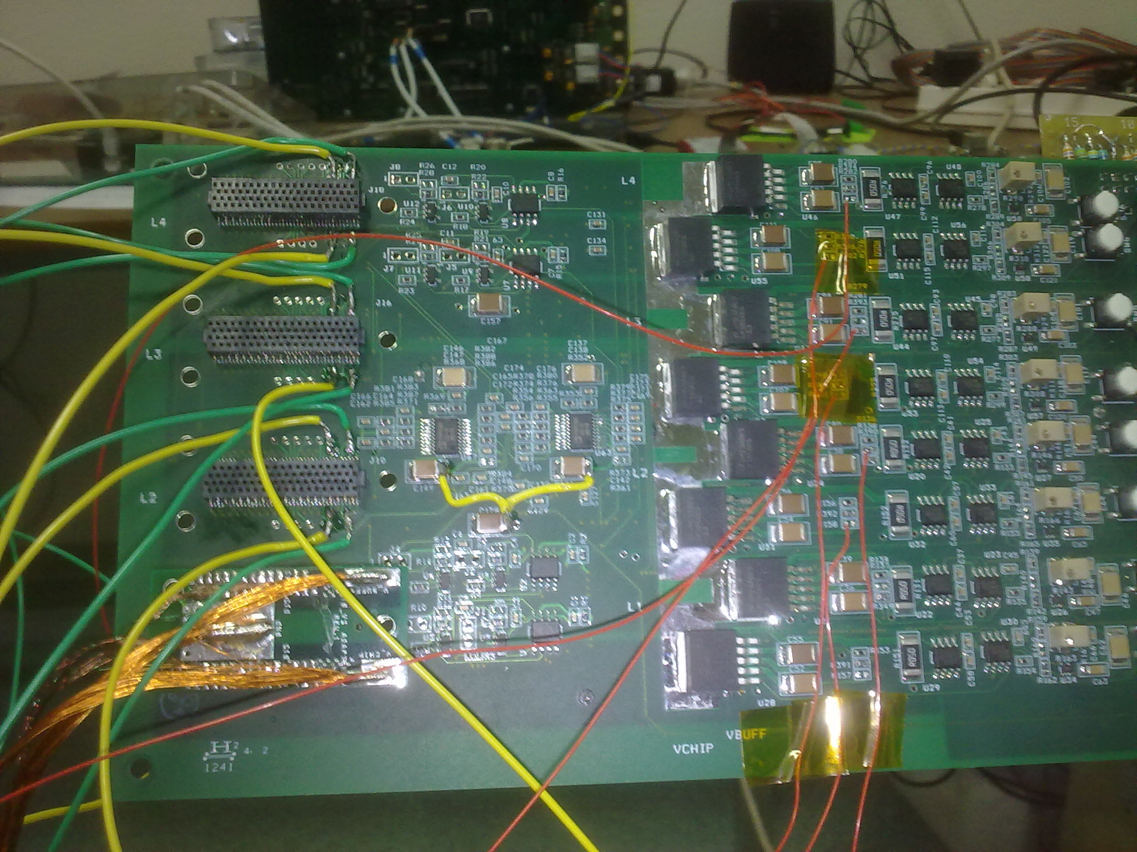
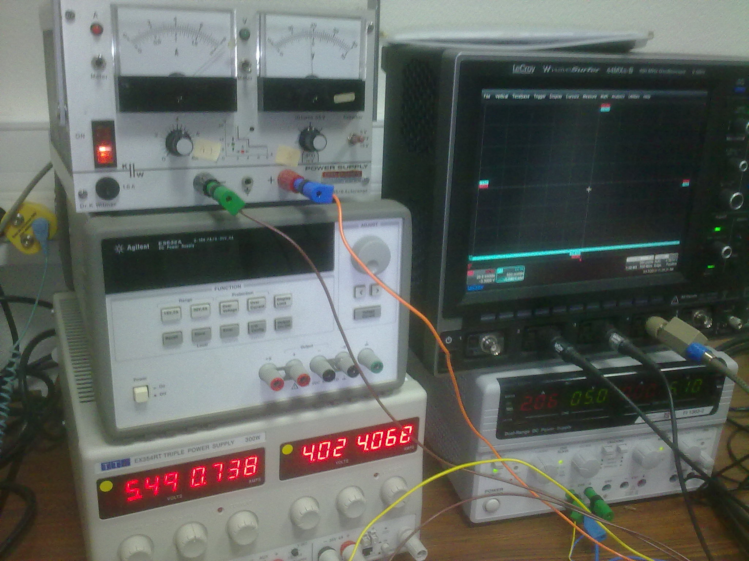
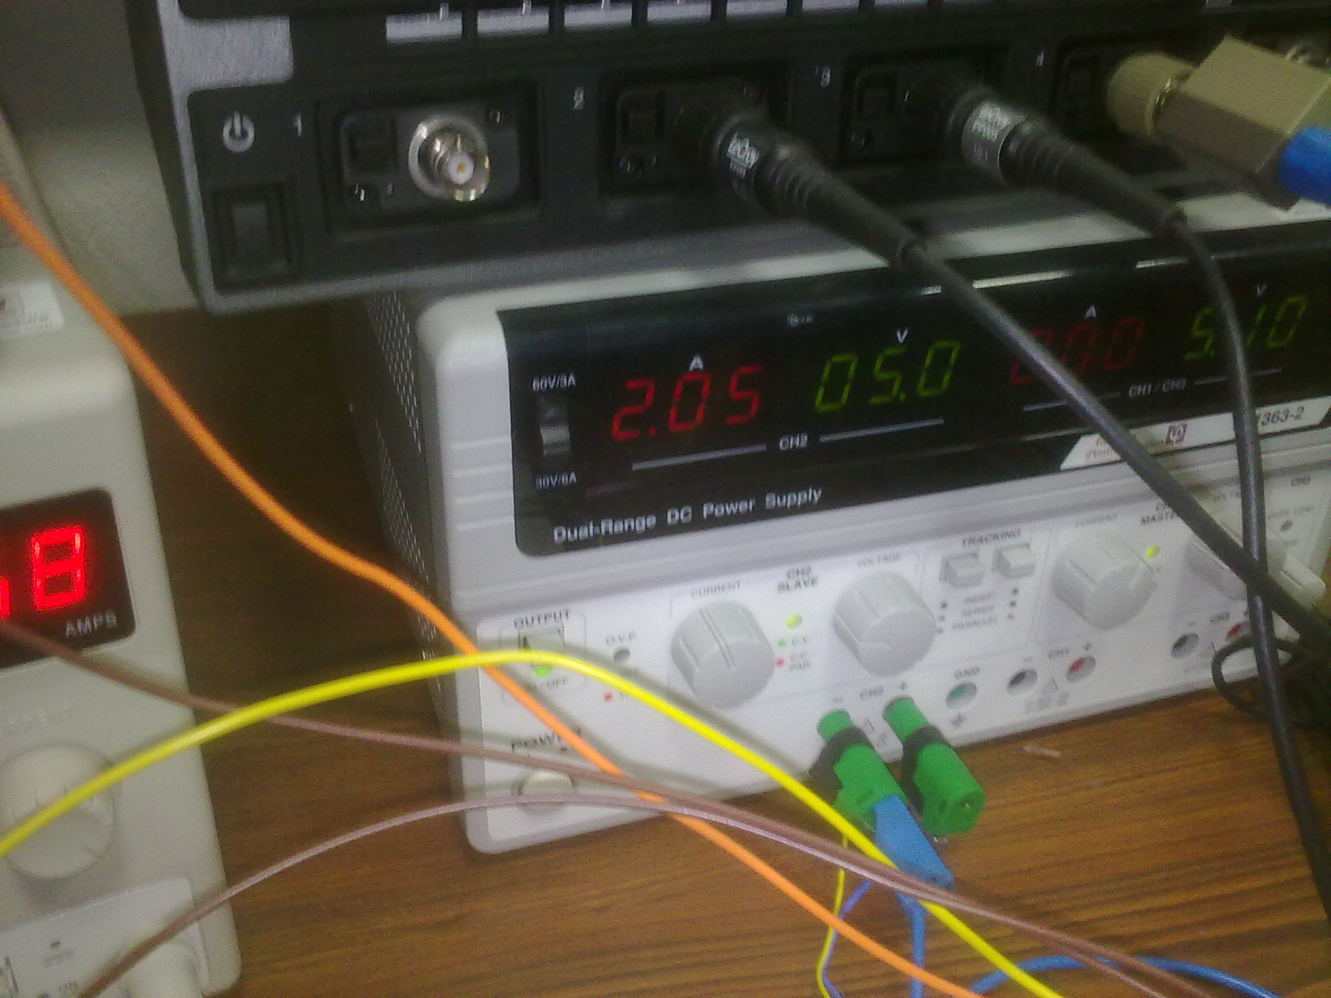
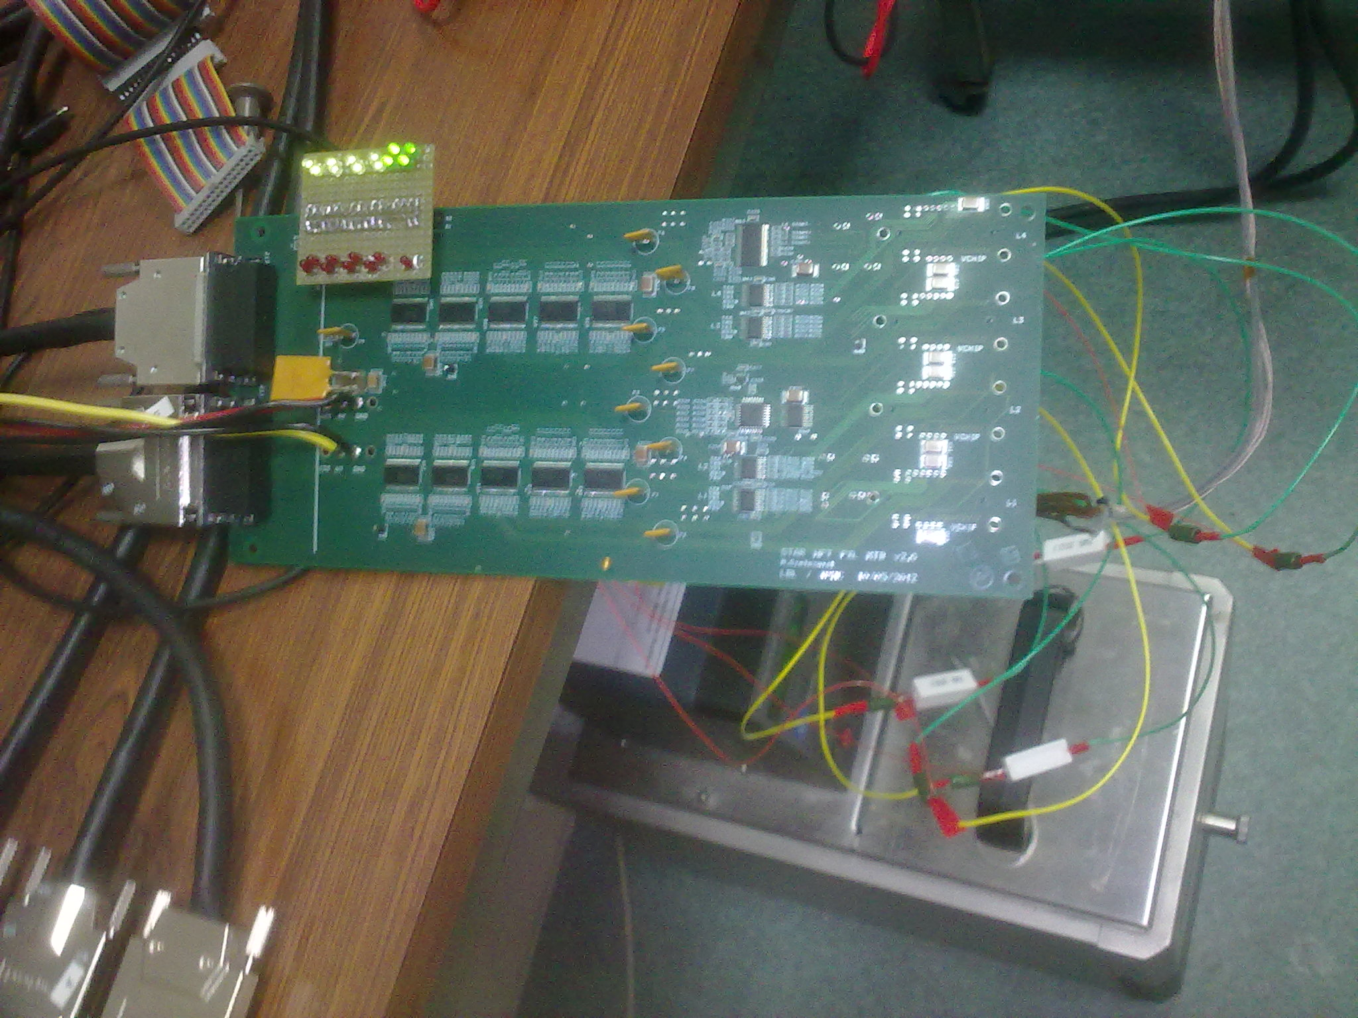
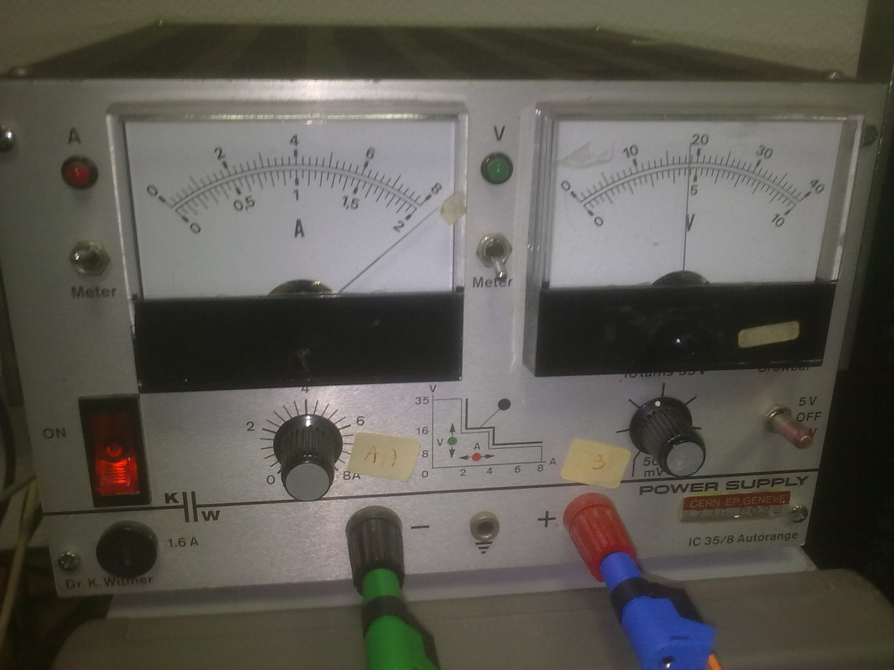
Test setup (2)
MTBv2.0
RDO
(Xilinx)
1 PXL production ladder
+ 3 “ladders” (resistors)

Slide 4
Single ladder vs. full power test - noise

Slide 5
Single ladder vs. full power test - FPN

Slide 6
Single ladder vs. full power test - offset

Slide 7
Summary
No discernible difference between single ladder tests and full current load tests (@ 8A)
Ladder performance tested using our new MTBv2.0 board is stable under low and high current load conditions
This performance will be validated with a full sector test

