Slide 1
STAR-PXL Mechanical Integration and Cooling
St. Odile Ultra-Thin Vertex Detector Workshop
8-Sept-2011
Howard Wieman
LBNL

Slide 2
PIXEL Mechanical Work
Lawrence Berkeley National Lab:
Leo Greiner
Eric Anderssen
Hans Georg Ritter
Michal Szelezniak
Xiangming Sun
Joseph Silber
Jim Thomas
Howard Matis
Mario Cepeda
Tom Johnson
Dan DeBoer
Brian Bentley
University of Texas Austin:
Jerry Hoffman
Herbert Boehl
Jo Schambach

Slide 3
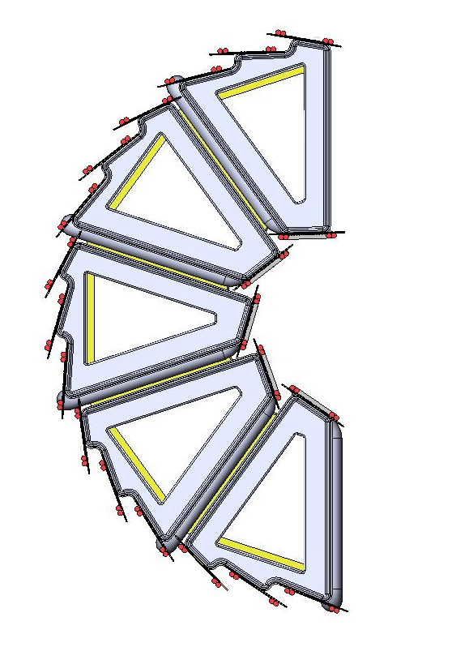
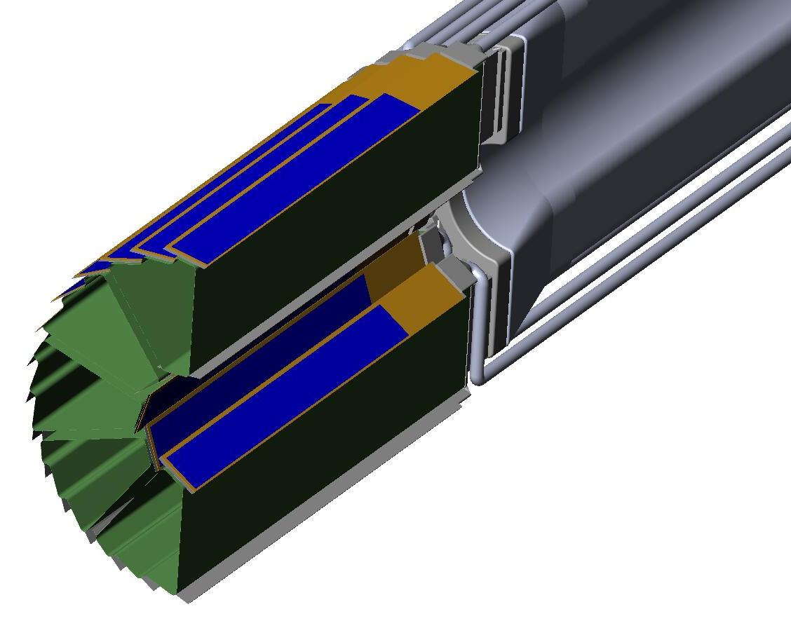
Pixel geometry
End view
8 cm radius
20 cm
2.5 cm radius
Inner layer
Outer layer
η coverage +-1
total 40 ladders
One of two half cylinders

Slide 4
Topics
Mechanical trade offs in achieving the highest pointing precision
Work addressing mechanical precision and stability.
Rapid Detector Replacement

Slide 5
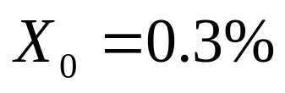
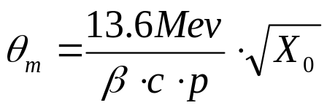
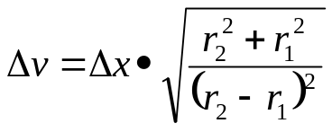
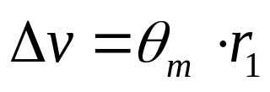
vertex projection from two points
expectations for the HFT pixels
pointing resolution = (13 ⊕ 22GeV/p⋅c) μm
first pixel layer
from
detector
position
error
from
coulomb
scattering
more than 3 times
better than hybrids
Δx
detector layer 2
θ_{m}
Δx
detector layer 1
r₁
r₂
r₁
r₂
perceived
vertex
Δv
true vertex
perceived
vertex
Δv
true vertex

Slide 6
Know where the pixels are
Build a mechanically stable structure
Measure pixel locations – i.e. generate a spatial pixel map that will not be corrupted by mechanical changes

Slide 7
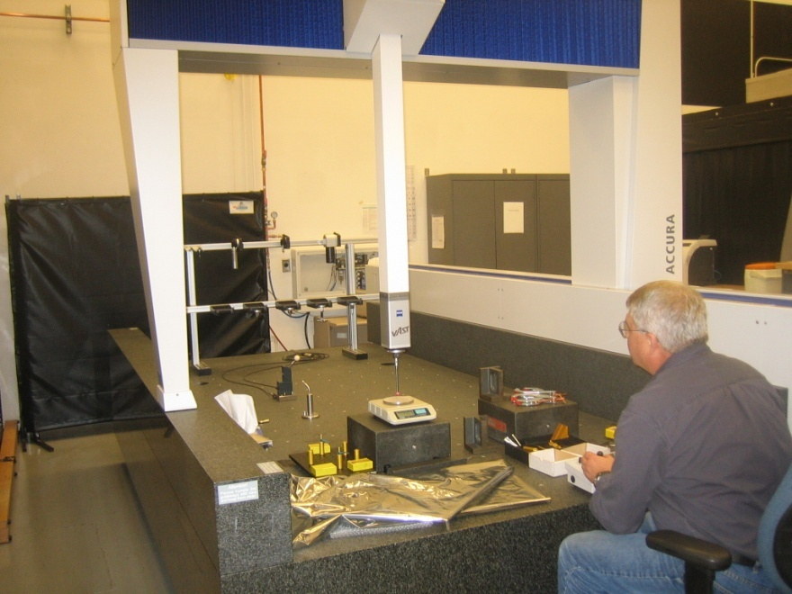
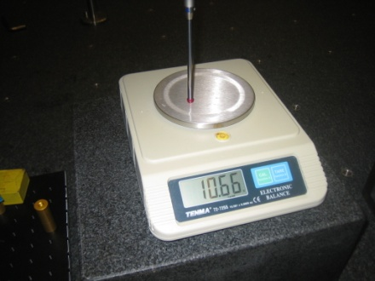
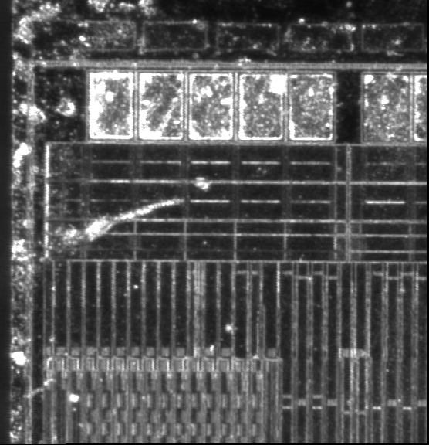
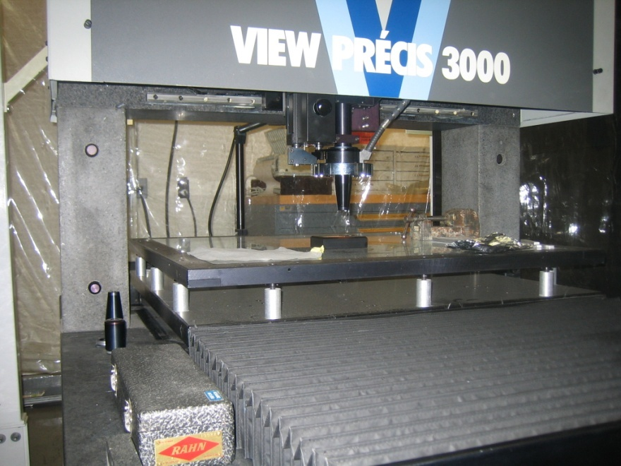
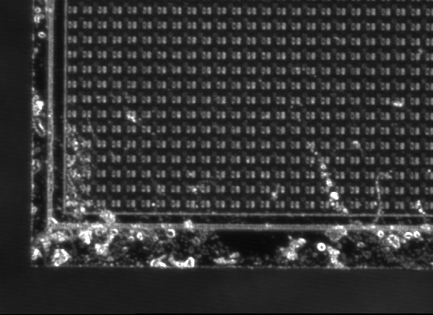
development of spatial map
Bob Connors
Spiros Margetis
Yifei Zhang
10 gm touch
probe force
touch probe 2-3 μm (xyz) and
visual 2-3 μm (xy) 50 μm (z)
active volume: huge
visual sub micron (xyz) repeatability
5 μm accuracy over active volume
Feather light touch probe
active volume:
30 in X 30 in X 12 in
MEMOSTAR3, 30 μm pitch

Slide 8
Mechanical Stability
Once the pixel positions are measured will they stay in the same place to within 20 µm? Issues addressed:
Movement induced temperature changes
Deflection from gravity
Vibration movement from mounts in STAR
Movement induced by cooling air
  vibration and static displacement

Slide 9
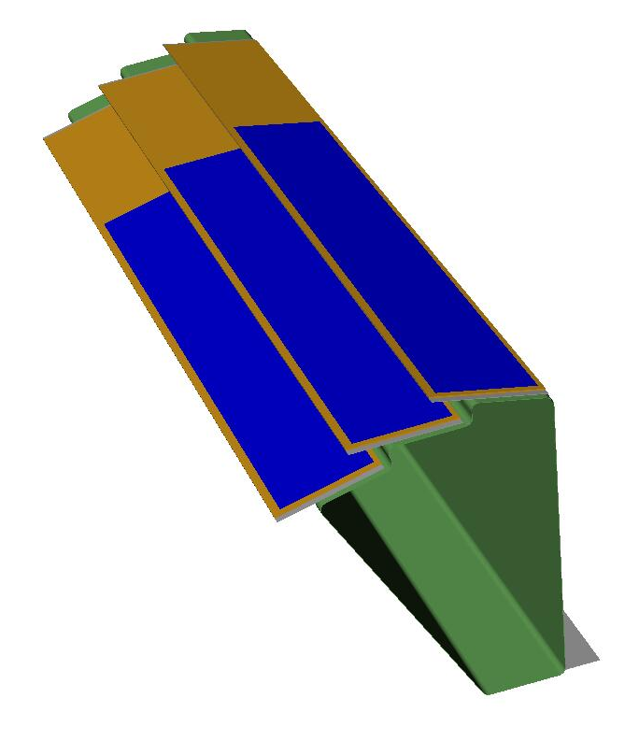
Stability requirement drove design choices
The detector ladders are thinned silicon, on a flex kapton/aluminum cable
The large CTE difference between silicon and kapton is a potential source of thermal induced deformation even with modest 10-15 deg C temperature swings
Two methods of control
  ALICE style carbon composite sector support beam with large moment of inertia
  Soft decoupling adhesive bonding ladder layers
Multiple designs were considered. This design optimized low X₀, mechanical stability and ease of fabrication

Slide 10
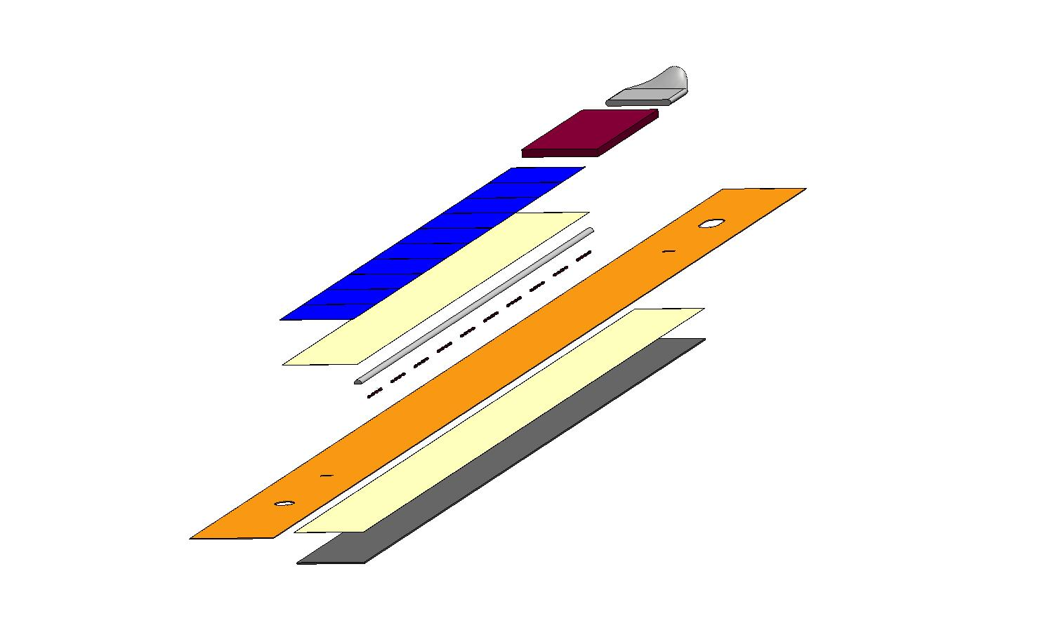
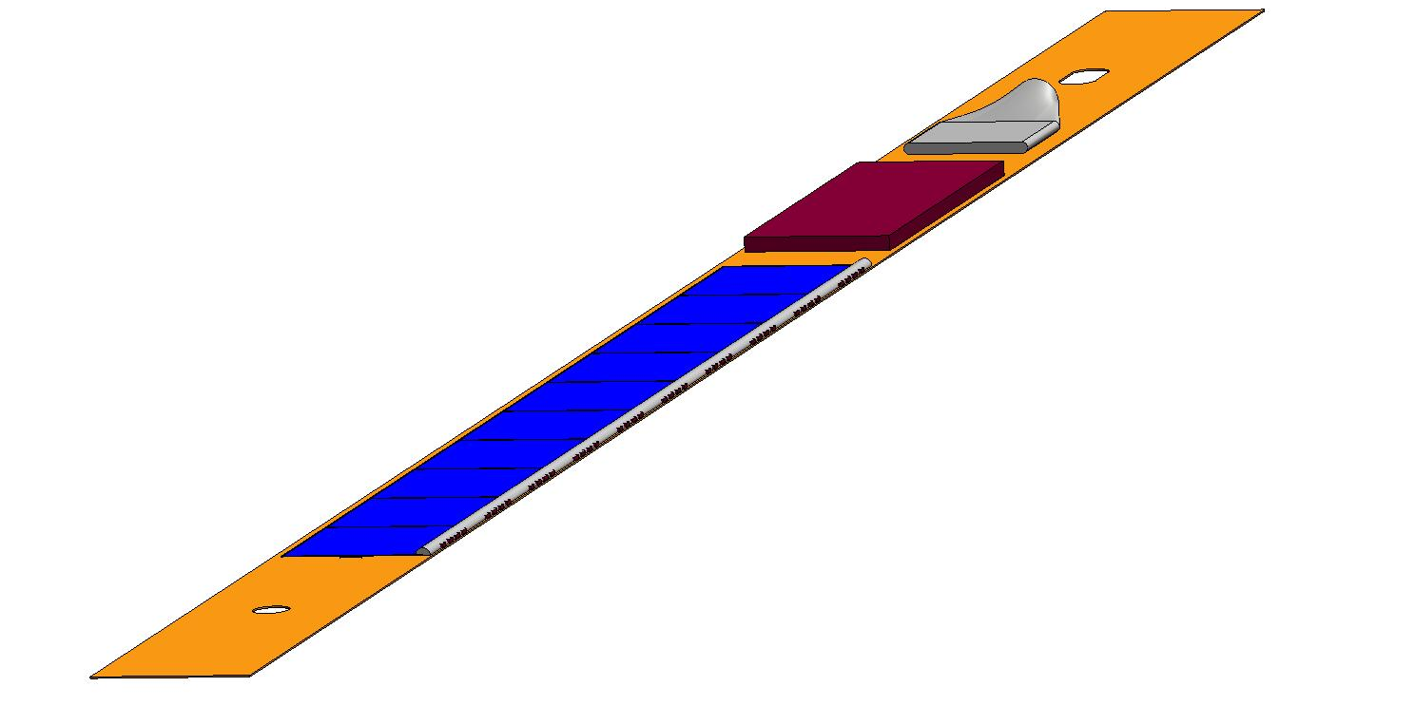
Ladder design with soft adhesive (6 psi shear modulus)
cable bundle
drivers
kapton flex cable
pixel chips
adhesive
composite backer
adhesive
wire bonds
capacitors
adhesive:
3M 200MP
2 mil, film adhesive

Slide 11
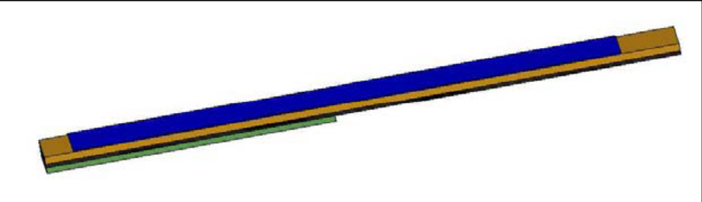
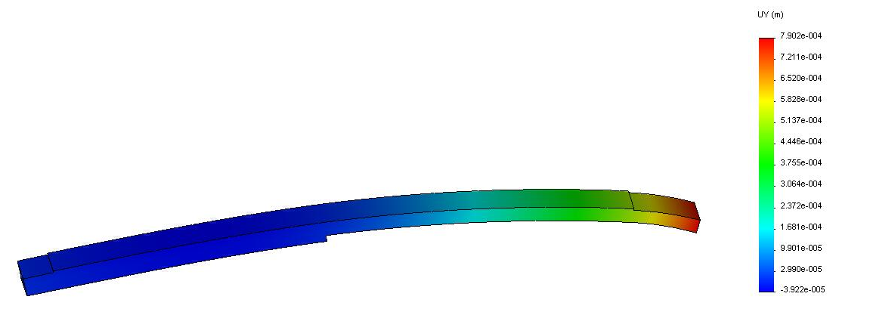
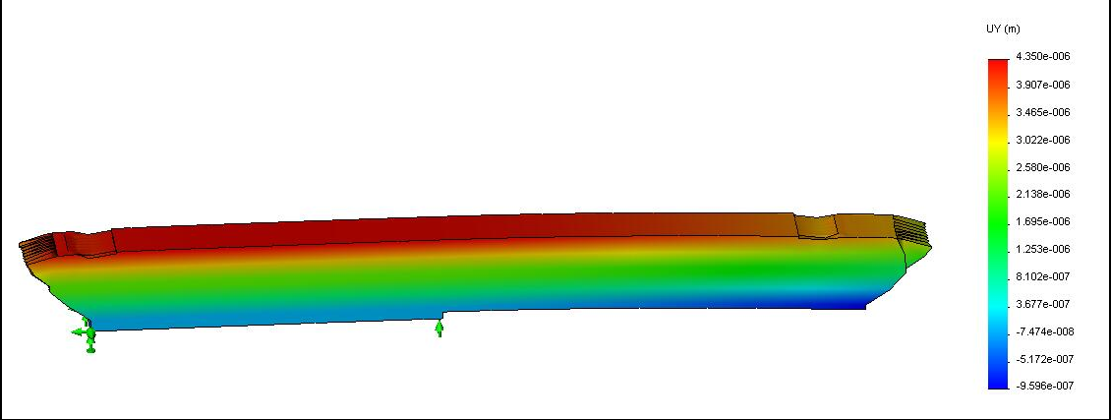
FEA analysis showing bi-metal thermally induced deformation
ladder cross section
short direction
20 deg C temperature change
rigid bond
500 micron deformation
soft adhesive
4.3 micron deformation

Slide 12
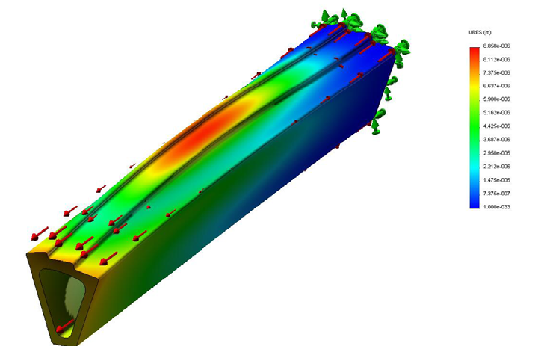
FEA analysis of thermally induced deformation of sector beam
FEA shell elements
Shear force load from ladders
20 deg temperature rise
Soft adhesive coupling
200 micron carbon composite beam
end cap reinforcement
Maximum deformation 9 microns (30 microns if no end cap)

Slide 13
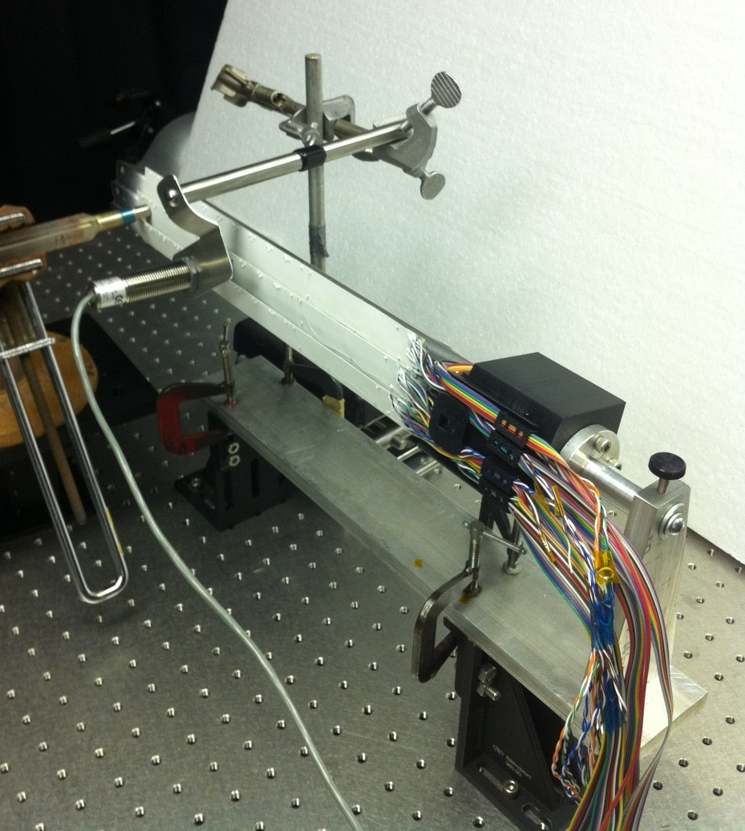
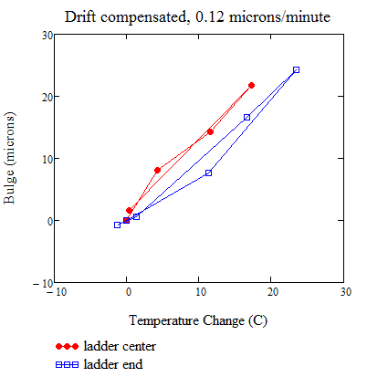
Center Ladder Deflection With Temperature
Preliminary
1.3 μm/deg C measured
0.5 μm/deg C FEA
Larger than predicted, but acceptable

Slide 14
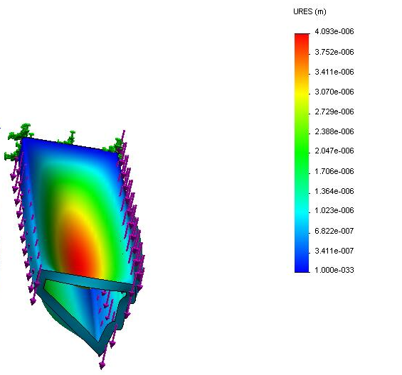
FEA analysis - sector beam deformation – gravity load
FEA shell analysis
120 micron wall thickness composite beam
gravity load includes ladders
maximum structure deformation 4 microns
ladder deformation only 0.6 microns

Slide 15
Air cooling of PXL detector
CFD analysis
Cooling tests with full size mockup

Slide 16
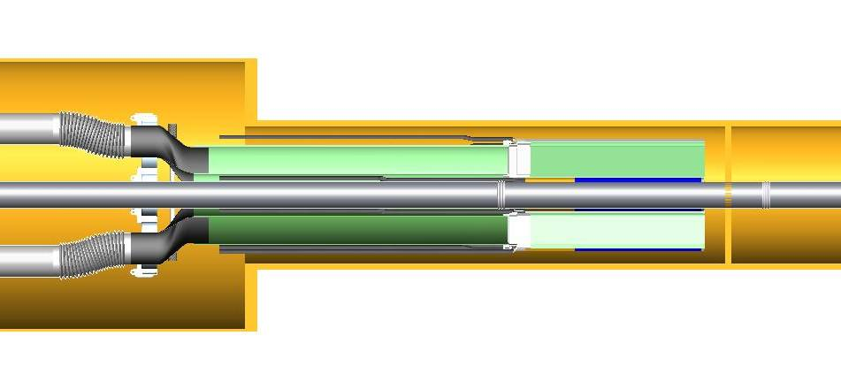
Air cooling of silicon detectors - CFD analysis
Silicon power: 100 mW/cm² (~ power of sunlight)
240 W total Si + drivers
air flow path – flows along both inside and outside surface of the sector

Slide 17
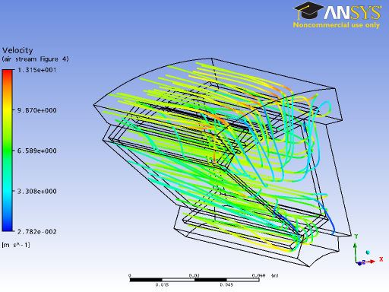
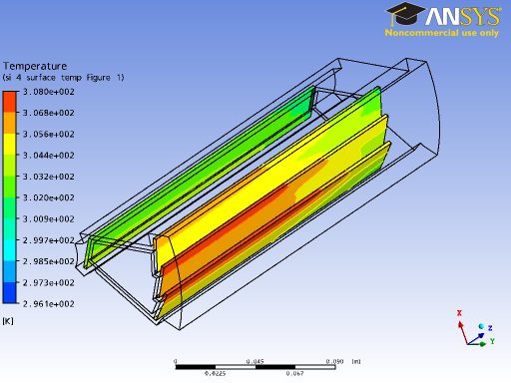
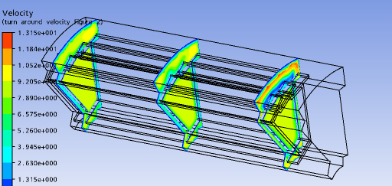
Air cooling – CFD analysis
air flow velocity 9-10 m/s
maximum temperature rise above ambient: 12 deg C
sector beam surface – important component to cooling
dynamic pressure force 1.7 times gravity
stream lines with velocity
silicon surface temperature
velocity contours

Slide 18
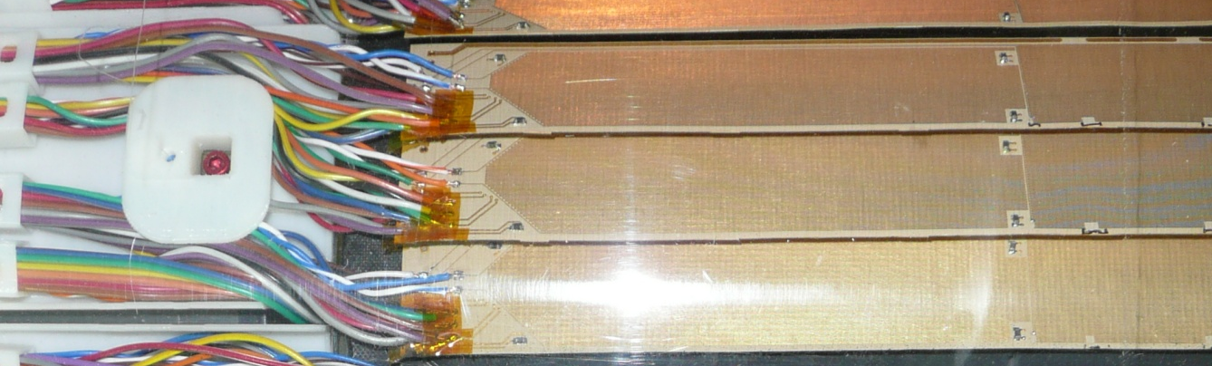
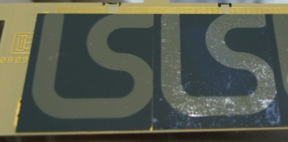
Detector mockup
Kapton cables with copper traces forming heaters allow us to dissipate the expected amount of power in the detector
Sensor section ~20 cm
Driver section ~6 cm
5 | 1 | 6
3 | 2 | 4
There are 6 thermistors on each ladder (except for the ladder with silicon chips mounted) that allow us to monitor their temperature with an automated measurement system based on the Touch-1 cable tester
One of the sectors (sector 1) was equipped with 10 dummy silicon chips per ladder, with Pt heaters deposited on top of silicon

Slide 19
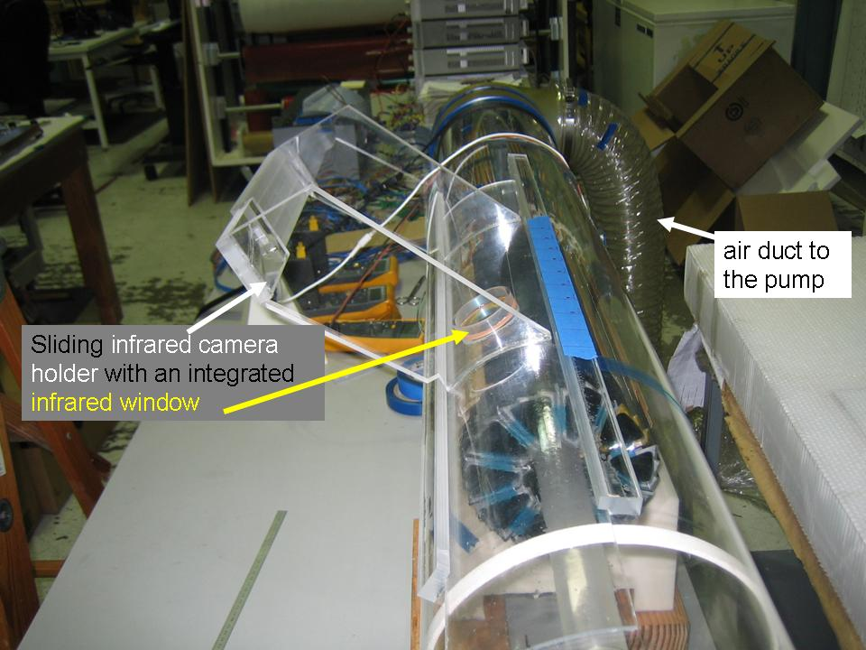
Setup

Slide 20
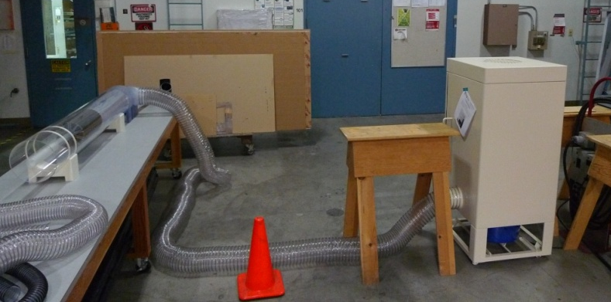
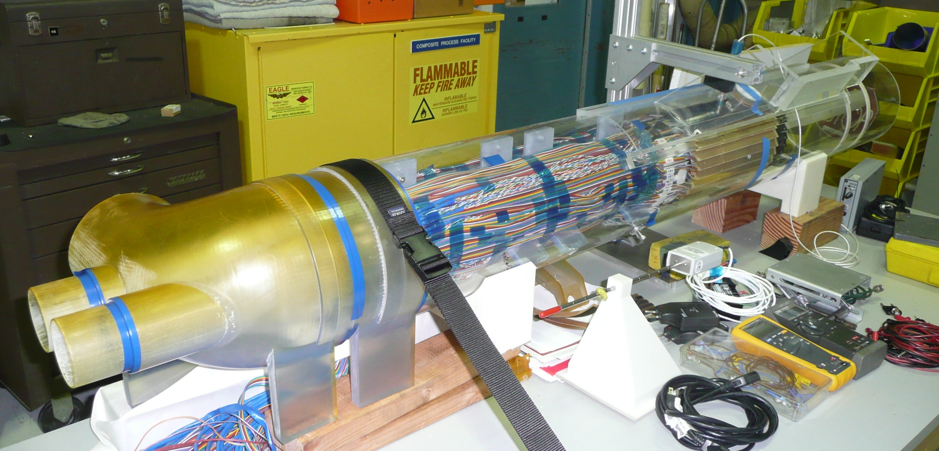
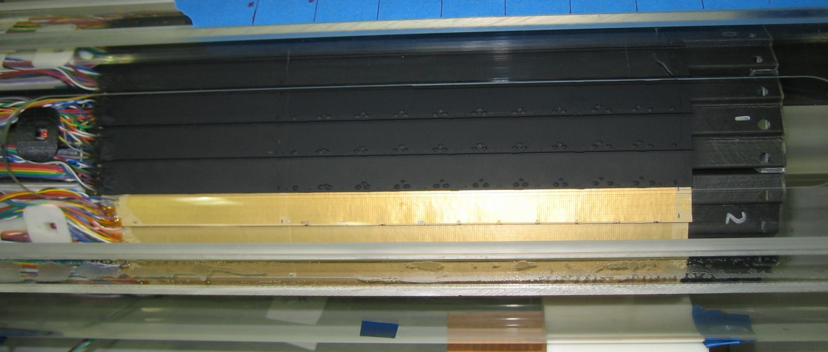
Setup

Slide 21
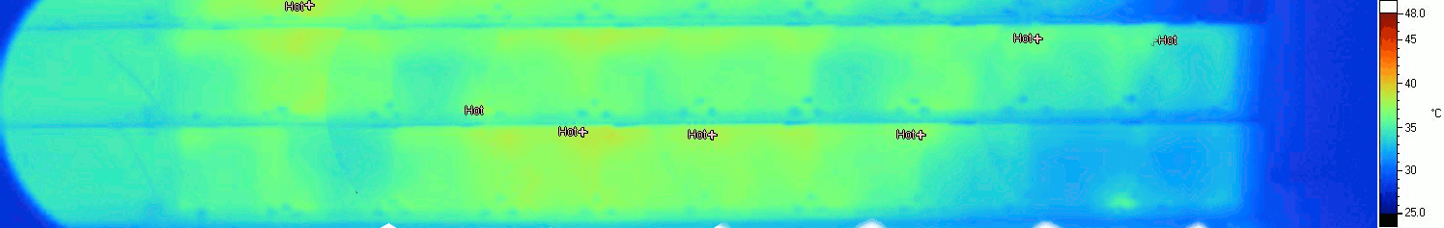
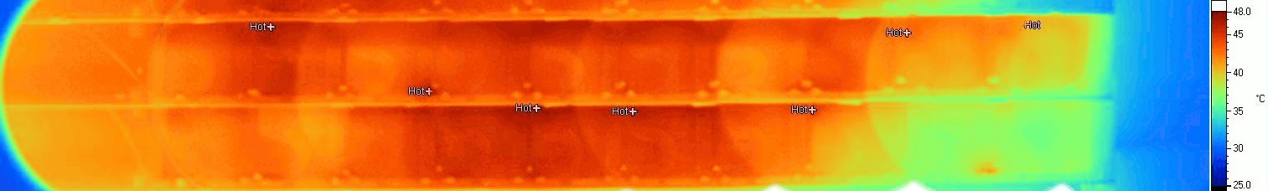
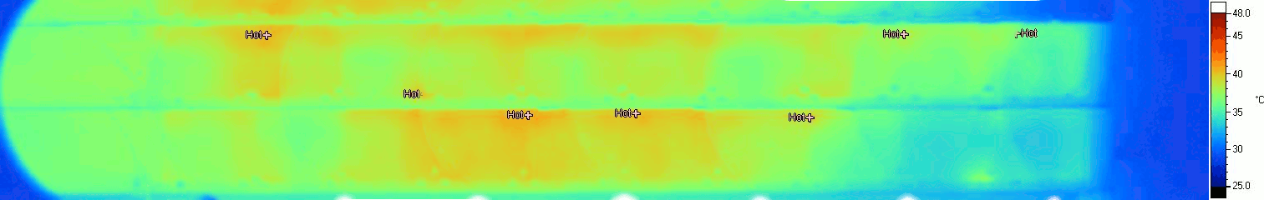
Cooling tests at ~360 W – IR images
Air 13.8 m/s Hot spots ~10 °C above input
Air 10.1 m/s Hot spots ~14 °C above input
Air 4.7 m/s Hot spots ~21 °C above input
Input air temperature ~27 °C

Slide 22
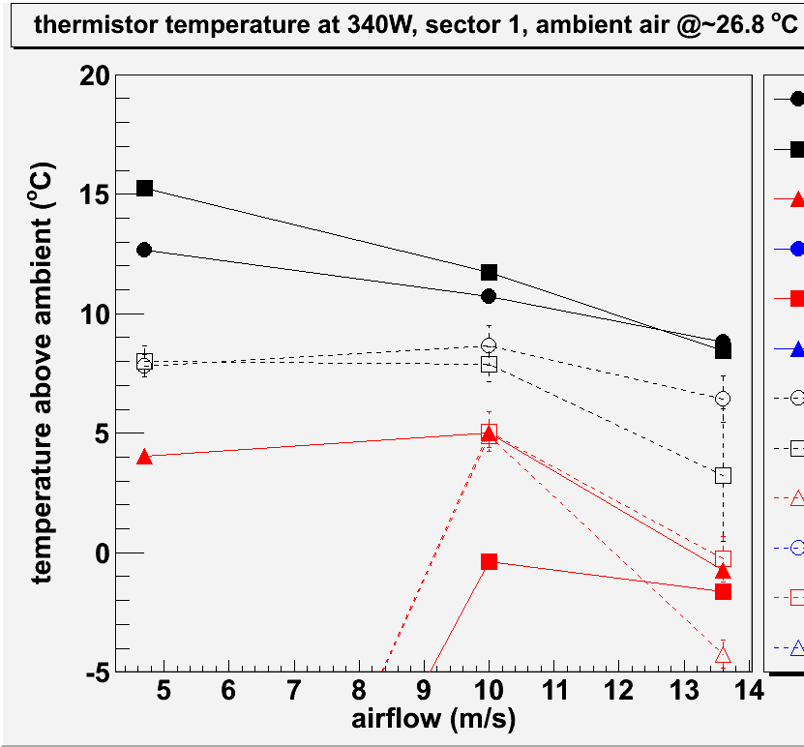
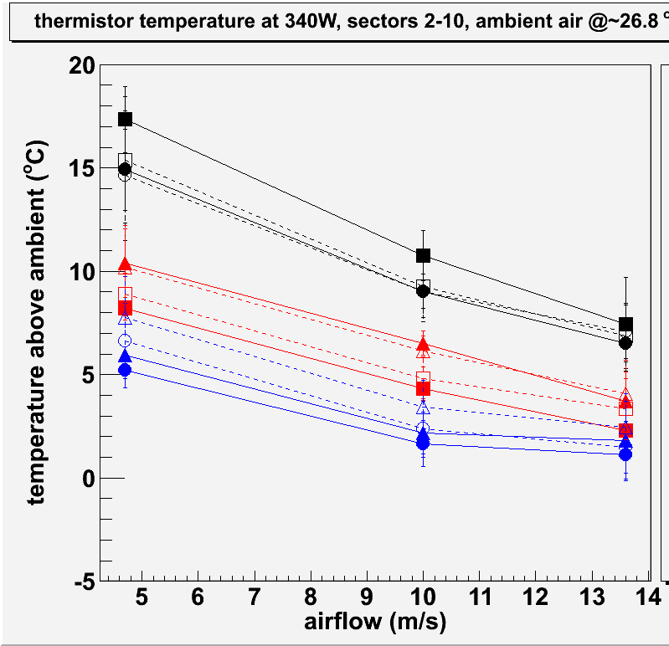
Cooling Tests at ~340 W
unsuported end
mid-section
fixed end
Solid – inner layer
Open – outer layer
Observations:
Mid-section is the hottest part of the ladder
max temperature increase above ambient is
  ~ 8 °C @ 13.8 m/s
  ~12 °C @ 10.1 m/s
  ~17 °C @ 4.7 m/s

Slide 23
Analysis and testing of vibration induced by cooling air

Slide 24
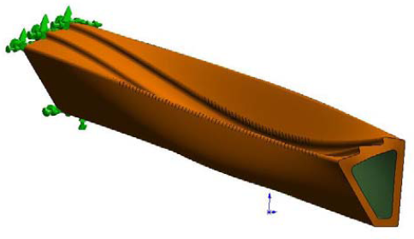
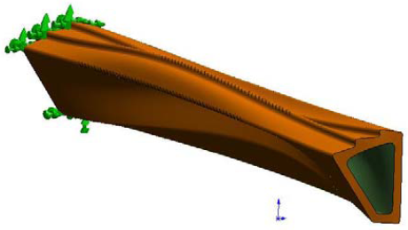
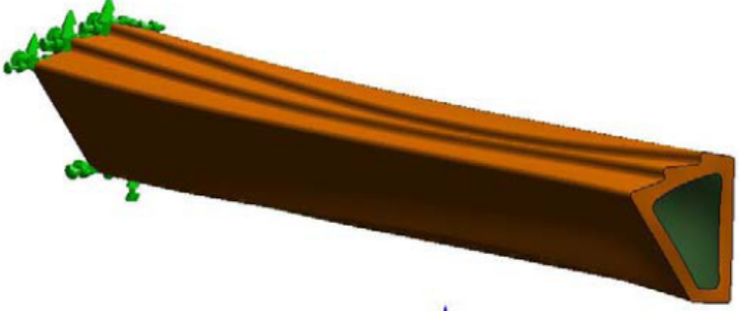
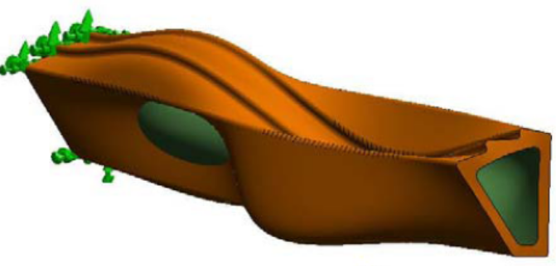
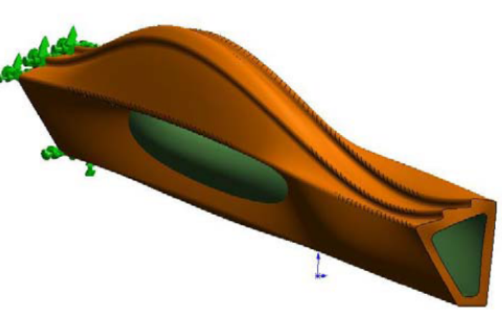
vibration modes with reinforced end cap
259 Hz
441 Hz
276 Hz
497 Hz
The message
  Lots of complicated modes close in frequency
  End cap raises frequencies a bit
397 Hz

Slide 25
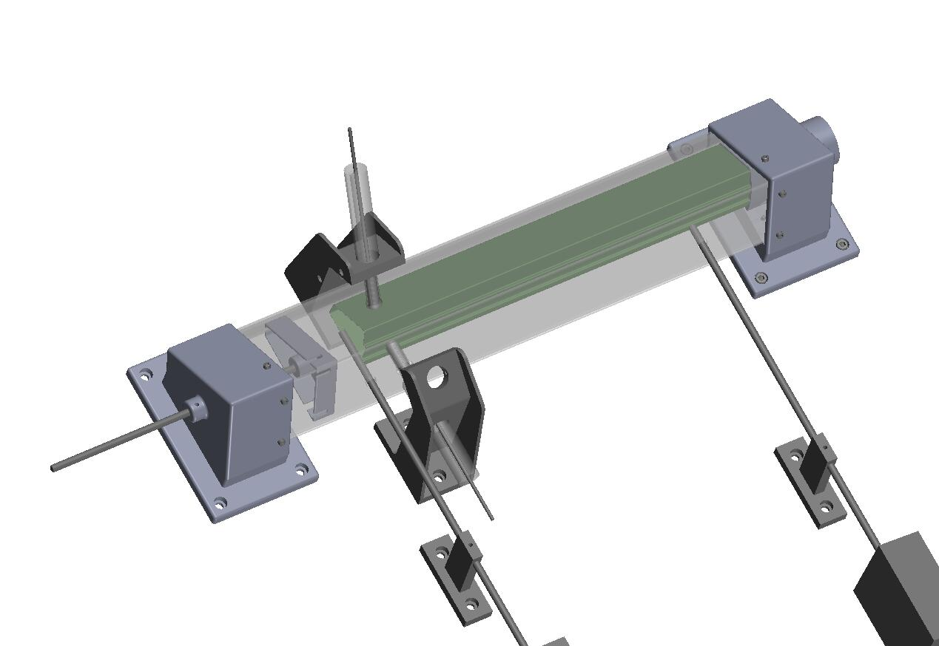
wind tunnel setup to test vibration and displacement
capacitance vibration probe
two positions shown
carbon fiber sector beam
air in
air out
adjustable
wall for air
turn around
air velocity probe
two positions
shown
C:\Documents and Settings\Howard Wieman\My Documents\aps project\mechanical\PXL phase 1 sept 2008\sector ph1 wind tunnel.SLDASM

Slide 26
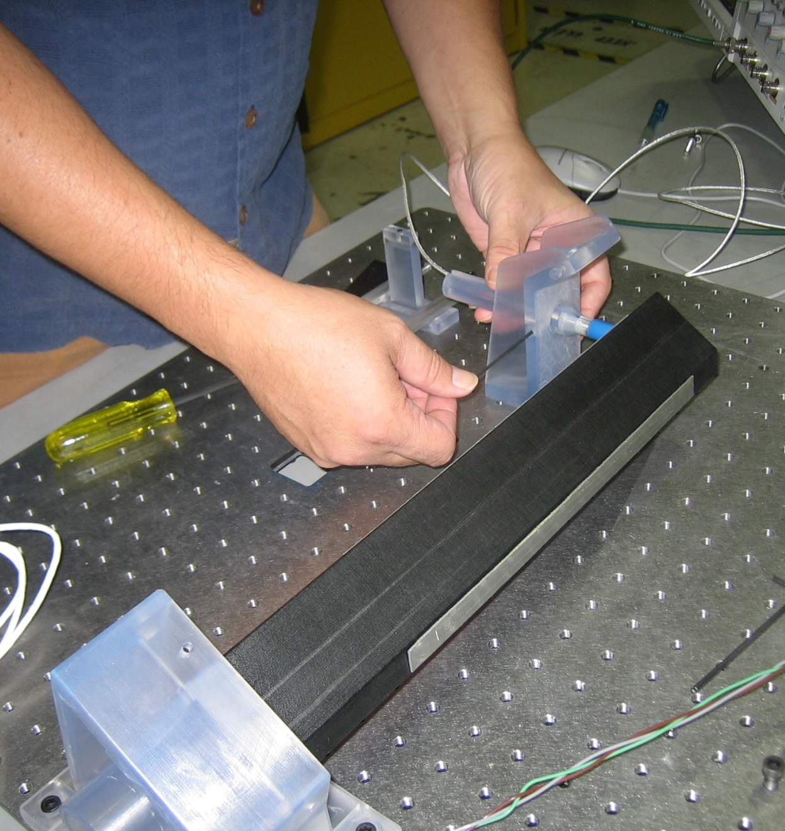
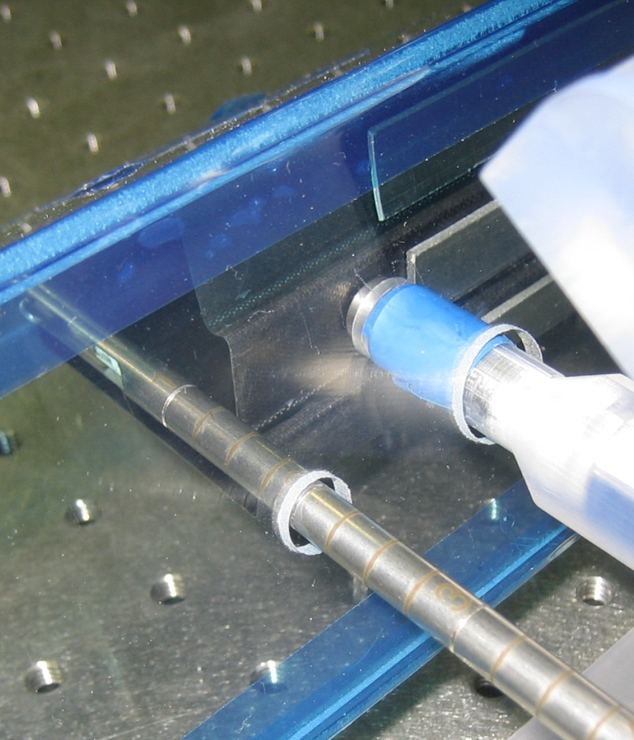
wind tunnel

Slide 27
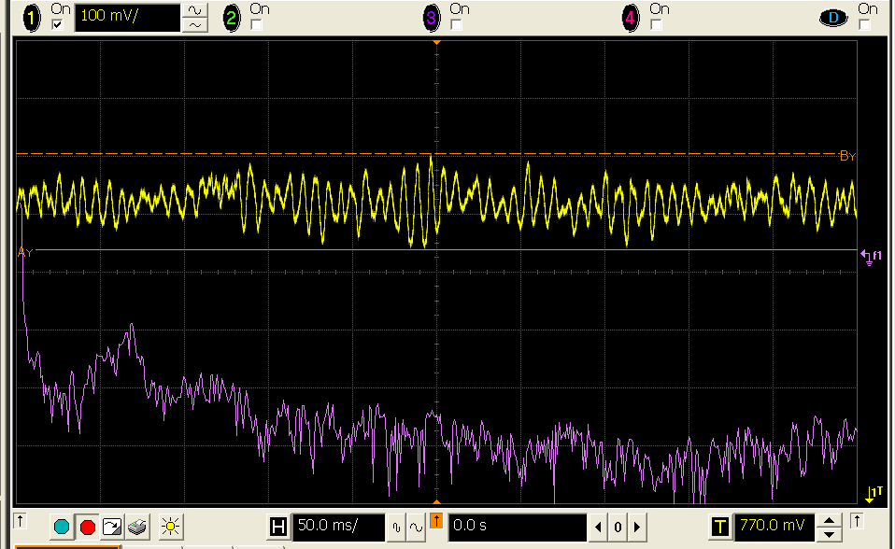
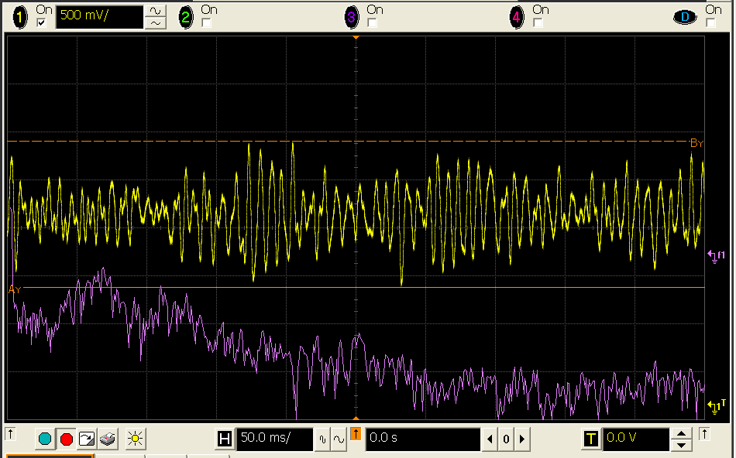
capacitive probe vibration measurements
air velocity 2.7 m/s
position signal, 25 μm/volt
log FFT, peak at 135 Hz
air velocity 9.5 m/s
position signal, 25 μm/volt

Slide 28
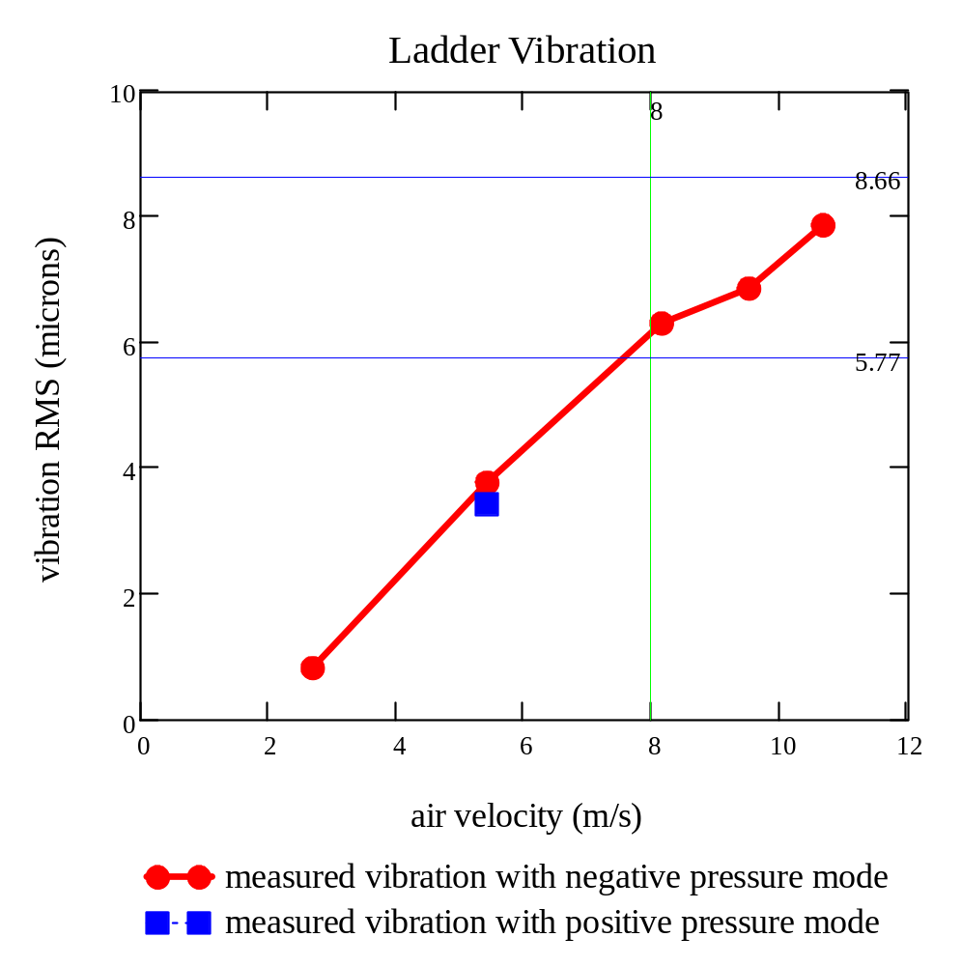


Ladder vibration induced by cooling air
no reinforcement at the end
system resolution limit
all errors
desired vibration target
required air velocity
18 mph

Slide 29
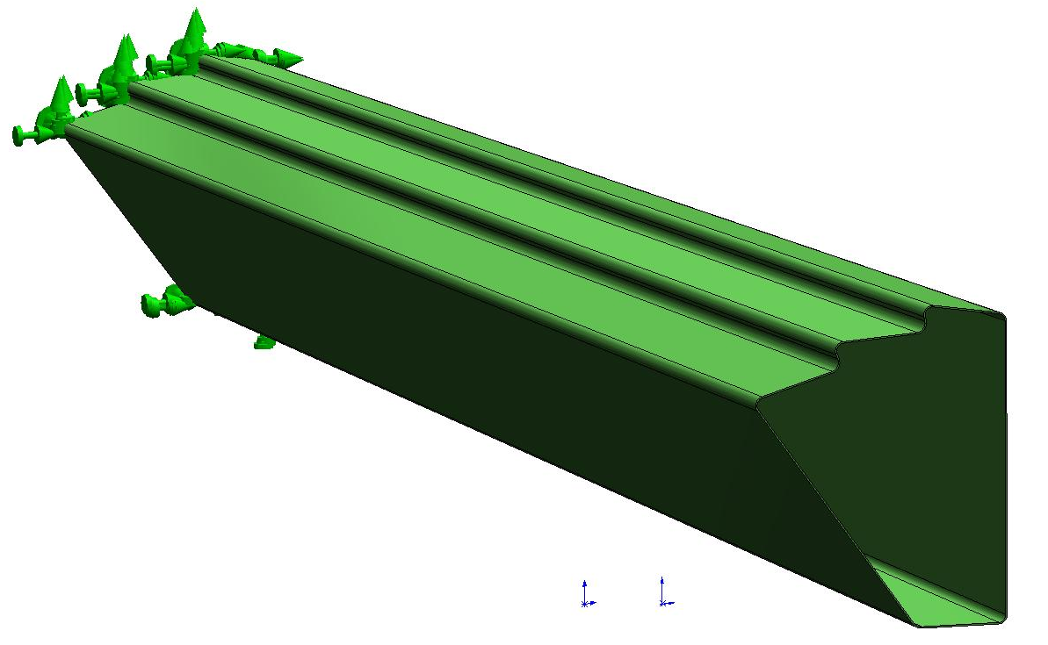
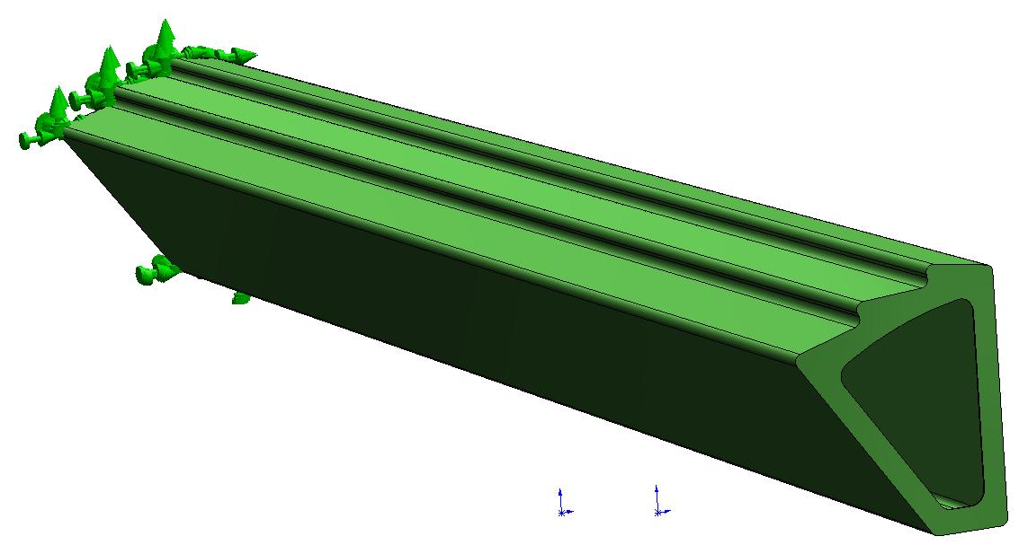
measured static deformation from 9 m/s air flow
17 µm
17 µm
6 µm
open end
-167 µm
9 µm
-179 µm
11 µm
-248 µm
1 µm
-156 µm
-163 µm
-113 µm
reinforced
end

Slide 30
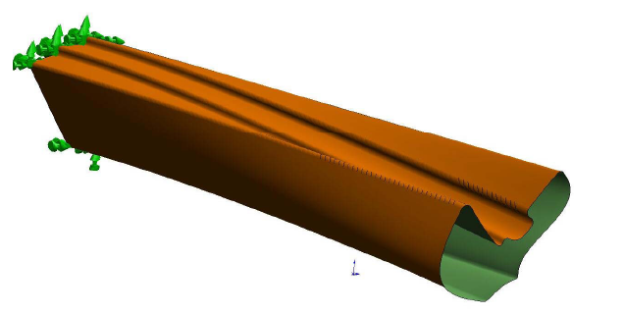
measured vibration (RMS) induced by 9 m/s air flow
4 µm
6 µm
6 µm
open
end
reinforced
end
3 µm
3 µm
13 µm
14 µm
2 µm
14 µm
8 µm
4 µm
11 µm

Slide 31
PXL insertion mechanism for rapid detector replacement

Slide 32

PXL detector centered in STAR
in the Middle Support Cylinder (MSC)
single end support allows rapid insertion and removal
Can replace PXL detector with less than day of shut down

Slide 33



Insertion and closing about the beam pipe
open to clear beampipe flanges
closing down
fully inserted and locked in kinematic mounts

Slide 34

insertion mechanism
cam and guides control lateral location during insertion
carriage rides on support rails
mechanical release to transfer load to kinematic mounts
hinge mechanism for lateral motion
kinematic mounts engage at center position
thin carbon half tube for PXL support and cooling air duct

Slide 35
Mechanical systems are being fabricated and tested
Stability is satisfactory
End of Presentation

Slide 36
Backup
extra

Slide 37

Development of sector beam and ladder fabrication
ladders
Eric Anderssen and Tom Johnson have been working on fabrication methods for:
  Sector Beam
  and Ladders
Produced sample beams, 244 μm thick, 7 ply, 21 gm
expected ladder mass 7.5 gm
sector beam

Slide 38

ladder to sector out2 bond fixture in the shops
(designed to allow ladder replacement)
ladder to out2 bond fixture.SLDASM

Slide 39

sector chuck parts
locating pin diamond MMC 8472A19.SLDPRT
locating pin MMC 8472A11.SLDPRT
¼-20 x 1.5 in, 1 of 4
bullet nose liner MMC 31335A51, 1 of 3
bullet nose aligning pin MMC 31335A11, 1 of 2
z locator.SLDPRT
¼-20 x 1 in, 1 of 2
sector chuck out2 base.SLDPRT
plunger pin 1lb MMC 3360A560, 1 of 2
sector chuck out2 cap.SLDPRT
bullet nose diamond aligning pin MMC 31335A31
1.5 in post hex MMC 91780A361, 1 of 4

Slide 40

ladder chuck parts
¼-20 x 1in, 1 of 4
plunger pin 3 lb MMC 3360A330, 1 of 4
ladder chuck handle.SLDPRT, 1 of 2
ladder chuck.SLDPRT
ladder chuck.SLDASM

Slide 41

out2 silk screen assembly for applying glue that holds ladder to the sector
stainless surface 25 mil
above aluminum surface
this surface is initially shimmed by 20 mils to be 5 mils below the stainless surface. This is to permit future adjustment
out2 silkscreen frame.SLDPRT
sized for 2 mil bond line between
stainless and aluminum

Slide 42

ladder assembly fixture
vacuum chuck system for placing chips and other ladder parts
3/8 OD tube connection to
vacuum
vacuum distribution manifold
vacuum release valve for
hold down of the vacuum chucks
¾ ID tube connection to
1 gallon vacuum ballast tank

Slide 43

ladder fixture
vacuum chuck system for placing chips and other ladder parts
ladder fixture.SLDASM

Slide 44




Sector structures

Slide 45

ladder fabrication and tooling

Slide 46

ladder fabrication and tooling

Slide 47

ladder fabrication and tooling
finalizing mechanical designs and developing rapid production methods

Slide 48


ladder fabrication and tooling
ladder with
silicon heater
chips
(50 μm thick)

Slide 49
Testing equipment used in cooling measurements
The tests we wanted to perform required measuring
  Air flow
  Input and output air temperature
  Ladder temperature
  Ladder vibrations
Equipment used:
  Industrial 1.1 KW air pump (dust collector) RD-211 → provided air flow
  Air velocity transducer FMA-905-I from Omega → air flow measurements
  K-type thermocouples → air temp. meas.
  Negative temperature coefficient (NTC) thermistors → ladder temp. monitoring
  Touch-1 cable tester from Cirris → automated temp. meas.
  Python-based visualization software → automated temp. monitoring
  Infrared camera → ladder temp. monitoring
  C1-A capacitive probe from the Lion Precision Co. → ladder vibration meas.

Slide 50




vibration modes – preliminary – better composite numbers available
224 Hz
348 Hz
229 Hz
473 Hz
316 Hz

Slide 51

Vibration from STAR support, accelerometer measurement
detector vibration from STAR support < 0.1 micron RMS

Slide 52

Vibrations caused by airflow
coupled means that the unsupported end is tied to sector 2
Sector 1, Ladder 2
(coupled )
(coupled )
(coupled )
Beginning of the driver section
(Supported end)
End of sensor section
(Unsupported end)

Slide 53

wind tunnel, rapid prototype parts from model
air flow control
parts built with
3D printer
parts built with SLA, stereolithography apparatus

Slide 54


