Slide 1
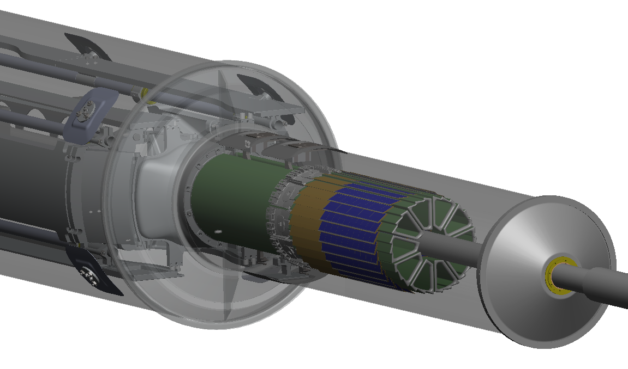
STAR Pixel Detector
Probe Testing
LBNL
Leo Greiner, Eric Anderssen,
Thorsten Stezelberger, Joe Silber, Xiangming Sun, Michal Szelezniak, Chinh Vu,
Howard Wieman
UTA
Jerry Hoffman, Jo Schambach
IPHC Strasburg
Marc Winter CMOS group

Slide 2
Talk Outline
Phase-1/2 probe testing system design
Current capabilities
Ultimate sensor probe testing
Summary

Slide 3
Probe Test System Design
Power
Supply
POWER
Probe
Card
CUSTOM
Probe
Station
The probe test system
is based on our prototype
readout board.
RDO Board
USB
Control
PC
SERIAL

Slide 4
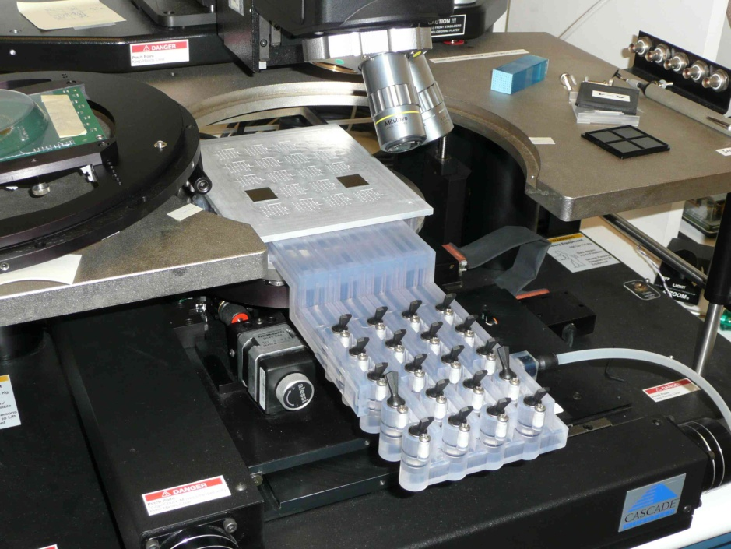
Probe Testing Mechanical Design
Vacuum chuck for probe testing 20 (50 μm thick) MAPS sensors per testing session.
Automated test system based on the prototype RDO system gives a qualitative analysis of probed sensors including identification of dead/stuck pixels/columns.

Slide 5
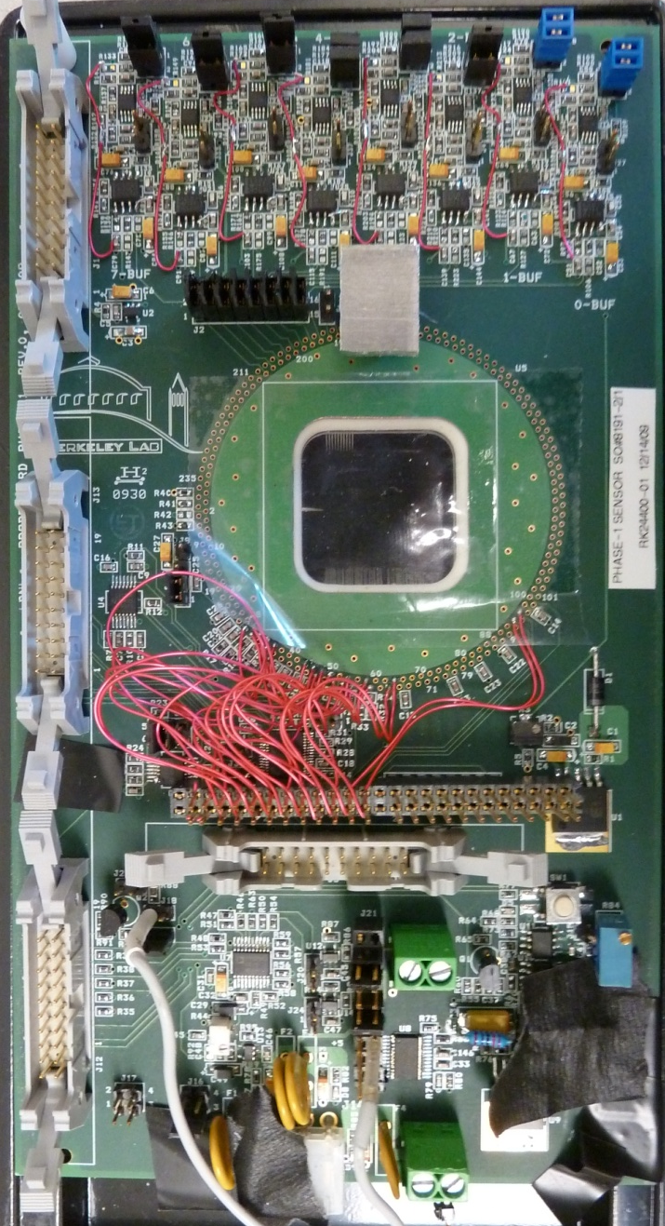
Phase-1 Probe Card
Analog buffering
⁵⁵Fe source shield
Probe pins
Ribbon cable connection to RDO Board
Digital section
Power regulation/switching

Slide 6
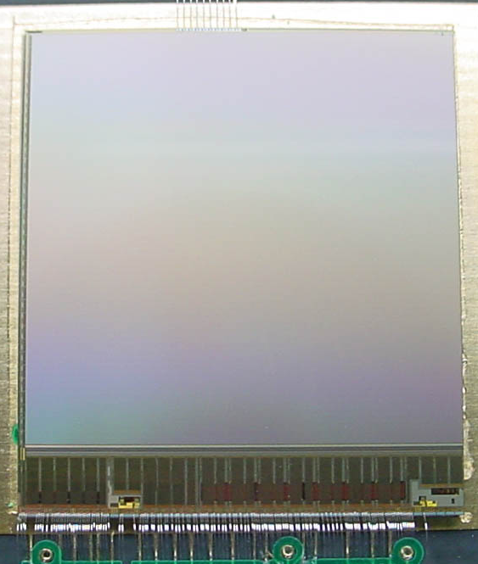
Probe card testing
We wire bond a sensor to the probe card to test the full functionality of the probe card and testing system before the probes are mounted to the card.

Slide 7
System Attributes
We have a scripted probe testing setup based on our individual testing board scripts.
We test at full RDO speed of 160 MHz.
Power is regulated and switched on the probe card.
Transfer function data is taken and analyzed in root with scripts.

Slide 8
Sensor Test Sequence
Current draw (power on)
Chip id (JTAG)
Test JTAG multiple patterns
Load Default JTAG
Measure current draw
Measure DACs - scan VREF2, then scan to find VREF1 so that threshold = 0
threshold scan
LED test + power consumption
Analog RDO noise measurement on all sensors
Source measurement on 1 sensor/wafer
Repeat sequence for 3.0V and 2.9V
All results are saved to a database that will be used for selecting sensors to build into ladders and sectors and for building configuration JTAG commands.

Slide 9
Ultimate Sensor Probe Card
Based on the successful Phase-1 probe card.
Schematic in progress at LBNL
Expected to be complete by September 15
Is IPHC interested in probe cards for Ultimate?

Slide 11
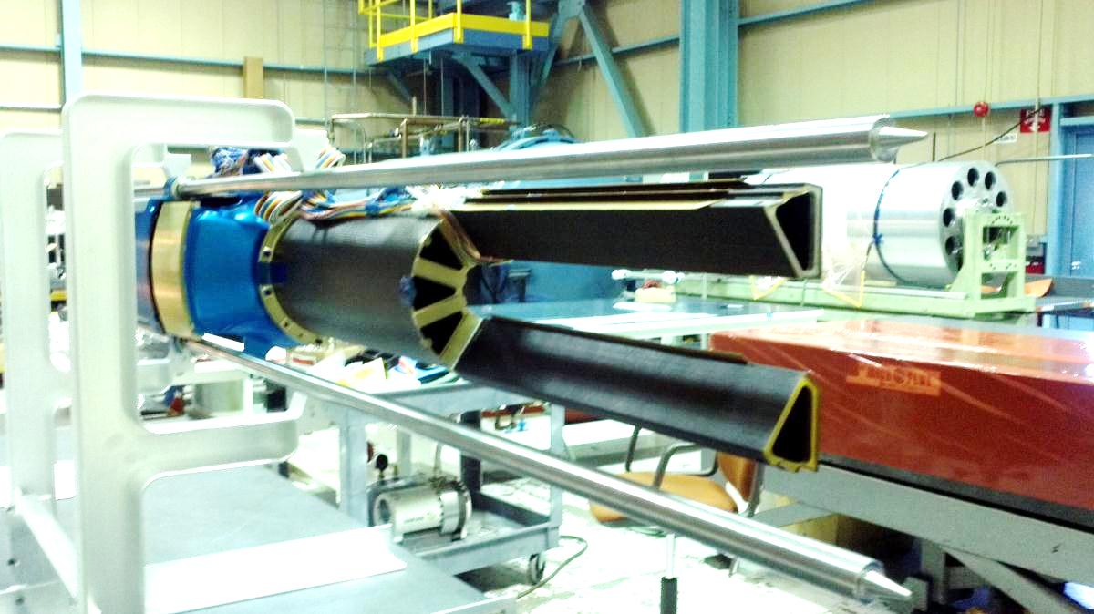
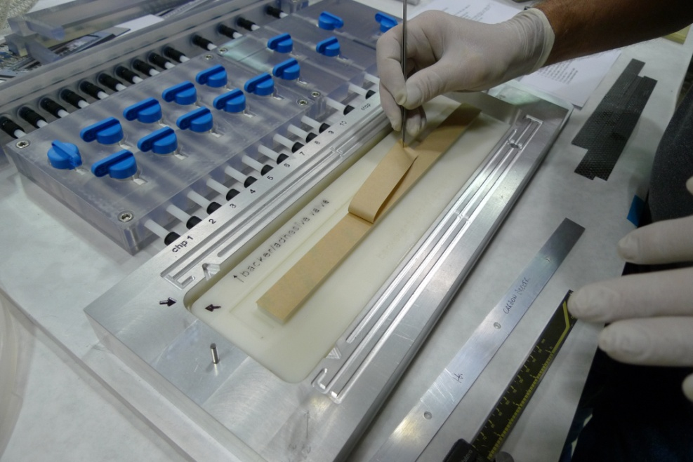
PXL Mechanical Construction
PXL Mechanical
D-tube and sectors
Ladder fixturing
Vacuum chuck for 50um sensors

