Slide 1
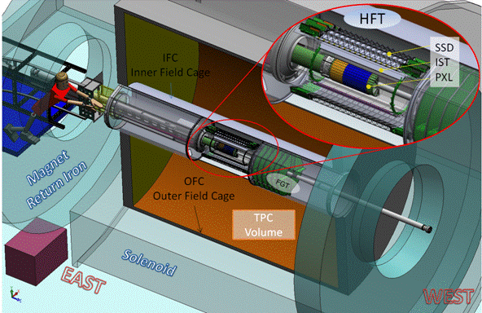
Plans for the next year
A short report on review results and plans for 2011-2012
TPC – Time Projection Chamber
(main tracking detector in STAR)
HFT – Heavy Flavor Tracker
SSD – Silicon Strip Detector
  r = 22 cm
  LBNL – Jim Thomas
IST – Inner Silicon Tracker
  r = 14 cm
  MIT – Bernd Surrow
PXL – Pixel Detector
  r = 2.5, 8 cm
  LBNL – Leo Greiner

Slide 2
CD-2/3 Review
“Lehman” Review held on July 13-14 at BNL
Production readiness review. For CD-3 design must be 80-90% complete. This involves a significant amount of technical and design documentation beyond the Technical Design Report (TDR).
Partial list of required materials (See EIR below):
  Complete resource loaded schedule – Critical path analysis, etc.
  Project execution plan – CD-4 parameters, Management plan, etc.
  Safety, Risk assessment, value engineering, etc.

Slide 3
CD-2/3 general results
The review went very well: presentations were good, good questions from the reviewers, generally well answered. Good detail in the technical breakout sessions. Overall the reviewers seemed quite satisfied.
All detector subsystems, integration/safety, management, etc. were judged to have met the review charge requirements.
The management/cost-schedule side of the review had comments that reflect some internal DOE questions, more on this later.
I will present only the relevant PXL recommendations, the complete closeout review report showing review committee, charge, etc. may be found at: http://rnc.lbl.gov/hft/hardware/docs/cd23/CLOSEOUT_STAR_HFT-Final.pdf

Slide 4
PXL CD-2/3 Selected Review results
2.1.3 PXL Recommendations
Decide by September 1 which technology, Phase-I or Ultimate Prototype, to implement in the engineering run. However, CD-2/3 approval is not contingent upon this decision.
The ESAAB review has been scheduled for September 22.
The Recommendation for PXL has been addressed, report on impact may be found here: http://rnc.lbl.gov/hft/hardware/docs/cd23/ultimate_prototype_changes.docx
We will use the final (Ultimate) sensors for the prototype detector.

Slide 5
Selected HFT Tasks for the next year
Installation of Inner Detector Support (IDS) system expected ~ October/November 2011. (staged for FGT installation, uses old beam pipe)
Beam testing of sensor telescopes at CERN (PXL) October 2011.
Production of the rest of the IDS to support the new beam pipe.
Installation of the new IDS pieces and new beam pipe in ~ October 2012.
Production of a prototype PXL detector using complete mechanics, installation tooling, sensors, RDO system, interface to STAR. This will allow for both an in beam test of the PXL design and a measurement of the charged particle environment at low radius.
The installation for the PXL prototype detector is scheduled for December 2012.
The SSD and IST detectors are not scheduled to be installed until 2013.

Slide 6
PXL tasks for 2011-2012
We have a deliverable of a working prototype detector (3 sectors) to be installed at the end of 2012.
Thus we need to produce first articles of all of the production stages for the final detector.
Tasks for 2011-2012:
Probe testing working for Ultimate sensors
Cable design complete with Cu conductors
New pre-production RDO (all boards) system working
Full firmware and software for data-taking
All mechanical designs complete and tested.
Mechanical structures fabricated.
Ladders => sectors fabricated + full scripted testing.
Metrology
Slow control system
Software for tracking using metrology data
Software for cosmic ray / beam testing tracking.
etc.

Slide 7
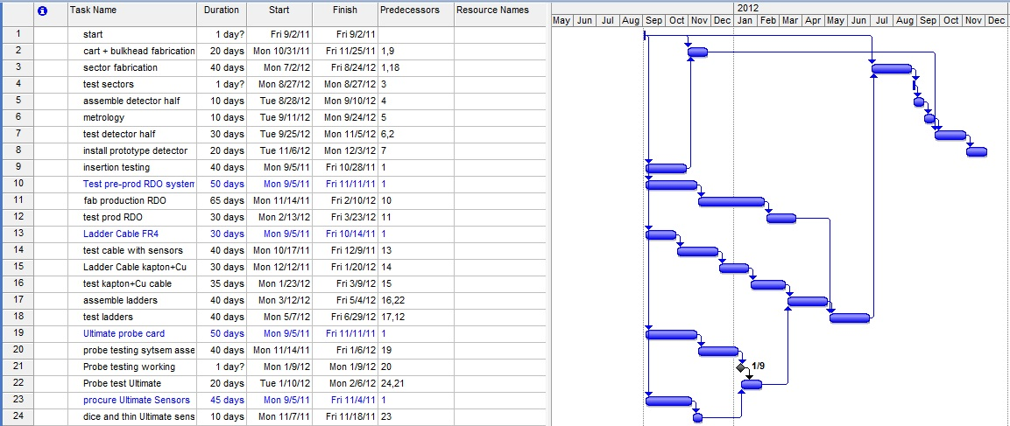
Simplified Schedule
A complete project schedule is available at: http://rnc.lbl.gov/hft/hardware/docs/misc/PXL_sched.pdf

Slide 8
Projected completion dates
Order Ultimate sensors: September 2011
First Ladder cable in FR-4: Oct/Nov 2011
First product probe testing: January 2012
Ultimate probe testing complete: February 2012
PXL RDO ready: April 2012
First prototype sectors: August 2012
Install Prototype detector: January 2013

